Slide 1
Implementing Microsoft Live Communication Server 2005 at ORNL
National Laboratories Information Technology Summit
June 2007
Dennis Depp
The Microsoft Guy

Slide 2

Implementing LCS at ORNL
FY 07 ORNL Began IT Renewal Project
Move from Stability to Innovation
  DID what we had to do
  IT renew what we want to do

Slide 3
Why Instant Messaging?
Instant Messaging is the next killer app
Paradigm shift from work means “on location” to work means “on line”
Minimize risk from IM traffic
On ORNL’s top 10 list of Technologies
Needed to attract the next generation of Scientists

Slide 4

IM and Age
20’s – 30’s Grew up with this technology
40’s – Use presence but not enamored with IM
50’s – Get this #$@% off my computer!

Slide 5
Why Microsoft LCS
Microsoft is market leader in office applications
LCS integrated with Microsoft Office applications
ORNL is standardizing on Microsoft for administrative applications
Integration with phone system

Slide 6
Goals of the project
Provide a supported, lab wide instant messaging client for ORNL
Standardize on a single instant messaging client
Deploy the client lab wide/integrate the client in our standard desktop
Integrate the LCS client to work with ORNL’s telephone system
Notes:
Moving from User managed systems to IT managed systems

Slide 7
Supported Lab wide IM client
Native client for Windows and Mac
Web client for Unix/Linux
Presence problems
Stealth install – External Address book
Kerberos problems – corrupt ticket
Notes:
Plagued by Presence issues.
External address book connects via authenticated SSL to a UNC path. Caused user prompts. Disabled this service to avoid the prompts.
Users used ornl email addresses for MSN connectivity. When ORNL setup PIC connectivity with MSN, users were sent emails saying they could no longer user their ORNL emil address to connect to MSN. Caused confusion.

Slide 8
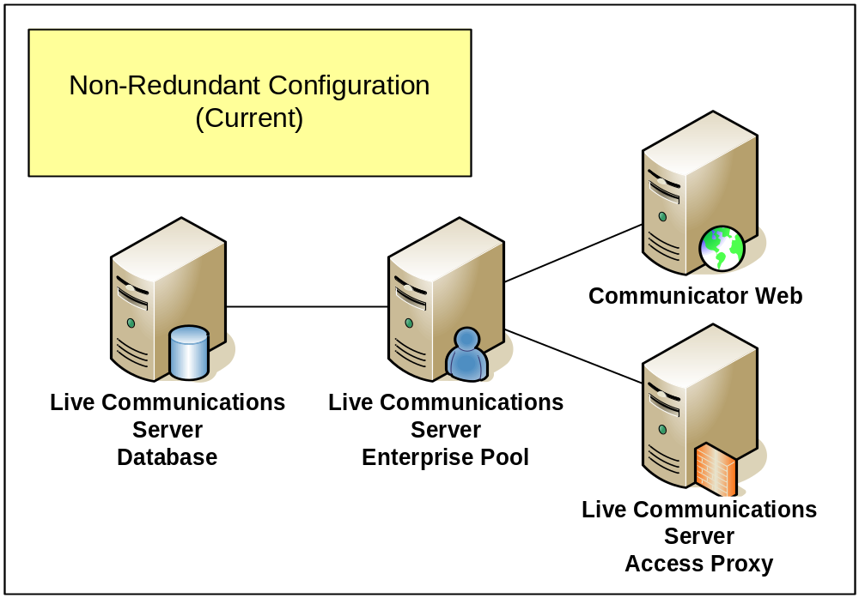
Supported Lab wide IM client
Initial Configuration

Slide 9
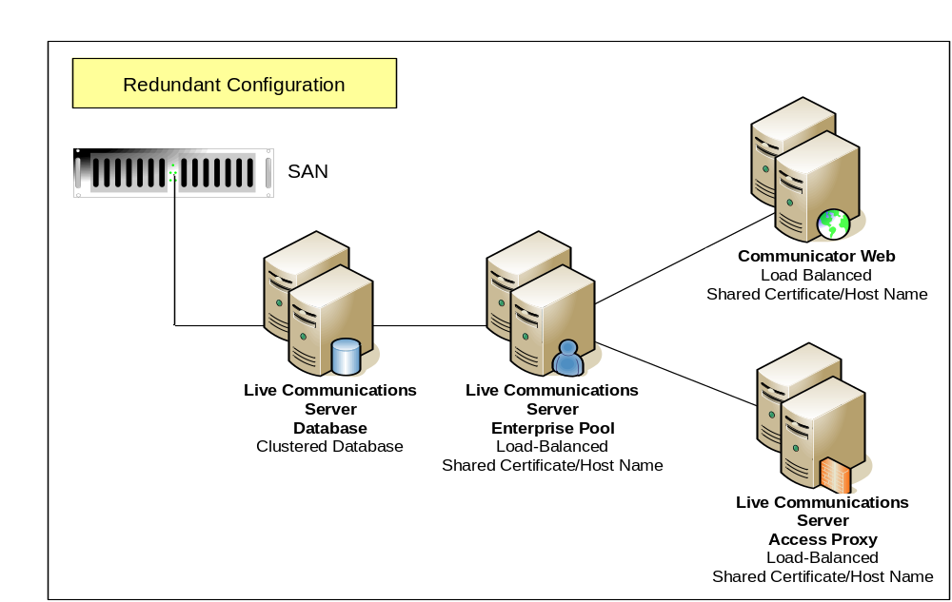
Supported Lab wide IM client
Redundant Configuration

Slide 10


Standardize on Single IM client
Purchased 1500 licenses for Public Instant Message Connectivity (PIC)
  Provides access to
    AOL
    MSN
    Yahoo
  Setup with MSN
  Public file transfer
What about Jabbber?
Notes:
Replace windows clients for Trillian, AOL, MSN and Yahoo with Microsoft Office Communicator.
Reduced functionality with Microsoft Office Communicator when compared with MSN messenger.
Third party product available to add support for Jabber
No freeware solution yet available.

Slide 11
Deploy Client Lab Wide
Covert deployment
Utilized Microsoft Systems Management Server to deploy client
  Oops!
Distinguish between desktop computers and instrument computers

Slide 12
Integrate with Phone System
ORNL has a Lucent 5ESS
Most vendors want to implement a new phone system @ $1-2M
Looking for a more economical system
Microsoft Office Communication Server 2007 (OCS) will allow a more economical solution

Slide 13


Goals of the project
Provide a supported, lab wide instant messaging client for ORNL
Standardize on a single instant messaging client
  Reduced PIC functionality
  Jabber Support
Deploy the client lab wide/integrate the client in our standard desktop (Windows Only)
Integrate the LCS client to work with ORNL’s telephone system
Notes:
Moving from User managed systems to IT managed systems

Slide 14


Questions?

