Slide 1


Slide 2

The International Polar Year is an intense scientific campaign to explore new frontiers in polar science, improve our understanding of the critical role of the polar regions in global processes, engage the public in polar discovery, and help attract the next generation of earth scientists.
Participation in the IPY allows the USGS to celebrate this enduring tradition with the rest of the global polar research community and to renew our commitment to polar science at a time when the world is focused on the extraordinary changes happening in these regions.

Slide 3
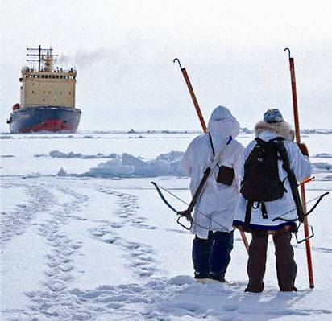
Status of USGS IPY
EoI submitted on 1/12/05
Working group established
  Kickoff meeting at ASC with PRB
  Internal website for IPY established
Internal website established
Full proposal due in June
IPY coordination role identified within International Office

Slide 4
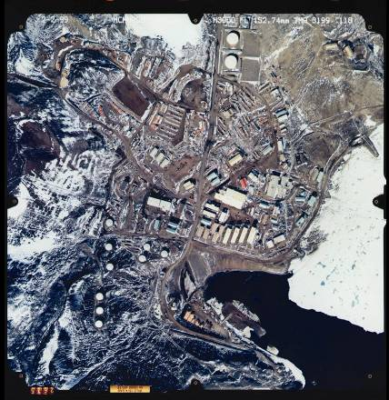
IPY International Themes
Current Status of the polar regions
Change - past and present, social and environmental
New Frontiers of Science
Unique Vantage Point
Human Dimensions

Slide 5
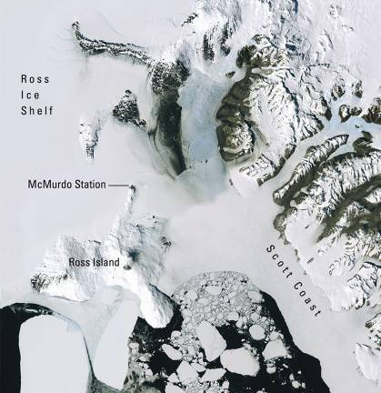

Slide 6


