Slide 1
U.S. Department of Energy
Office of Hydrogen, Fuel Cells and Infrastructure Technologies
Hydrogen Production and Delivery
September, 2003

Slide 2
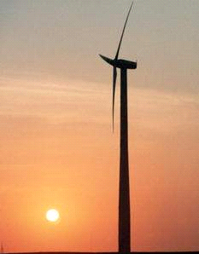

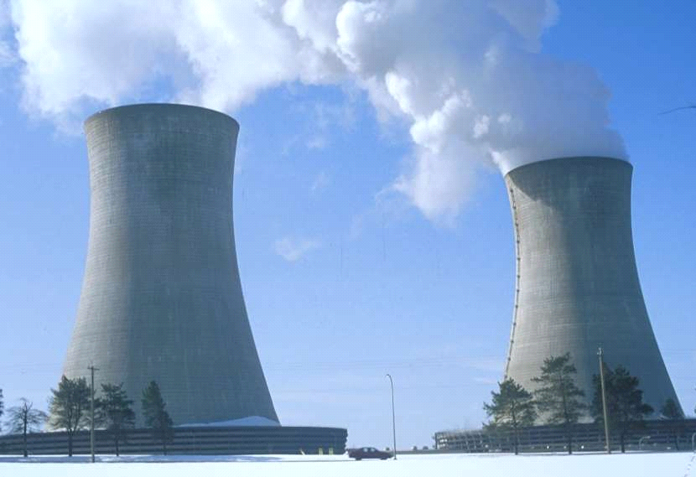


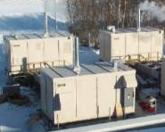
National Energy Security
DIVERSE DOMESTIC RESOURCES
Why Hydrogen?
Transportation
Biomass
Water
Biomass
Biomass
Hydro
Hydro
Wind
Hydro
Solar
Geothermal
Wind
Wind
Solar
Solar
Nuclear
Nuclear
Oil
Distributed Generation
Oil
n
n
o
o
i
i
t
t
a
a
r
r
The Environment
ZERO/NEAR ZERO GHG
and other EMISSIONS
t
Coal
t
Coal
s
s
e
e
u
u
q
q
e
Natural
e
Natural
S
S
Gas
Gas

Slide 3
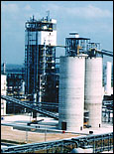
Production Feedstock/Process Options
Coal
  Supply: 5,780 Quads recoverable reserves
  Process options: central production from gasification
  Cost: Current: $0.90-1.80/kg
  Projected: $0.50-1.10/kg
  Requires sequestration and near-zero other emissions

Slide 4
Production Feedstock/Process Options
Natural Gas
  Supply:
    188 Quads proven reserves
    Currently importing 15% of our needs
  Process Options
    Central Reforming
      Cost: Current: $0.60-1.00/kg Projected: $0.40-$0.90/kg
      Requires sequestration
      Lowest cost current route
    Distributed Reforming
      Cost: Current: $4.00-$6.00/kg Projected: $1.50-$3.00/kg
      Lowest cost current route for delivered hydrogen
      Very sensitive to NG price
      GHG emissions unavoidable

Slide 5

Production Feedstock/Process Options
Production Feedstock/Process Options
Biomass
  Supply
    6-10 Quads/yr. currently possible
    Could be much more with biotech advancements
  Feedstock Cost and Infrastructure are Key Issues
  Central Production Process Options
    Gasification
      Cost: Current $2.00-$4.00/kg Projected: $1.00-$3.00/kg
    Fermentation
      Relatively unexplored
    Anaerobic Fermentation Methane Hydrogen
      Agriculture, MSW or industrial sites
      Existing biomass “collection” infrastructure
      Co-Gen power and hydrogen possible
      Sensitive to scale of operations and required distribution infrastructure

Slide 6

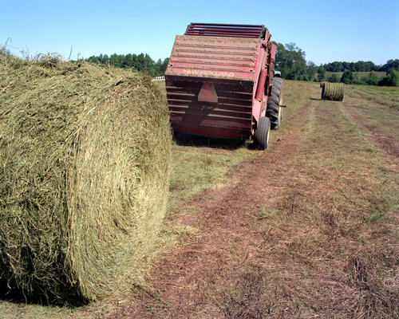
Production Feedstock/Process Options
Biomass
  Central/Distributed Process Options
    Trades hydrogen delivery costs for liquid carrier costs plus reforming
    Fermentation Ethanol Hydrogen
      Fungible transition from ethanol fuel
      Cost ??
    Gasification Syngas Methanol (Ethanol) Hydrogen
    Pyrolysis Bio-Oil Hydrogen
    Sugar Hydrogenation Sugar Polyols (e.g., Sorbitol) Hydrogen

Slide 7
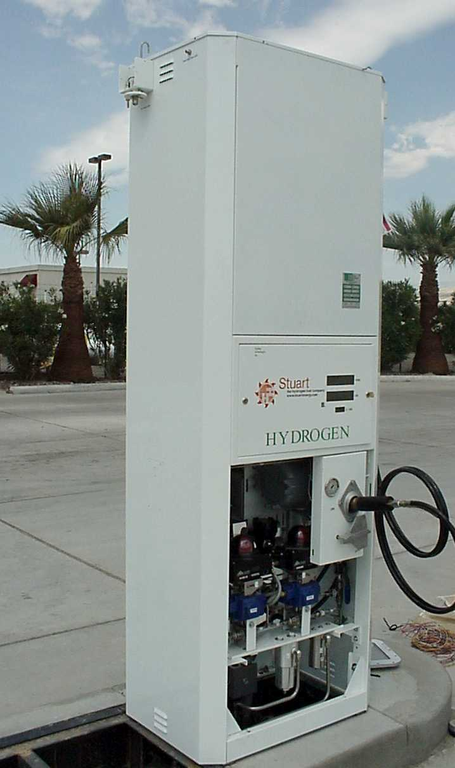
Production Feedstock/Process Options
Water: Electrolysis
  Distributed and central production
  Requires non-GHG emitting clean power: wind, solar, geothermal, hydroelectric, nuclear, fossil with sequestration
  Supply:
    Essentially unlimited
    Need purified water

Slide 8
Production Feedstock/Process Options
Distributed Electrolysis
  Cost: Current: $4.00-$8.00/kg Projected: $2.50-4.50/kg
  Electricity cost is the driver/controlling
  Eliminates hydrogen delivery costs and infrastructure
Central Electrolysis
  Cost: need better analysis
  Enables more efficient use of intermittent renewables
  Enables more efficient use of off peak power availability
  High temperature steam electrolysis may be more efficient
  Requires hydrogen delivery

Slide 9

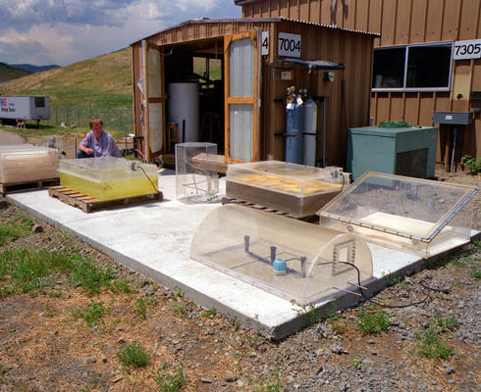
Production Feedstock/Process Options
Water: Photolytic Production
  Supply: Unlimited
  Central Production Utilizing Photosynthetic Organisms (Algae)
    Cost: Current ~$200/kg Projected: <$5.00/kg
    Requires breakthroughs in biotechnology and systems engineering
    Land area requirements or ocean operations
  Central or Distributed Direct Photoelectrochemical Production
    Cost: Current: N/A Projected: <$3.00/kg
    Requires breakthroughs in materials
    Intermittent: diurnal cycle
    The ultimate system if successful: renewable, unlimited, simple

Slide 10
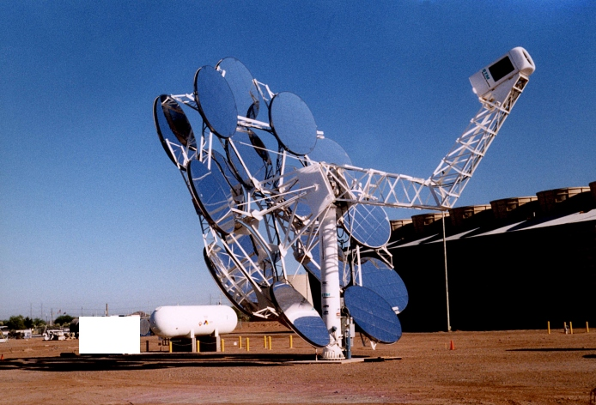
Production Feedstock/Process Options
Production Feedstock/Process Options
High Temperature Thermochemical Water Splitting
  Process Options
    High temperature (500-1000 C) central production utilizing advanced nuclear energy heat source (or other source) and S-I or CaBr (or other) cycles
    Ultra-high temperature (1000-3000 C) water splitting chemical cycles utilizing concentrated solar energy
    Direct water splitting
  Unproven Chemical Cycles
  Materials Issues

Slide 11
Summary
Summary
Route | $/kg Current | $/kg Projected | %EE WTP¹ | GHG WTW Reduc.^{1,2}
Coal: Central Gasification | $0.90-1.80 | $0.50-1.10 | _ | High W/Sequest.
Coal: C/D Gasification/Reforming | _ | _ | _ | Low-Medium
NG: Central Reforming | $0.60-1.00 | $0.40-0.90 | 62% | 61%
NG: Distributed Reforming | $4.00-6.00 | $1.50-3.00 | 60% | High
Biomass: Central Gasification | $2.00-4.00 | $1.00-$3.00 | _ | High
Biomass: Central Fermentation | _ | _ | _ | High
Biomass: Central Ferm./Methane/Hydrogen | _ | _ | _ | High
Biomass: C/D Gasification/Methanol or Ethanol/Hydrogen | _ | _ | _ | High
Biomass: C/D Pyrolysis | _ | _ | _ | High
Biomass: C/D Ferm./Ethanol/Hydrogen | _ | <$3.00 | 41% Total 92% Fossil | 98%
Biomass: C/D Sugar Hydrogenation/Polyols/Hydrogen | _ | _ | _ | High

Slide 12
Summary
Summary
Route | $/kg Current | $/kg Projected | % EE WTP¹ | GHG WTW Reduc.^{1,2}
Water: Electrolysis: Distributed | $4.00-8.00 | $2.50-4.50 | 28% Grid 68% Renew. | (22%) Grid ~100% Renew.
Water: Electrolysis: Central |  | _ | _ | Low: Grid High: Renew.
Water: Central Photolytic: Organisms (e.g. algae) | ~$200 | <$5.00 | _ | High
Water: Central or Distributed Photolytic: Photoelectrochemical | _ | <$3.00 | _ | High
Water: Central HT Splitting Chemical Cycles | _ | <$2.00 | _ | High
Water: Central U-HT Splitting Chemical Cycles | _ | _ | _ | High
Water: Direct Water Splitting | _ | _ | _ | High
The estimates, except for the distributed water electrolysis case using renewable electricity, are from “Guidance for Transportation Technologies: Fuel Choice for Fuel Cell Vehicles, Final Report prepared by Arthur D. Little for U.S. Department of Energy, February 6, 2002, http://www-db.research.anl.gov/db1/cartech/document/DDD/192.pdf. The distributed water electrolysis estimates are from Wang, M., “Fuel Choices for Fuel-Cell Vehicles: Well-to Wheels Energy and Emissions Impacts,” Journal of Power Sources, 112(1): 307-321, October 2002.
GHG well-to-wheels reduction is the reduction of GHG emissions as compared to the emissions from standard/today’s gasoline ICE.

Slide 13
Potential Scenarios
Short Term
Distributed: NG, Liquids (including biomass derivatives), Electrolysis
Central NG, Coal and Biomass
Renewable Power: Wind, Solar, Hydro, Geothermal
Central Coal with Sequestration
Photolytic: Photoelectrochemical, Photosynthetic organisms
Thermochemical Water Splitting Nuclear, Solar, Other
Long Term

Slide 14
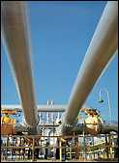
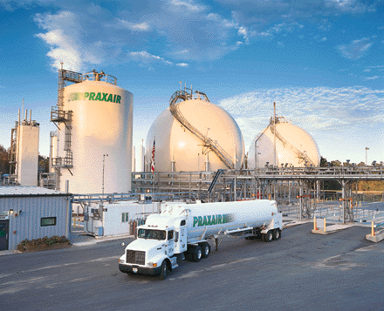
Hydrogen Delivery
Hydrogen Delivery: Develop cost effective, energy efficient delivery technologies for hydrogen to enable the introduction and long term viability of hydrogen as an energy carrier.
Barriers
Lack of hydrogen/carrier infrastructure options analysis
Capital cost of hydrogen pipelines
Cost of hydrogen compression and liquefaction
Cost of gas or liquid truck or rail transport
Hydrogen capacity and cost of known solid or liquid carriers.
Chemical carriers (i.e. ethanol, bio-oils, naphtha) require two processing operations

Slide 15
Delivery Options
End Game
  Pipeline Grid
  Other as needed for remote areas
    Breakthrough Hydrogen Carriers
    Truck: HP Gas & Liquid Hydrogen
  Electrolysis and Distributed reforming of NG, Renewable Liquids (e.g. ethanol etc.)
Transition
  Electrolysis and Distributed reforming of NG, Renewable Liquids (e.g. ethanol etc.), other liquids
  Truck: HP Gas & Liquid Hydrogen
  Regional Pipeline Grids
  Breakthrough Hydrogen Carriers

Slide 16
Technoeconomic Analysis
Basic economic analysis of individual processes to produce or deliver hydrogen
  Project by project basis: Project Team or other resources
  H2A Core effort

Slide 17
H2A Core Effort
Timeframe: 2005, 2015, 2030
Most better known routes to hydrogen
Consistent, comparable, transparent approach
Central Production
  Coal Gasification
  NG Reforming
  Biomass Gasification
  Nuclear: S-I, HT Steam Electrolysis
  Wind Electrolyis

Slide 18
H2A Core Effort
Forecourt/Distributed
  Dispensing Only
  NG Reforming
  Electrolysis
  Ethanol Reforming
  Methanol Reforming
Delivery: Hydrogen Pipeline, Tube Trailer, Liquid Truck
  Components
  A few basic metropolitan and interstate cofigurations

Slide 19
Infrastructure: Transition & End Game
In what scenarios (under what conditions) will the hydrogen economy succeed?
How do individual technologies affect the transition to and functioning of the system?
How do alternative energy sources affect the transition to and functioning of the system?
How will the evolution of the system over time and geographically affect costs and benefits?
What is the role for policy in the transition and maintenance of the hydrogen economy?
What are the costs and benefits (including the global macroeconomic effects) of a hydrogen economy?

Slide 20
Infrastructure: Transition & End Game
FY04 Plan: Learn by Doing
  Insert some hydrogen pathways and FCVs into TAFV (ORNL) model
  GIS level modeling of infrastructure in the mid-west (Joan Ogden)
  Metropolitan infrastructure modeling (Tellus)
  All energy systems modeling (LLNL)
  Small region/U.S. modeling (WINDS: NREL)
  Infrastructure NPV analysis (TIAX)
  Delivery options analysis (Solicitation)
  Transitions analysis (Solicitation)

