Slide 1
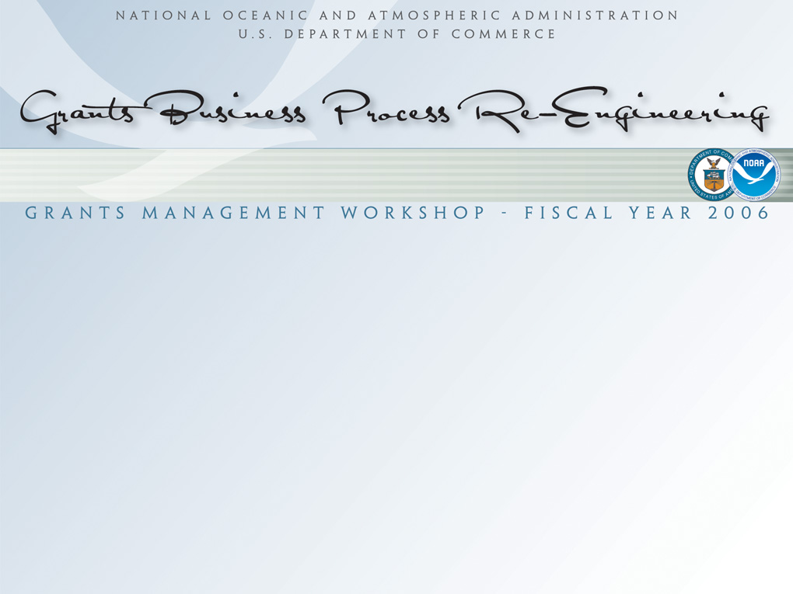
NOAA Cooperative Institutes
John Cortinas, Ph.D.
OAR Cooperative Institute Program, Program Manager
NOAA Cooperative Institute Committee, Chairperson

Slide 2

Outline
Goal: Provide information about NOAA Cooperative Institutes (CIs) and the new CI policy.
Introduction
General Information about CIs
New Policy
New CI Handbook
Transition

Slide 3
Introduction
CIs represent one type of NOAA research partnerships: multiple long-term, and collaborative research projects with NOAA scientists.
New NOAA-wide CI policy help ensure that NOAA meets its obligation to support a research portfolio that is excellent and aligned with its mission goals.
NOAA Science Advisory Board recommended (2004) that NOAA develop a NOAA-wide policy and associated processes to manage CIs.
NOAA adopted new policy on September 2005.

Slide 4

NOAA Cooperative Institutes
Long-term collaborative research partnerships that conduct research in support of NOAA’s mission.
Located at universities and non-profit research institutions in 17 states.
Most CIs are located near NOAA facilities to encourage collaboration.
Provide NOAA-related graduate degrees.
Long and successful history: First CI began in 1967.
NOAA administers CI awards in NOAA Line Offices (LOs).
(cont.)
(cont.)

Slide 5
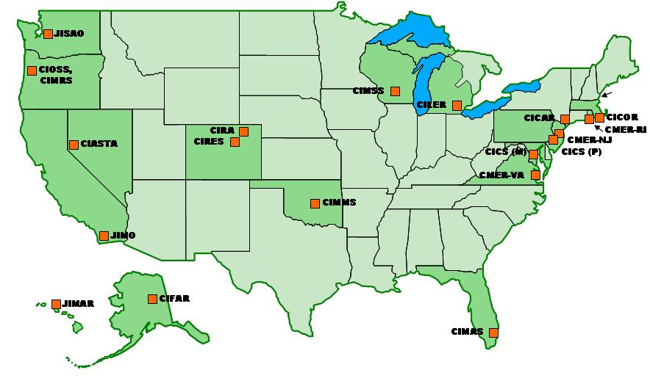
NOAA Cooperative Institutes
(cont.)

Slide 6
NOAA Cooperative Institutes
Mutual Benefits:
  Access to outstanding research scientists and facilities.
  Funding and research activities support education goals of the CI’s parent research institution(s).
  Long-term commitment of research support.
  Training and Outreach Activities.
  Quick funding mechanism.
  Provides future NOAA scientists.
(cont.)

Slide 7
NOAA Cooperative Institutes
Typical CI Organization
Director
Associate Director
Executive Board
(Includes NOAA
management)
Science Fellows
(Includes NOAA
employees)
Financial
Administrator
Division 1
Division 2
Division 3
(cont.)

Slide 8
NOAA Cooperative Institutes
Research
Institution
Dept.
  CIs foster collaboration among multiple programs and research institutions.
NOAA
Office
NOAA
Office
CI
NOAA
Office
Research
Institution
(cont.)

Slide 9
Typical Cooperative Institute Activities
Task I – Support CI administration and other activities that provide overall benefit to the CI (e.g., education, outreach, postdocs, visiting scientists)
Task II – Research that involves NOAA scientists.
Task III – Research with minimal NOAA scientist involvement.

Slide 10
New NOAA Policy on Cooperative Institutes
NOAA Administrative Order 216-107: NOAA Policy on Cooperative Institutes (effective 9/2/05).
NOAA’s CI policy sets forth basic principles to be applied in making decisions regarding NOAA CIs.
Describes why and how NOAA would establish a CI.
  For NOAA, the purpose of this partnership is to promote research, education, training, and outreach aligned with NOAA’s mission, to obtain research capabilities that do not exist internally, and/or to expand research capacity in NOAA-related sciences.
(cont.)

Slide 11
New NOAA Policy on Cooperative Institutes
Establishes a CI Committee under the NOAA Research Council (RC) to assist with oversight responsibilities.
Establishes a CI Handbook (describes all procedures for implementing the CI policy).
http://www.nrc.noaa.gov/ci
(cont.)

Slide 12
NOAA Cooperative Institute Committee
Mission: Ensure compliance with the NOAA CI policy described in NAO 216-107.
  Established to provide the RC with support to fulfill its oversight responsibility of the NOAA CI program.
Membership: Includes a representative from each LO and the NOAA Acquisition and Grants Office.
  Members and the Committee Chairperson are appointed by the Research Council chairperson.
(cont.)

Slide 13
NOAA Cooperative Institute Committee
Responsibilities
  Develop and maintain policies and procedures for the NOAA CI Program.
  Serve as the primary NOAA source for information on the NOAA CI program.
  Take action on topics and issues related to the CI program as directed by the RC.
(cont.)

Slide 14
Cooperative Institute Handbook
Documents all procedures associated with NOAA CIs
  Establishment
  Maintenance
  Renewals and Reviews
  Sunsetting
  Early Termination
Public comment period: 12/2/05 – 1/18/06.

Slide 15
Establishment
Request for new CIs is made to the RC by NOAA LOs and Goal Teams after internal evaluation to determine need.
NOAA Administrator approves establishment of all new CIs prior to competitive announcement.
NOAA publishes a Federal Funding Opportunity in Grants.gov and the Federal Register describing competition for the new CI.
Proposals are submitted through Grants.gov and are reviewed according to NOAA standard grant procedures.
Initial cooperative agreement awarded for 5 years.
(cont.)

Slide 16
Establishment
Standard Evaluation Criteria or Selection Factors (see Handbook for complete list):
  Internationally recognized experts with a demonstrated record of outstanding performance to conduct collaborative/interdisciplinary research.
  Demonstrated commitment (resources and facilities) to enhance existing NOAA and university resources.
  Strong education program with established graduate degrees in NOAA-related sciences.
  Well-developed business plan.
  Clearly stated goals to be achieved during award period.
  Cost-sharing (required).
(cont.)

Slide 17
Maintenance: Beyond Establishment
Handbook describes processes associated with CI award activities, including:
  Submission and review of proposals through Grants.gov
  Use and access to federal and CI facilities and computer systems
  Intellectual property rights
  Annual CI meetings
  Annual performance reporting

Slide 18
Renewals and Reviews
Annual review of performance reports.
One non-competitive renewal up to five additional years is allowed pending the outcome of a peer review in the fourth year of the cooperative agreement.
Review is conducted under the auspices of the NOAA Science Advisory Board and organized by the CI and the responsible NOAA LO.
(cont.)

Slide 19
Renewals and Reviews
Review outcomes:
  Outstanding - consistently demonstrated superior achievement. NOAA will renew up to 5 additional years, pending available funding.
  Satisfactory - achieved some or all of its goals and demonstrated acceptable performance. NOAA may renew less than 5 years at reduced funding.
  Unsatisfactory - demonstrated failure to achieve some or all of its agreed-upon goals. NOAA will not renew award.
(cont.)

Slide 20
Sunsetting
Sunset - The process by which a CI closes gracefully at the end of an award period.
  Occurs after one renewal if NOAA does not recompete the CI or the CI unsuccessfully competes in the recompetition.
  Occurs if the CI award is terminated early.
Sunset period is typically one year.
NOAA will work closely with a CI to minimize the impact on people and research.

Slide 21
Transition: Implementing the New Policy
NOAA Transition Plan available at CI website:
http://www.nrc.noaa.gov/ci
Current CIs will be sunsetted according to a staggered schedule through 2010.
NOAA will determine whether new CIs should be established prior to the end of each current CI award.
All new CIs will be established according to the procedures in the CI Handbook.

Slide 22
Final Thoughts
CIs are valuable resources to NOAA and represent one mechanism to collaborate with the external community.
NOAA’s CI policy sets forth basic principles to be applied in making decisions regarding NOAA CIs.
  Supports “One NOAA”
  Ensures consistent use of CIs across all NOAA LOs
  Emphasizes competition

Slide 23
Questions?

