Slide 1
“Who was that masked man?”
Computer Registration

Slide 2
Node Registration Facts
You must register your computer to use the network.
There are two types of registration:
  Temporary for visitors ( 4 days or less ).
  Permanent for regular network use.
Visitors register & get on the network fast!
  90% of the registrations take < 3 minutes…
You must fill out the permanent registration form after 4 days of temporary registration

Slide 3
Temporary Registration is Simple!
Power on your computer.
Open a web browser.
Fill in the form.
Reboot.
TIP: Instead of rebooting you can release and renew your DHCP address.

Slide 4
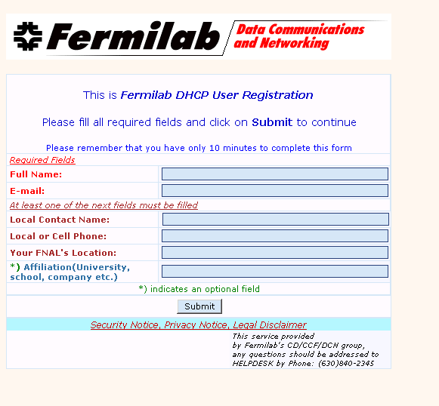
Temporary Registration Form
Required Information
Name
E-mail
A way to contact you

Slide 5
Temporary Registration Address Grant
Provides full onsite & offsite network access:
  But it expires at midnight!
Re-registration is required each day for a maximum of 5 days.
For permanent access you must fill out Miscomp Node Registration Form
  All of your hardware addresses must be registered...

Slide 6
Permanent Registration
To permanently register your machine, the following information is required:
System name
System administrator
Hardware information
Location
All Ethernet hardware “MAC” addresses
  This is the 12 digit, hexadecimal unique identifier for each of your network interfaces.
  A laptop might have three MAC addresses:
    wireless, wired, and a docking station.

Slide 7
Frequently Asked Questions
The Miscomp Node Registration form and other valuable information can be found in the DHCP Registration FAQ.
http://fndcg0.fnal.gov/dhcp-faq.htm

