Slide 1

EPA’s Version of
America’s Pathway to Sustainable
Water Utility Management
Better management
Water efficiency
Full cost pricing
Watershed approach
The
Agenda
For
Sustainability

Slide 2

The One Thing That Is Critical To Sustainability Is That Utilities Are Able to Do Their Work Expertly On Into The Future

Slide 3


Becoming Expert at Maintenance, Repair, Renewal or Replacement Is the Heart of Managing a Successful Water or Wastewater Service
Repair
Renew
Maintain
Replace

Slide 4
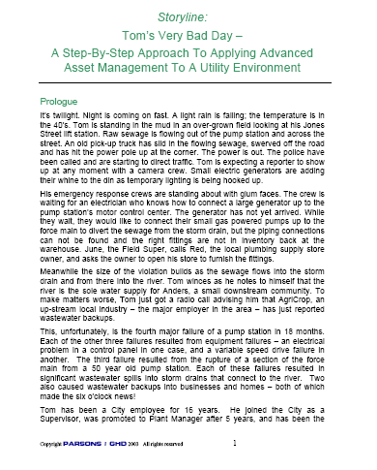

The Focus Of Advanced Asset Management
Core Questions, Process
& Life Cycle Cost

Slide 5
The Five Core AM Questions
Core Questions
1. What is the current state of my assets?
  What do I own?
  Where is it?
  What condition is it in?
  What is its remaining useful life?
  What is its economic value?
2. What is my required sustained Level Of Service?
  What is the demand for my services by my stakeholders?
  What do regulators require?
  What is my actual performance?
3. Given my system, which assets are critical to sustained performance?
  How does it fail? How can it fail?
  What is the likelihood of failure?
  What does it cost to repair?
  What are the consequences of failure?
4. What are my best “minimum life-cycle-cost” CIP and O&M strategies?
  What alternative management options exist?
  Which are most feasible?
5. Given the above, what is my best long-term funding strategy?

Slide 6
Core AAM Program Process Tools
System Layout;
Data Hierarchy;
Data Standards;
Data Inventory
Condition
Assessment,
Rating
Methodologies
Expected Life
Tables;
Decay Curves
Valuation;
Life Cycle Costing
Demand Analysis;
Balanced Scorecard;
Performance Metrics
Inventory
Assets
Assess
Condition
Determine
Residual
Life
Determine
Replacement
$ & Date
Set Target
LOS
Assign
BRE Rating
(Criticality)
Determine
Appropriate
Maintenance
Determine
Appropriate
CIP
Fund
Your Strategy
Build the AMP
FMECA;
Business Risk Exp;
Delphi Technique
Root Cause;
RCM;
PdM;
ORDM
Confidence Level
Rating;
Strategic Validation;
ORDM
Renewal Annuity
Asset Mgt Plan,
Polices & Strategy,
Annual Budget

Slide 7


USEPA
Advanced Asset Management Training
Prior Locations
Atlantic City, New Jersey
Phoenix, AZ,
Gainesville, Florida
San Antonio, Texas
N. Chelmsford, Massachusetts.
Tinton Falls, New Jersey.
St Louis, Missouri.
2005

Slide 8
How to make a Deal!
Typically attendance runs 80 to 100 attendees.
  The Partnership (we don’t act alone).
  Attendee fees.
  Cosponsors Responsibilities.
  Continuing Education
  The Brochure
  Timing
Note: All of the materials that will be presented during the training session will be available on the Website. The materials from past sessions at:
http://www.epa.gov/owm/asses_management.htm

