Slide 1
Licensing Infrastructure
Issues
Solutions
Experience
Matthias Schröder for
N.Høimyr, M.Katzarova, P.Saiz, A.M.Osborne, A.Thys, P.Bähler, H.Hansbakk

Slide 2
Issues
Commercial software requires licences
Several schemes possible
  Single user
  Node locked
  Network/Floating
  Site wide
  Home use

Slide 3
Management Aspects
Licences need to be managed
  Purchase the correct number
    Too few: users are very unhappy
    Too many: your management is very unhappy
  Install them
  Keep them accessible
  Renew them in time
    Warn the product maintainer, so he can take action
  Retire unused versions

Slide 4
Service Issues
Appropriate Infrastructure needed
  Assure availability
  Monitor usage
    Adapt number of licences to usage
  Inform about issues
    Make sure you can contact the users
  Keep track of available products
    120 products in database
      Products can have many features

Slide 5
Licence Management Systems
Challenge: many different systems
  Macrovision FlexLM
  IBM LUM
  Wolfram MathLM
  Microsoft SMS logs
  Many proprietary systems
No common interface
Some are plain incompatible
Require different operating systems
Some require hardware keys

Slide 6

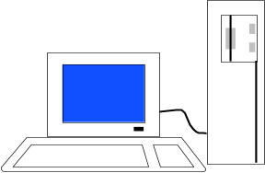
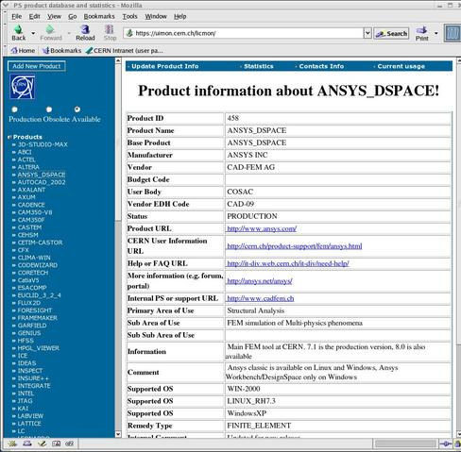
Our Setup
Log parser
Clients
Licence servers
Web-
interface
Product
database

Slide 7
Log Parser
Read logfiles of different license managers
  Each with own format…
  ~ 1k lines of perl, C or shell per parser
Extract needed information and store in DB
  Which product, feature, version
  Used by whom, when, from which host
Provides unified interface
Long term storage in DB
Easy access

Slide 8
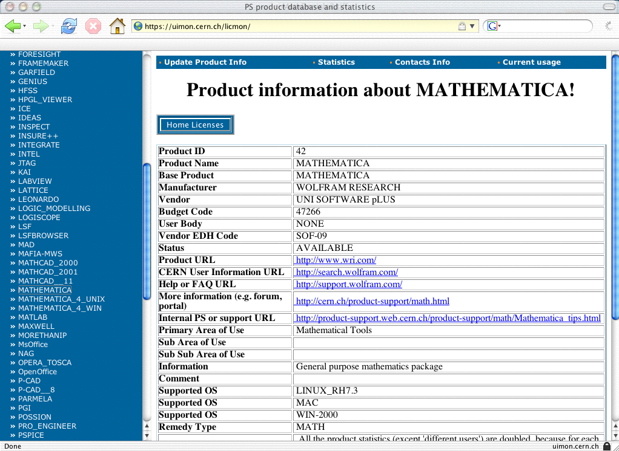
Web Interface – Product Information

Slide 9
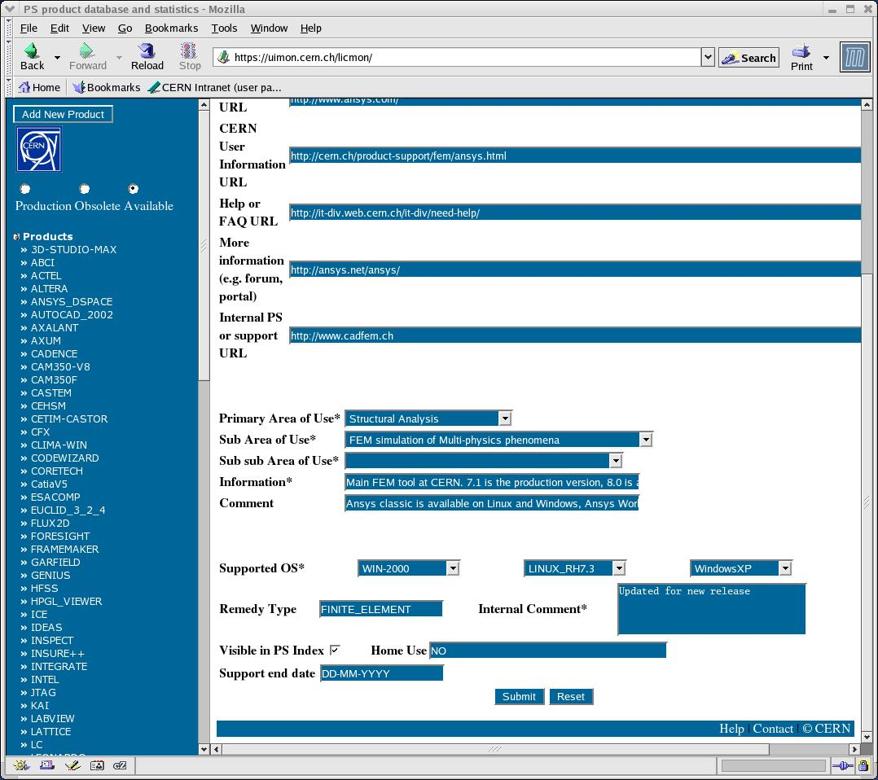
Web Interface – Product Maintainer Page

Slide 10
Usage Monitoring
Do we have enough/too many licences?
  Maximum number of concurrent users
  Number of denials
  For the different operating systems
  For the different versions of the product

Slide 11
Usage Monitoring 2
Lists of users
  Current users
    Ask user X to free a licence for Y
    Warn them about imminent changes
  Recent users
    Inform about planned changes, downtimes
  With email address

Slide 12
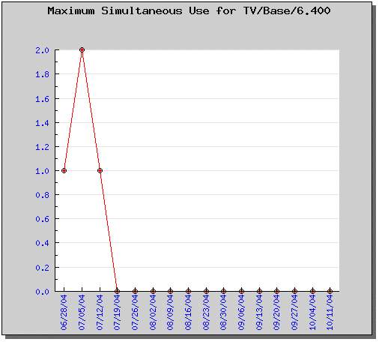
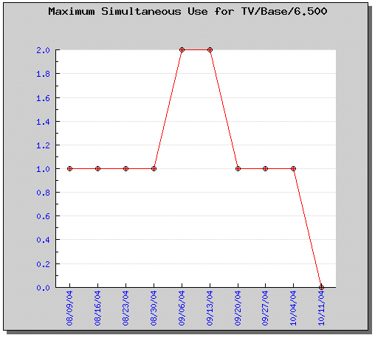
Web Interface - Statistics
Version 6.4 of TotalView not used anymore, consider retirement

Slide 13
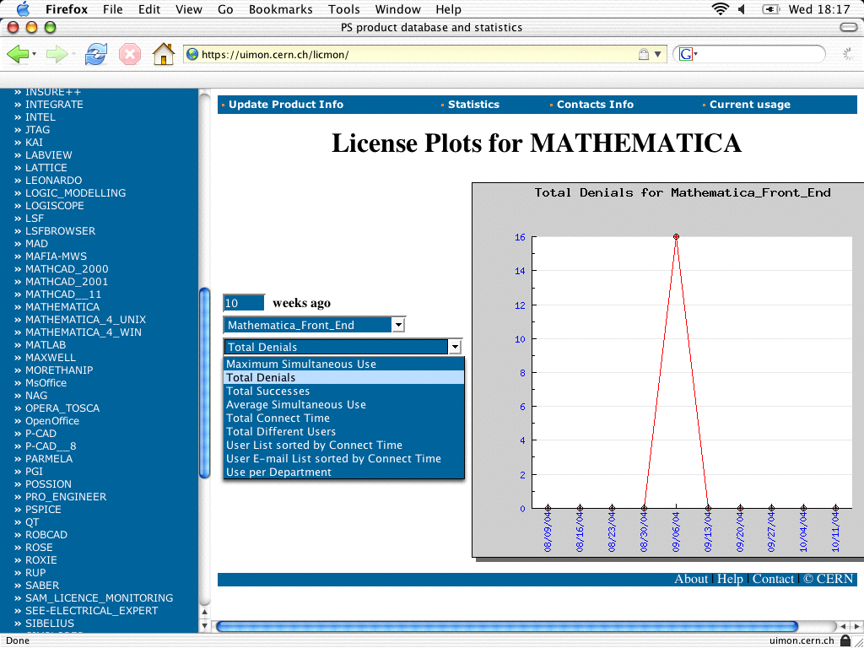
Web Interface - Statistics

Slide 14
Server Monitoring
Availability of Service very important
  Systems must be up at all times
  Licence manager daemons as well
Have redundant servers
  2*3 Solaris
  3+1+1+1 Windows
Not all licence managers allow fallback setup
  Monitor servers and daemons and start/stop daemons
  If vendor is not flexible enough: no fallback

Slide 15
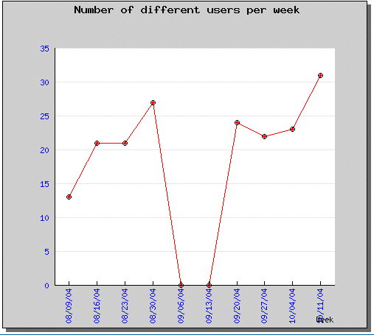
If things go wrong
Problems in fetching a logfile
  No stats for a product for that week

Slide 16
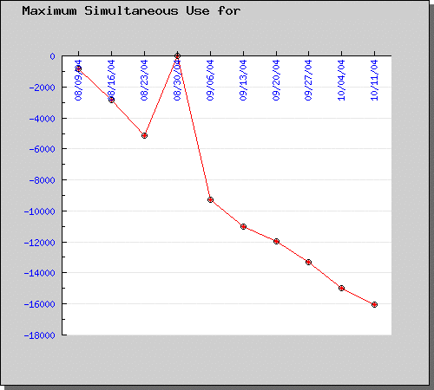
If things go wrong
Problems in parsing a logfile
  Strange results…

Slide 17
Conclusion
Proper infrastructure helps managing licences
Monitoring essential for estimate of needs
Variety of licence managers does not ease task
Log parsers help in dealing with variety

