Slide 1



National Energy Research
Scientific Computing Center
(NERSC)
NERSC Site Report
Shane Canon (canon@nersc.gov)
NERSC Center Division, LBNL
10/15/2004

Slide 2
NERSC Outline
PDSF
Other Computational Systems
Networking
Storage
GUPFS
Security

Slide 3
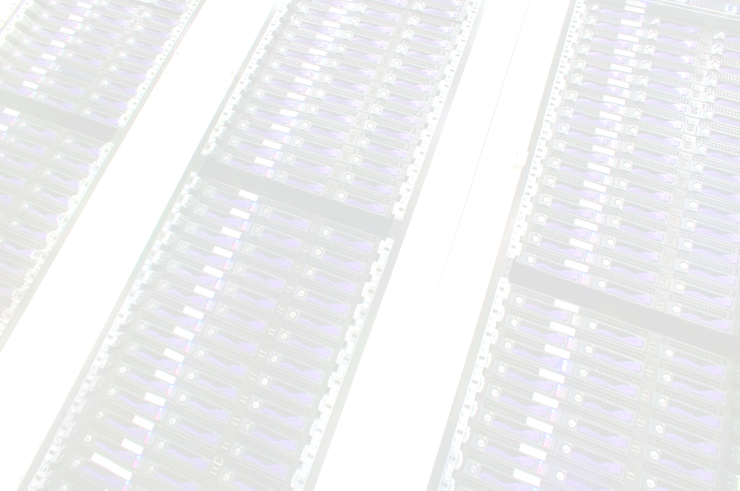
PDSF – New Hardware
49 Dual Xeon Systems
10 Dual Opteron Systems
All nodes are using native SATA controller (SI 3112 and SI 3114)
All nodes are gigE
Upgraded hard drives on 14 nodes (Added ~14 TB formatted
Foundry FES48 – 2 10G, 48 1G ports

Slide 4
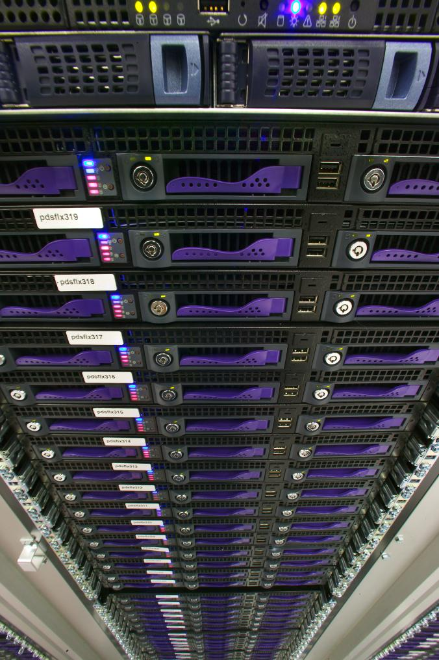
PDSF – Other Changes
New hardware will run SL (3.03)
CHOS already installed and will help ease transition to SL for users
New nodes will run under Sun GridEngine
  PDSF did not renew LSF maintenance
  LSF nodes will slowly be transitioned over to SGE

Slide 5
PDSF Projects
Exploratory work has been hampered by involvement with NCS procurement, GUPFS project (and bike accidents)
Recent focus has been
  CHOS
  Deployment of new hardware
  SL
  Lustre

Slide 6
PDSF - Lustre
Still not tested with users
Newer versions seem much more robust
Good at spot lighting flakey hardware
Older hardware is being reconfigured for use as a Lustre pool. Roughly 10 TB of total space.

Slide 7
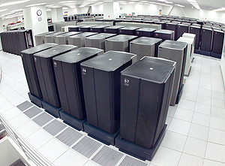
NERSC - IBM SP
Upgraded to 5.2
  Serious problems at first
  IBM dispatched team to diagnose and fix problems
Added FibreChannel disk
  ~13 TB
  FAStT 700 based

Slide 8
NERSC Systems - NCS
Award has been made
No formal announcement until acceptance is completed

Slide 9
NERSC Systems - NVS
New Visualization System
Small Altix System (4 nodes)
Some early issues
  Channel bonded Ethernet Jumbo not supported
Using a Apple Xserve raid on it until O3k is decommissioned

Slide 10
Networking – 10G
NERSC is building up a 10G infrastructure
Two MG8s provide core switching and routing for 10G network
Jumbo frames
Initially focused on core, mass storage, and visualization system. Exploring ways to extend to Seaborg. PDSF provided its own 10G Layer 3 switch.

Slide 11
NERSC - WAN
10 G upgrade to WAN is in the works
Waiting on Bay Area Metropolitan Area Network deployment by ES Net. Procurement is already under way

Slide 12
Mass Storage
Latest Hardware
  New Movers will have 10G links (testing is starting)
  LSI based storage
Other projects
  DMAPI work
  Portals and other web interfaces into HPSS

Slide 13
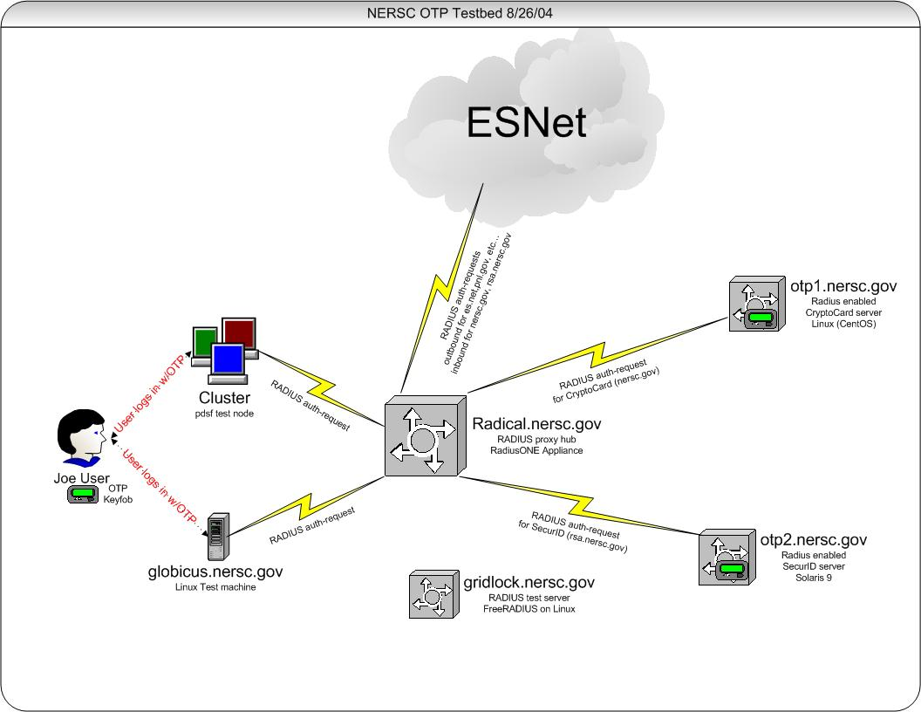
Security - OTP
Project on hold while funding is explored
To date various tokens have been evaluated
Focus is on products that are extensible and can be integrated fully in to NERSC and DOE infrastructures
Testing of cross RADIUS delegation
Should integrate into Grid using MyProxy or KCA approach

Slide 14
Bro Lite
DOE Funded
Simplify Bro
  Configuration (GUI)
  Output filters
  Available: Soon
    Beta slots available
    Contact: security@nersc.gov

Slide 15
GUPFS
Planned deployment late 2005
Unified filesystem spanning all NERSC systems (NCS, Seaborg, PDSF)
Possible candidates
  GPFS, ADIC, Lustre, Panasas, Storage Tank
Results: http://www.nersc.gov/projects/GUPFS
Contact: gupfs@nersc.gov

Slide 16
GUPFS Tested
File Systems
  Sistina GFS 4.2, 5.0, 5.1, and 5.2 Beta
  ADIC StorNext File System 2.0 and 2.2
  Lustre 0.6 (1.0 Beta 1), 0.9.2, 1.0, 1.0.{1,2,3,4}, 1.2.1
  IBM GPFS for Linux, 1.3 and 2.2. Beta 2.3.
  SANFS starting soon
  Panasas
Fabric
  FC (1Gb/s and 2Gb/s): Brocade SilkWorm, Qlogic SANbox2, Cisco MDS 9509, SANDial Shadow 14000
  Ethernet (iSCSI): Cisco SN 5428, Intel & Adaptec iSCSI HBA, Adaptec TOE, Cisco MDS 9509
  Infiniband (1x and 4x): InfiniCon and Topspin IB to GE/FC bridges (SRP over IB, iSCSI over IB),
  Inter-connect: Myrinnet 2000 (Rev D)
Storage
  Traditional Storage: Dot Hill, Silicon Gear, Chaparral
  New Storage: Yotta Yotta GSX 2400, EMC CX 600, 3PAR, DDN S2A 8500

Slide 17
Procurements
Several Procurements are starting up
GUPFS
  Global Filesystem for NERSC
  Deployment targeted for Spring 2005
NERSC5 –
  Follow on to Seaborg
  Likely target is 2005/2006
NCSe
  Second year of funding for new capability at NERSC (NCS was first block)
  Target Workload still being determined

Slide 18
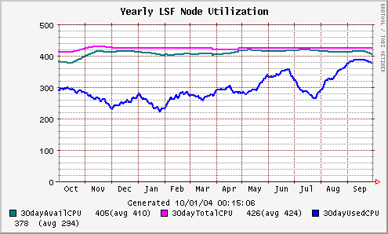
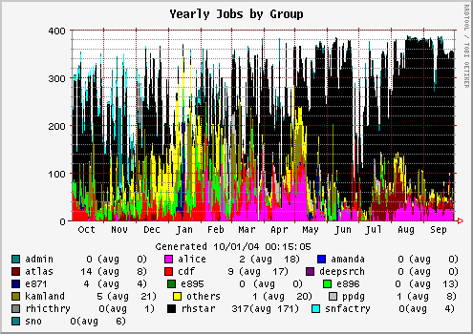
PDSF - Utilization
STAR has steadily picked up production over past months primary reason
Continued to encourage use of SGE pool for smaller groups and Grid projects

