Slide 1

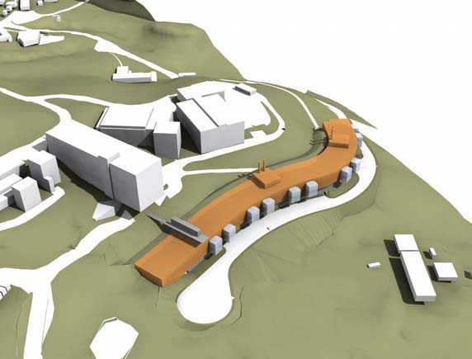


Helios Energy Research Facility Project

Slide 2
Tonight’s goals
To present the proposed project and schedule
To give community members an opportunity to provide input into the environmental review process

Slide 3
Other methods for input
planning@lbl.gov
Letter to: Jeff Philliber at Berkeley Lab
Fill out a card this evening
Tonight’s presentations will be made available on the Lab’s community relations website.

Slide 4
Tonight’s Agenda
I. Overview of Meeting-Mark Chekal-Bain
II. Research Objectives-Dr. Susan Jenkins
III. Design and Construction-Sheree Swanson
IV. Environmental Issues-Jeff Philliber
V. Public Comment-Facilitated by
Mark Chekal-Bain, 1.5 hours

Slide 5

Global Energy Challenge
Demand
Supply
Security
Environmental
These problems need to be addressed by multidisciplinary research teams using the most current technological approaches available

Slide 6
Mean Global Energy Consumption
(Total 12.8 TW)
5
4.52
4
2.96
3
2.7
TerraWatts
2
1.21
0.828
1
0.286
0.286
0
Oil
Gas
Coal
Hydro
Biomass
Renew
Nuclear
Source: Nate Lewis, Caltech

Slide 7
Potential of Carbon
Neutral Energy Sources
TW
1000000
100000
10000
1000
100
10
1
0.1
Hydro
Tides &
currents
Wind
Geothermal
Solar
Current use
Source: Basic Research Needs for Solar Energy Utilization, DOE 2005

Slide 8

Helios Concept
Plants
Photosynthetic
microbes & algae
Methanol
Ethanol
Hydrogen
Hydrocarbons
Electrons
Artificial
Photosynthesis
Photovoltaics
Notes:
Enabling the energy portfolio of fifty years hence is our goal, and we don’t know what that portfolio will include. It is too soon to down select. Instead, we have stressed scientific discovery with broad application and initially the exploration of several routes to fuel production from the sun.
As a result, Helios has four routes to fuel production. Much basic science, in such areas as photosynthesis, nanomaterials, catalysis,electrochemistry, separations, bioengineering, and modeling approaches are shared by the different routes.

Slide 9
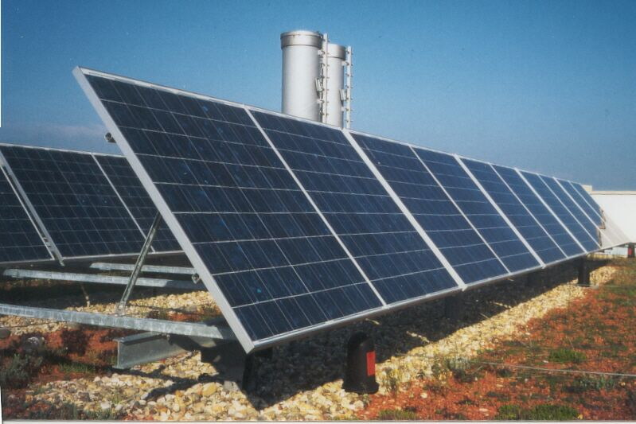
Potential for Photovoltaics
At current efficiency, the United States would need 25 million acres to satisfy all current energy needs
New PV technologies will increase efficiency of solar conversion
The United States has an estimated 35+ million acres in paved roads, parking lots,
and rooftops
Notes:
But is solar energy practical? How much area would we need to collect enough sunlight? The answer depends on how efficient our solr-to-fuel process are.
For example, our analysis shows that 1% efficiency we’d need 40M acres to meet current gasoline consumption, but at 10% efficiency we’d need only 4M acres.
Some processes, including biofuels, may never be able to reach that 10% level efficiency. However, we do have a huge amount of non-cultivated cropland--in fact, almost 40M acres! So that a 1% efficiency target can have a big impact on this problem.
For other routes to solar energy, for example photovoltaic cells, we have potentially higher efficiencies. And we know we can cover large areas with inexpensive materials, because we now have 35M acres in paved roads, parking lots, and rooftops.

Slide 10
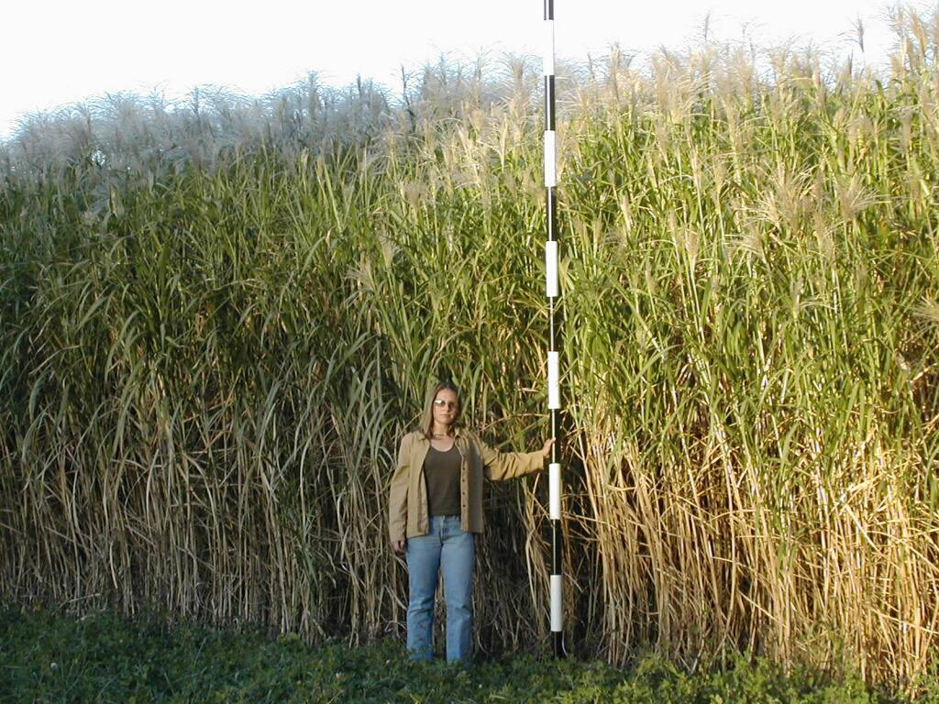
Potential for Biomass
The Energy Independence and Security Act (EISA) of 2007 established a 36-billion-gallon mandate for biofuels by 2022
Current ethanol production methods would require over 70 million acres, or 25% of 2006 harvested cropland
Using new, improved methods on non-food crops would reduce the requirement to just 5.8% of 2006 harvested cropland
The United States has 38 million acres of non-cultivated land and the world has a total of a billion acres of abandoned agricultural land
Sources: S. Long, UIUC, and Increasing Feedstock Production for Biofuels, BR&Di, 2007
Campbell et al., Env. Sci. Technol. (2008) ASAP Article, 10.1021/es800052w
Notes:
But is solar energy practical? How much area would we need to collect enough sunlight? The answer depends on how efficient our solr-to-fuel process are.
For example, our analysis shows that 1% efficiency we’d need 40M acres to meet current gasoline consumption, but at 10% efficiency we’d need only 4M acres.
Some processes, including biofuels, may never be able to reach that 10% level efficiency. However, we do have a huge amount of non-cultivated cropland--in fact, almost 40M acres! So that a 1% efficiency target can have a big impact on this problem.
For other routes to solar energy, for example photovoltaic cells, we have potentially higher efficiencies. And we know we can cover large areas with inexpensive materials, because we now have 35M acres in paved roads, parking lots, and rooftops.

Slide 11
EBI Research Focus
Social, Environmental &
Economic Dimensions
Complete life-cycle assessment
Biofuels evaluation
Markets and networks
Social interactions and risks
Environmental concerns
Molecular/Chemistry/Lab
Agronomy/Field
Biomass pretreatment
Enzyme discovery
Chemical catalysis
Systems biology
Pathway engineering
Feedstock production
Genetics & breeding
Harvest, transport, storage
Pests & pathogens
Environmental factors
(water, sunlight, climate, etc.)

Slide 12
Education & Outreach
Provide external investigators broad access to UCB, UIUC and LBNL intellectual resources as visiting scholars
Educate the next generation of energy scientists
  Postdoctoral
  Ph.D.
  B.S.
Educate the public
  general public
  policy makers
  public policy students
  K-12 teachers and students
Provide extension activities targeting the agricultural community

Slide 13
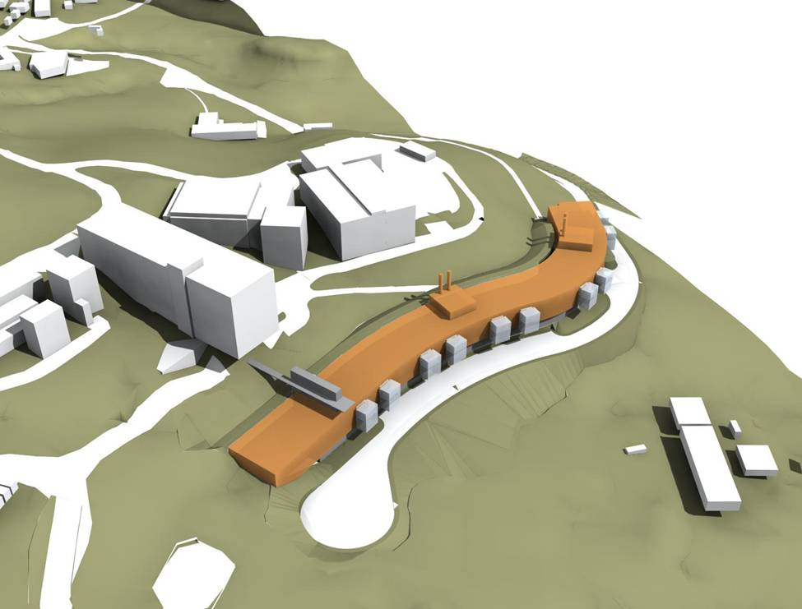
Public Scoping Meeting
Helios Energy Research Facility
January 7, 2009

Slide 14
Key Project Objectives
Design the project to minimize environmental impacts
Construct a facility that will reflect the University’s commitment to environmental stewardship, sustainability, energy efficiency and exceptional design

Slide 15
Key Project Details
Project Description
  144,000 gross square feet, 3 to 4 Stories facility
  $198 Million total project budget (~$135M construction)
Proposed Project Site
  Adjacent to LBNL Material Science Research Cluster
  Primary access via Centennial Road, secured access to LBNL
  Parking limited to 50 vehicles
  Primary transportation will be via shuttle buses
Population
  Helios Facility will support 500 people
Facility will be owned & operated by Univ. of California

Slide 16
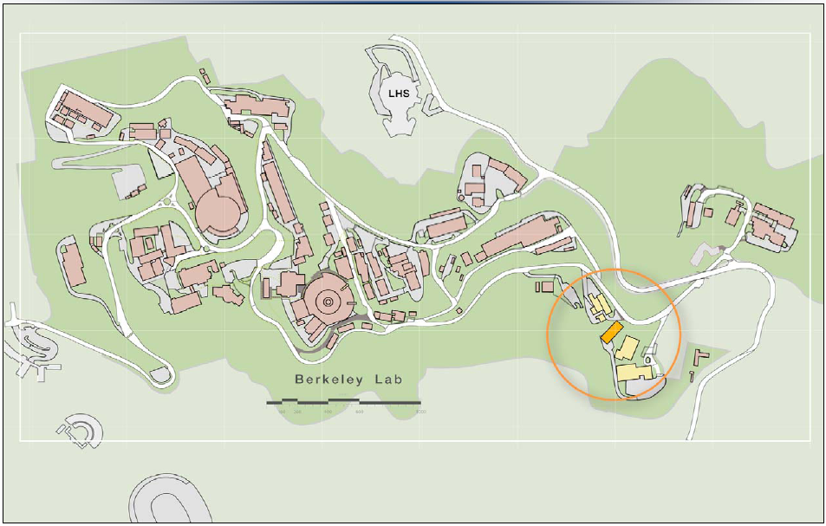
Lawrence Berkeley National Lab
72
67
66
62
Helios
Material Sciences Research Cluster

Slide 17
Key Project Details
Project Description
  144,000 gross square feet, 3 to 4 Stories facility
  $198 Million total project budget (~$135M construction)
Proposed Project Site
  Adjacent to LBNL Material Science Research Cluster
  Primary access via Centennial Road, secured access to LBNL
  Parking limited to 50 vehicles
  Primary transportation will be via shuttle buses
Population
  Helios Facility will support 500 people
Facility will be owned & operated by Univ. of California

Slide 18
Lawrence Berkeley National Lab
72
67
66
62
Helios
Material Sciences Research Cluster

Slide 19
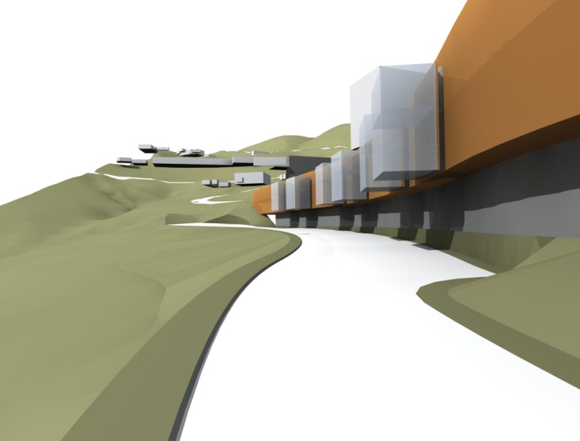
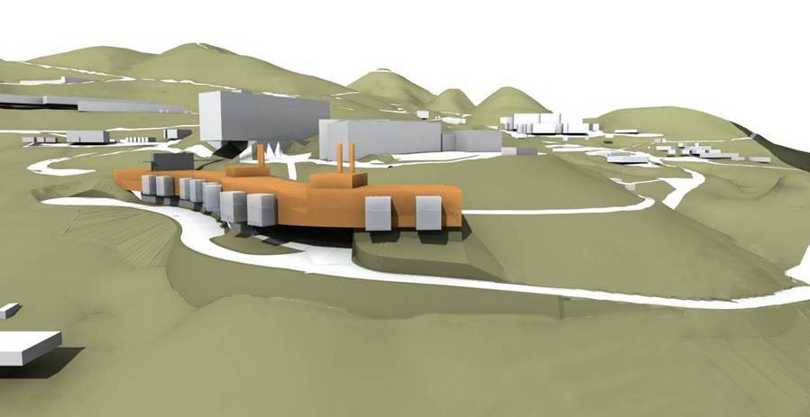
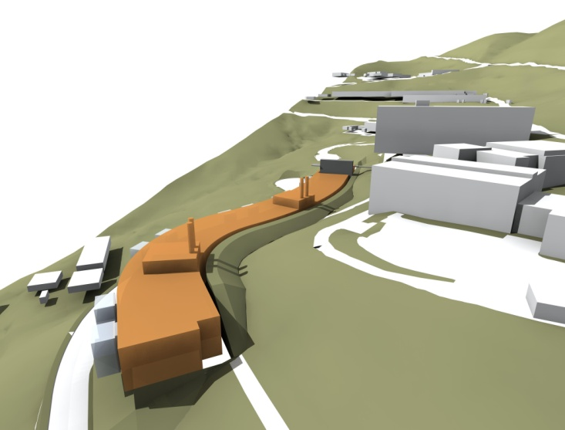
Architectural Massing
VIEW FROM ENTRY ROAD
VIEW FROM BELOW
AERIAL LOOKING NORTH

Slide 20
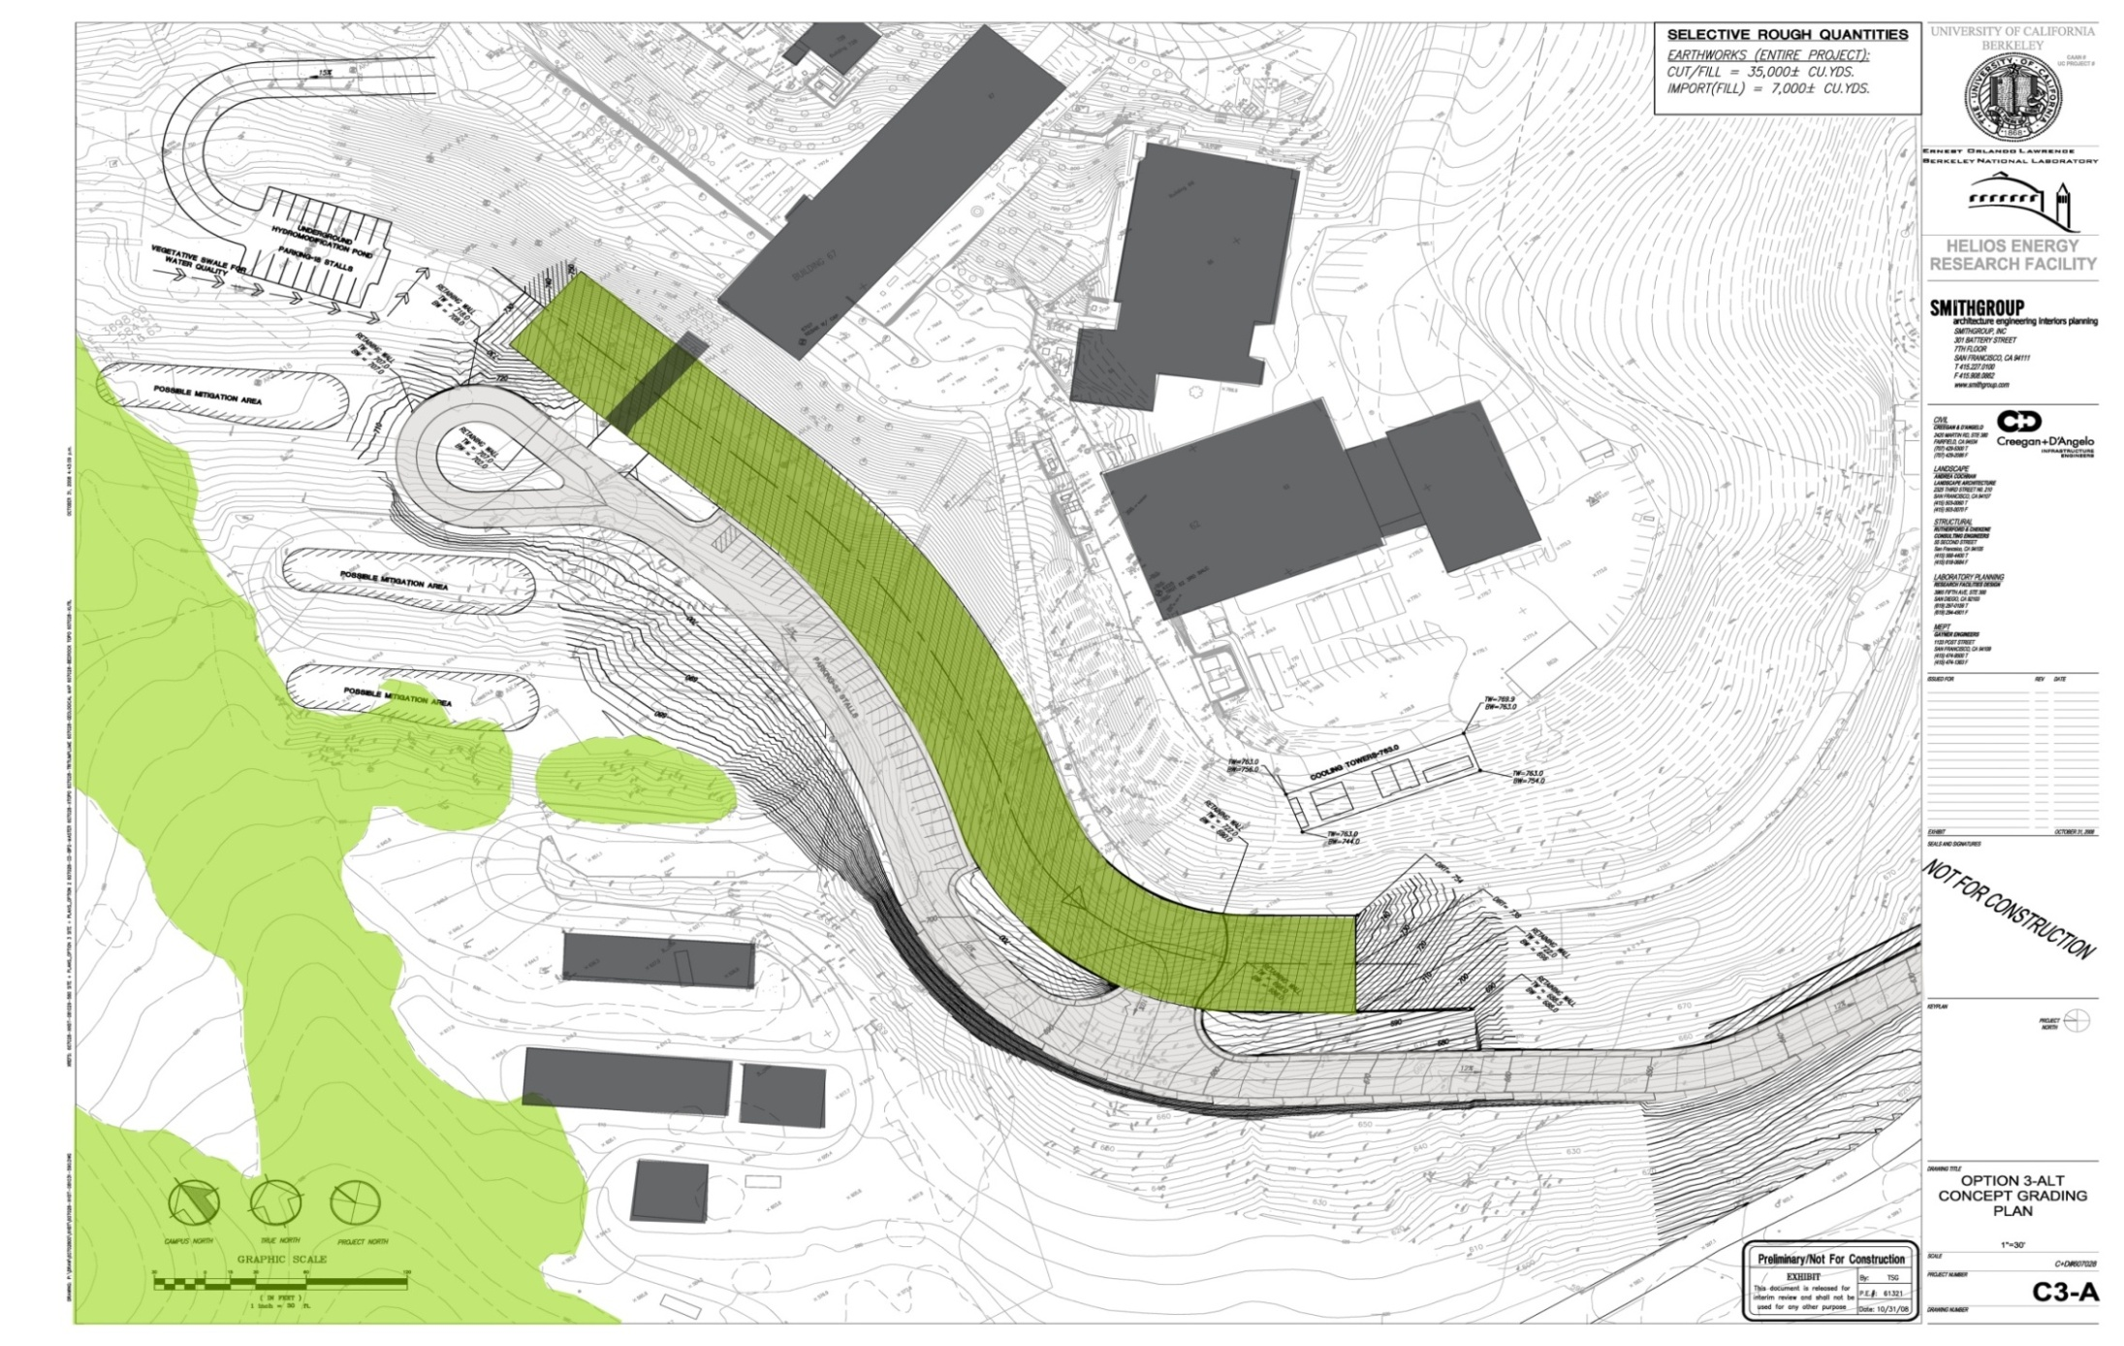
Site Conditions
GEOLOGY
SOIL IMPORT/EXPORT
GREEN ROOF
ROADWAY
RIPARIAN ZONE
ARBORIST SITE ASSESSMENT
LBNL/UCB
CONNECTION
GREEN
ROOF
RIPARIAN ZONE

Slide 21
Key Features
Energy Efficient / Sustainable Design
Reduced Visual Impact
  Design building to match existing topography
  Maximize “Green planted” roof
  Design access road to maximize use of “Green” stabilization systems
The new, low profile design is consistent with our commitment to be responsible stewards of the land as well as of the public and private funds supporting the project

Slide 22
Helios
Public Scoping Meeting
CEQA Presentation
January 7, 2009

Slide 23
Scoping Meeting
Present basic project information
Explain CEQA process
Record public comments

Slide 24
Scoping Meeting
Not a Q & A forum or discussion
  Detracts from purpose of meeting
  Environmental analysis underway
Questions answered in two ways:
  Procedural/Basic questions to Berkeley Lab
  Substantive questions in Draft EIR

Slide 25
CEQA Process
Scoping
  Notice of Preparation
  Public Scoping Meeting
Draft EIR
  Public review and comment period
  Public Hearing
Final EIR
  Public Review
Regents Meeting
  Decision to certify EIR

Slide 26
CEQA Schedule
Scoping --------------------- Dec ’08 – Jan ‘09
  Initial Study / Notice of Preparation
  (47 days)
  Public Scoping Meeting
Draft EIR ----------------------- Mar – Apr ‘09
  Public review and comment period
  (45 days)
  Public Hearing
Final EIR ----------------------- June ‘09
  Public Review (7 – 10 days)
Regents Meeting ----------------------- July ’09
  Decision to certify EIR
Construction: Spring 2010 – Spring 2013

Slide 27
EIR
Project specific, stand-alone EIR
Build on existing sitewide models
  Health Risk Assessment
  Sitewide visual simulation model
  Will adopt all mitigation measures from 2006 LRDP EIR
NEPA not required

Slide 28
EIR Issues to be Evaluated
Aesthetics
Air Quality
Biological
Cultural
Geology / Seismicity
Hazards / Haz Mat
Hydrology
Noise
Trans. & Traffic
Utilities
Cumulative Impacts
Alternatives

Slide 29
Alternatives
No Project
Reduced Project
Centennial Site (Berkeley Lab)
Off Site (Berkeley)
Off Site (Richmond Field Station)

Slide 30
Environmental Issues
(areas of likely impact)
Aesthetics
Air Quality
Biological Resources
Cultural
Geology / Hydrology
Traffic

Slide 31
Environmental Values
Follow UC Sustainability Policy
Energy efficient building
No net increase in storm water runoff
Limited parking
Lower Profile than previous Design

Slide 32
Public Comment Period
Please fill out a card with your name

