Slide 1
How to Register A Medical Device Establishment and List Devices With the FDA
Presented by Bryan H. Benesch
Office of Compliance, CDRH
April 2004

Slide 2
Regulatory Authority
Sections 510 of the Food, Drug and Cosmetic Act As Amended requires establishment registration and device listing

Slide 3
R&L Regulations
21 CFR Part 807, subparts A-D
  A: Definitions
  B: Procedures for Domestic Device Establishments
  C: Registration Procedures for Foreign Device Establishments
  D: Exemptions

Slide 4
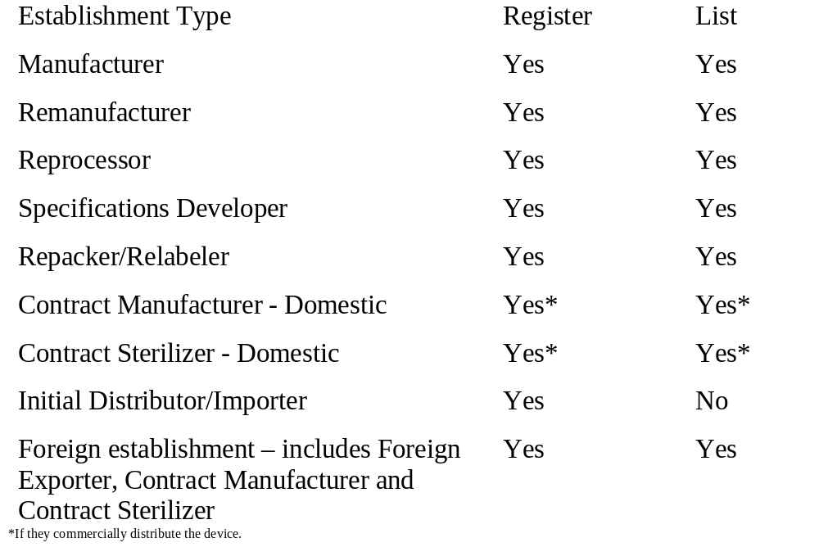
Who Must Register and List?

Slide 5
Registration Requirements
Initial domestic establishment registration within 30 days of starting commercial distribution of a device.
Foreign establishments must register before importing or offering for import devices to the United States
Submit form FDA 2891
Renew registration annually using form
FDA 2891a (see 807.21 for mailing schedule)

Slide 6
Foreign Establishment Requirements
FDA Modernization Act (FDAMA) of 1997 makes establishment registration mandatory and adds requirement to appoint a United States agent
Effective February 11, 2002

Slide 7
United States Agent Requirement
All foreign establishments shall appoint a single United States agent
Must notify FDA within five days of appointing or changing United States agent
United States agent must reside or have a physical place of business in the United States - no Post Office boxes or mail drops allowed

Slide 8
United States Agent Responsibilities
Assist FDA with scheduling of inspections
Assist FDA with communications
Accept information or documents that FDA is unable to provide directly to the foreign establishment
Respond to questions concerning products being imported or offered for import
May act as Official Correspondent

Slide 9
Device Listing Requirements
Device listing by domestic establishments within 30 days of starting commercial distribution of a device.
Foreign establishments must list before importing or offering for import devices to the United States.
Submit form FDA 2892.
One device listing for each type of device (not each model, catalog number, brand name).

Slide 10
Device Listing Updates
Semi-annual review of all information is required in June and December.
Updates due in June, December, or at time of change.
Only certain items of the initial information requires updating.
Update information using new FDA 2892 or a letter when changing large numbers of records.

Slide 11
Registration Updates
Update information by submitting annual registration form FDA 2891a, or by letter rest of time.

Slide 12
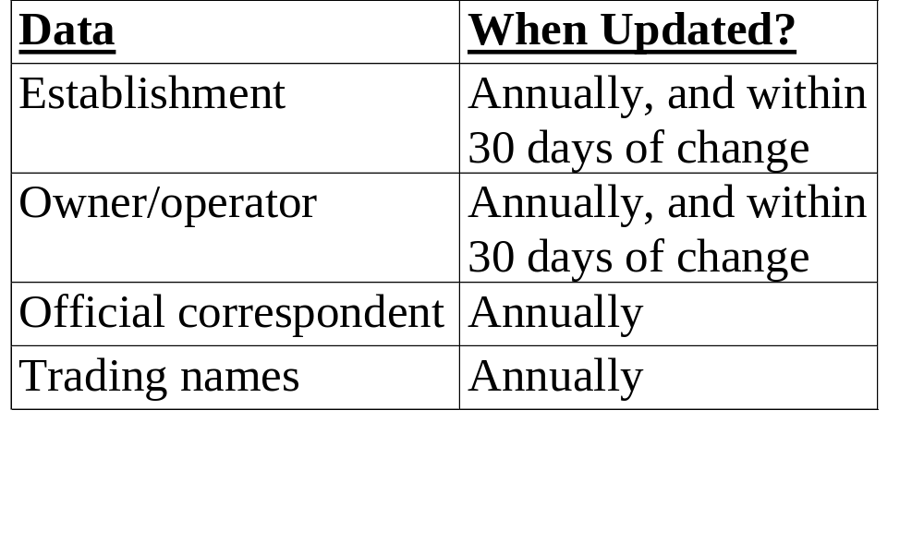
What Registration Data Has to Be Updated?

Slide 13
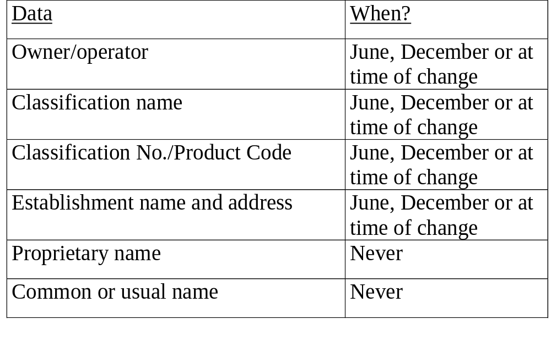
What Listing Data Has to Be Updated?

Slide 14
Where Do My Pieces of Paper Go?
You mail forms FDA 2891, 2891a, 2892, U.S. agent notification letter to CDRH
We receive and accept or return them
If accepted, we send you a letter with your newly assigned owner/operator number
We send the 2891 to appropriate FDA District Office
District reviews form, issues registration number and sends form back to CDRH
CDRH enters data and sends you your registration number

Slide 15
Top Problems - Form 2891
An official version of the form was not used.
An illegible photocopy of the form was submitted.
A post office box was used for the establishment's address, instead of the required street address.
The official correspondent fails to sign the form or enter his or her title.

Slide 16
Top Problems - Form 2891
The establishment fails to submit a device listing form (2892) with its initial registration form (2891).
The "establishment type" section is not filled out correctly.
Information on the establishment's owner/operator is missing or incomplete.
Sections of the form are incomplete.

Slide 17
Top Problems - Form 2892
A photocopy of the form was submitted. Because each form is uniquely numbered, only an original copy is acceptable. This document ID number is the "device listing number." It is required when importing a medical device into the United States.
The classification number is missing or unclear. This is the three letter product code that FDA assigns to each type of medical device.
The official correspondent fails to sign the form.
The owner/operator listed more than one classification name and number on the form. Each form can only include a single product type.

Slide 18
Top Problems - Form 2892
The form is a duplicate of a previously submitted form for the same classification number. This occurs when a new brand name or model number is added to an existing product line. FDA does not require a new form every time a new brand name, model number, or catalog number is added or changed.
Sections of the form are incomplete.
Missing, incomplete or incorrect establishment information or owner/operator information.

Slide 19
Sources of Registration and Listing Information
1. Registration and Listing for Firms http://www.fda.gov/cdrh/reglistpage.html
2. Establishment Registration (part of Device Advice) http://www.fda.gov/cdrh/devadvice/341.html
3. Medical Device Listing (part of Device Advice) http://www.fda.gov/cdrh/devadvice/342.html
4. Releasable Establishment Registration and Device Listing Files http://www.fda.gov/cdrh/comp/estregls.html

Slide 20
Sources of Registration and Listing Information
5. Product Code Classification Database http://www.fda.gov/cdrh/prodcode.html
6. Use of PDF Version of Form FDA 2891 Initial Registration of Device Establishment
http://www.fda.gov/cdrh/comp/fda2891.html
7. Use of PDF Version of Form FDA 2892 Device Listing
http://www.fda.gov/cdrh/comp/fda2892.html

Slide 21
How to Contact R&L Program Office
Registration and Listing Program
Office of Compliance
Center for Devices and Radiological Health
9200 Corporate Blvd., HFZ-308
Rockville, MD 20850-4015
Tel: 301-827-4555, press 3
E-mail for forms and status requests: reglist@cdrh.fda.gov
E-mail for policy questions and import detention issues: rlprogram@cdrh.fda.gov

