Slide 1
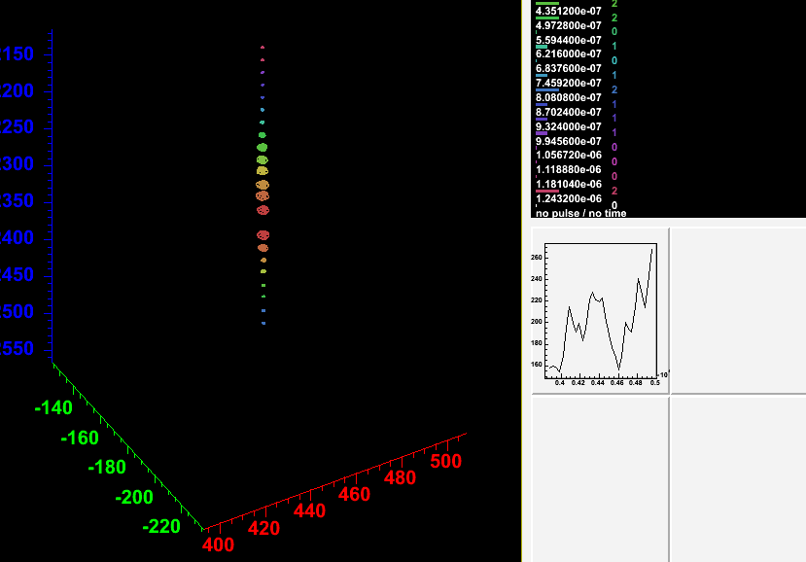
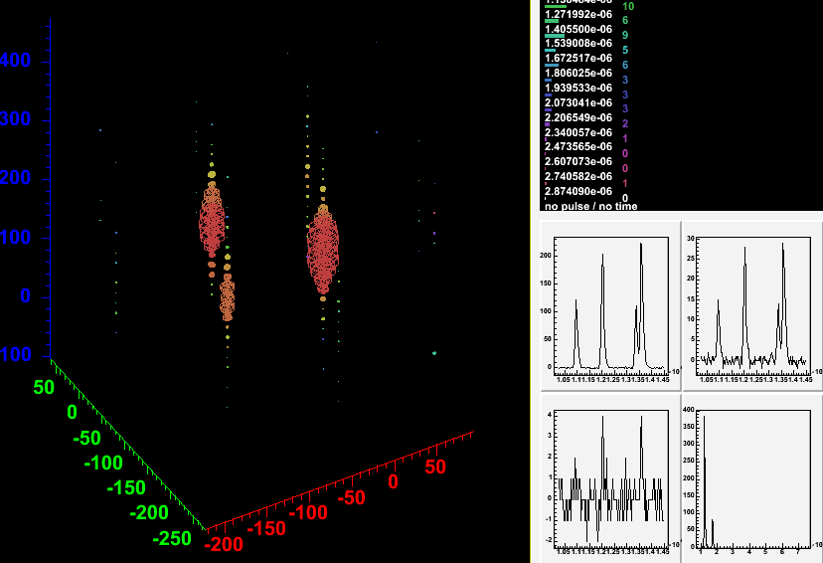
Cascade and
Flasher Workshop
Welcome!
Spencer Klein, LBNL
Logistics
Agenda
Goals

Slide 2
Logistics
Talks Monday and Tuesday mornings
  Otherwise: Work Time
    Small groups and individuals
  Progress Reports Wed. morning and closeout Wed. afternoon.
Monday, Tuesday in Perseverance Hall
Wednesday in Bldg. 2, Room 100B
Separate ‘breakout’ room available in afternoons
Wireless in all conference rooms
  Some ethernet available. Ask for a cable if you need one

Slide 3
Talks on the web
I will put all of the talks on the web
Please email me your talks!

Slide 4
Talks
Monday:
  ???: A users guide to the flashers” Mark Krasberg
  “Flashers, Brightness Calibrations and Module Orientation” Chris Wendt
  “Flasher Analysis with AMANDA” Kurt Woschnagg
  “How to simulate cascades and flashers” Tom McCauley
  “Characteristics of Flasher data” (Sourav Mandal)
Tuesday
  “Flashers and Hole Ice” (Doug Rutledge)
  “Analyzing flasher events with Renew” (Tom McCauley)
  “Waveform based reconstruction” (Sean Grullon)
  “String 21 flashers in AMANDA" Dave Hardtke
  “Flasher reconstruction” (Dima Chirkin)
  TBC: “Characteristics of Cascade Simulations” Spencer Klein

Slide 5
Goals
Goals: Push forward with cascade and flasher analysis
  Produce Flasher verification plots
    What are the most appropriate plots?
      Ice properties, timing, geometry, …
  Simulate Cascades and Flashers
    Find problems in simulations
      E.g. 1.pe. Pulses in simulation are ~ 2-3X larger than in data
  Develop cascade algorithms using flasher (& simulation) data

Slide 6
Flasher Verification
What can the flashers tell us about how well IceCube is working?
What can the flashers tell us about ice quality?
  We are ~ 300 m from AMANDA – is the ice any different?
What can the flashers tell us about hole ice?
Do we need additional runs with different configurations?
  Not all LEDs?
  AMANDA lasers

Slide 7
Flashers - Specific Tasks
Understand Flasher characteristics (nhits,…)
Systematic Timing verification (new flasher data)
  Simulation for comparison data
  Solve for individual resolution
Geometry verification (LLH reconstruction)
  Location of DOM 60?
  Start on inter-string geometry calibrations
Energy/Brightness calibrations
Ice properties
Hole Ice (probably not)
Orientation effects
Photonics for flashers?
Comparison of flasher data and cascade simulations
AMANDA looking at IceCube flashers

Slide 8
Cascade and Flasher simulation
IceTray simulations may finally be ready for physics use
  Input/output & calibrations working
  Photonics tables
Generate events and look at them
Compare flasher data and flasher simulations

Slide 9
Cascade Algorithm Development & Testing
Many different cascade algorithms, in different stages of development
What are similarities vs. differences?
What are appropriate metrics for comparing algorithms & how should they be weighted?
  Vertex & energy reconstruction accuracy
  Background rejection
  Speed & robustness (for use at pole)
Can we make more progress by working together?
  Common framework
  Common simulations

