Slide 1
U.S. Wood Product Exports
Between 1999 and 2003, the value of U.S. wood product exports decreased from $6 billion to $5 billion. The primary factors contributing to the decline included increased world production of wood products and the resultant increased competition, a strong U.S. dollar and slow economic growth in many of the United States’ major markets.
In 1999, Canada replaced Japan as the top market for U.S. wood exports. U.S. exports to the EU, especially softwood lumber, have also fallen on hard times due mainly to increased competition from Russia, Poland and Latvia. On a positive note, U.S. exports to China increased from $57 million in 1999 to $250 million in 2003 as reduced tariffs, market reforms and logging bans stimulated China’s demand for imported wood products.

Slide 2
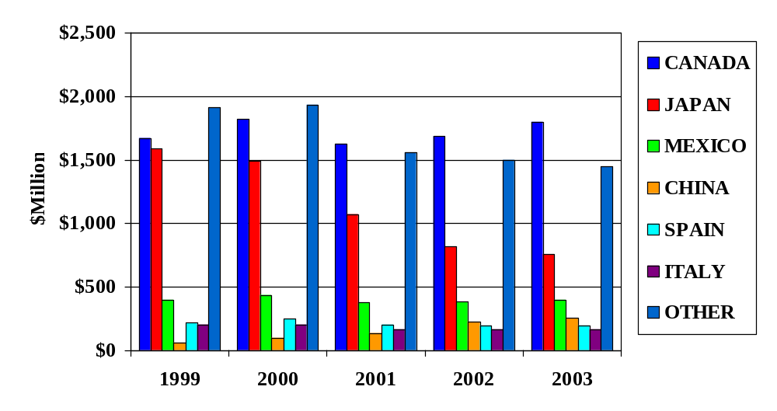
U.S. Wood Product Exports

Slide 3
U.S. Wood Product Exports, by Category
Hardwood lumber is the leading wood product commodity group exported from the United States. In 2000, exports reached $1.4 billion before falling back to $1.3 billion in 2003. U.S. hardwood lumber, log and veneer exports to China and Southeast Asia have increased, with an increasing amount of furniture being produced in this region. U.S. softwood log exports decreased from $880 million in 1999 to $680 million in 2003 primarily due to falling demand in Japan. Softwood lumber exports decreased from $740 in 1999 to $380 million in 2003 mainly due to falling demand in Japan, the EU and Canada. Hardwood veneer exports increased from $370 million in 1999 to $420 million in 2003.

Slide 4
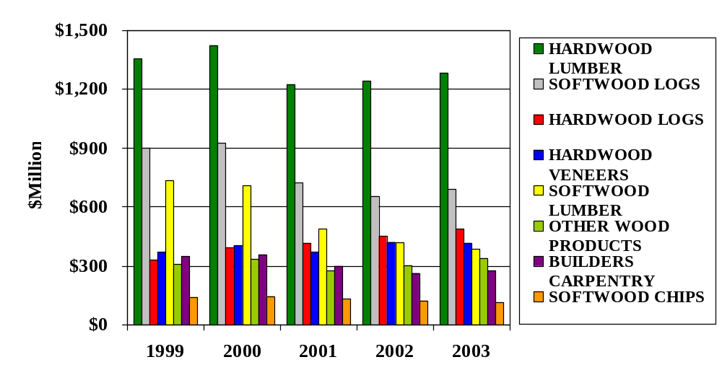
U.S. Wood Product Exports, by Category

Slide 5
U.S. Wood Product Exports in 2003, Based on Value
Nearly one-half of the value of all U.S. wood product exports fall within three commodity categories; hardwood lumber (25 percent), softwood logs (14 percent) and hardwood logs (10 percent). Other important export commodities include softwood lumber (8 percent), hardwood veneer (8 percent) and builders carpentry (6 percent).

Slide 6
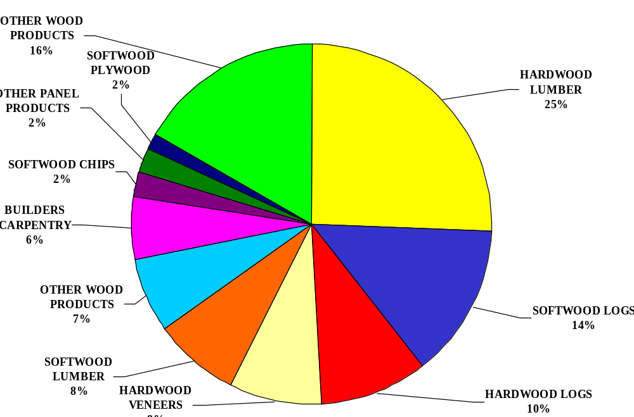
U.S. Wood Product Exports in 2003, Based on Value

Slide 7
U.S. Softwood Log Exports to Major Markets
Japan is the leading market for U.S. softwood logs, despite exports decreasing from $700 million in 1999 to just $430 million in 2003. As recently as 1996, the United States exported $2 billion of softwood logs to Japan, and Douglas-fir logs accounted for 75 percent of this trade. The primary reason for the sharp decline was the collapse of Japan’s housing market, which decreased from a record 1.6 million starts in 1996 to just 1.2 million starts in 1998. Between 1998 and 2000, U.S. softwood log exports remained stable. However, when Japan implemented the Housing Quality Assurance Act in April 2000, demand for U.S. softwood logs (especially Douglas-fir logs) was reduced. The new law requires builders to guarantee their products for 10 years, favoring imports of kiln-dried products over green logs. Japanese kiln-drying capacity is limited.

Slide 8
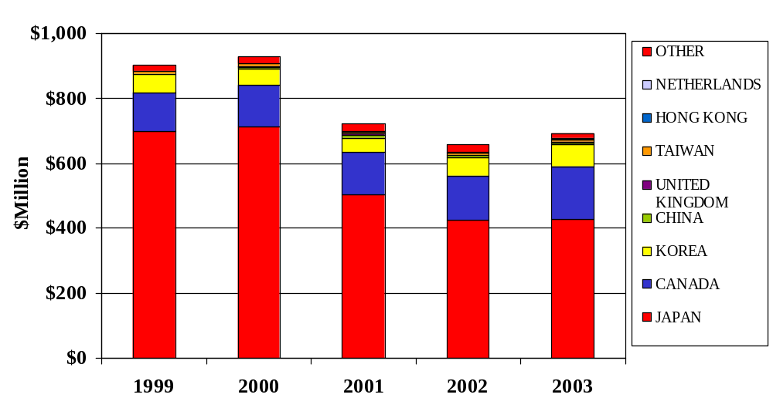
U.S. Softwood Log Exports to Major Markets

Slide 9
U.S. Hardwood Log Exports to Major Markets
U.S. exports of hardwood logs have been increasing steadily over the last decade. In the last five years, exports to Canada and China accounted for 80 percent of the $140 million of growth. Hardwood log exports to Canada are used to supply Canada’s furniture market as well as its door, window and molding manufacturers. Many of these products are then exported back to the United States. U.S. hardwood log exports to China have increased from $5 million in 1999 to over $50 million in 2003, with walnut, yellow poplar, cherry and red oak logs accounting for much of the growth.

Slide 10
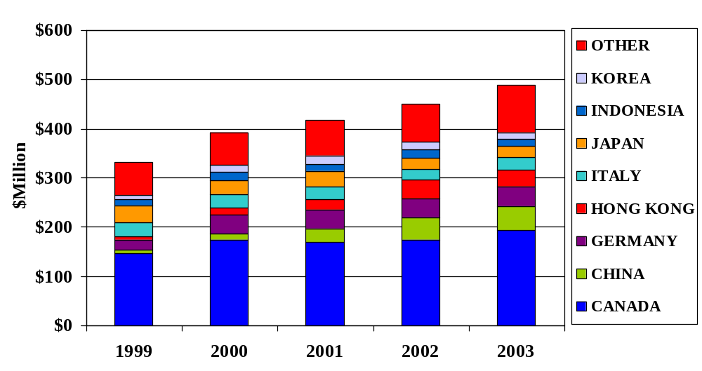
U.S. Hardwood Log Exports to Major Markets

Slide 11
U.S. Softwood Lumber Exports to Major Markets
U.S. softwood lumber exports have decreased significantly, falling from $740 million in 1999 to $380 million in 2003. During this period, exports to Japan decreased $130 million. Japan’s economic recession, decreased housing starts, and new regulations for wood used in construction contributed to the decline. U.S. softwood lumber exports to the EU also decreased significantly. Competition from Russia and Latvia in combination with the EU’s contracting softwood lumber import market have caused U.S. exports to the EU to decrease.

Slide 12
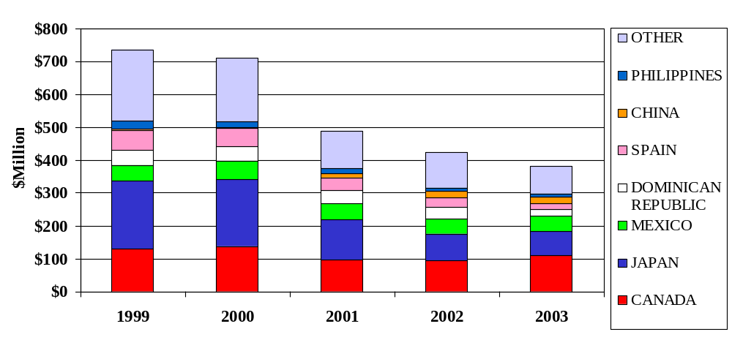
U.S. Softwood Lumber Exports to Major Markets

Slide 13
U.S. Hardwood Lumber Exports to Major Markets
U.S. hardwood lumber exports decreased from $1.4 billion in 1999 to $1.3 billion in 2003. During this time period, exports to the EU decreased due due to slow economic growth in many EU countries and increased competition from within the EU as well as the Balkans. In 2003, hardwood lumber exports to Canada were valued at $410 million. Much of the hardwood lumber exported to Canada is manufactured into furniture, doors, windows and molding and then exported back to the United States. Between 1999 and 2003, hardwood lumber exports to China increased $80 million on the strength of China’s growing furniture industry.

Slide 14
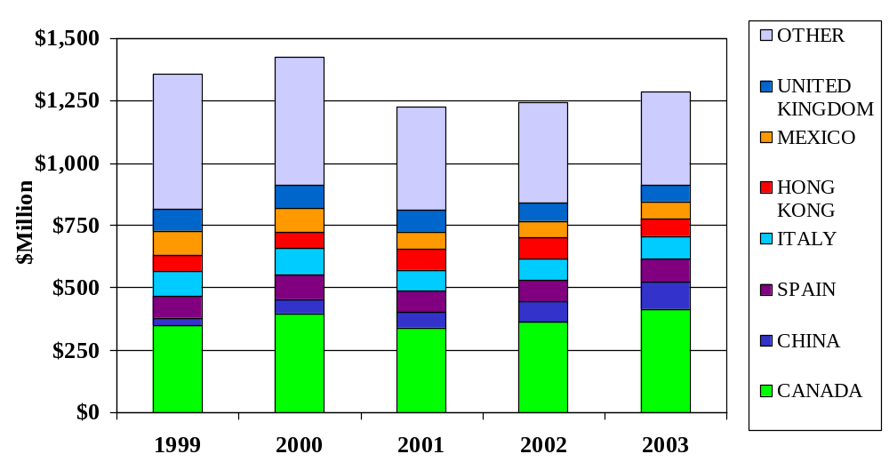
U.S. Hardwood Lumber Exports to Major Markets

