Slide 1
Wood Product Exports

Slide 2
Exports – All Wood Products
Exports of all wood products for reporting countries in 2004 totaled $65.7 billion, a 25 percent increase from 2003. The world’s leading exporter of wood products was Canada ($17.3 billion), followed by the EU-25 ($10.4 billion) and the United States ($6.2 billion).
Major markets in 2004 for the top three wood exporters:
Canada - United States, Japan and the United Kingdom
EU-25* - United States, Japan and Switzerland
United States - Canada, Japan and Mexico
*Excluding intra-EU trade

Slide 3
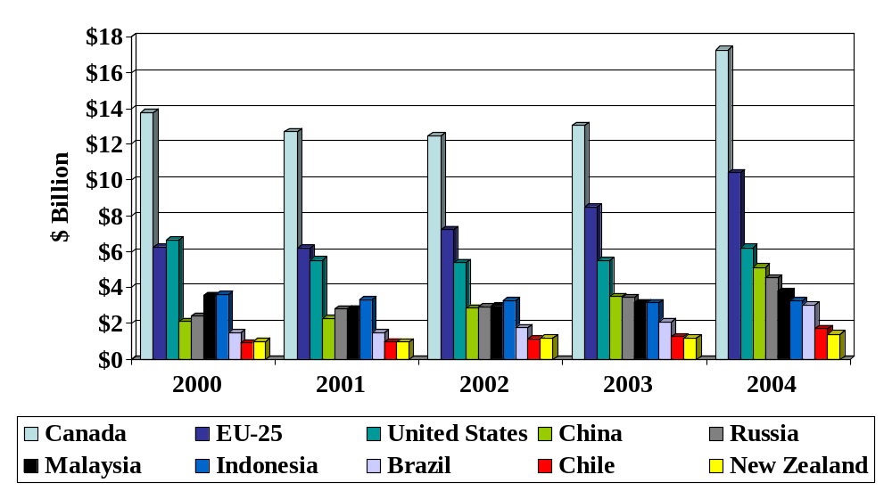
Top 10 Wood Product Exporters
Source: Global Trade Atlas (reporting countries)

Slide 4
Exports – Softwood Logs
Exports of softwood logs for reporting countries in 2004 totaled $3.7 billion, a 19 percent increase from 2003. The world’s leading exporter of softwood logs was Russia ($1.8 billion), followed by the United States ($869 million) and Canada ($349 million).
Major markets in 2004 for the top three softwood log exporters:
Russia - China, Japan and Finland
United States – Japan, Canada and South Korea
Canada – United States, Japan and Korea

Slide 5
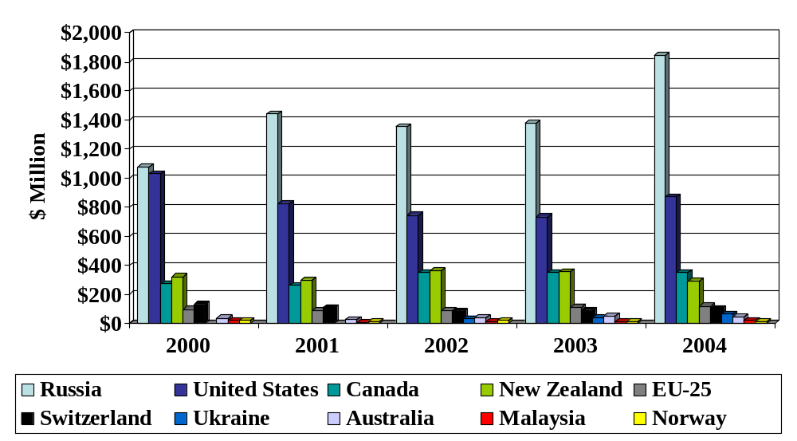
Top 10 Softwood Log Exporters
Source: Global Trade Atlas (reporting countries) - Note: Ukraine data unavailable for 2000 and 2001

Slide 6
Exports – Hardwood Logs
Exports of hardwood logs for reporting countries in 2004 totaled $2.1 billion, a 11 percent increase from 2003. The world’s leading exporter of hardwood logs was the United States ($603 million), followed by Malaysia ($525 million) and Russia ($483 million).
Major markets in 2004 for the top three hardwood log exporters:
United States - Canada, China and Germany
Malaysia – India, Japan and China
Russia – Finland, China and Sweden

Slide 7
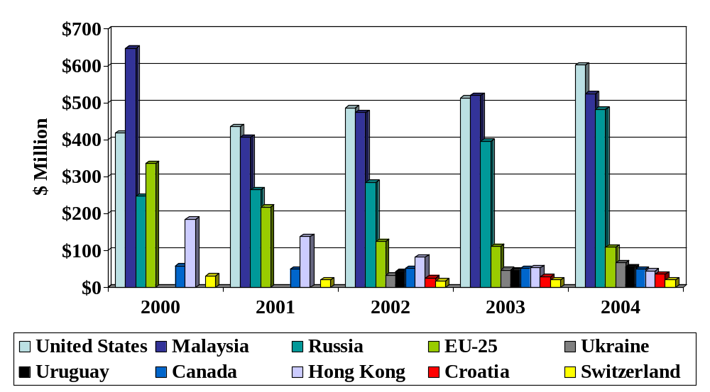
Top 10 Hardwood Log Exporters
Source: Global Trade Atlas (reporting countries) – Note: Ukraine and Uruguay data unavailable for 2000 and 2001

Slide 8
Exports – Softwood Lumber
Exports of softwood lumber for reporting countries in 2004 totaled $15.3 billion, a 32 percent increase from 2003. The world’s leading exporter of softwood lumber was Canada ($8.5 billion), followed by the EU-25 ($2.6 billion) and Russia ($1.5 billion).
Major markets in 2004 for the top three softwood lumber exporters:
Canada – United States, Japan and the United Kingdom
EU-25 – Japan, United States and Norway
Russia – Japan, Egypt and the United Kingdom

Slide 9
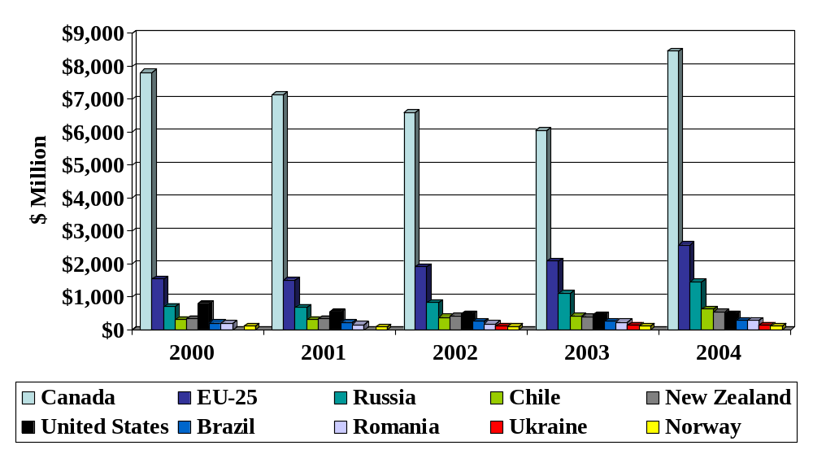
Top 10 Softwood Lumber Exporters
Source: Global Trade Atlas (reporting countries)

Slide 10
Exports – Hardwood Lumber
Exports of hardwood lumber for reporting countries in 2004 totaled $5.1 billion, a 12 percent increase from 2003. The world’s leading exporter of hardwood lumber was the United States ($1.5 billion), followed by Malaysia ($742 million) and Brazil ($543 million).
Major markets in 2004 for the top three hardwood lumber exporters:
United States – Canada, China and Spain
Malaysia – Thailand, the Netherlands and Japan
Brazil – China, France and the United States

Slide 11
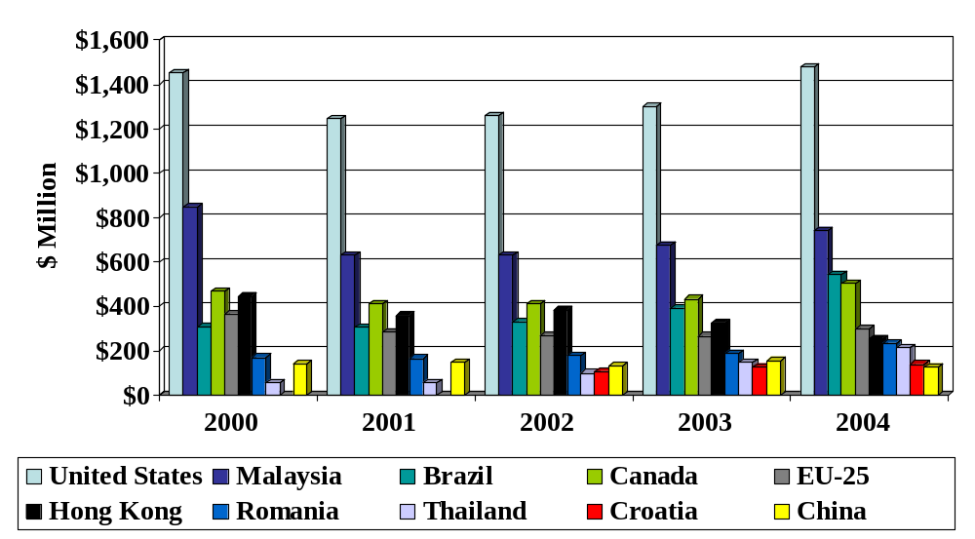
Top 10 Hardwood Lumber Exporters
Source: Global Trade Atlas (reporting countries) – Note: Data unavailable for Croatia in 2000 and 2001

