Slide 1
Rapid Assessment of Market Change in the South
Douglas Carter and Dave Wear
Assoc. Prof., SFRC, Univ. of FL
and
Project Leader, Economics Work Unit,
USFS SRS

Slide 2
Problem
Perception that there has been a loss of markets in southern region to foreign competition
Declining returns to investment as indicated by declining stumpage prices
Unclear future of the southern forest resource

Slide 3
Objective
Analyze recent structural changes in markets using best available data
  harvests and prices
  demand and supply factors
Consider potential implications for the future of the southern forest sector

Slide 4
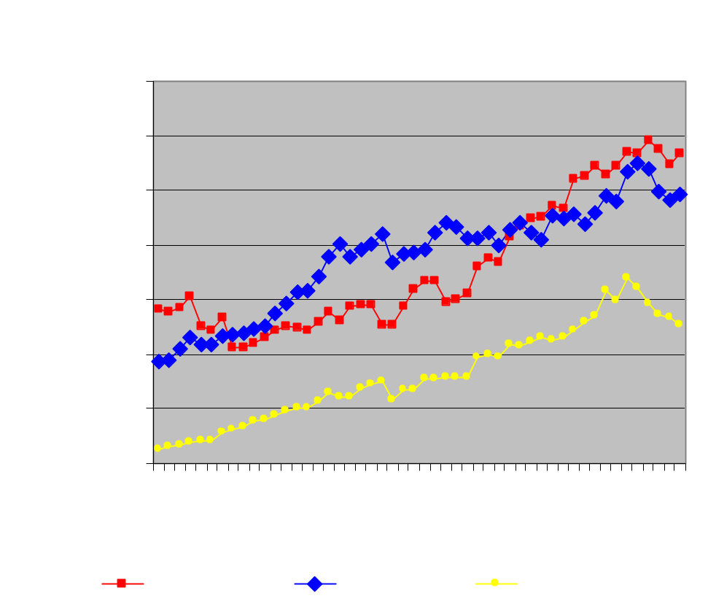
What Has Happened?
--Harvests--
Steady growth ’62-’98
Declining harvests ’98-’01
Softwood and hardwood pulpwood harvests declined 11% and 21% from ’98-’01
Softwood sawtimber harvests were more stable
Southern US Timber Harvests

Slide 5
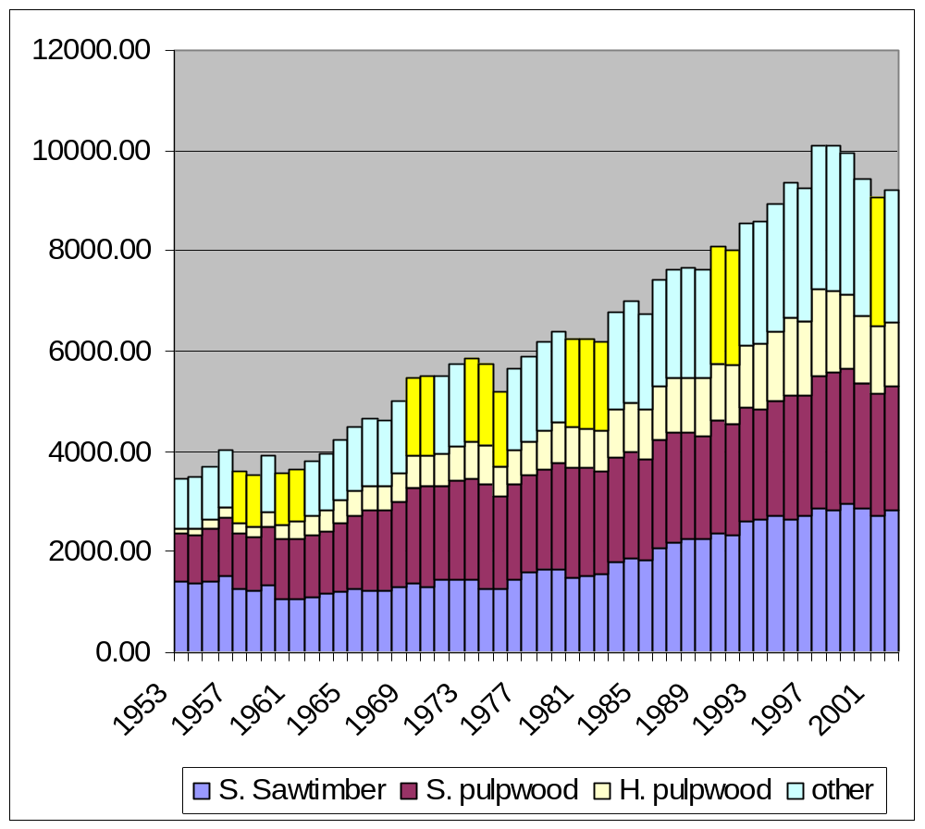
Harvests (continued)
Yellow bars indicate recession years
This is the first decline in production not associated with a recession
Structural changes are indicated

Slide 6
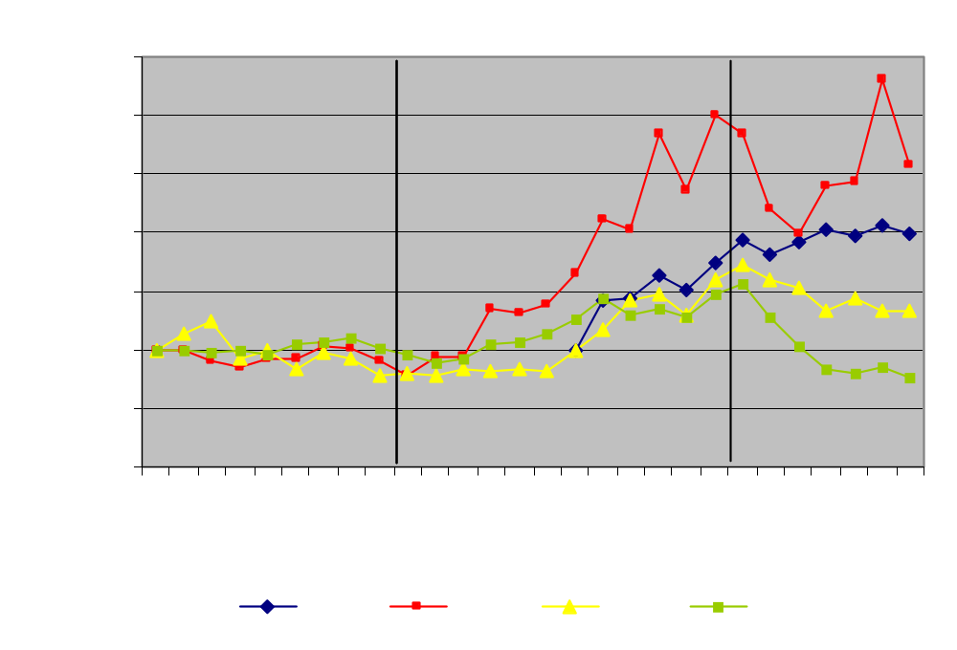
What Has Happened?
--Prices--
Biggest declines were in softwood pulpwood since ‘98.
Softwood sawtimber not impacted as severely.
Hardwood pulpwood more volatile but regained strength since 2000.
Southern US Stumpage Prices

Slide 7
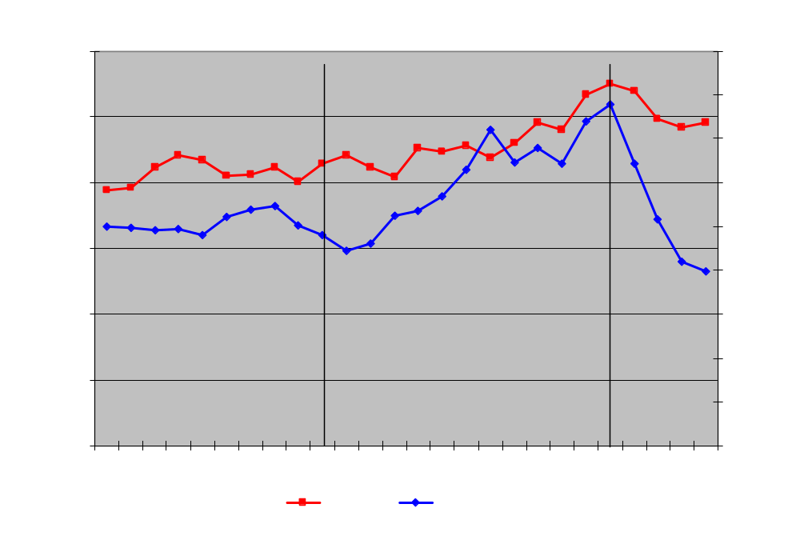
Softwood Pulpwood Markets
Most Impacted

Slide 8
Summary of Changes
Moderate Growth Phase (1977-1986)
  Harvests increased at a moderate rate
  Prices constant or declining for all three products (soft. pulp., hard. pulp, soft saw.)
  Consistent with demand and supply expanding
Rapid Growth Phase (1986-1998)
  Harvests increasing at a faster rate
  Prices increasing at a higher rate than harvests
  Consistent with strong outward shift in demand

Slide 9
Summary of Changes
Adjustment Phase (1998-2002)
  Both harvests and prices declining for pulpwood
  Consistent with demand contraction for pulpwood, especially
  For sawtimber, harvests leveled off with declining prices
    Consistent with expansion of sawtimber supplies

Slide 10
Market Factors Examined
Demand Factors
  Competing products--substitution and technical change
  Domestic demand
    Capacity data
  International trade
Supply Factors
  Land use
  Investment
  Ownership
  Inventory

Slide 11
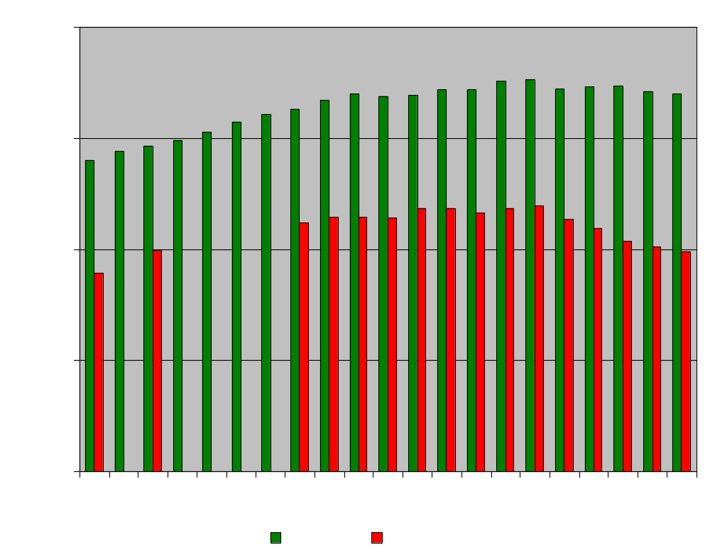
Domestic Demand--Pulpwood
Southern pulping capacity down 16% since 1998 and down relative to US production
No indications of increasing domestic demand
  Per capita use of paper products declines
Capacity expanding in other countries
  e.g., Chile, Brazil, Finland
Loss of comparative advantage in new markets (costs)
Pulp Mill Capacity

Slide 12
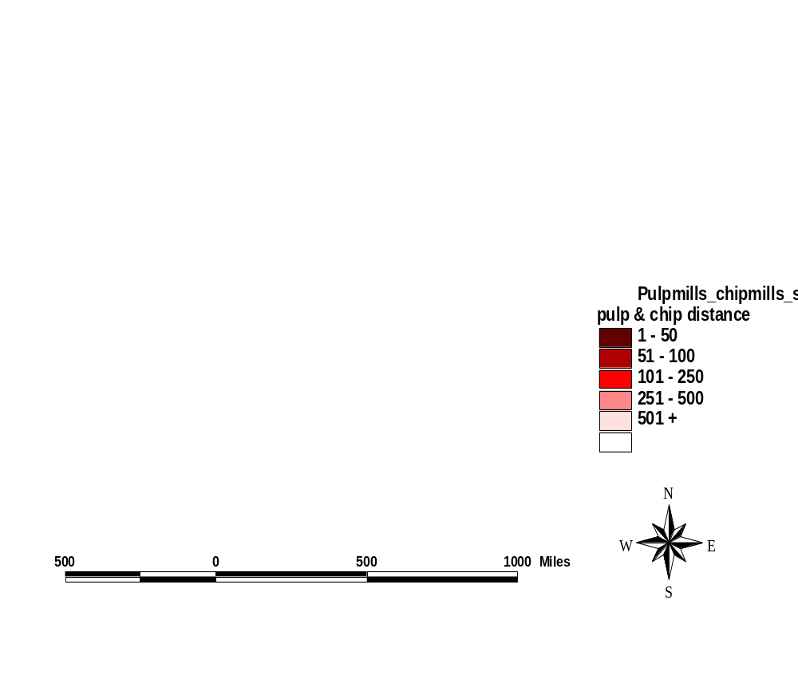
Average Distance to Pulpmills and Chipmills in the South

Slide 13
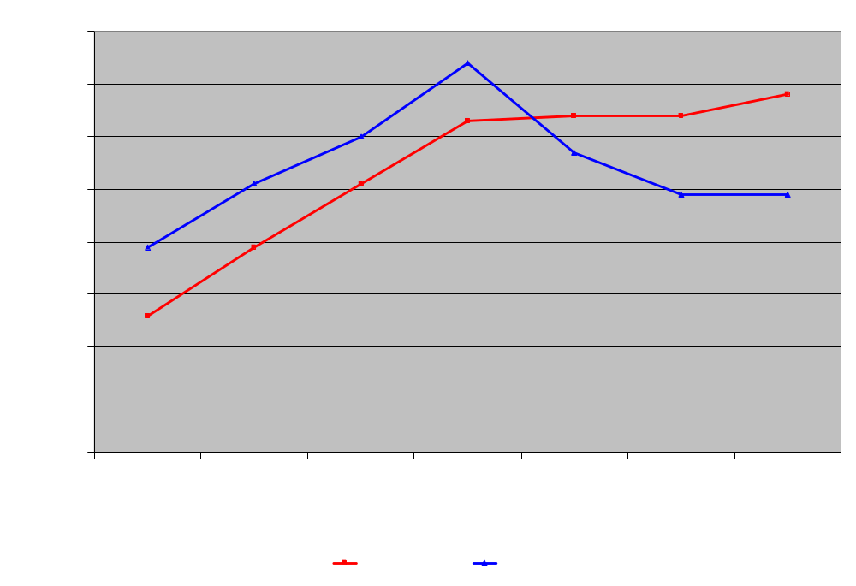
Domestic Demand--Lumber
Southern softwood lumber capacity increasing 1997-2003
No indication of decreasing demand overall
  Even given increases in engineered wood products
Softwood Sawmill Capacity

Slide 14

Average Distance to Sawmills

Slide 15
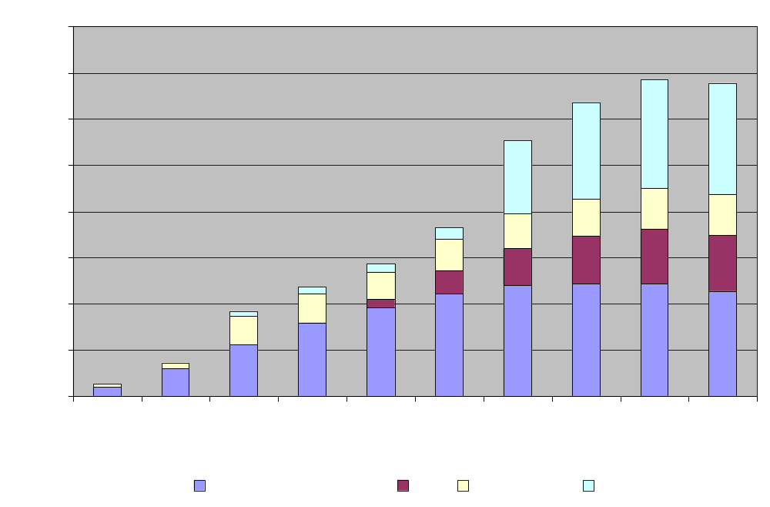
Domestic Demand--Panels
Panel capacity grew strong through 1997
Shift from solid wood raw material to chips and fiber
Southern Panel Capacity

Slide 16
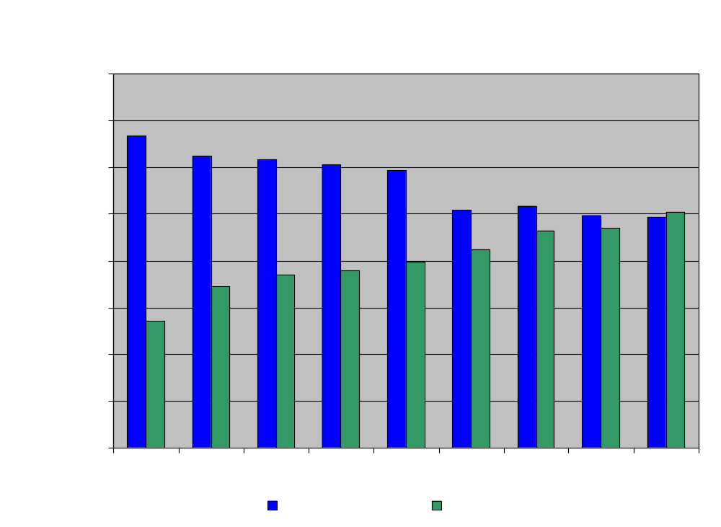
Domestic Demand--Panels
No indication of decreasing demand
Total southern panel production stable
OSB production grew 8.1% per year from ‘96 to ‘04
Southern Panel Production

Slide 17
Domestic Demand--Summary
Demand, as measured by capacity, is stable for most products, with the notable exception of pulpwood.
Southern pulpwood capacity has declined in both absolute terms (declined 16% since 1998), and relative to total US capacity.
Demand by pulp mills somewhat offset by increasing demand for OSB and, to a lesser degree, engineered products.

Slide 18
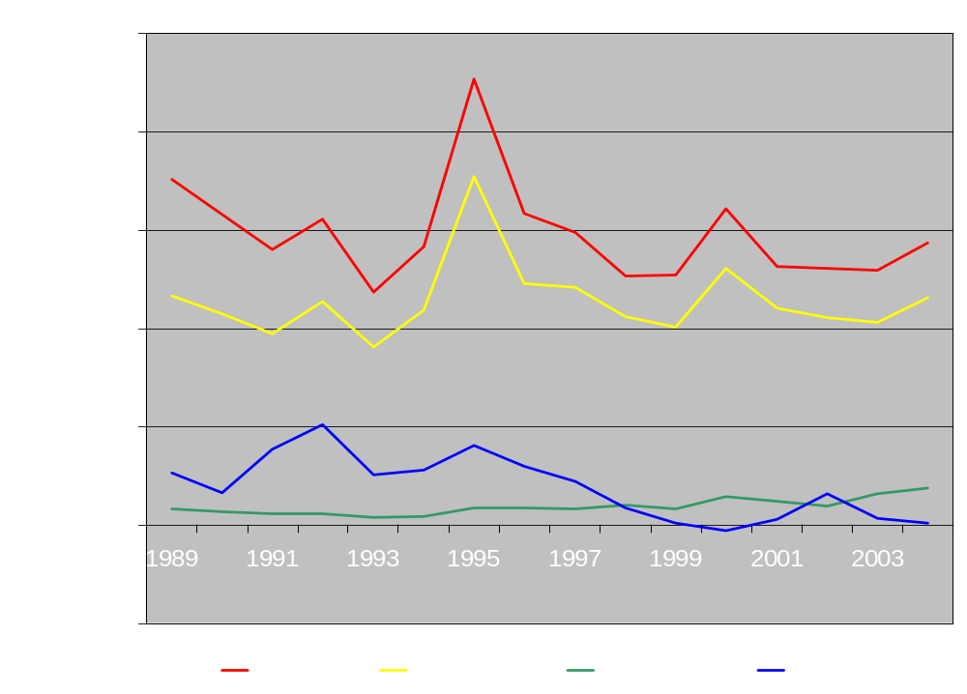
Trade--Wood Pulp
US exports roughly equal to imports in recent years
US southern ports export ~7 times imports
Southern imports however have increased to 2-3% of total southern wood pulp production
US Trade in Wood Pulp

Slide 19
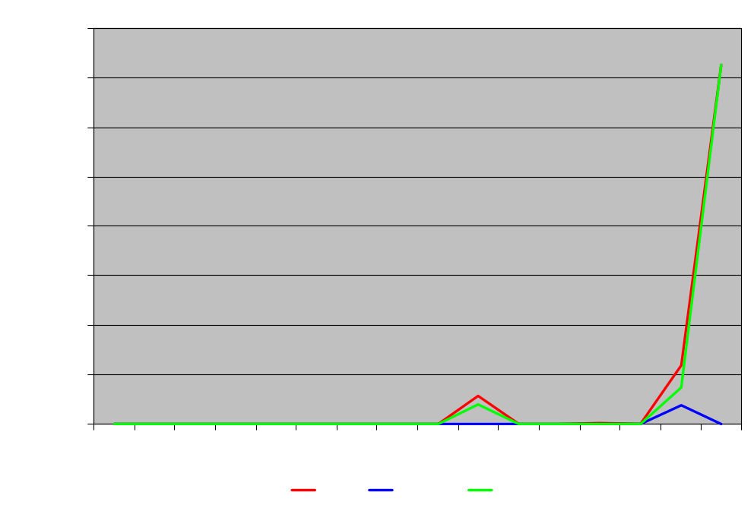
Trade--Wood Chips--Imports
Brazilian imports of eucalyptus wood chips much higher since 2002
But, only 0.9% of total southern chip production
Addressing local scarcity of hardwood
Southern US Wood Chips Imports

Slide 20
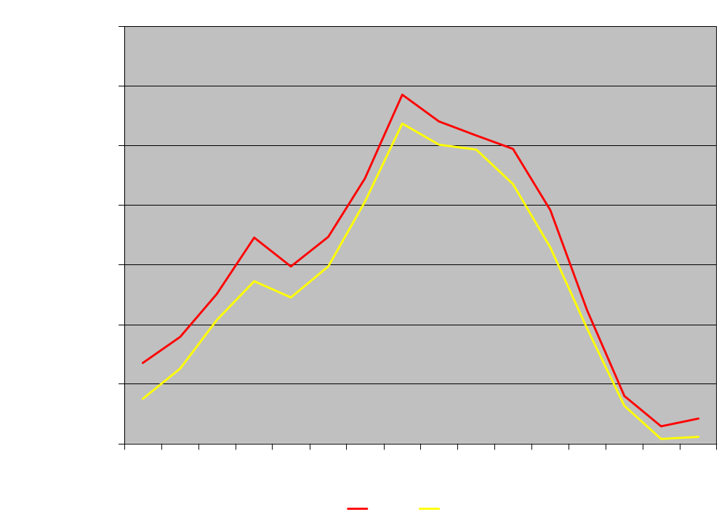
Trade--Wood Chips--Exports
Near complete loss of exports to Japan
Would account for ~9% of southern chip production in 1996
Significant reduction in domestic demand
Southern US Wood Chips Exports

Slide 21
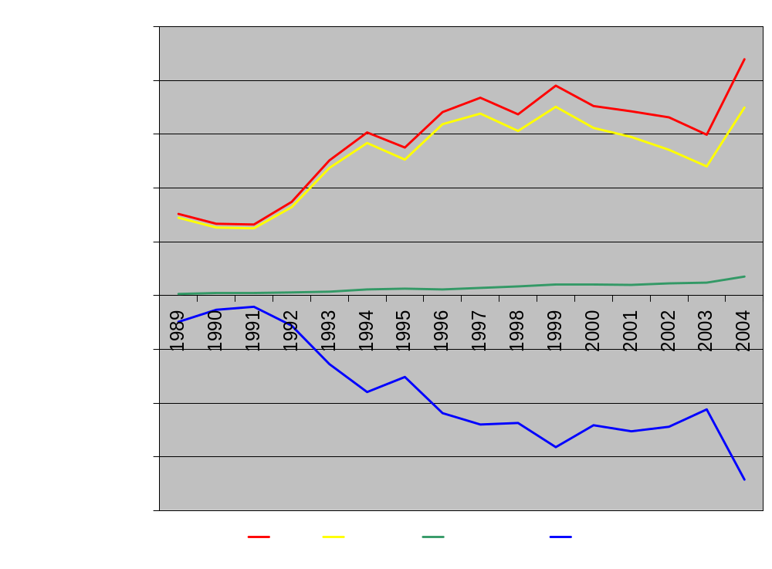
Trade--Lumber--Imports
Canada by far leading importer of lumber into US
However, little direct impact on southern lumber demand
Imports from S.A. small but rising
Softwood Lumber Imports and BOT

Slide 22
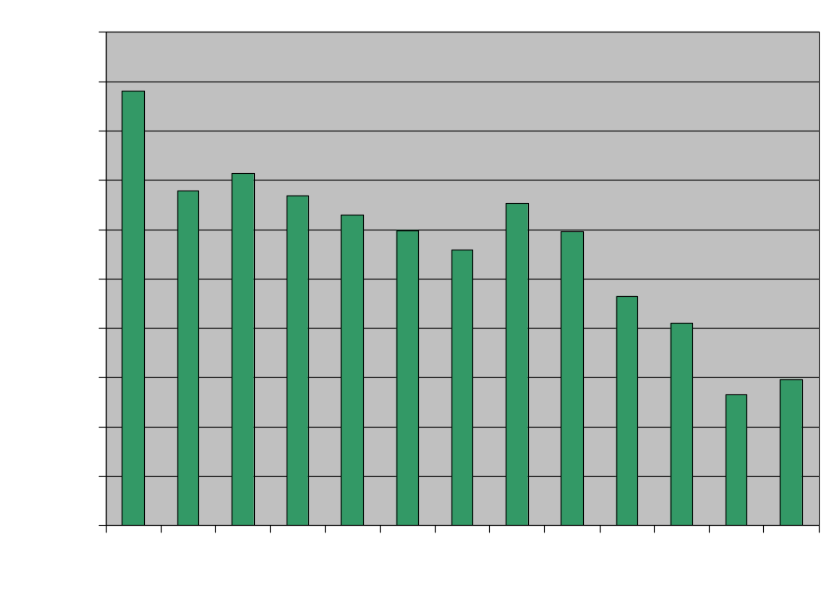
Trade--Lumber--Southern Exports
Lumber exports from US South small and have declined over time
  About 2 percent of southern production in 1995
  <1 percent in 2004
Southern Softwood Lumber Exports

Slide 23
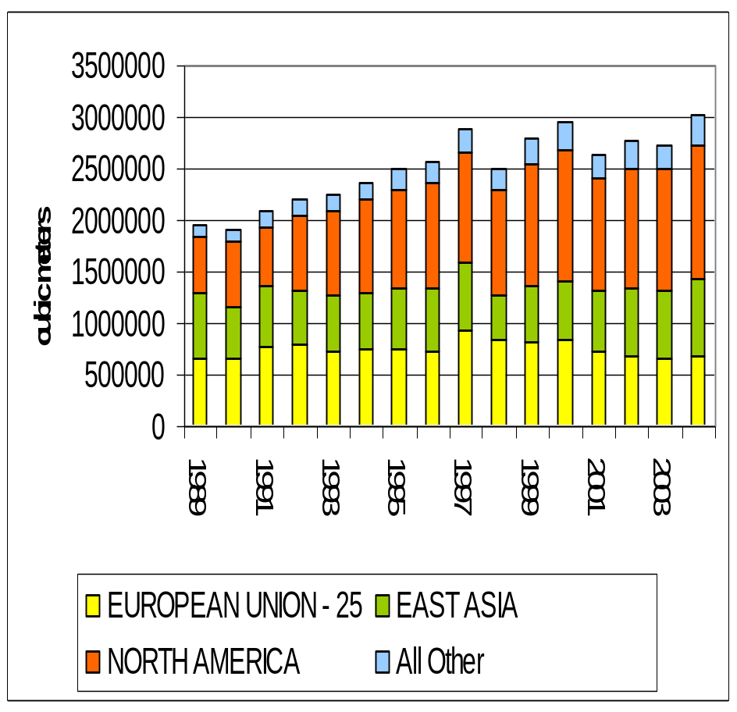
Trade-Hardwood Lumber-US Exports
Increased by about 50% between 1989 and 2004
Canada is most important trading partner
Big increase in shipments to China offsetting declines in shipments to other countries in Asia

Slide 24
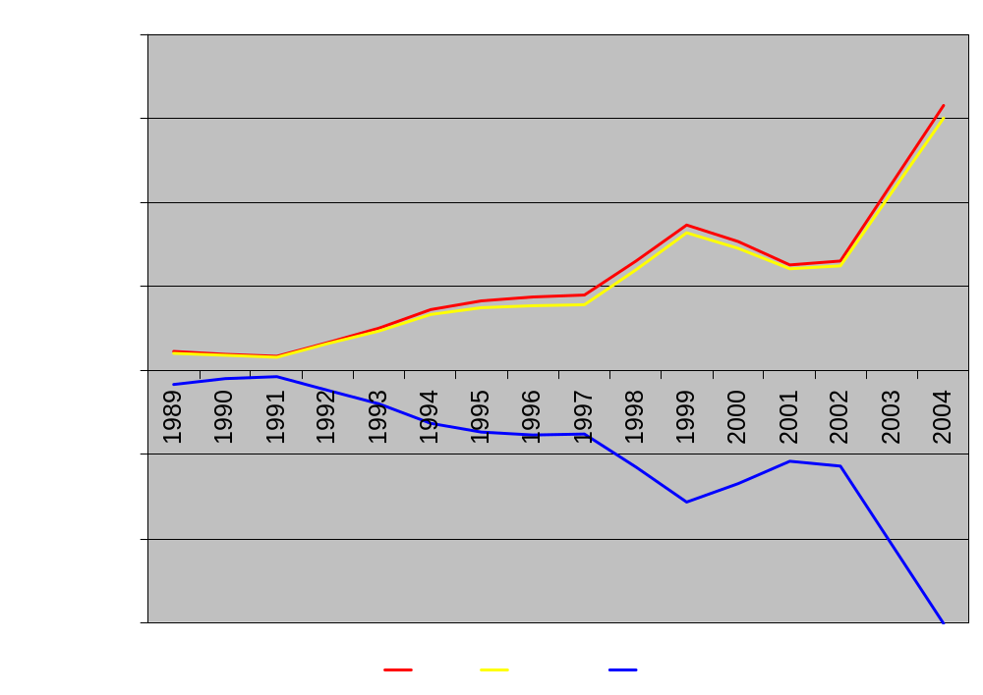
Trade--Panel Products
Import nearly all from Canada
Imports rising significantly since 2002
No exports to speak of
Imports of Plywood, OSB, Waferboard

Slide 25
Trade--Summary
Loss of southern softwood chip exports to Japan
  At peak, 9% of 2002 southern chip production
  Reduction in domestic demand for pulpwood
Imports of raw material (wood chips) are currently small but could rise in response to local scarcity
Increases in panel imports such as OSB dampen domestic demand for smaller diameter wood

Slide 26
Supply--Land Use
Historically, southern US forest area relatively stable since 1940’s
  Except for 5% loss in 1970’s due to ag conversion
Future forest area may change from no net loss to a loss of up to 31 mm acres by 2040
  Depends upon ag vs. forest returns
Net loss of forests due to urbanization in some areas
  Particularly along coasts and Piedmont

Slide 27
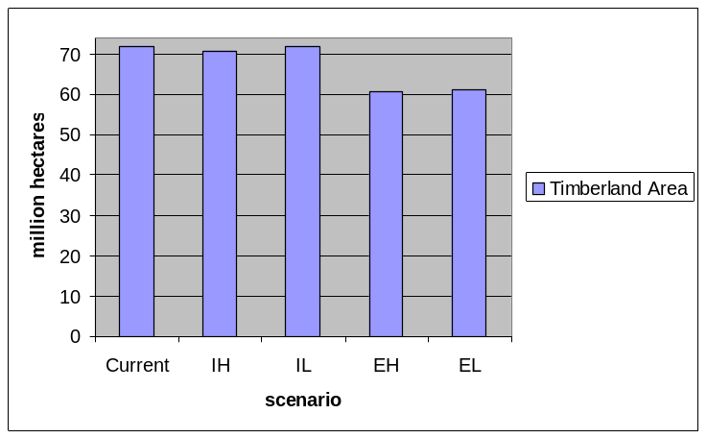
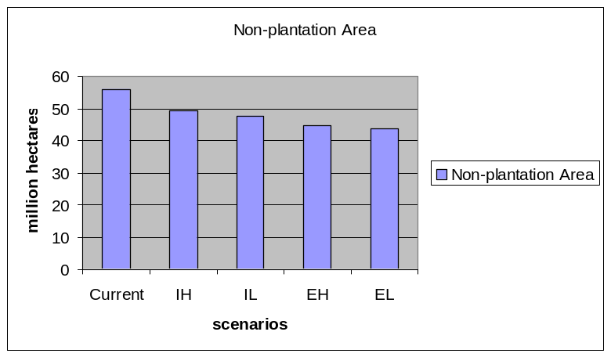
Supply—Land Use
SFRA findings
“Weak” demand scenarios (EH and EL)
  Reduction in forest land (2020)
  Both planted and nonplanted forests
Notes:
Current Value is about 72 million hectares.

Slide 28
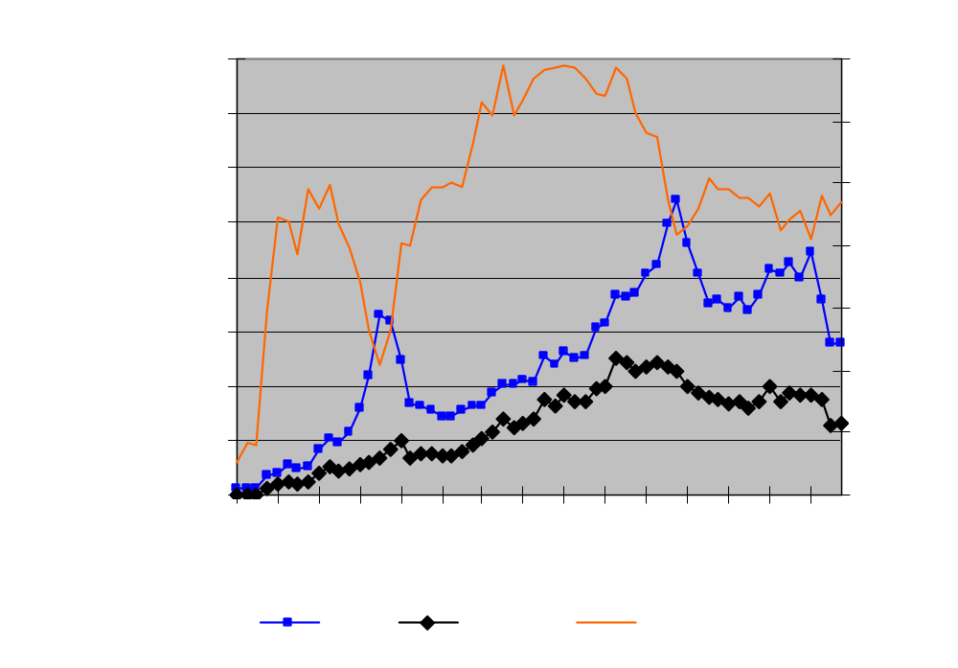
Supply--Investment
Plantations have grown from 0 to 32 mm acres from 1945-1999
  16% of all timberland
Industry has highest share of plantings
  45-70%
Non-industry plantings significantly higher during Soil Bank and CRP programs
Strong expansionary investment through the 90’s
Sharp decline in investment since 2001
Acres Planted in US South

Slide 29
Supply--Ownership
Current ownership breakdown
  69% non-industrial private, 20% industry, 14% other
Divestiture of industry lands with high share of forest capital
Shift toward TIMOs
Increasing urbanization may shift margin between physical and economic availability of timber supplies
  Increased parcelization, fragmentation in some cases
  Long run effects on timber supply unknown

Slide 30
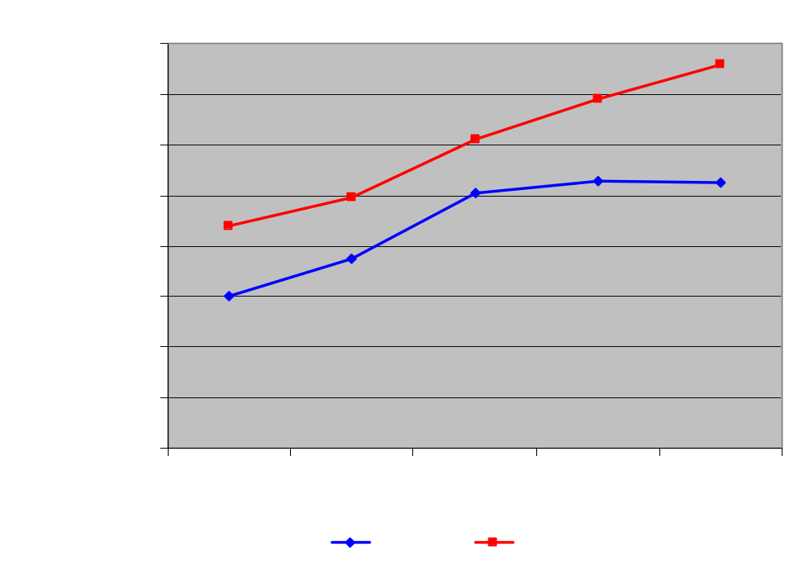
Supply--Inventory
Overall, softwood inventory stable
  Growth=removals
  Market responsive
Hardwood inventories increasing
  Growth>removals
  availability
Local effects important
  Shifting production
Forest Growing Stock in the US South

Slide 31
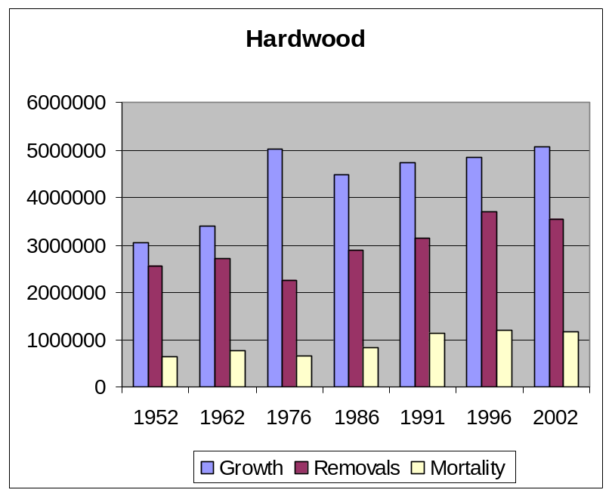
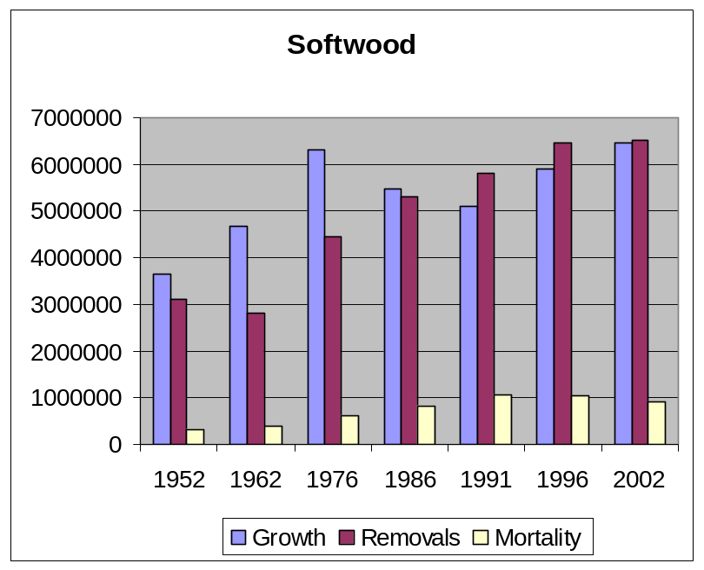
Supply--Inventory
Growth, removals, and mortality
RPA Data Base, including most recent data (2002)

Slide 32
Supply--Conclusions
Long period of investments in softwood plantations implies no short to medium term reductions in supply
  Supply is a slow moving factor
Recent declines in plantation investments indicate long run adjustment to supply
Localized inventory declines are likely
  Urban and urbanizing areas

Slide 33
Conclusions

Slide 34
Conclusions
Markets are NOT going away
  South has advantage in US
Southern timber markets are in a period of adjustment after rapid growth in the 1990’s
  This is demand driven
Important changes in perspective and rhetoric
  From scarce to plentiful

Slide 35
Key Finding no. 1
Demand growth has declined
  Consumption of solidwood has not kept pace with growth in housing starts
  Per capita consumption of paper has declined
  Demand for exports has declined
    Especially chip exports
  Long run—population growth will fuel expanding demand at a lower rate

Slide 36
Key Finding no. 2
Domestic timber supply continues to expand
  Area of timberland roughly constant since 70’s
  Intensive management expanded
  Expansionary investment continued through the 1990’s
  Supply adjusts with a long lag time

Slide 37
Key Finding no. 3
Net effect of demand contraction and strong supply is a disproportionately large decline in price relative to harvests.
  Observed in pulpwood markets since 1998
  Short run: likely to remain low unless demand expands considerably
  Long run: contraction of softwood investment leads eventually to decline in economic inventory and price increases

Slide 38
Key Finding no. 4
Patterns of investment in processing do not indicate growth in demand
  Solidwood capacity is stable
  Paper production capacity has declined since the late 1990’s
    16% reduction in southern pulping capacity since 1997 indicates a sustained decline in demand
  Pulpwood prices may not rebound to mid-90’s levels in foreseeable future

Slide 39
Key Finding no. 5
Low relative prices for pulpwood defines opportunities for producing other products in the region
  Ample supply of material for OSB and other engineered wood products
  Downturns lead to restructuring of industry and increased efficiency (creative destruction)

Slide 40
Key Finding no. 6
Increasing hardwood pulpwood prices and decreasing softwood prices encourage substitution in paper production
  Reversal of long trend toward hardwood in paper production
  Already observed in some operations

Slide 41
Key Finding no. 7
Imports of hardwood chips indicate a backstop price for hardwood pulpwood in the region
  Price that draws exports from South America
  Has this ceiling been reached?
  Will discourage intensive management of hardwoods

Slide 42
Forest Management Implications
Landowners need more information regarding risks
  Physical AND market risks
  Especially TIMO’s
Rapid changes indicate need for effective monitoring
Afforestation strategies are altered
  Marginal cropland—effective conversions?
  Restoration strategies?
  Defining low cost approaches that yield ecosystem benefits

Slide 43
Program Implications
Importance of rhetorical changes
Without concerns for timber supply—different perspectives on the role of forestry
  Effects on program support?
  Who supports programs?
Loss of support for a large portion of forestry research
  Long term effects on competitiveness?

Slide 44
Key Uncertainties
Trade
  Exchange rates—strength of the dollar
  International demands
Housing Markets
Electronic media (the next generation)
Industry structure
Ag policies
  Response of land to reduction in subsidies

Slide 45
Thank You
Thanks to our economics task force
  UGA
  Texas A&M
  Mississippi State
  Florida
  NC State
  US Forest Service

