Slide 1

The Timber Economy of the Mid-Atlantic
Evan Mercer
Southern Research Station
USDA Forest Service
Notes:
Forest Fragmentation Conference
Alliance for the Chesapeake Bay
Annapolis, MD
November17-18, 1999
Information in this talk was derived from work done for the the EPA’s Mid-Atlantic Integrated Assessment.

Slide 2
Mid-Atlantic Integrated Assessment
EPA’s Office of Research and Development and EPA Region 3
Multidisciplinary
Research, monitoring, & assessment
Objective:
  To develop high-quality scientific information on the condition of ecosystems and stressors in the U.S. Mid-Atlantic region

Slide 3
Objectives: socio-economic assessment
to measure market & non-market benefits produced by MAIA’s forest resources
to measure resource and land-use variables that influence production of forest benefits
to analyze how policies for forest conservation and management influence human welfare

Slide 4
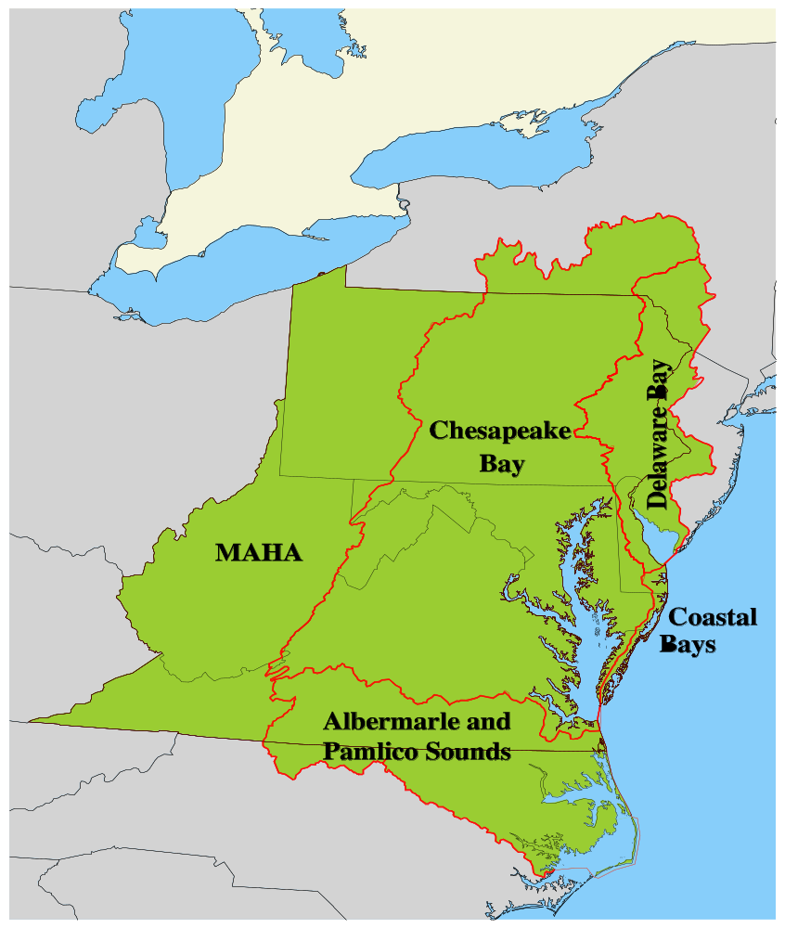

Mid-Atlantic Assessment Area
Watersheds of Delaware Bay Chesapeake Bay Albermarle-Pamlico Sound
Highlands of the Appalachians
Notes:
MAIA region in dark grey. Watersheds outlined by red lines. MAHA= Mid-Atlantic Highlands Assessment (a previous EPA project)

Slide 5
MAIA Population
Total pop. (1990) = 35 million
Avg. pop. Density = 275/sq. mile
  Highest (NJ) = 608/sq. mile
  Lowest (WV) = 75/sq. mile

Slide 6
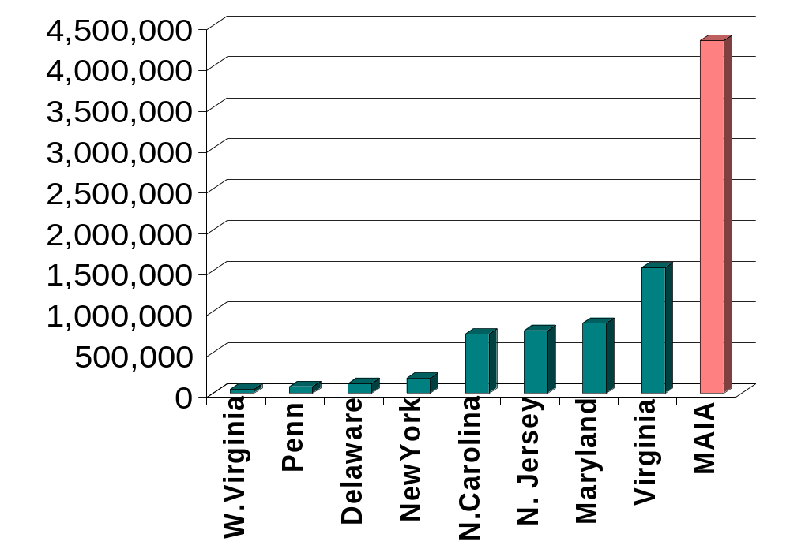
Population Change: 1970-1990

Slide 7
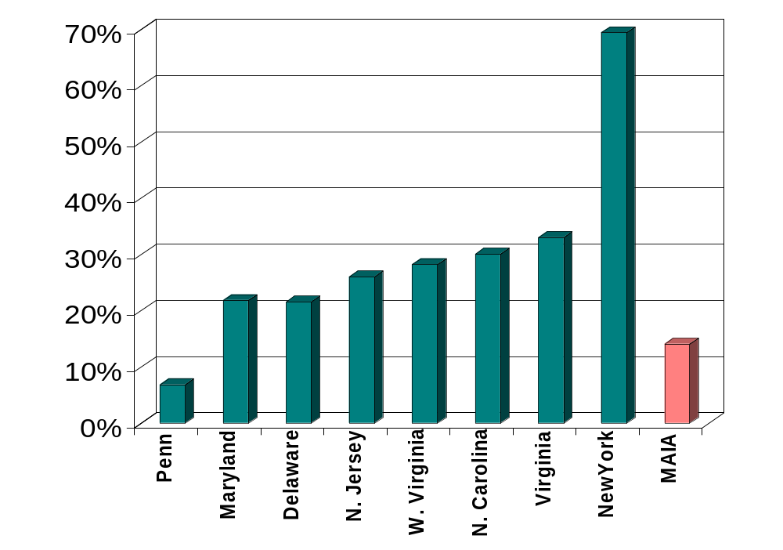
Population: Percent Change1970-90

Slide 8
How does population impact timber supply?
Increasing population density may impact future timber supply in two ways:
  Forests are converted to urban or residential
  Reduced investments in forest management in anticipation of population growth and land use changes

Slide 9
Impacts of Population on Forestry
Person/mile² Prob of Com. Timberland
0 82%
20 75%
45 50%
70 25%
100 10%
>150 0%
Wear et al. 1999
Notes:
Information derived from:
Wear, D.W., R. Liu, J.M. Foreman, and R.M. Sheffield. 1999. The effects of population growth on timber management and inventories in Virginia. Forest Ecology and Management 118:107-115.

Slide 10
Impacts of Population on Forestry
Transition between rural and urban uses of forests occur between 20—70 persons/mile²
Estimates of timberland based on purely physical measures may overstate timber supply
Including population impacts reduced timberland and growing stock estimates by 40%
Notes:
Information derived from:
Wear, D.W., R. Liu, J.M. Foreman, and R.M. Sheffield. 1999. The effects of population growth on timber management and inventories in Virginia. Forest Ecology and Management 118:107-115.

Slide 11
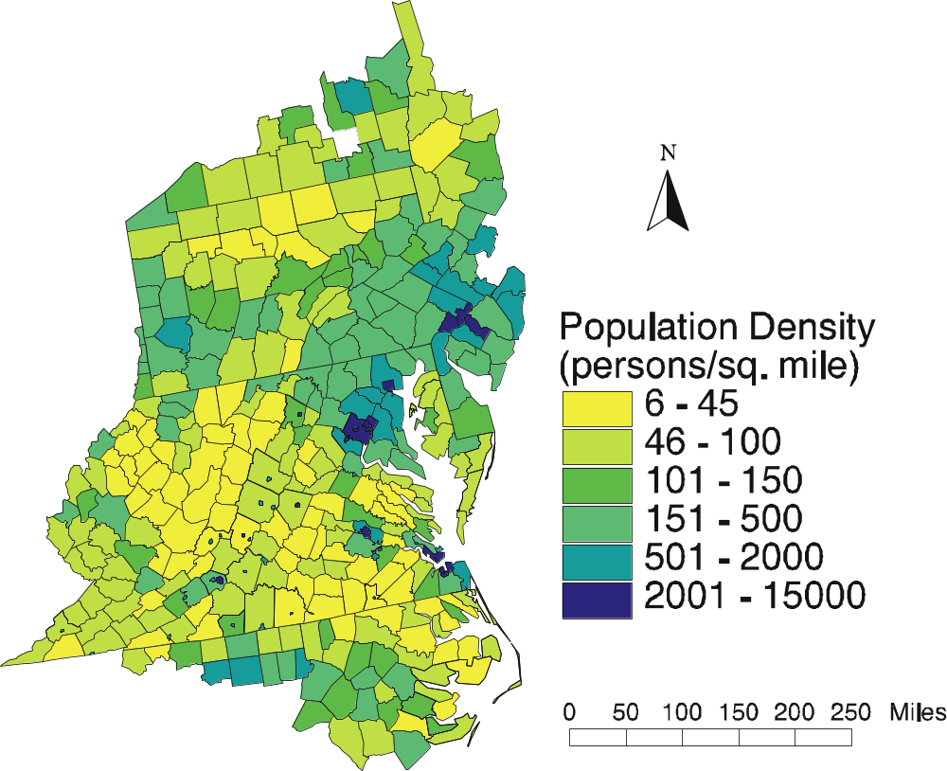
Population Density 1990
Notes:
Pop density of 6-45 (yellow): 50-80% probability of commericial forest management
Pop density of 46-100 (light green): 10-50% probability of commericial forest management
Pop density 101-150: 10-0% probability of commericial forest management
Pop density >150): 0% probability of commericial forest management

Slide 12
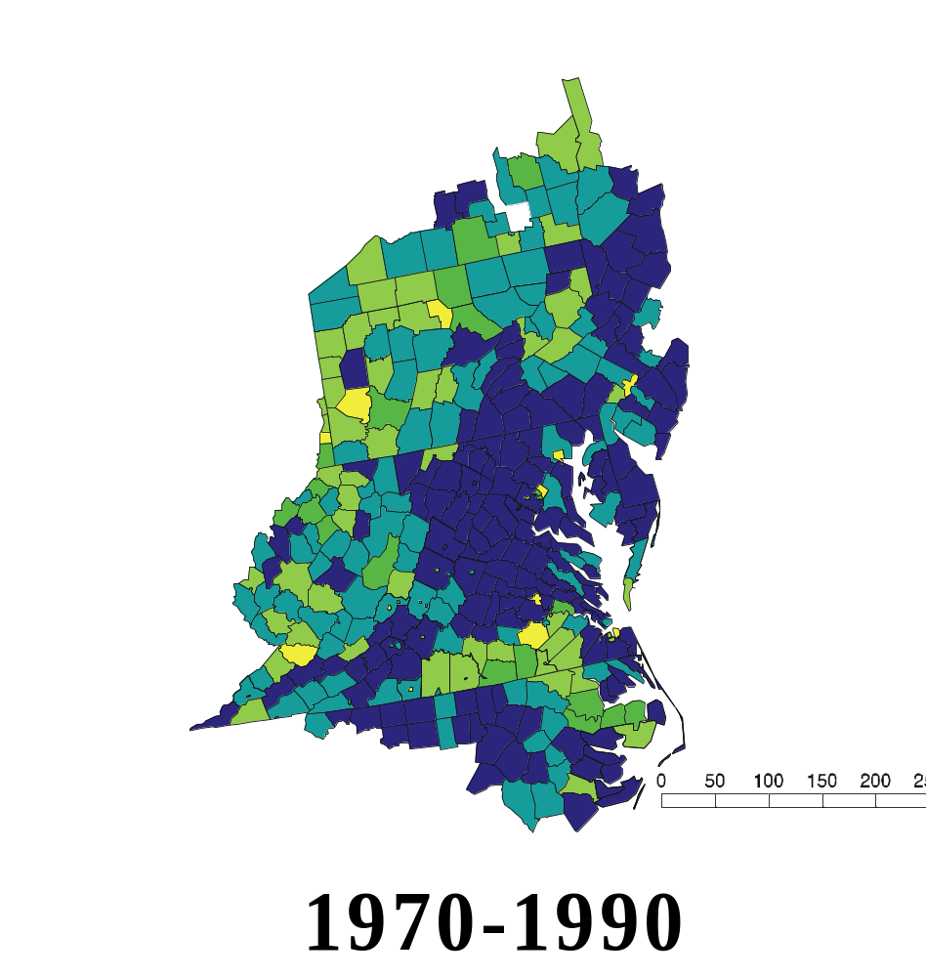
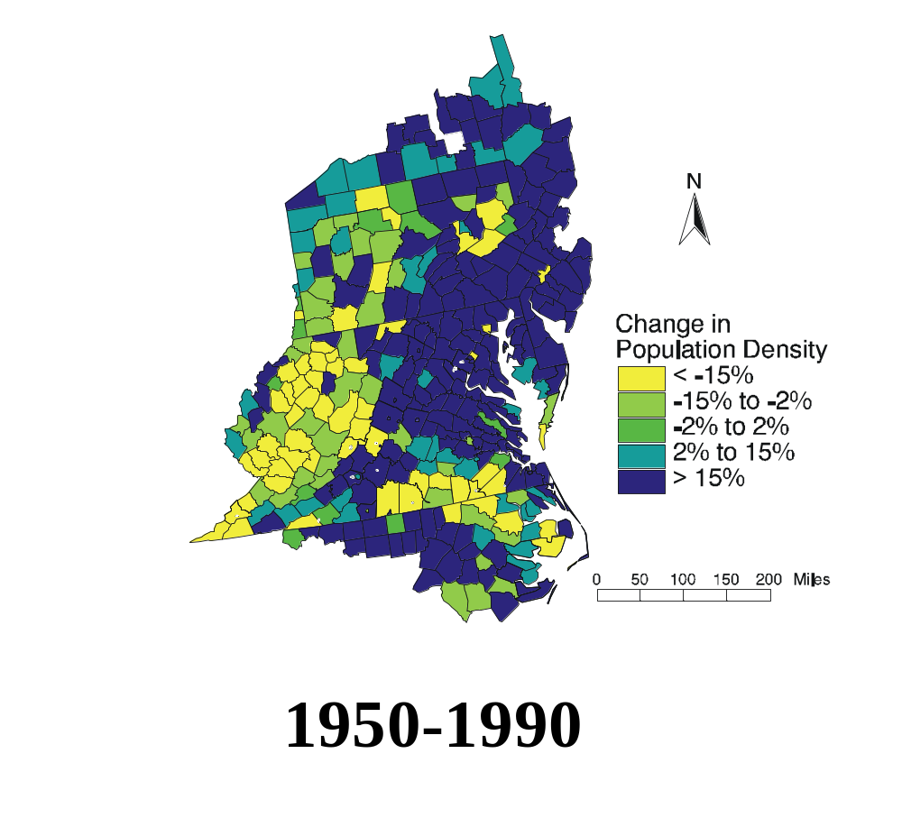
Percentage Change in Pop. Density

Slide 13
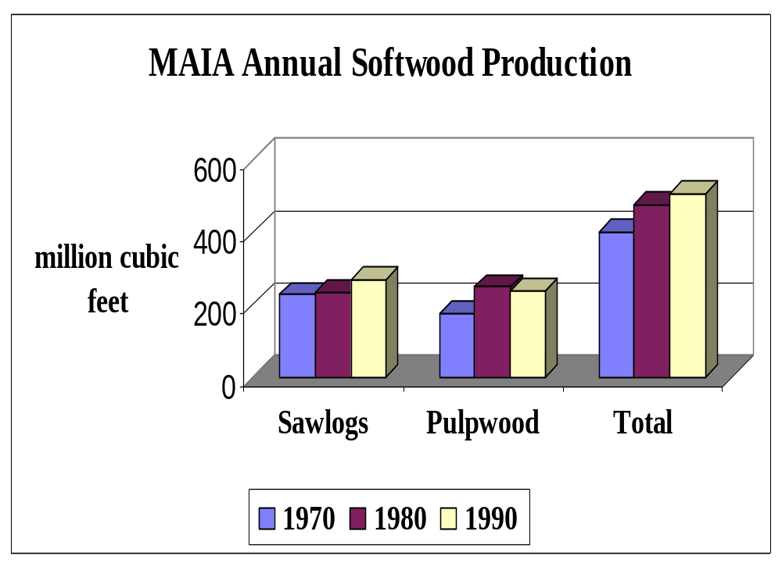
Notes:
Average annual production per decade

Slide 14
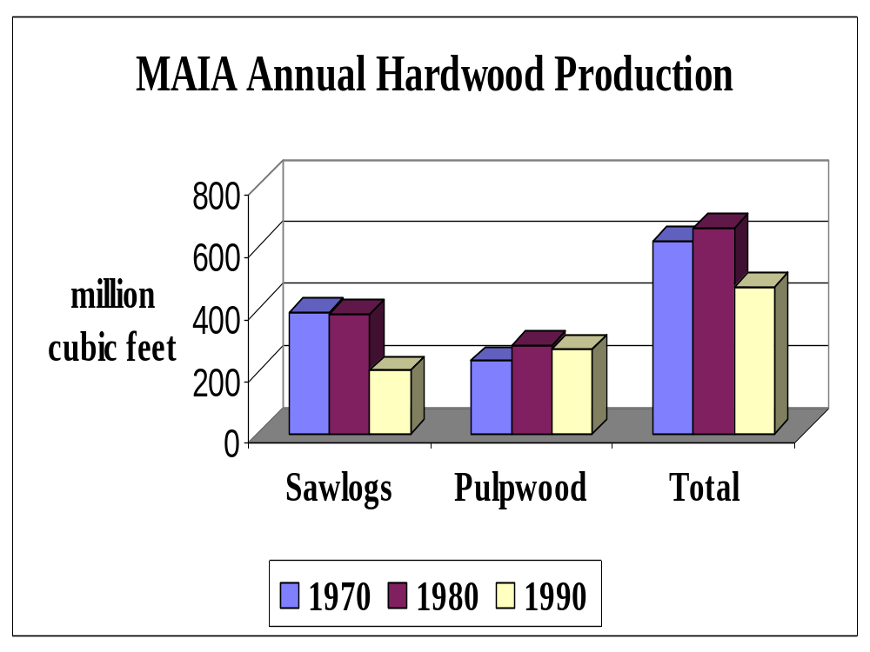
Notes:
Average annual production per decade

Slide 15
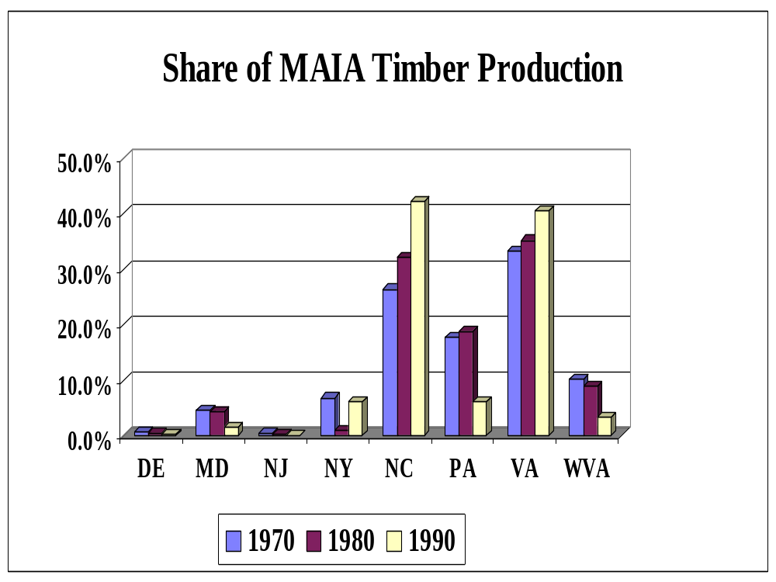

Slide 16
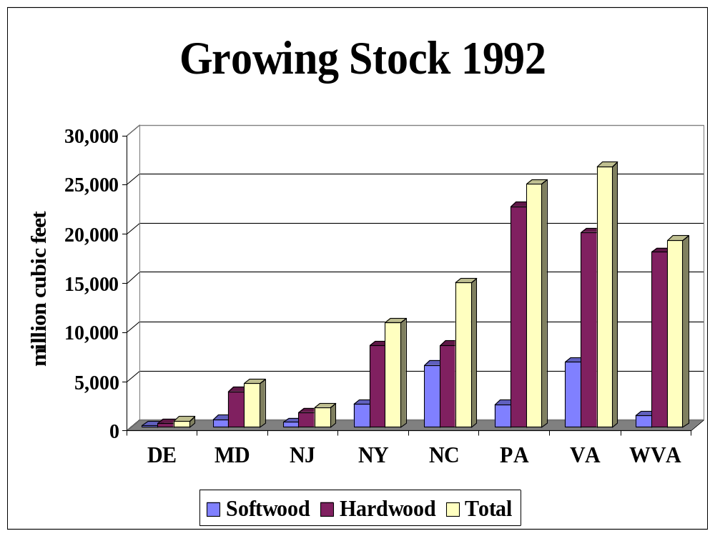

Slide 17
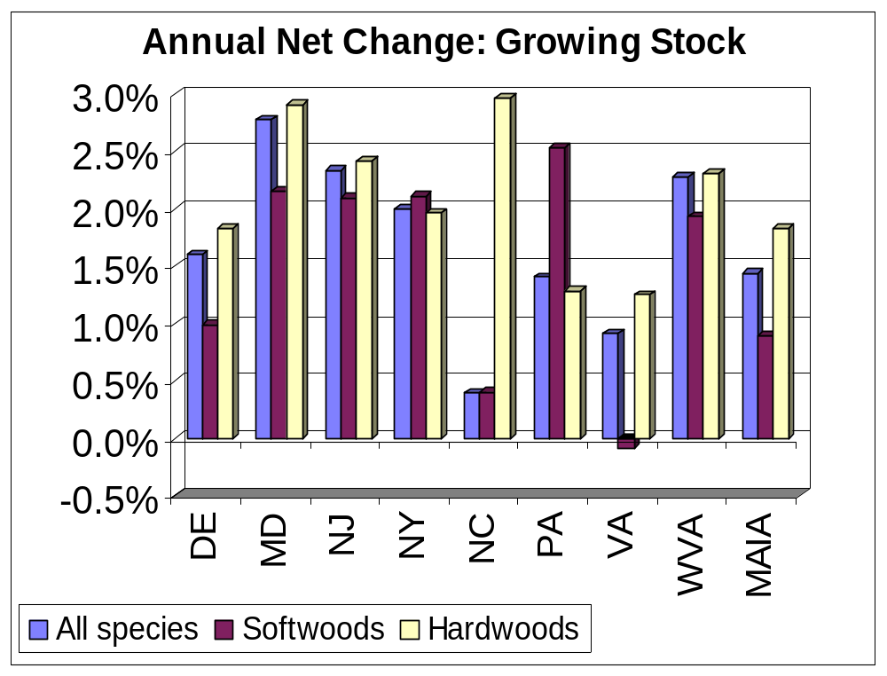

Slide 18
Forest Products Industry Benefits in MAIA Region: 1975-1995
244,100 jobs/year
$4.5 billion/year in real wages
2% of all wage employment & income

Slide 19
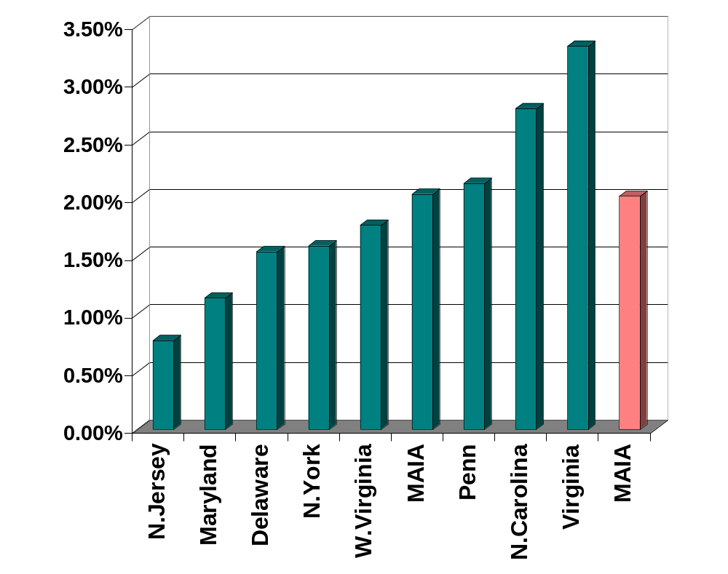
Forest Industry Percent of Total Employment 1975-1995

Slide 20
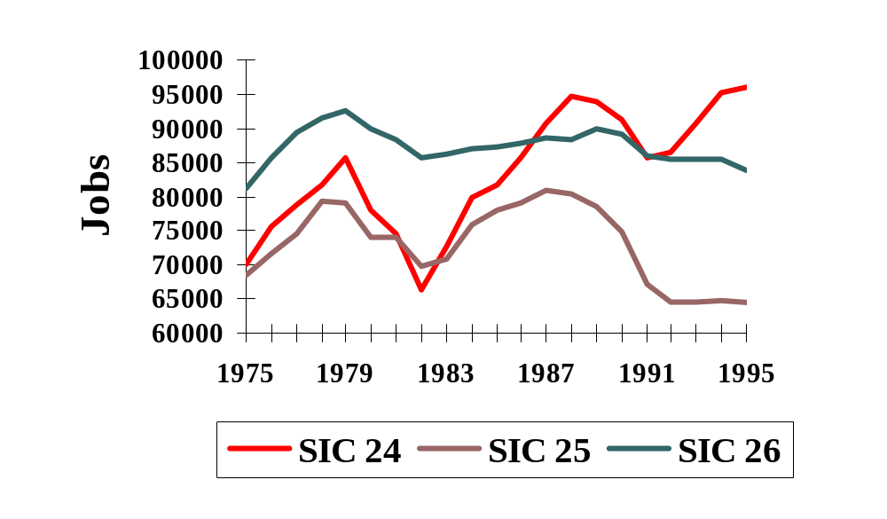
Wage and Salary Employment
SIC24 = Lumber and Wood Products
SIC25 = Furniture and Fixtures
SIC26 = Paper and Allied Products

Slide 21
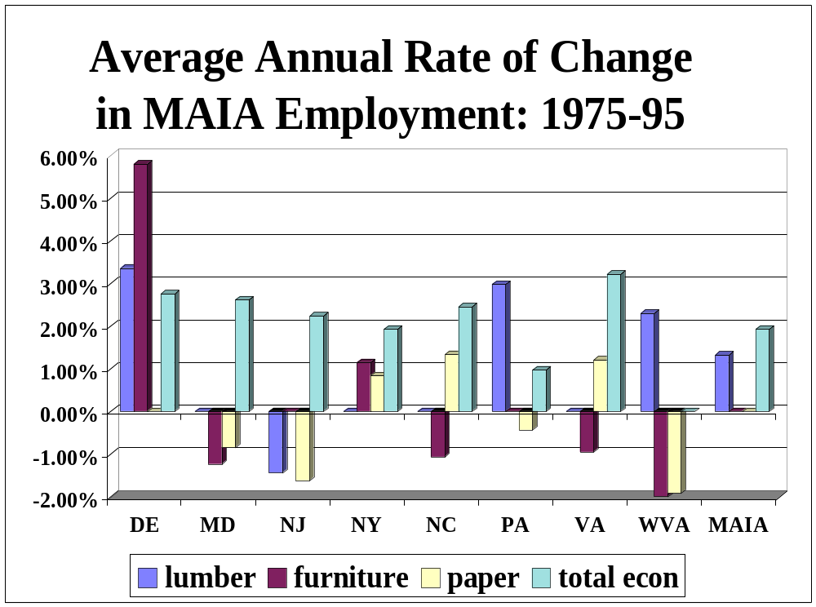

Slide 22
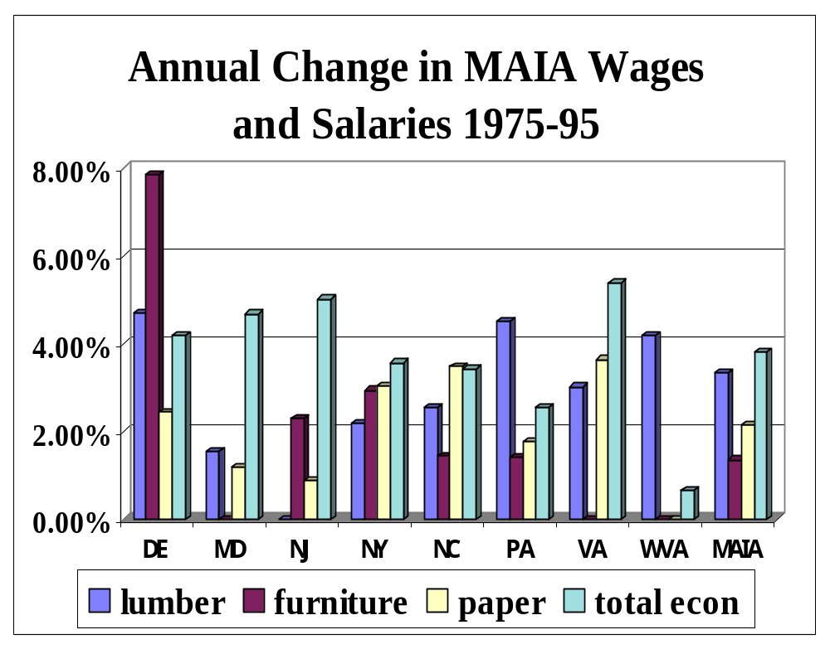

Slide 23
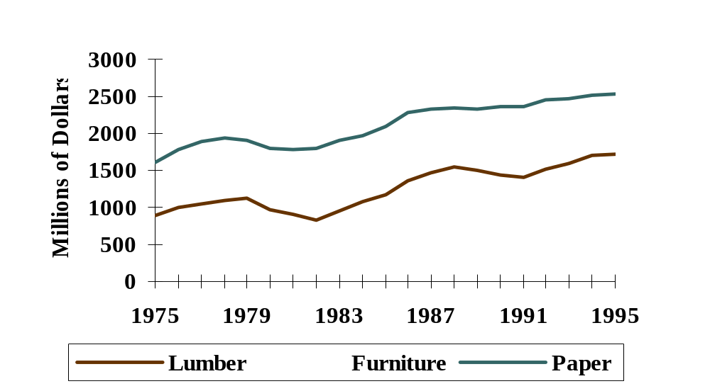
MAIA Forest Industry
Real Wages & Salaries: 1975-95

Slide 24
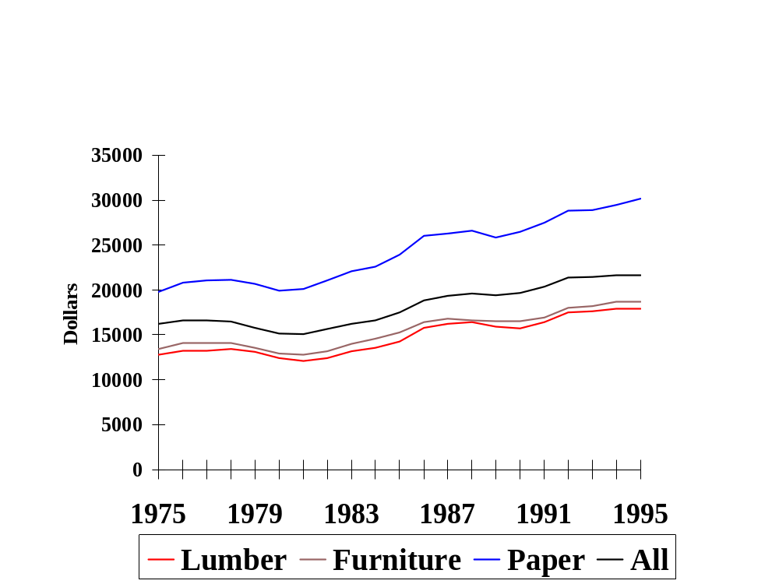
MAIA Real Wages Per Job:
1975-95

Slide 25
Non-Timber & Non-Market Forest Benefits
NON-MARKET
  Recreation
  Biodiversity
  Wildlife
  Environmental Protection
NON-TIMBER FOREST PRODUCTS
  herbs, floral greens, mushrooms, ginseng, materials for crafts, ornamental plants, etc.

Slide 26
RECREATION BENEFITS
Delaware: $943.5 million/year; 7.1% of employment
Penn: $2.4 billion/year; 8.4% of employment
Virginia: $9.3 billion/year ($7.7 billion from out of state)
W. VA: $2.54 billion/year

Slide 27
Conclusions
MAIA forest industry produces:
  244,100 jobs/year;
  $4.5 billion/year in real wages;
  2% of employment
Economic importance of forest recreation appears to be larger than forest industry
  $9.3 billion/year in VA
  $2.4 billion/year; 8.4% of employment in PA

Slide 28
Forest Products Industry Outlook
Forest industry growth slower than rest of MAIA economy except in:
  Delaware (Lumber, Furniture)
  PA (lumber)
  WVA (lumber)
If recent trends continue forest products will continue to be important source of income and employment for parts of MAIA but importance will decline relative to entire MAIA economy
.

