Slide 1
Milton R. Cole
May 27, 1929 - June 28, 2001

Slide 2
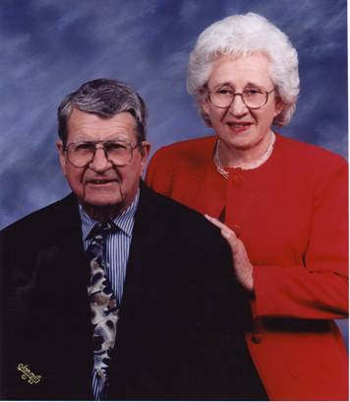
Mom and Dad’s Church Photo

Slide 3
Description Of My Father Milton R. Cole Prior To Being Prescribed an SSRI
Happily married 47 years
Father and Grandfather
Always a protector of his family
Had just built a new home
  Built many features into the home that he wanted
  Built cabinets with his son and a friend from raw lumber
  Built storm/tornado shelter in new home
  Looking forward to having friends over to new home
  Many other planning type activities
  These are not the type of things you do if you are planning on dying
Upbeat
Did not drink or gamble
Did not have any of the recognized prerequisites for suicide unless you consider all men in their 70’s suicidal.
Generally very good health

Slide 4
The Tragic and Preventable End of My Father’s Life
Experienced chest pains about 1 1/2 months after moving into new home
As a precaution, visited a cardiologist
Heart tested perfectly healthy
My father was upbeat and excited about new home and new grandchild
Prescribed the SSRI Prozac OFF LABEL to manage pain
Doctor did not prescribe for depression
11 days after starting Prozac he exhibited symptoms of Akathisia
  Felt jittery
  Fingers tingled and skin felt odd
  Easily aggravated
  Told his son “I can not stand the way this drug makes me feel”
2 days later he committed suicide
  Would not watch movies where people were hanged
  He would turn the channel
  Had told his son 30+years ago that he had nightmares about hangings after seeing a movie with a hanging as a child and in his words “did not care to watch such shows”.
  When a teenager died in the neighborhood years ago by suicide Milton commented to his family “How could he have done this to his family”
  Died by means of his worst nightmare
Completely out of character

Slide 5
Protect Our Children
There are thousands of people who have lost loved ones on SSRI’s. The pharmaceutical companies continue to expand their marketing of these drugs and push even “Off Label” prescriptions. When the amount spent on the marketing of these drugs rivals that of a soft drink manufacturer, something is wrong. Do we really have that many people depressed?
Please protect our children from the dangers of these drugs.

