Slide 1

Hantavirus Pulmonary Syndrome
Rodent Exclusion

Slide 2
SIGNS OF RODENT INFESTATION
Droppings
Tracks
Gnawing damage
Burrows
Runways

Slide 3
SIGNS OF RODENT INFESTATION
Grease marks
Urine stains
Live or dead rodents
Rodent noises
Rodent odors

Slide 4
Control Rodents Outside

Slide 5
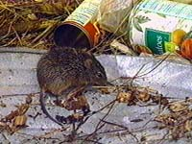
Control Rodents Outside
Store garbage in tight-fitting
containers.

Slide 6
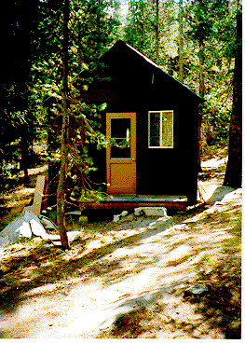
Control Rodents Outside
No gaps > 1/4 inch between
door and door frame.
No lumber, rocks etc. <50 ft
from buildings.

Slide 7
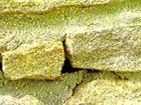
Control Rodents Outside
Fill in holes > 1/4 inch.

Slide 8
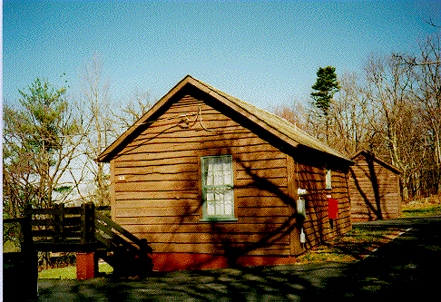
Control Rodents Outside
Attic vent screened.
No gaps or cracks > 1/4 inch
between window and cabin.
No holes in screens.

Slide 9
Control Rodents Outside
No gaps > 1/4 inch where
utility lines enter cabin.
No gaps or cracks
> 1/4 inch beneath
structure.

Slide 10
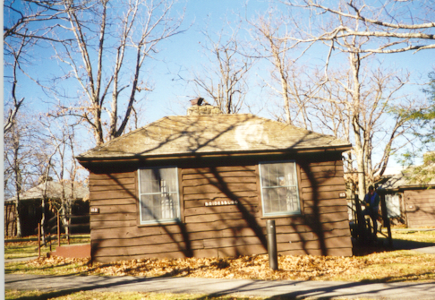
Control Rodents Outside
Chimneys and roof vents screened.
No gaps > 1/4 inch along eaves.
No gaps or cracks > 1/4 inch between siding.

Slide 11
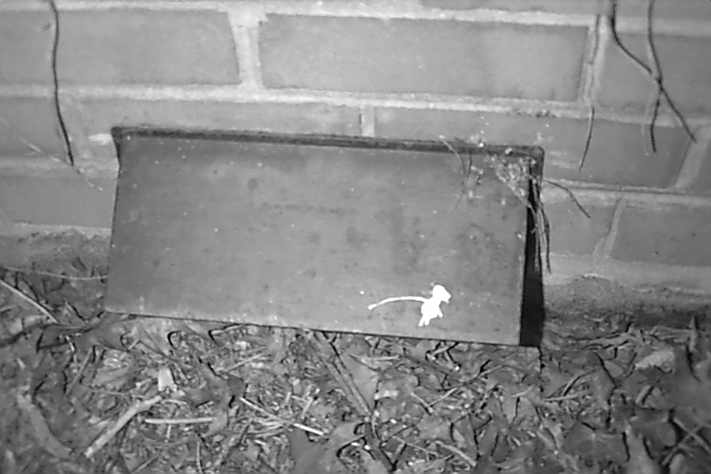
Control Rodents Outside
Exhaust flaps close tightly.

Slide 12
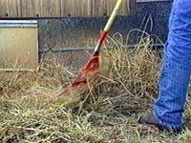
Control Rodents Outside
Control vegetation within
18 inches of building.

Slide 13
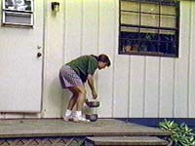
Control Rodents Outside
Control pet food and water.

Slide 14
Control Rodents Inside

Slide 15
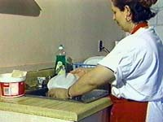
Control Rodents Inside
Good housekeeping.

Slide 16
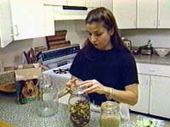
Control Rodents Inside
Properly store foods.

Slide 17
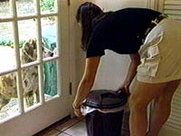
Control Rodents Inside
Properly store garbage.

Slide 18
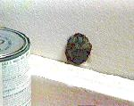
Control Rodents Inside
Fill in holes > 1/4 inch.

Slide 19
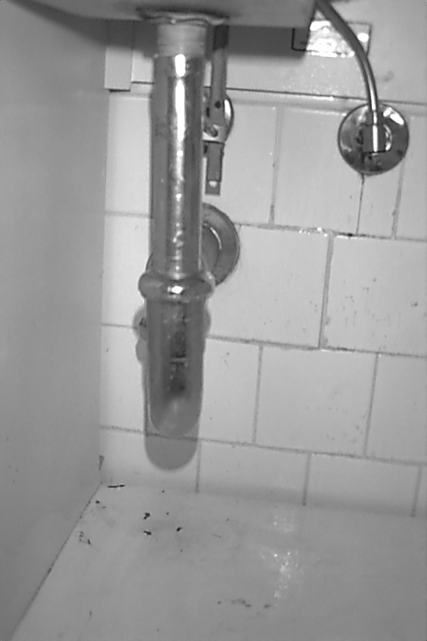
Control Rodents Inside
Check utility lines beneath sinks for
holes > 1/4 inch.

Slide 20
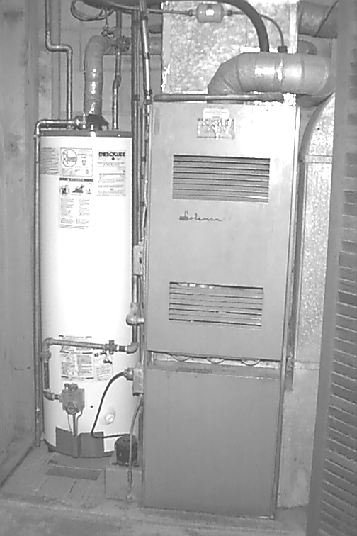
Control Rodents Inside
Check behind water heater and furnace for
utility holes > 1/4 inch.

Slide 21
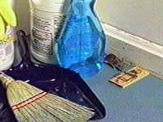
Control Rodents Inside
Use snap traps. Don’t use poison baits.

Slide 22
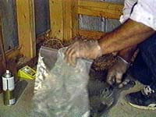
Control Rodents Inside
Wrap carcasses in plastic bags.

Slide 23
Rodent Exclusion
For additional information see the National Park Service’s
“Mechanical Rodent Proofing Techniques” document or contact
your regional or park Public health Consultant.

Slide 24

The End

