Slide 1


OSHA CHALLENGE
&
VPP CORPORATE
PILOTS

Slide 2
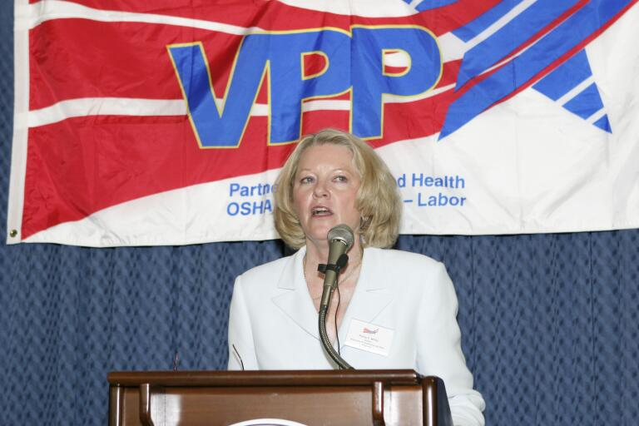
Welcome and Opening Remarks from
Paula White, Director, OSHA Directorate of
Cooperative and State Programs

Slide 3
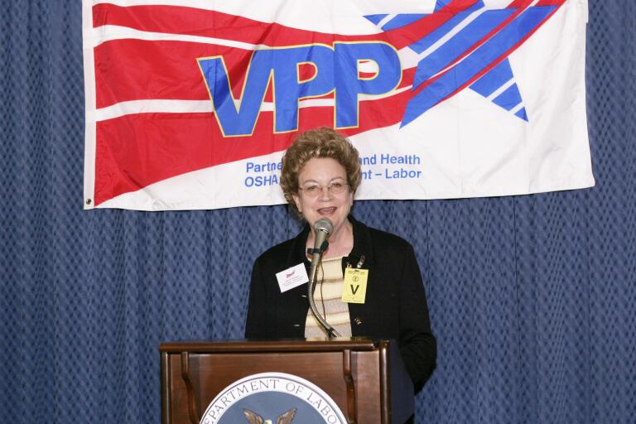
Remarks from
June Brothers, Chair, VPPPA Board of Directors
Georgia Pacific Corporation

Slide 4
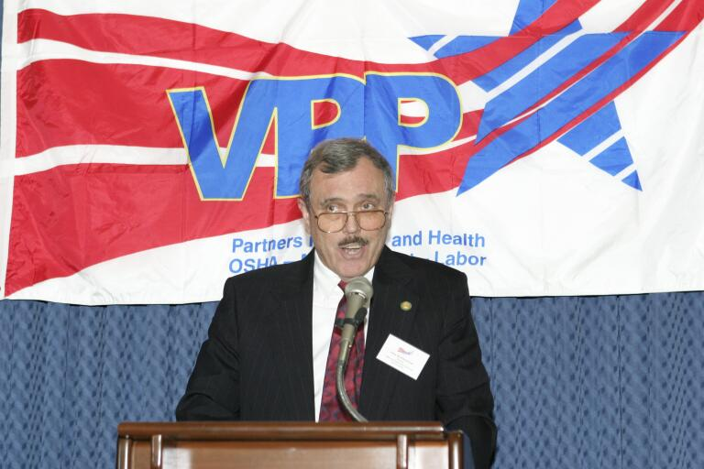
Remarks from
Stew Burkhammer, Director, OSHA Directorate of Construction Services, Office of Construction Services

Slide 5
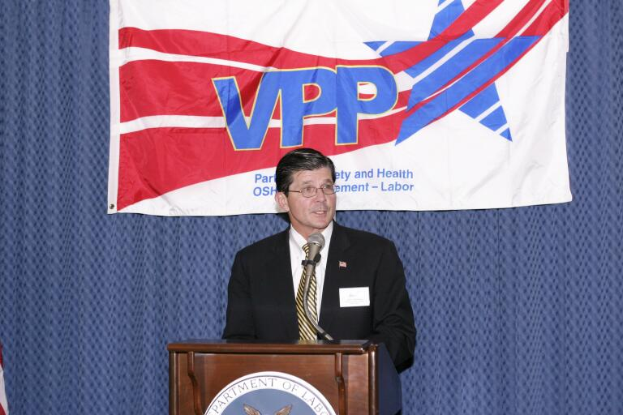
Remarks from
John Henshaw, OSHA Assistant Secretary

Slide 6
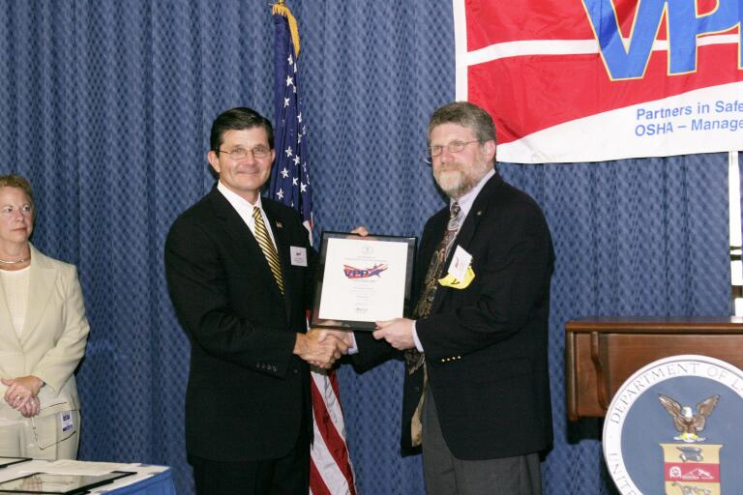
OSHA CHALLENGE PILOT
Certificate Presentation
Jon Hallgren, Vice President, Curtis Lumber Company

Slide 7
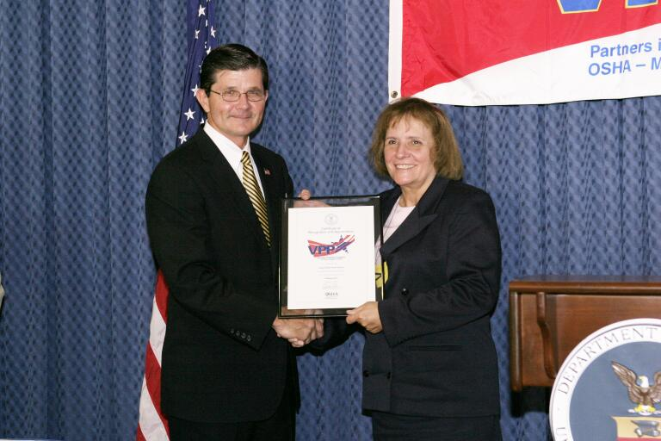
OSHA CHALLENGE PILOT
Certificate Presentation
Suzanne Medvidovich, Senior Vice President, Human Resources, United States Postal Service

Slide 8
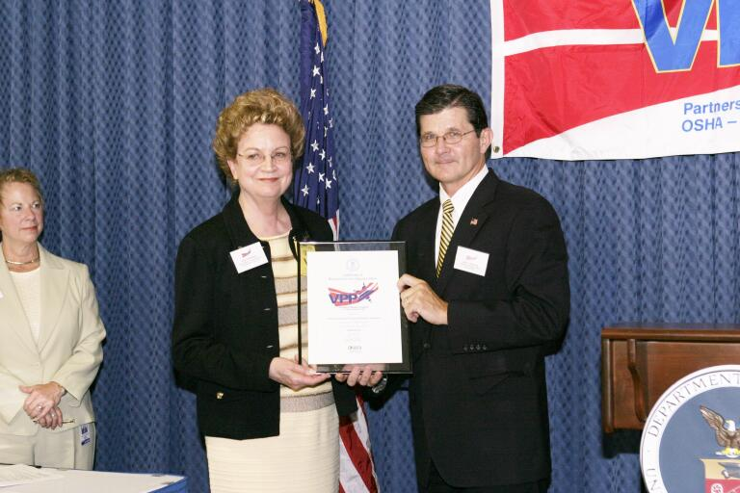
OSHA CHALLENGE PILOT
Certificate Presentation
June Brothers, Voluntary Protection Programs Participants’ Association, Chair, Board of Directors

Slide 9
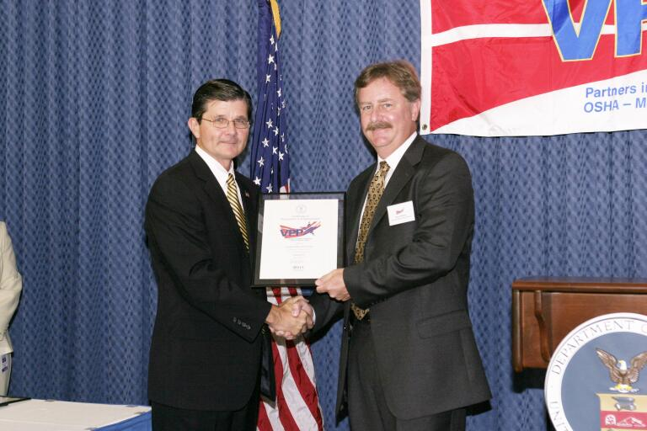
OSHA CHALLENGE PILOT
Certificate Presentation
Steve Wiltshire, Associated Builders and Contractors
Corporate Safety, Turner Construction Company

Slide 10
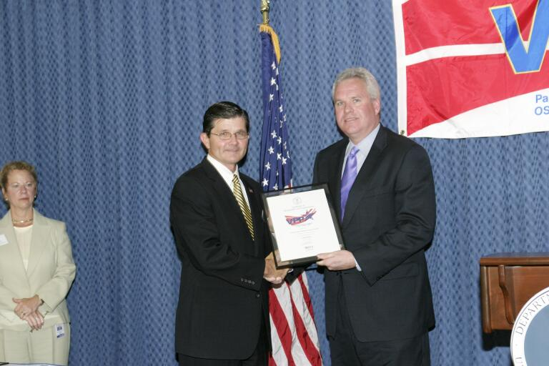
OSHA CHALLENGE PILOT
Certificate Presentation
Stephen Sandherr, CEO,
Associated General Contractors of America

Slide 11
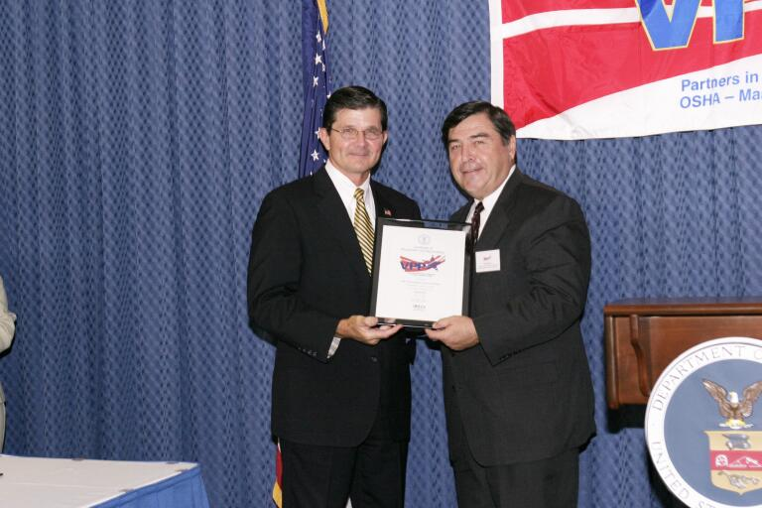
OSHA CHALLENGE PILOT
Certificate Presentation
Noel Borck, Executive Vice President
NEA— The Association of Union Constructors

Slide 12
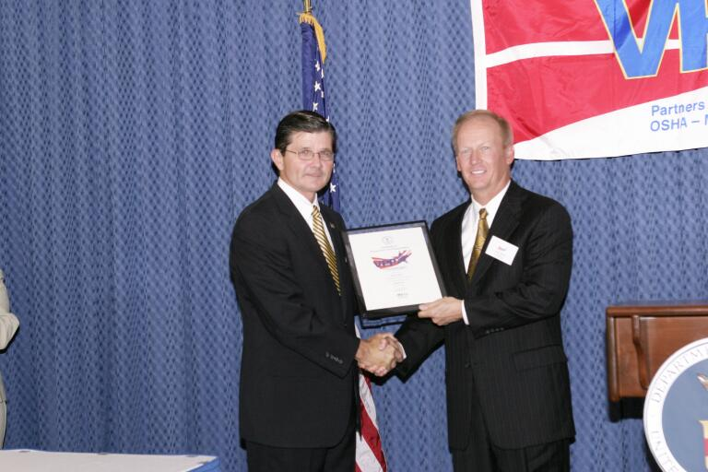
OSHA CHALLENGE PILOT
Certificate Presentation
Dean Oskvig, President, Power Delivery Division
Black & Veatch

Slide 13
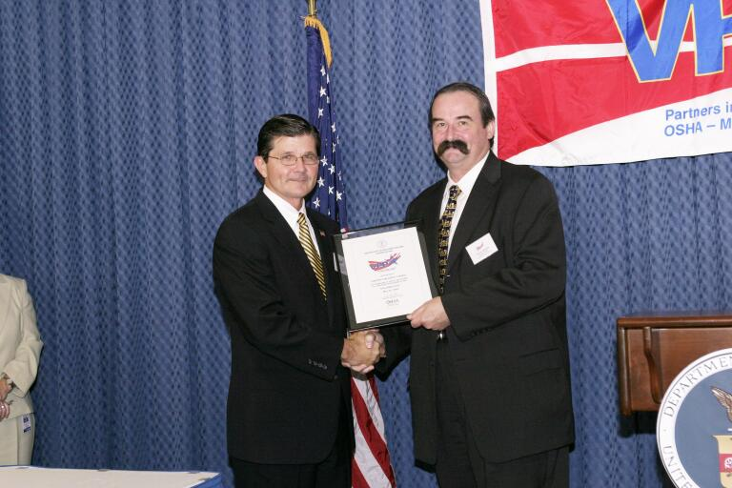
OSHA CHALLENGE PILOT
Certificate Presentation
Thomas A. Broderick, Executive Director
Construction Safety Council

Slide 14
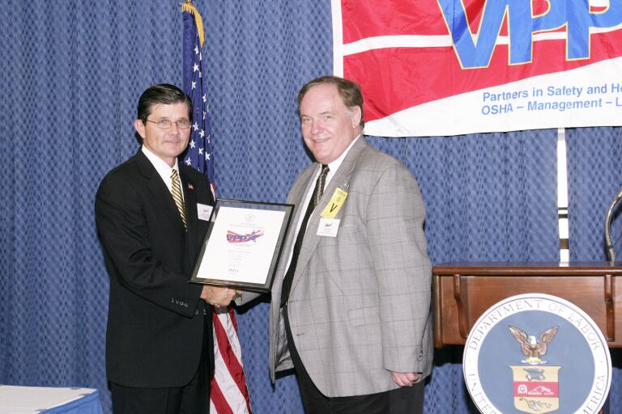
OSHA CHALLENGE PILOT
Certificate Presentation
Larry Mullins, Vice President
Independent Electrical Contractors

Slide 15
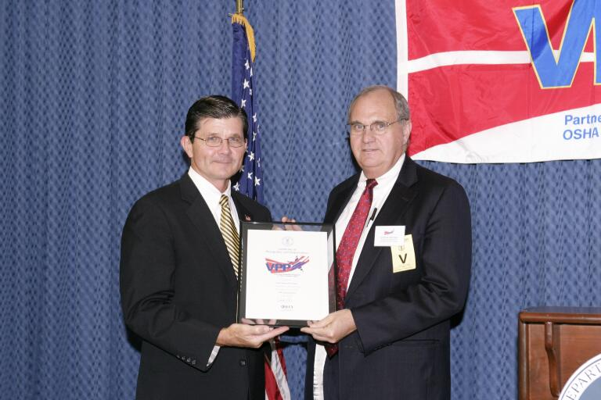
VPP CORPORATE PILOT
Certificate Presentation
Arnold A. Allemang, Executive Vice President Operations
Dow Chemical Company

Slide 16
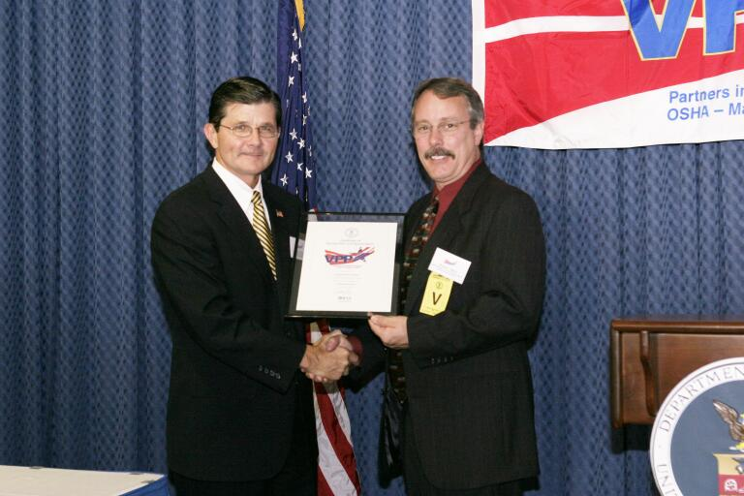
VPP CORPORATE PILOT
Certificate Presentation
Michael Vigezzi, Global Manager - VPP & Safety Programs
General Electric Company

Slide 17
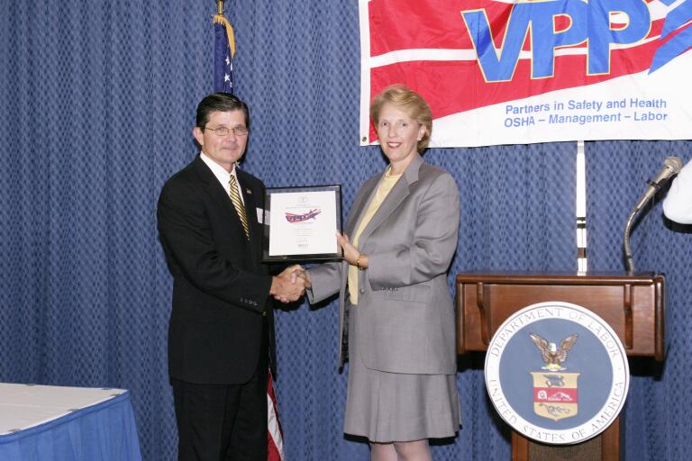
VPP CORPORATE PILOT
Certificate Presentation
Patricia A. Barnard, Executive Vice President, Human Resources, Georgia Pacific Corporation

Slide 18
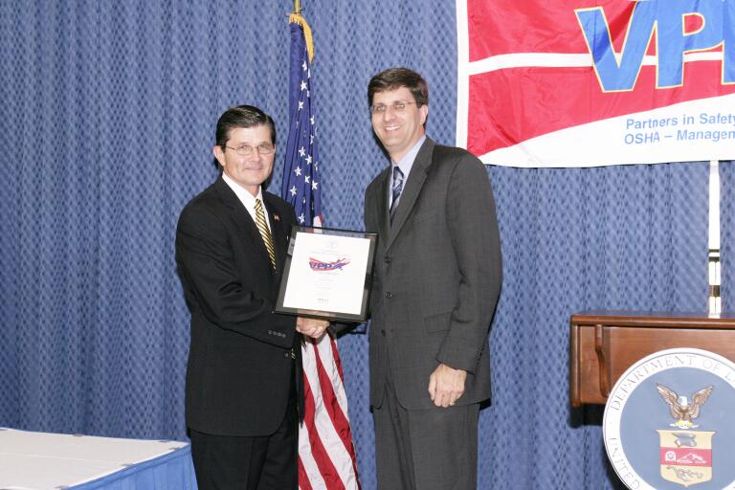
VPP CORPORATE PILOT
Certificate Presentation
David Struhs, Vice President Environmental Affairs
International Paper

Slide 19
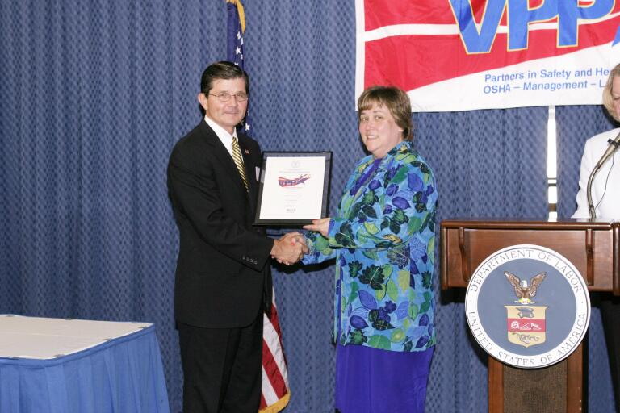
VPP CORPORATE PILOT
Certificate Presentation
Donna Capizzi, Director of World-Wide Health and Safety
Johnson & Johnson

Slide 20
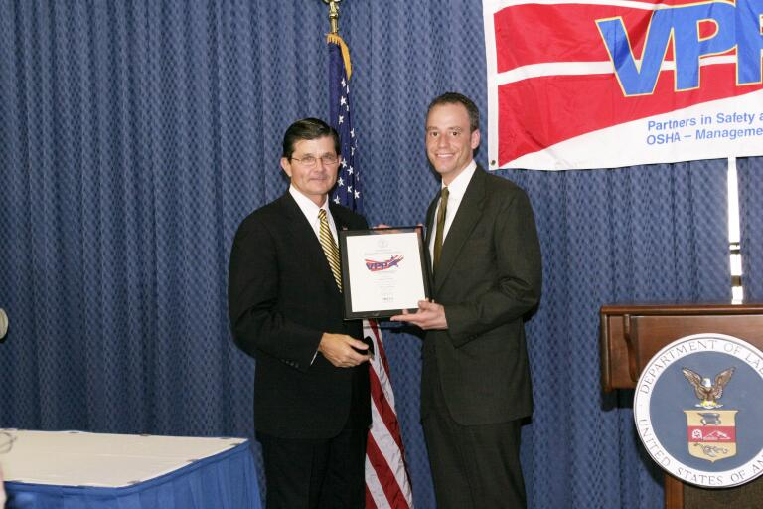
VPP CORPORATE PILOT
Certificate Presentation
Greg Steiner, Vice President, Government Affairs
Maytag Corporation

Slide 21
VPP CORPORATE PILOT
Certificate Presentation
Suzanne Medvidovich, Senior Vice President, Human Resources, United States Postal Service

