Slide 1





The Building Permits Survey:
Measuring The American Dream

Slide 2

Erica Filipek, Salima Jenkins, Trent Langley
Residential Construction Branch
Manufacturing and Construction Division
(301) 763-5160

Slide 3

Why does the Census Bureau collect data on building permits?
Policymakers, investors, public officials, and businesses all need to know what the future holds in store for the economy
New construction generates a need for everything from lumber to sinks to curtains, so it affects many different parts of the economy
Building permit estimates are a component of the U.S. Index of Leading Economic Indicators
Data on building permits are also used to estimate the numbers of Housing Starts, Housing Completions, and New Home Sales

Slide 4
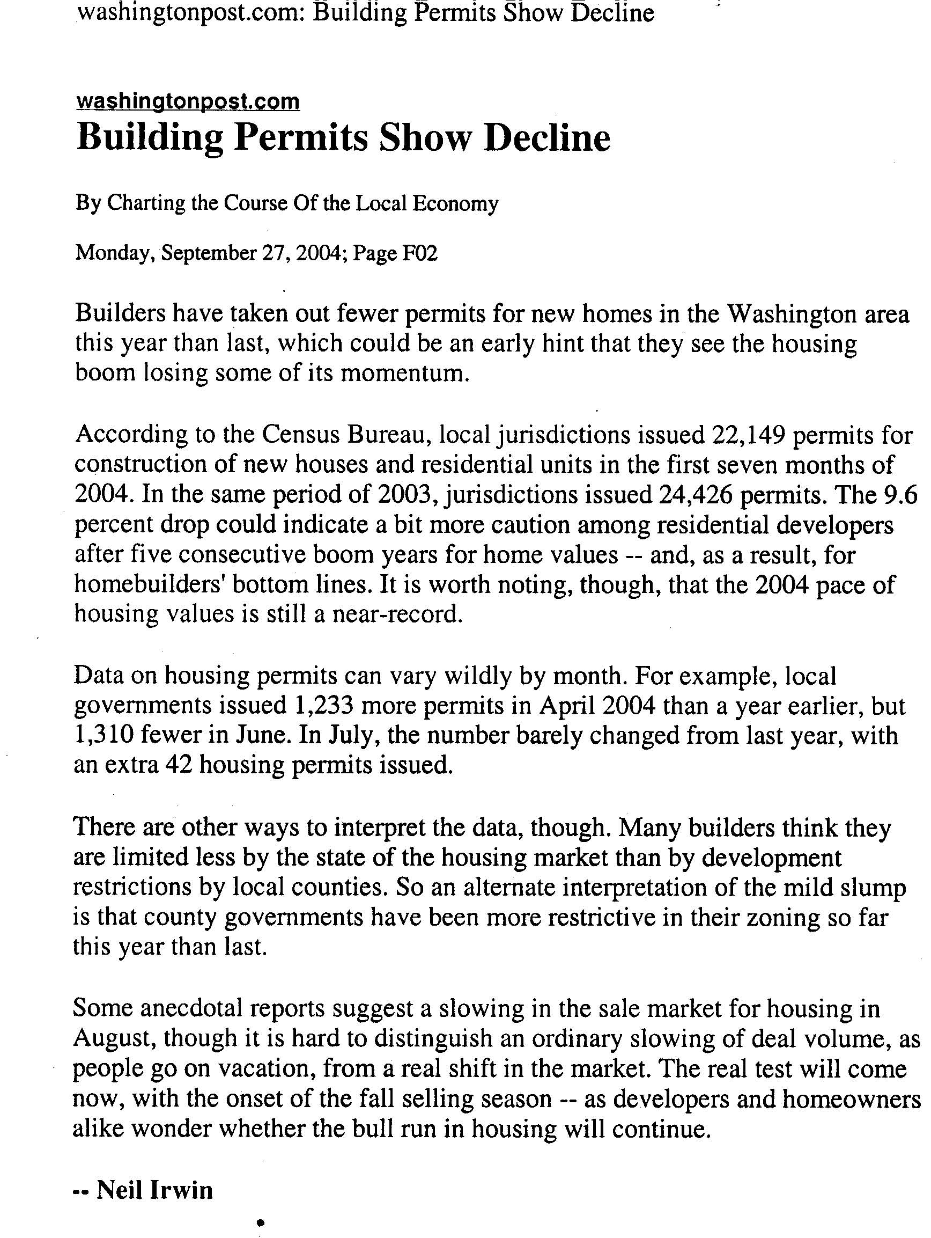

Slide 5

Estimates of new residential housing units are also used by Population Division in the calculation of population estimates!

Slide 6

Which building permits do we count?
What types of permits are included in the survey?
  Only residential permits:
  Single-family houses (attached and detached)
  Apartments
  Senior housing, assisted living facilities, congregate care, etc.
  Permits for additions, alterations, and renovations
What types of permits are excluded?
  Group quarters (nursing homes, dormitories, etc.)
  Non-residential permits (discontinued in 1995)
  Permits for buildings that are completely publicly-owned

Slide 7

Where do we get the building permits data?
There are 42,000 active governments in the U.S. :
8,000 do not require permits
13,000 require a permit from another jurisdiction
1,000 exist in multiple counties
19,000 unique permit offices make up the
Building Permit Survey (BPS) universe
42,000 total governments
A jurisdiction’s status can change monthly!

Slide 8

Some offices are surveyed monthly and some are surveyed only annually
There are around 8,700 permit offices in the
monthly sample
  The monthly data are used to make national, regional, and state estimates
  Most larger permit offices and a sample of smaller offices are surveyed monthly
The remaining permit offices are surveyed annually
Participation in the survey is voluntary!

Slide 9

What methods do we use to collect the data?
Most respondents receive Form C-404 in the mail
We try to make reporting easy. Unlike many surveys, we will accept data from respondents in almost any form!
These include:
  Form mailed back
  Form faxed back
  Paper listings in various formats
  Electronic files – We receive a file from some states
  E-mail – We hope to provide this option in the future
  Internet (Permit data from respondents’ websites)

Slide 10

What happens if respondents do not report?
We impute the data based on previous reports
We try again to get the reported data when we
do the annual survey
  We request missing monthly data
  if 1 to 4 months are missing
  We request annual data for monthly
  places if 5 or more months are missing
We call respondents to encourage them to respond
State Data Centers and other state officials
- We are asking for your assistance today!

Slide 11
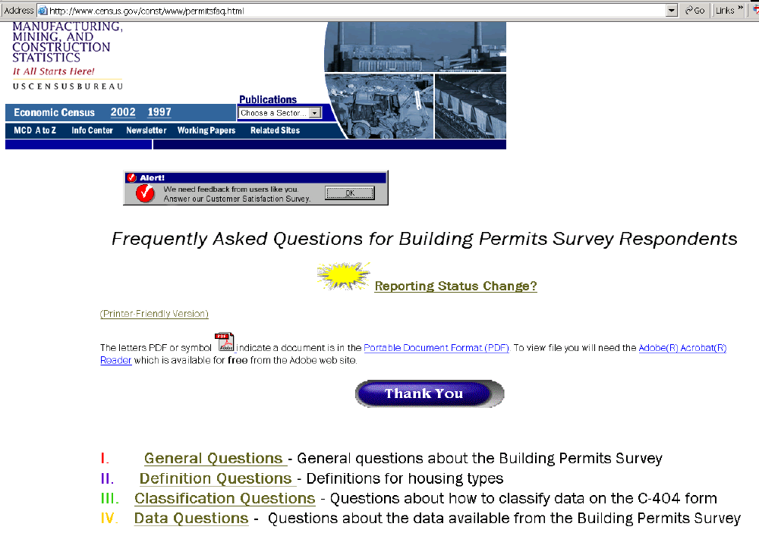
We provide assistance for respondents on our website: www.census.gov/permitsfaq

Slide 12

What data are available from the survey?
Permits are public information (not subject to Title 13)
Data are released monthly and annually for the U.S. total and:
      The 4 Census Regions
      The 9 Census Divisions
      The 50 States and the District of Columbia
      Metropolitan Areas
      Counties
      Individual jurisdictions
The survey provides a wealth of timely information on local residential construction trends.
Local monthly data are released on the 18th workday of the following month.
There is great interest in this information because very few (if any!) Census Bureau economic surveys provide such timely local data!

Slide 13


What do our monthly data products contain?
State Data – Based on Data from 8700 monthly reporting places; some of the monthly places are weighted to represent annual places that are collected at the end of the year.
Metropolitan Area (MA) data – Every MA is listed, but the data only comes from the 8700 monthly reporting places.
County Data – The counties that are listed are the counties where every place within the county reports monthly; currently there are approximately 900 such counties.
Place level data – individual jurisdictions that report monthly.

Slide 14

What do our annual data products contain?
Local data for all 19,000 jurisdictions are available annually!
State/Metropolitan Area data - Every State/MA in the U.S. is listed, and the data represents every permit issuing place.
County Data – Every county within the U.S. is listed; over 3000 counties.
Place level data – 19,000 individual jurisdictions that report monthly.

Slide 15
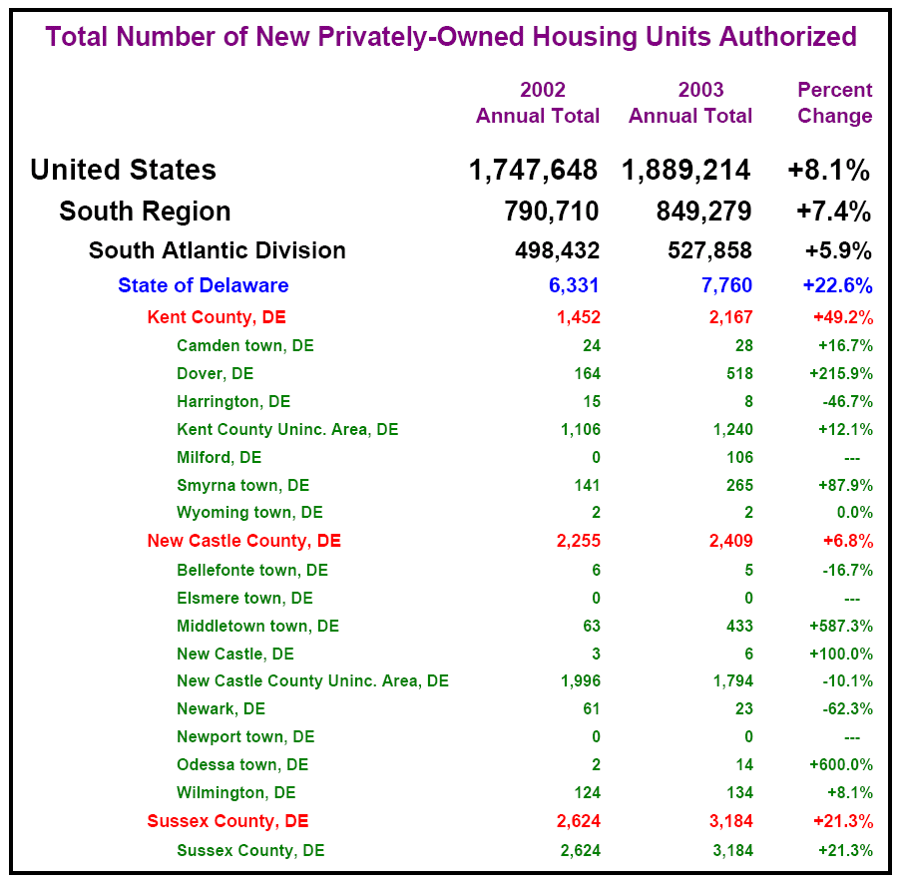

Slide 16

So the Building Permits Survey is unique!
The BPS is one of the only surveys which releases data based on individual responses!
Local officials can identify the areas where data are imputed because they did not report!
Lack of reporting also affects the population estimates which are based on the permit data.

Slide 17

Data CD
Today we are providing you with a CD-Rom containing
Place level data for each of your states. Each CD contains:
Places that reported Annual 2003 data
Places that should have, but did not report Annual 2003 data
Places that reported data for August 2004
Places that should have, but did not report for August 2004

Slide 18
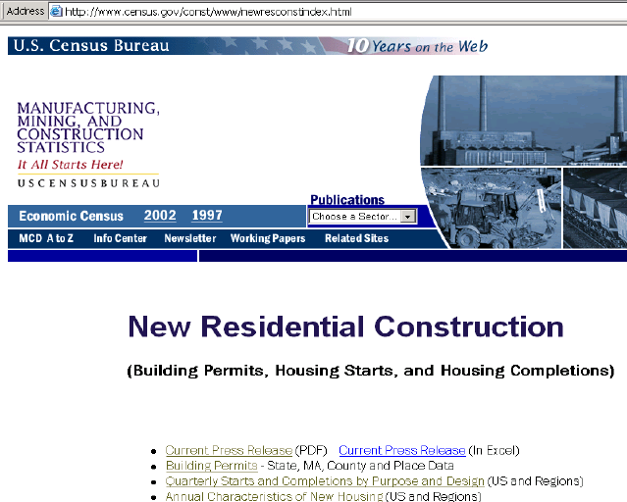
How to access local data?
Permits data is located at www.census.gov/permits
    Click on ‘Building Permits’
  Click on ‘Permits by County or Place’
  Select state and proceed from that point

Slide 19

Are there any
Questions?

Slide 20


Please contact our office
Phone: (301) 763-5160
If you are interested in receiving data or have questions about the CD-Rom.
If you know of an area where permit coverage has changed due to:
  Permits no longer being required
  Permits office merging with another permit office
  Permits office splitting into two or more jurisdictions
  Permits no longer being required

