Slide 1





The Building Permits Survey:
Measuring The American Dream

Slide 2

2005 State Data Center /
Business and Industry Data Center
Annual National Training Conference
September 13, 2005
Erica Filipek
Residential Construction Branch
Manufacturing and Construction Division

Slide 3




Why does the Census Bureau collect data on building permits?
Data on building permits are used to estimate the
numbers of Housing Starts, Housing Completions,
and New Home Sales
New construction generates a need for everything from
lumber to sinks to curtains, so it affects many different
parts of the economy
Policymakers, investors, public officials,
and businesses all need to know what the future
holds for the economy
Building permits estimates are a component of the U.S.
Index of Leading Economic Indicators
The data are also used in the calculation of
population estimates

Slide 4

Which building permits do we count?
What types of permits are included in the survey?
  Only residential permits:
  Single-family houses (attached and detached)
  Apartments
  Senior housing, assisted living facilities, congregate care, etc.
  Permits for additions, alterations, and renovations
What types of permits are excluded?
  Group quarters (nursing homes, dormitories, etc.)
  Non-residential permits (discontinued in 1995)
  Permits for buildings that are completely publicly-owned
  Manufactured (mobile-HUD inspected) homes

Slide 5

Where do we get the building permits data?
There are about 40,000 active
governments in the U.S. :
7,000 do not require permits
12,000 require a permit from another jurisdiction
1,000 exist in multiple counties
20,000 unique permit offices make up the
Building Permits Survey (BPS) universe
_________
40,000 total governments
The permit coverage can change monthly!

Slide 6

Offices are surveyed either monthly or annually
There are around 8,900 permit offices in the monthly sample
    The monthly data are used to make
    national, regional, and state estimates
    Most larger permit offices and a sample of smaller
    offices are surveyed monthly
The remaining permit offices are surveyed annually
Every 10 years a new monthly sample is selected, most
recently in 2004
Monthly and annual reporters keep their reporting status for
the life of the sample, unless we are notified that they wish
to change reporting status
Participation in the survey is voluntary!

Slide 7

What methods do we use to collect the data?
Most respondents receive Form C-404, “Report of Privately- Owned Residential Building or Zoning Permits Issued”, in the mail
We try to make reporting easy. Unlike many surveys, we will accept data from respondents in almost any form!
These include:
  Mailed Form
  Faxed Form
  Paper listings in various formats
  Electronic files – We receive a file from some jurisdictions

Slide 8

How do we review the data?
We review the data prior to the release of preliminary,
revised monthly and annual estimates
Data that fall outside established edit parameters are flagged
  Data are also compared to historical patterns for the place
  We contact respondents for clarification of questionable data
  Late reports and corrections received after monthly place-
  level data are released are reflected in year-to-date or
  annual totals

Slide 9

What happens if respondents do not report?
We obtain the housing units from the Survey of Construction for
the 900 permit offices that are also in that survey
We make another attempt to get missing monthly data when
we do the annual survey
We make a second attempt to obtain annual data for places
that did not respond to our first request
We impute the data for non-respondents
We also seek assistance from State Data Centers
and other state officials

Slide 10

What data are available from the survey?
Permits are public information
Data are released monthly and annually for the U.S. total and:
      The 4 Census Regions
      The 9 Census Divisions
      The 50 States and the District of Columbia
      Metropolitan Areas
      Counties
      Individual jurisdictions
The survey provides a wealth of timely information on local residential construction trends
Local monthly data are released on the 18th workday of the following month
There is great interest in this information because very few (if any!) Census Bureau economic surveys provide such timely local data!

Slide 11

What do our monthly data products contain?
State data – Based on data from 8,900 monthly reporting places; some
of the monthly places are weighted to represent annual places that are
collected at the end of the year
Metropolitan Area (MA) data – Every MA is listed, but the data
only come from the monthly reporting places
County data – The counties that are listed are the counties
where every place within the county reports monthly; currently
there are approximately 900 such counties
Place level data – individual jurisdictions that report monthly

Slide 12

What do our annual data products contain?
Local data for all 20,000 jurisdictions are available annually on May 1st!
State/Metropolitan Area data – Every State/MA in the U.S. is listed,
and the data represent every permit-issuing place
County data – Every county within the U.S. is listed; over 3,000
counties
Place level data – 20,000 individual jurisdictions

Slide 13
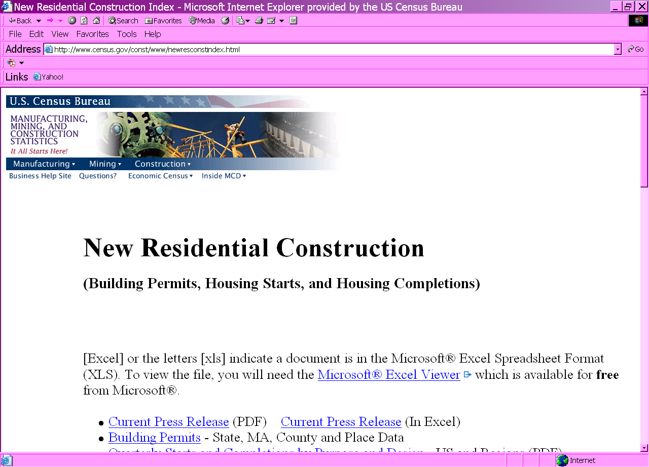
How to access building permits data?
Use the shortcut www.census.gov/permits to get to the New Residential Construction page
Click on Building Permits

Slide 14

Building permits data are used in
the annual creation of population estimates
  Our annual data are also very important because they affect
  the population estimates used by government agencies
  to allocate funding and other resources to your local area and for
  various planning purposes
We do not revise the published annual data after May 1st
  However, we will provide the Population Division with late
  reported data and corrections received after our annual closeout
  for use in their population estimates

Slide 15

How can we work together to improve your state’s building permits data in the future?
We will notify you when we mail out the annual survey
We will provide information on the SDC website on contact information
for permit offices in your state, with those who did not respond to the
monthly survey or to last year’s annual survey identified
We need your support to update the contact information
and to encourage your jurisdictions to respond
We will provide the detailed annual data for your review
prior to their use in population estimates
Please contact CLO if you have feedback on how to implement
this process
We will provide more details on this process soon
Through teamwork, we will be able to improve
the response for the survey!

Slide 16

State Data Centers and the local jurisdictions can also receive a free subscription to our standard data products

Slide 17

Please contact our office
If you:
are interested in receiving data
have information that affect data
have questions
Our phone number is:
(301) 763-5160
Our toll free number for respondents is:
800-845-8244

Slide 18

Are there any questions?

