Slide 1


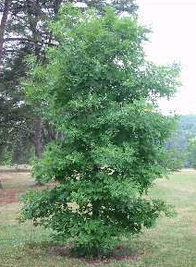
white oak
Quercus alba L.
Synonym: Quercus repanda.
Other common names: stave oak, ridge white oak, northern white oak, eastern white oak, Quebec oak, forked-leaf white oak, fork-leaf oak, stone oak.
PLANT FACTS:
The white oak grows on a wide range of soils. It grows best on deep, well-drained fertile loam soils. It naturally crosses easily with other oak species and numerous hybrids have been identified. It normally grows 60 to 80 feet tall, but has been recorded as reaching more than 150 feet in height. The trunk may be up to 4 feet in diameter.
The white oak is often planted in yards and parks for landscaping. It tolerates extremes in environments, is tolerant of many soils, lives a long time (more than 100 years), is an excellent source of shade, has a nice green color during the growing season and the leaves often turn a beautiful red color in autumn.
This is the most important lumber tree of the white oak group. The quality of its wood makes it useful for many things, like housing construction and furniture. Pioneers used this tree to make staves for barrels, hence the common name, stave oak.
The acorns are an important food crop for many wildlife animals. However, the tree normally does not reach fruit bearing stage until it is 30 years old. Even then only good acorn crops are normal once every 3 years.
A large portion of the famous naval ship, the U.S.S. Constitution, better known as "Old Ironsides" is made out of white oak.
White oak is the official state tree of Connecticut, Illinois and Maryland.
Photo courtesy of: ©J.S. Peterson. USDA NRCS NPDC. USDA ARS National Arboretum, Washington, D.C.. June 13, 2002. This copyrighted image may be freely used for any non-commercial purpose. For commercial use please contact J.S. Peterson. Please credit the artist, original publication if applicable, and the USDA-NRCS PLANTS Database. The following format is suggested and will be appreciated: J.S. Peterson @ USDA-NRCS PLANTS Database.
Slide developed by Pat Broyles, Soil Conservationist, Manhattan, KS. PMC. USDA is an equal opportunity employer.

Slide 2
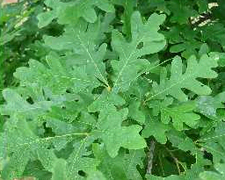
white oak
Photo courtesy of: ©J.S. Peterson. USDA NRCS NPDC. USDA ARS National Arboretum, Washington, D.C.. June 13, 2002. This copyrighted image may be freely used for any non-commercial purpose. For commercial use please contact J.S. Peterson. Please credit the artist, original publication if applicable, and the USDA-NRCS PLANTS Database. The following format is suggested and will be appreciated: J.S. Peterson @ USDA-NRCS PLANTS Database.
FOOD:
Acorns from all oak trees were used as food. They contain about 6% protein and 65% carbohydrates. However, due to their high tannin content the acorns must be treated before they are edible. Acorns with red or pink spots taste the sweetest. There were a number of ways different tribes used to leach the tannin out and get rid of the bitter taste. All of these preparations took a lot of time and work, a few took days, others took weeks and some even months.
One way was to dry the acorns, flail the husks off and boil the pulp. This water was then thrown out or used in dyeing and tanning. The acorn meat was then boiled as many times as needed in fresh water. It is easy to tell when enough of the tannin has been leached out by simply tasting it.
Another method was to wrap all the acorns into a porous sack and hang them in a running stream for a few weeks.
A third common way was to bury all the acorns together in boggy ground and leave them throughout the winter.
Settlers used roasted acorns as a tea or coffee substitute.
Slide developed by Pat Broyles, Soil Conservationist, Manhattan, KS. PMC. USDA is an equal opportunity employer.

