Slide 1
EMERGY & ENERGY SYSTEMS
Session 8
Short Course for ECO Interns, EPA and Partners
Notes:
In the previous session, we finished presenting the components that are important to a regional evaluation (and to many other kinds of evaluations as well). You should now have a broad understanding of the physical laws governing all interactions and connections within a process, whether it is a small manufacturing process or a larger regional economic evaluation.

Slide 2
Ratios and Interpretations
Unit emergy ratios
  Transformities
  Specific emergy
Co-products versus splits
Other ratios and interpretations
Notes:
In this session, we will talk a little about how these evaluations are used to build a set of ratios and indices useful in understanding the relations between systems. We will also introduce a little emergy algebra for networks. Because we are evaluating flows across boundaries and not the complexity of internal networks, you do not really need to know much at this point about network emergy algebra. If you are interested in learning more about tracking emergy through networks, Chapter 6 in Environmental Accounting (Odum 1996) offers a number of examples and explanations. In this session we will only present the concept of splits and co-products, not so much because you need them for regional evaluations, but because you may have to calculate a transformity to complete the evaluation.

Slide 3
Unit Emergy
Transformity – emergy input per unit energy output
Emergy per mass, specific emergy – emergy input per unit material output
Interpretations
  Tomato 1: 5E7 sej/J; Tomato 2: 5E6 sej/J; Tomato 3: 1E5 sej/J
  Tomato 1 process is new, in an area where tomatoes are difficult to grow, or there is an error in some input
  Tomato 3 is likely to be a product of a low fuel use process such as an organic farm or primitive society or a geographic area highly conducive to crop production
Notes:
We presented the definition and concept of transformities and emergy per mass several sessions ago. This ratio has several uses as an indice. The most obvious one is its ability to immediately rank any item on the energy/material transformation hierarchy continuum. For example, tomatoes at their minimum transformity are two orders of magnitude below gas and therefore not suitable as a primary energy source.
Whenever an emergy ratio is an order of magnitude or more higher than other similar items (table ready vegetables such as sweet corn and tomatoes are similar, but not feedstock such as grain corn or sugarcane), the first thing you should look at is your math and the setup of your spreadsheet calculations. The next thing you should check is the raw data itself. Sometimes, data has extra things added into it, or it is actually measuring something other than what you have a transformity for. One example of this would be fertilizer data. Make sure the raw data is for active ingredients only, not total application which is often as much as 90% inert ingredients. If you are applying 200 pounds of fertilizer, in many cases only 20 pounds of it is phosphorus and the rest is non-caking agents, sand or some other carrier. The transformity for reagent grade phosphorus is about 10 orders of magnitude higher (1E12 to 2) than sand, and consequently you would be making a large difference in the total emergy input based on the raw data.
If there is no error in the calculation or the assumptions used, then the differences in transformity can be used to draw some conclusions about the processes being compared. A higher transformity for the same process would indicate that the process is in its beginning phase and inputs not have been optimized yet. Remember that maximizing empower does not mean maximizing inputs (if you are not familiar with the Maximum Power Principle, ask us). It may also mean that the process is not conducive to the position it is occupying in the hierarchy or geographically. For example, although the weather in Florida is conducive to growing tomatoes almost all year round, the predators and low nutrient soil are highly limiting factors. To overcome these, more fuel, fertilizers and other goods are required to overcome these limits, and hence the transformity is higher there than for tomatoes grown in a midwest backyard during the summer or in Mexico.

Slide 4
Splits and Unit Emergy
Splits
  Same entity
  Emergy splits
  Same transformity
4000sej
2x4s, 8ft. long
2000sej/100J
Sawmill
2000sej
2x4s, 10 ft. long
4000sej/200J
Notes:
When calculating unit emergy ratios, it is important to specifiy the actual item being evaluated. Consider a sawmill as an example. This process produces both milled lumber and sawdust, and therefore we could be calculating an emergy ratio for any of these components – the entire process, the milled lumber, or the sawdust. Let’s look at just the lumber evaluation first.
This kind of network connection is the easiest for most people to understand. We are all familiar with balance sheets of one kind or another – what goes in equals what comes out minus what got left behind or used. That is exactly what a split does. The same material or energy is simply split between two receiving units, and because it is the same material, the same split in emergy travels along with it. In this example, a total of 6000 solar emjoules were required to make lumber. The paths are different sizes of lumber but it is the same basic energy and material requirements to make this lumber regardless of size (this may not be true for very large stock size lumber or extremely small remnants). If 1/3 of the timber goes to one path and 2/3 to the other, 100 and 200 joules, then 1/3 of the emergy travels with the first path and the remainder follows the bottom path.

Slide 5
Co-product Unit Emergy
Co-products
  Different entities but inseparable byproducts from process
  All emergy goes to each path
  Different transformities
4000sej
Lumber
6000sej/300J
Sawmill
2000sej
Sawdust
6000sej/600J
Notes:
Now let’s look at the sawdust. Sawdust is a byproduct of the lumber milling process. You cannot make lumber without making sawdust, and sawdust is made at the same time as lumber is milled – these are not sequential or mutually exclusive processes. Consequently, all the emergy required to make the lumber in this process was also necessary to make the sawdust. We call these pathways co-products, and all of the process emergy is assigned to both paths.
This is a difficult concept for some to accept, because they want the inputs to equal the outputs just like a typical accounting procedure. If you remember the emergy concept, however, all of the energy required to make an item is included in its emergy. Consequently, because you cannot make lumber without sawdust in this procedure, and the energy is used at the same time, all the emergy for the entire process is allocated to each output path. Now admittedly, this may not be the best way or lowest transformity way to obtain sawdust. We would probably get very different emergy ratios if we considered the output of termites eating wood as a sawdust process or considered that fine-scale chipping would net more sawdust for less energy overall.
However, if an evaluation is considering the use of lumber byproducts as a fuel for making ceramic bowls, for example, the entire process must be considered, and the unit emergy ratio for this input would come from a co-product calculation as shown above.

Slide 6
Process Unit Emergy
Resembles 3-arm diagram
“Blackbox” evaluation
4000sej
Sawmill
2000sej
Total Yield
6000sej/900J
Notes:
If we needed the unit emergy ratio of the entire sawmill, it would not matter what was leaving the process, only how much total energy was available for transfer to another higher level process. In this case, the evaluation resembles the three arm diagrams presented in Session 2. The emergy of the main feedstock, a natural resource, enters from the left, and the purchased inputs are shown entering the top of the box. The final yield leaves to the right. Please keep in mind that the numbers presented here are completely bogus, having no basis in reality, and are only presented as a way to make the point between splits and co-products. Wood products actually have a unit emergy ratio in the E3 to E6 range.

Slide 7
Other Ratios and Interpretations
Investment ratio – emergy of purchased feedbacks : emergy of renewable inputs
  Region 1: Ir =2; Region 2: Ir = 10; proposed resort: Ir = 25
  First choice: don’t permit the resort as is, reduce consumption
  Second choice: build it next to Region 2 to minimize negative impacts
Investment ratio – purchased inputs : renewable and non-renewable used within region
  Region 1: Ir = 0.5, Region 2: Ir = 25.0
  Region 1 will be attracting investment and needs to plan for growth while Region 2’s new investments will be slowing down and should be planning for a downturn or ways to recycle
Notes:
There are several kinds of investment ratios that can be calculated using emergy values. Investment ratios are conceptually a means for determining how much emergy is supporting a process from different categories of inputs – renewable, non-renewable or purchased. These ratios explore the percentage of a process that comes from outside a region, how much the local environment is being utilized or exploited and how much of a process is not accounted for in typical economics. We will talk about two of these ratios here, but a more complete listing is given in Chapter 5 of Environmental Accounting.
When you compare all purchased inputs to free renewable inputs, you gain a quantitative understanding about the intensity of human influence on the process. Natural systems and more primitive human societies have very low purchased to free ratios. This information is particularly useful in choosing where to place particular kinds of development. This ratio is similar to a unit emergy ratio in its ability to demonstrate a continuous hierarchy, in this case, of development intensity. Recall that the unit emergy ratio indicates where in the system hierarchy an element or process works best, an item such as a contaminant, with a high transformity does useful work when it is used in a process at the same general level in the hierarchy, while overloading or changing system networks much lower in the hierarchy (natural aquatic systems for example). This ratio can be used the same way: place developments of a particular intensity near other similar developments in order to avoid disruptive effects.
Another investment ratio compares the purchased inputs from outside the system to the natural resources supporting the region, both renewable and non-renewable. The ratio above assumes most non-renewables extracted from a region are the same as purchased goods because they are privately owned and sold for money. This ratio is assessing the natural resource available to a region regardless of ownership or method of exchange. It is important to note that this is the non-renewable resource actually used within the region, not what is exported…..that is another ratio altogether. Again, a low ratio is usually indicative of an undeveloped area, but it may also indicate an area with reserves abundant enough to provide a large proportion of regional support. An area in this situation will attract investment, and can use this knowledge to plan for reasonable growth. A region with a high ratio has already used their non-renewable resources to build a large economy and is now more dependent upon money circulation for services or value added goods. A region in this situation is less likely to attract investments than the lower ratio area.

Slide 8
Other Ratios and Interpretations
Emergy to dollar ratio
  Rural areas have high emergy to dollar ratio
    More wealth goes from environment to consumer without money exchange
Emergy per person
  High ratio indicates higher standard of living, but not necessarily more developed area.
Notes:
The emergy to dollar ratio was presented in sessions 2 and 4. You will recall that this ratio assumes a direct link between the emergy used within a given region in a given year and the amount of currency in circulation for that year. The fact that economies are supported by material or energy exchanges and supplies is not a difficult concept to support. The real difficulty in the emergy to dollar ratio lies in the confusion over what economic indice best quantifies money in circulation. Without getting into the middle of the argument over what is included in the gross national or state product, this is still the leading economic indice of money in circulation, and consequently, this ratio divides the annual emergy flow by the annual currency flow to derive another important unit emergy ratio. We showed in session 4 how this ratio was used to assess equity in exchange between regions and countries. We showed a comparison of ratios for different countries, where the more developed countries have low ratios and less developed countries hav high ratios. The same is tru for smaller regions – cities, states, etc. Rural states generally have higher emergy to dollar ratios. This indicates that natural wealth is moving more directly from the environment to the consumer. A low emergy to dollar ratio does not mean that less emergy is in circulation….in fact, many areas with low emergy to dollar ratios have very high per capita emergy use. It just means these regions are more dependent upon using environmental resources from outside their boundaries, and are consequently using money to obtain goods and services to support the economy.
Per capita emergy is just that: the emergy used on average per person in a region. In general this provides some gross information about the relative standard of living between regions. Remember, however that quality of life is a subjective value. What this ratio does not tell you is where this emergy is coming from – directly from the environment or via purchased inputs. It also does not tell you if the emergy use is actually clumped in a few scattered locations while the rest of the region has very low per capita emergy available.

Slide 9
Spatial Ratios
Empower density – emergy flow over some unit time into a specific unit area (aerial empower density)
Empower density interpretation
  Egg 1: 1E20 sej/ha/yr; egg 2: 1E16 sej/ha/yr
  Egg 1 is produced in a commercial layer facility; egg 2 comes from a hen given more territory and is in line with other protein production, or a buffer zone has been added for abatement of odor or manure treatment, but its not a free range egg yet (E14ish)
Notes:
The amount of emergy that flows into a specific area is an important way of distinguishing different levels of development or relative productivity. A similar concept is used by urban and regional planners when they designate residential development as high or low density, although this is often based on an average number of people, bedrooms or bathrooms rather than the total energy flow. While the number of people or housing units per acre can be considered a surrogate for energy level, this same type of head count does not work for natural, commercial or industrial systems.
In general, empower density increases along a continuum of natural systems to developed with the highest emergy at the center of urban cities. This continuum has a few outliers of interest – notably, large scale agrobusinesses, some other commercial enterprises such as hospitals, and industries.
This ratio, along with storages and investment ratios discussed a few slides back, is useful in determining appropriate placement of development on the landscape as well as providing information on sustainability. The more emergy flowing into a unit area, the higher the amount of support area required somewhere else, and, similar to unit emergy ratios, an empower density value similar to surrounding values is typically a better fit for the emergy flow.

Slide 10
Support Area
2E21 sej/yr
Purchased
Support area
  the amount of environmental service area required to support economic activity in an area of high empower density
City
Support Area
Region Purchased to Free ratio = 8
Renewable empower density = 4E14 sej/ha/yr
Support area = (purchased/regional ratio)/(renewable empower)
= (2E21 sej/yr / 8) / (4E14 sej/ha/yr)
= 625,000 hectares support area
Notes:
This is one way to quickly estimate the amount of natural area required to support a high empower land use. Assuming you know what the regional investment ratio is, an average amount of renewable inputs to the surrounding region is used to calculate an amount of adjacent land required to support the higher level of emergy use. You can estimate support area based on a global perspective as well using the purchased to renewable ratio of 2, and an average renewable empower density of 1.85E10 sej/ha/yr. From a global perspective, the required support area for a land use of this high intensity would be 5.41E10 hectares, or about 0.01% of the total earth’s surface. This is one way of estimating global sustainability.

Slide 11
Practice Excercise
If you are familiar with matrices methods, see if you can complete these examples. If not, then just look carefully at both diagrams and determine the difference between the two and what it will mean for the emergy ratios calculated from the energy flows.
Notes:
Two diagrams are on the next two slides.

Slide 12
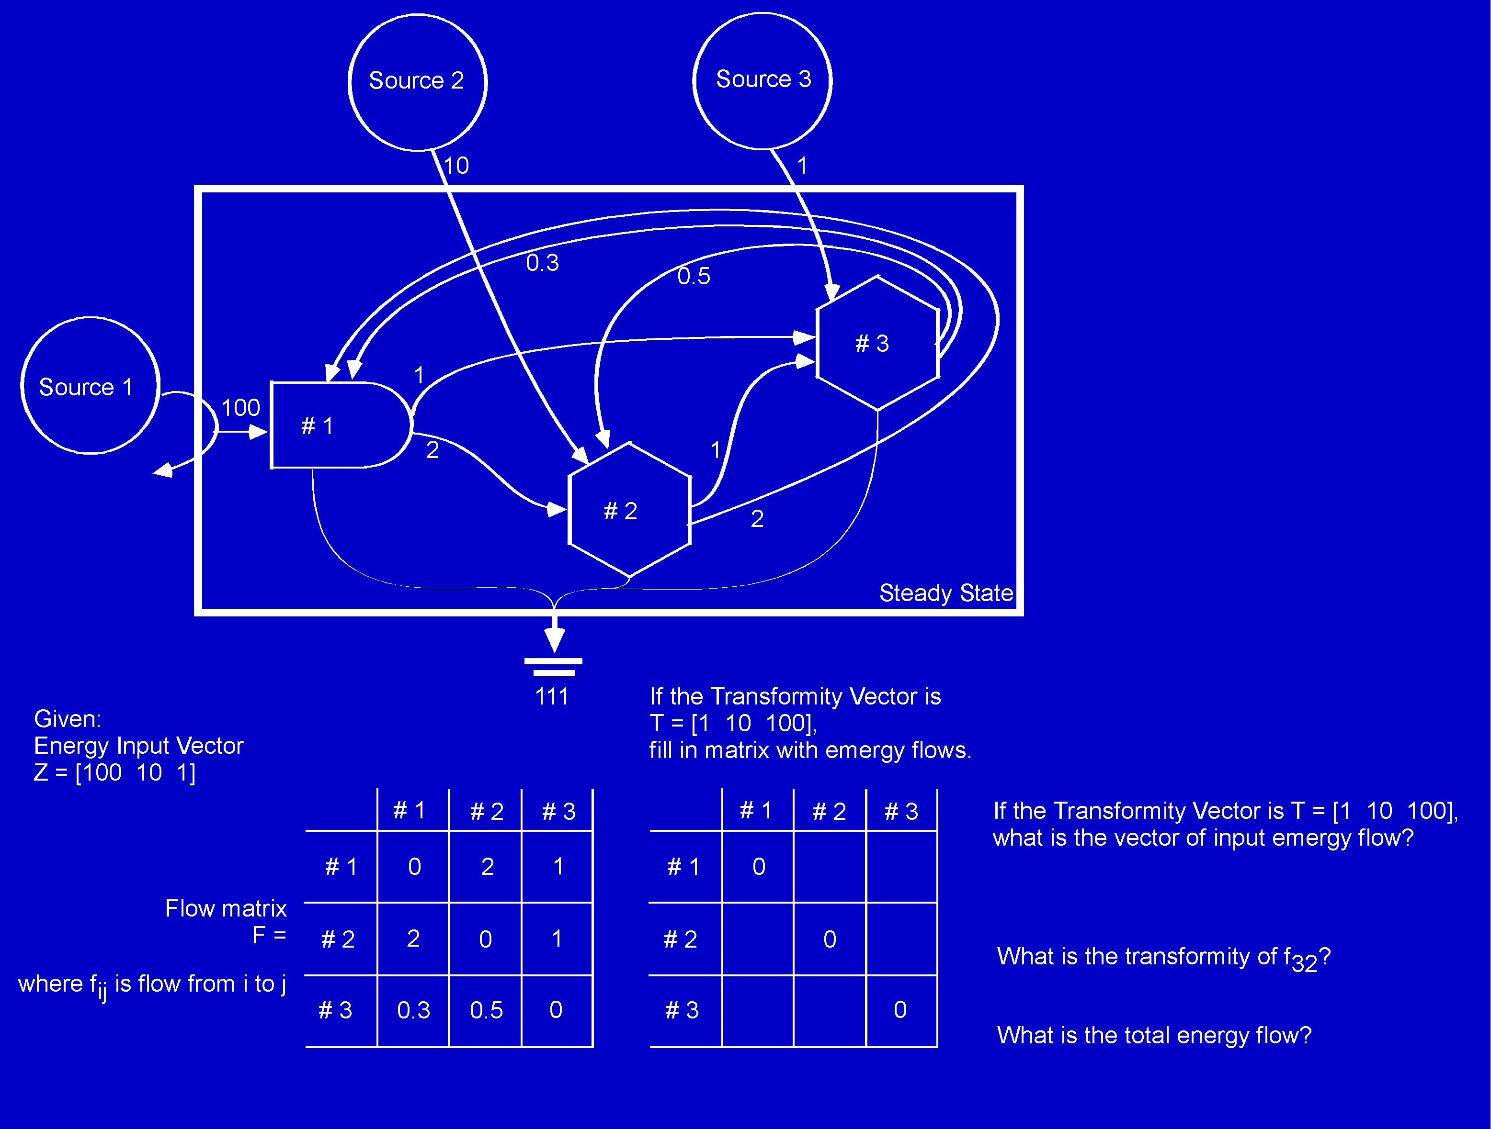
Notes:
Questions? Send an email.

Slide 13
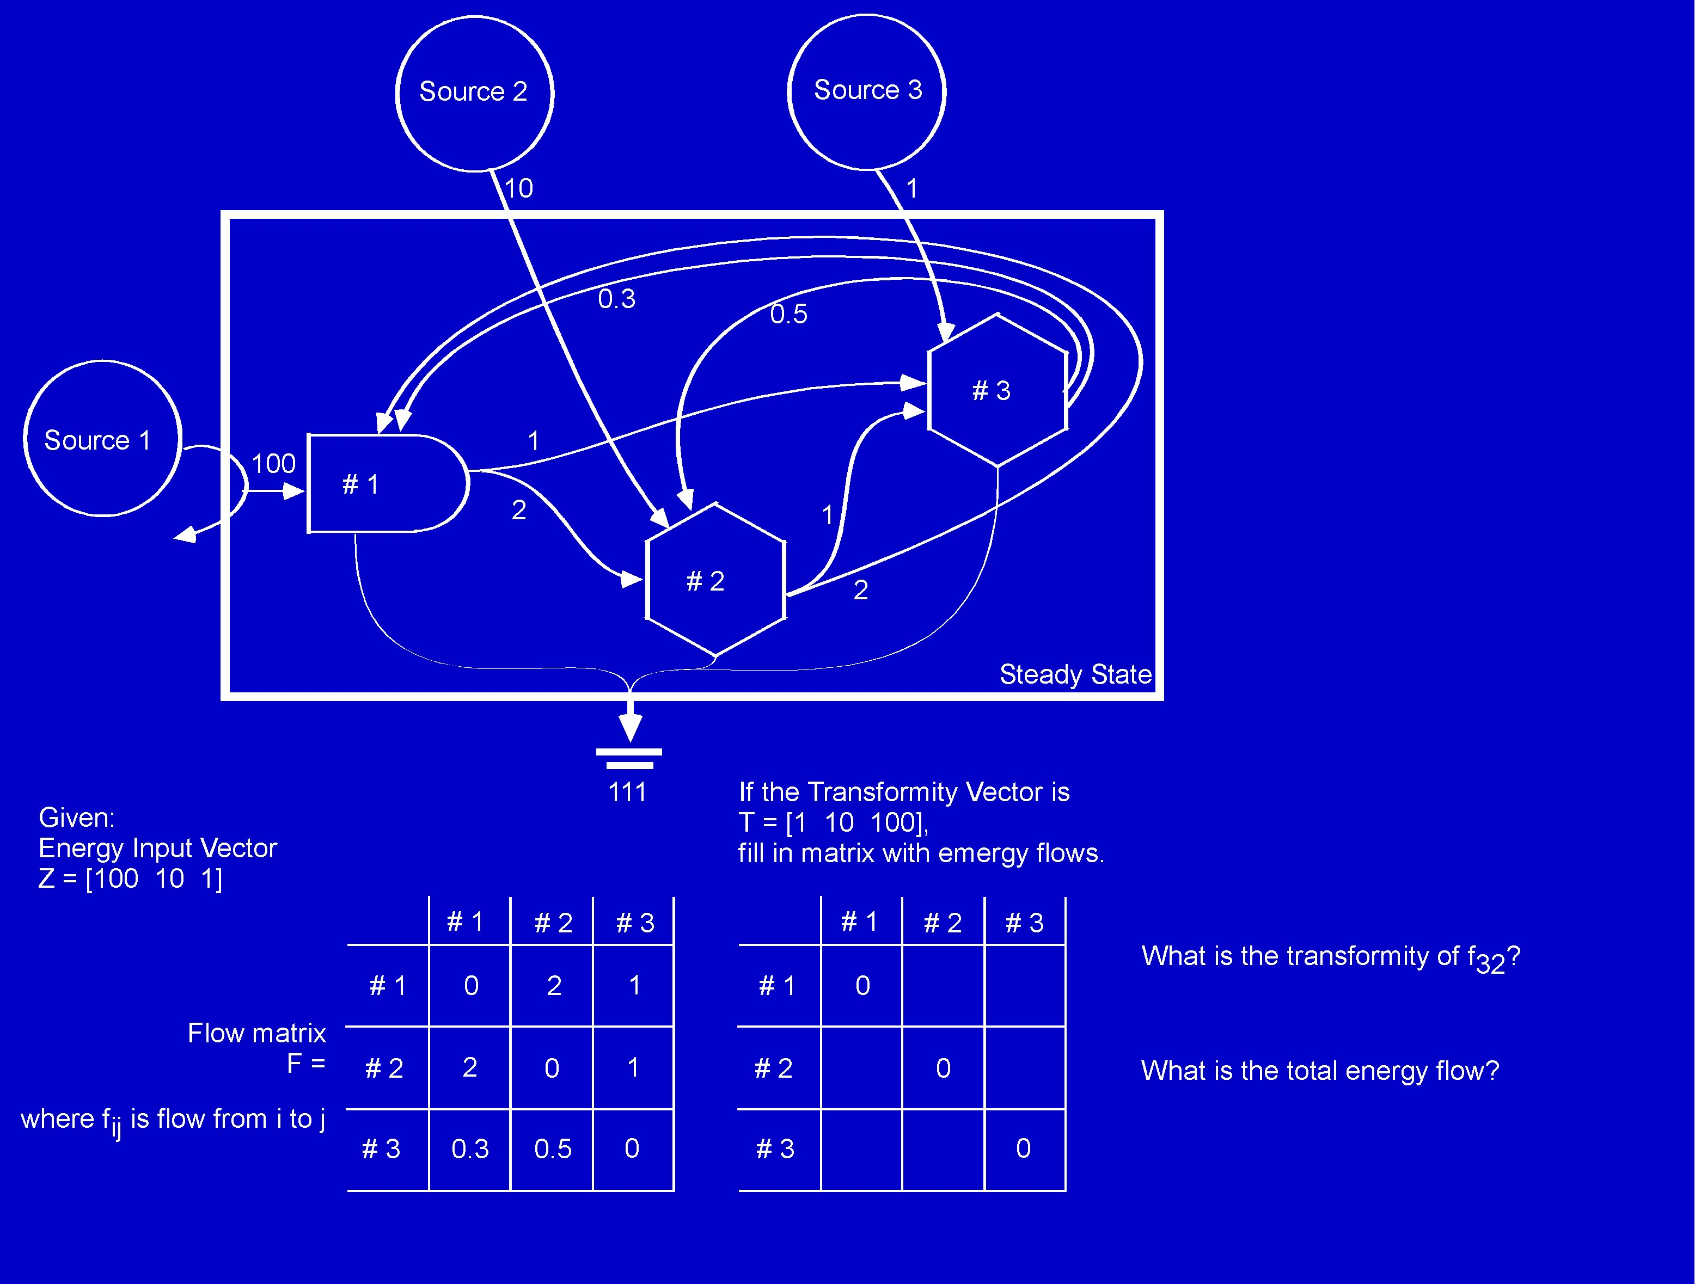
Notes:
Questions? Send an email.

