Slide 1
OSHA’s Alliance With the Airlines Industry
Lee Anne Jillings
Director, Office of Outreach Services and Alliances
Occupational Safety and Health Administration
June 4, 2003

Slide 2
OSHA Programs
What is an OSHA Alliance?
Program created by OSHA to enable organizations committed to safety and health to collaborate with OSHA to prevent injuries.
Alliance
Partnerships
VPP

Slide 3
Alliances
Agreements established at the National,
Regional or Area office level
Goals focus on:
  Training and education
  Outreach and communication
  Promoting the national dialogue
Customized implementation teams
Two-year, renewable
Quarterly update meetings or conference calls

Slide 4
Benefits of an Alliance
Build cooperative and trusting relationship with OSHA
Network with other organizations committed to workplace safety and health
Leverage resources to maximize worker protection

Slide 5
Current OSHA Alliances
OSHA currently has 27 National Alliances and
14 Ergonomic-Specific Alliances, including the Airlines Industry Alliance

Slide 6
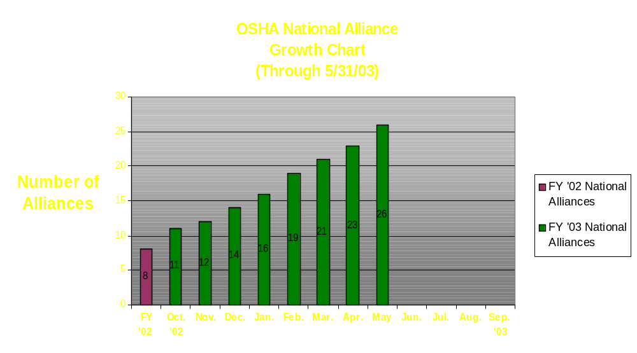
National Alliances

Slide 7
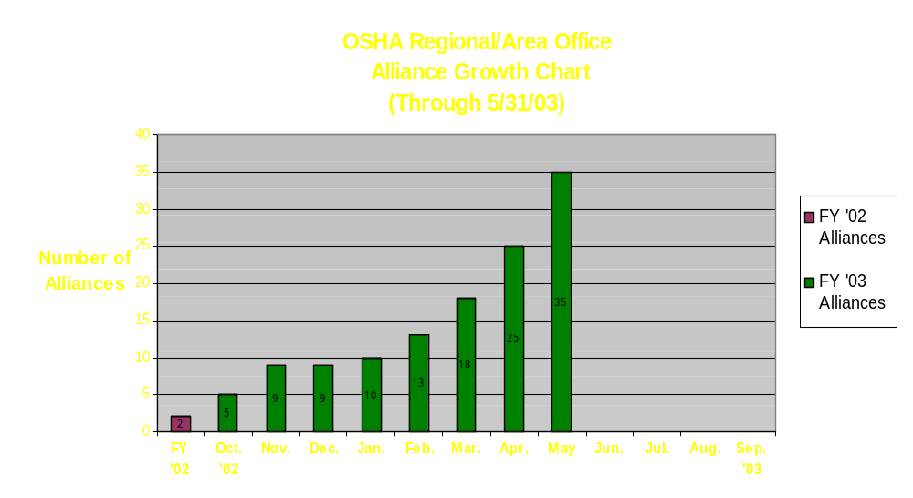
Regional Alliances

Slide 8
Some Working Alliances
The Dow Chemical Company
American Biological Safety Association
Society of the Plastics Industry
Independent Electrical Contractors, Inc.
National Association of Shooting Ranges & Sporting Arms & Ammunition Manufacturers Institute
International Mass Retailers Association
Washington Group International

Slide 9
New Alliances
Sealant Waterproofing & Restoration Institute
Air Conditioning Contractors of America
American Association of Occupational Health Nurses
National Hearing Conservation Association
American Apparel and Footwear Association
Tree Care Industry Association

Slide 10
Pending Alliances
Clark Construction
National Lumber and Building Materials Dealers Association
American Shipbuilding Association
National Shipbuilding Research Program
National Electrical Contractors Association

Slide 11
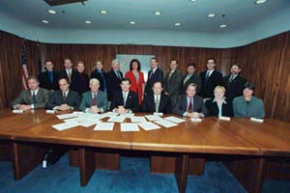
Airline Alliance Members
Signed November 12, 2002
Air Canada
Airtran Airways
Alaska Airlines
American Airlines
American Trans Air
America West Airlines
Continental Airlines
Delta Air Lines
Jetblue Airways
Midwest Express Airlines
Southwest Airlines
United Airlines
US Airways
NSC International Air Transport Section

Slide 12
Airlines Alliance Vision
Year 1
  Define strategy and best practices
  Educate and communicate process with interested parties
  Share successes with others
    VPP Conference
    NSC Congress

Slide 13
Airlines Alliance Vision
Year 2
  Reaffirm membership
  Review past year and identify specific projects and goals for upcoming year
  Involve interested parties
  Expand awareness of the Alliance world-wide

Slide 14
Airlines Alliance Vision
Future
  Continually re-evaluate and prioritize
  Identify additional safety and health issues to address in the airlines industry
  Continuous improvement

Slide 15
Alliance Action Items
Training and Education
  Develop a body mechanics training module
  for employees handling checked baggage

Slide 16
Alliance Action Items
Outreach and Communication
Review and provide input on way to improve OSHA’s baggage handling eTool
-On-site visits in January and April 2003
Hold a one-day seminar on OSHA’s VPP process
-June 4, 2003, Delta Airlines, Atlanta, Georgia
Sponsor a workshop on the Alliance program
-National Safety Council Congress, September 10, 2003,
      Chicago, IL
-Review the Alliance’s first year for OSHA’s National Office

Slide 17
Alliance Action Items
Promote the National Dialogue on Workplace Safety and Health
Educate interested parties on the ergonomics of baggage handling
    -Shared baggage handling eTool draft with interested parties in April 2003

Slide 18
Alliance Timeline – Year 1
November 12, 2002 - Signed
  OSHA, Washington, DC
December 18, 2002 - Kick-off Meeting
  OSHA, Washington, DC
January 27 & 28, 2003 - Workshop
  OSHA Salt Lake Technical Center, Salt Lake City, UT
April 28 & 28, 2003 - Workshop
  OSHA Salt Lake Technical Center, Salt Lake City, UT
June 4, 2003 - VPP Presentation
  Delta Airlines, Atlanta, GA
September 10, 2003 - NSC Presentation/Panel Discussion
  National Safety Council Congress, Chicago, IL
October 2003 - Group Performance Appraisal

Slide 19
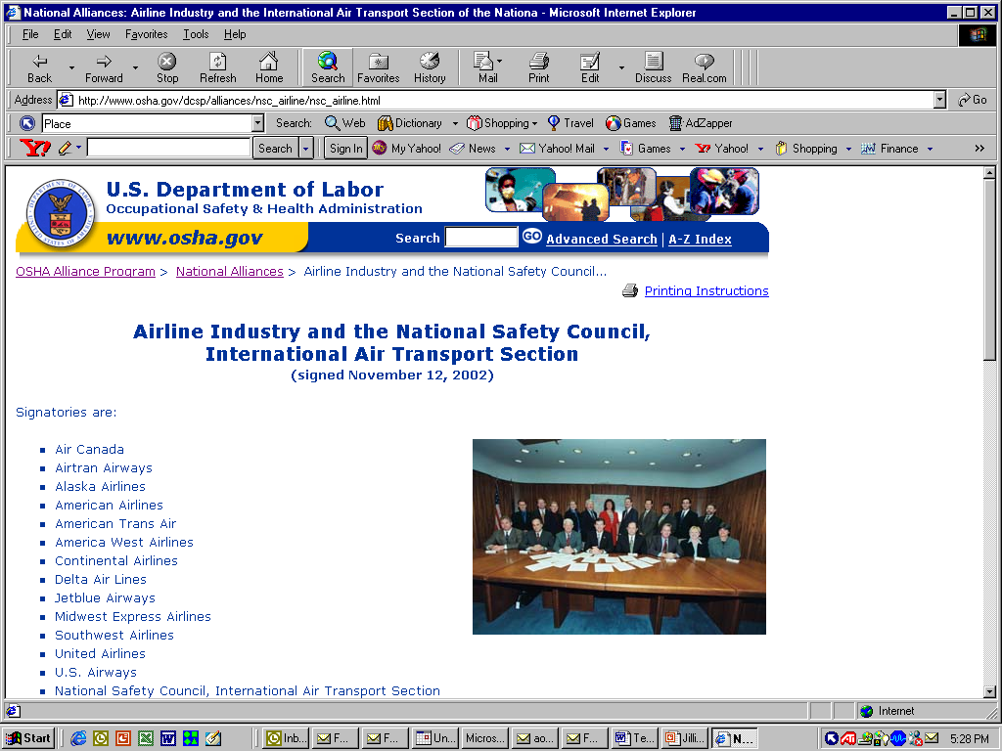

Slide 20
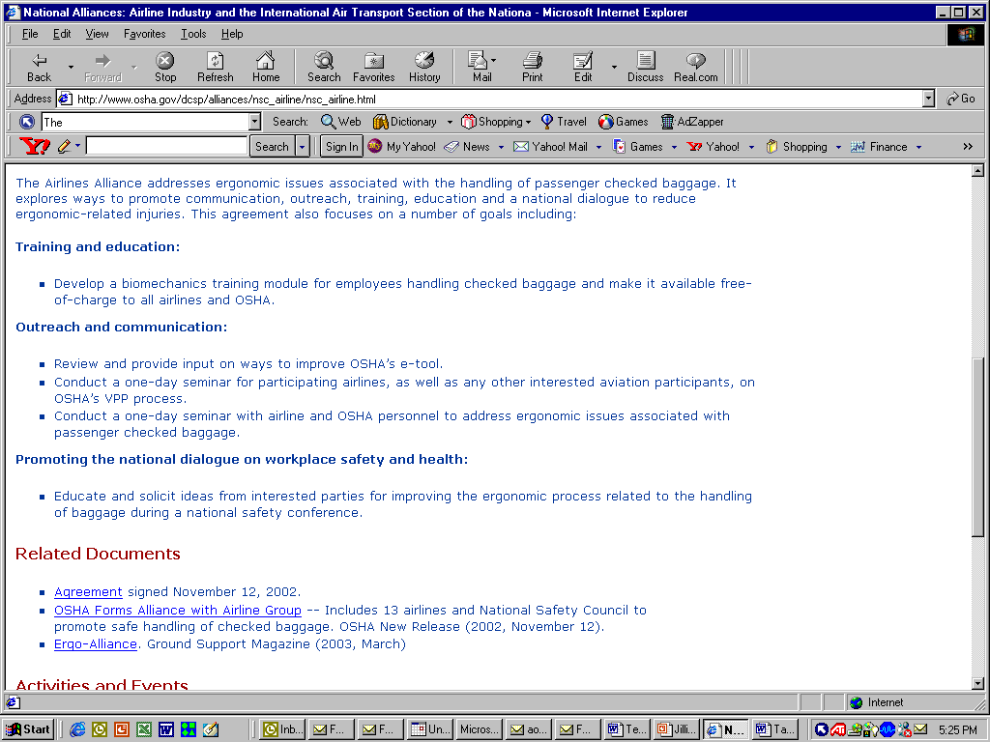

Slide 21
