Slide 1

Implementing E.O. 13423: Opportunities for Industrial Materials Recycling
Federal Environmental Symposium
June 4, 2007
Nicole Villamizar
U.S. EPA, Office of Solid Waste

Slide 2
Overview
What are industrial materials, and why should they be recycled?
What is EPA’s Industrial Materials Recycling (IMR) Program?
How can IMR help federal agencies comply E.O. 13423?
Case Studies & additional resources
Summary points

Slide 3
What are industrial materials, and why should they be recycled?
Industrial materials are the byproducts of industrial processes
  Examples: Coal ash, slag, silica fume, spent foundry sand, and construction and demolition (C&D) materials
U.S. produces over half a billion tons annually
Industrial materials have chemical and physical properties similar to virgin materials

Slide 4
What are industrial materials, and why should they be recycled?
Environmental and economic benefits:
  Preserves natural resources
  Saves energy and reduces GHG emissions
  Reduces disposal costs for generators & material cost for end users
  Keeps valuable materials out of landfills
Performance benefits:
  Coal ash (in replacement of cement) can improve the strength and durability of concrete
For buildings, earns LEED credits

Slide 5
What is EPA’s Industrial Materials Recycling (IMR) Program?
Increasing the recycling and beneficial use of industrial materials is a priority of EPA’s Resource Conservation Challenge (RCC)
The IMR Program was formed to develop and implement strategies to achieve the RCC goals for industrial materials recycling

Slide 6
What is EPA’s IMR Program? (cont’d…)
EPA is currently focusing on 3 industrial material streams:
  Coal combustion products
  C&D materials
  Spent foundry sand

Slide 7
What is EPA’s IMR Program?
(cont’d…)
Material | Can be recycled in:
Coal Combustion Products | -Portland cement and concrete -Flowable and structural fill -Agricultural uses
C&D materials | -Asphalt paving -Concrete -Re-milled lumber
Foundry sand | -Road embankments -Agricultural uses

Slide 8
What is EPA’s IMR Program?
(cont’d…)
Why focus on these three material streams?
  Existing markets
  Large volumes
  Improvable recycling rates
IMR Program focus may expand to include other industrial materials
  (e.g., slag, scrap tires, silica fume, pulp from paper mills.)

Slide 9
What is EPA’s IMR Program?
(cont’d…)
Initiatives include:
  Coal Combustion Products Partnership (C2P2)
  Recycling C&D materials
  Recycling spent foundry sand
  Construction Initiative
For more information, visit the IMR Program website: www.epa.gov/oswer/osw/conserve/priorities/bene- use.htm

Slide 10
How can industrial materials
recycling help your agency comply
with E.O. 13423?
(Why you are here)

Slide 11
Sec. 2 (f) of the E.O.: “Ensure that new construction and major renovation of agency buildings comply with the Federal Leadership in High Performance and Sustainable Buildings MOU (2006)”
Part (V) of this MOU: Reduce environmental impact of materials
  Purchase products with recycled content
  Salvage or recycle 50% of C&D materials

Slide 12
  “Recycled Content: For EPA-designated products, use products meeting or exceeding EPA’s recycled content recommendations…”
  -Part V of the Federal Leadership in High Performance and Sustainable Buildings MOU

Slide 13
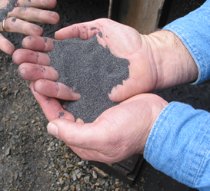



How can industrial materials recycling help your agency comply with E.O. 13423?
Recycled-content construction products
EPA recommends the use of coal fly ash, ground-granulated-blast-furnace-slag (GGBF), cenospheres, or silica fume in cement and concrete products

Slide 14
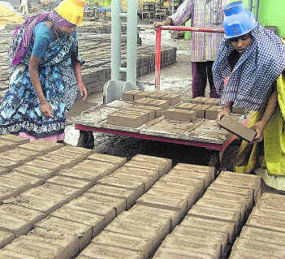
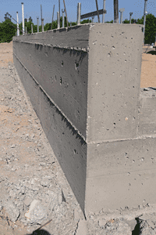
Why use construction products containing recycled industrial materials?
Improves the strength and durability of concrete and bricks
Earns LEED points in the materials and resources category
Reduces the environmental impact of construction

Slide 15
Cement Specifications | Concrete Specifications
ASTM C 595,"Standard Specification for Blended Hydraulic Cements.” | ASTM C 618, "Standard Specification for Fly Ash and Raw or Calcined Natural Pozzolan for Use as a Mineral Admixture in Portland Cement Concrete."
ASTM C 150, "Standard Specification for Portland Cement." | ASTM C 311, "Standard Methods of Sampling and Testing Fly Ash and Natural Pozzolans for Use as a Mineral Admixture in Portland Cement Concrete."
AASHTO M 240, "Blended Hydraulic Cements." | ASTM C 989, "Ground Granulated Blast-Furnace Slag for Use in Concrete Mortars.“
Source: Comprehensive Procurement Guidelines: Cement and Concrete Specifications. www.epa.gov/cpg/products/cemspecs.htm

Slide 16
“Construction Waste: During a project’s planning stage, identify local recycling and salvage operations that could process site-related waste. Program the design to recycle or salvage at least 50 percent of construction, demolition and land-clearing waste...”
-Part V of the Federal Leadership in High Performance and Sustainable Buildings MOU

Slide 17
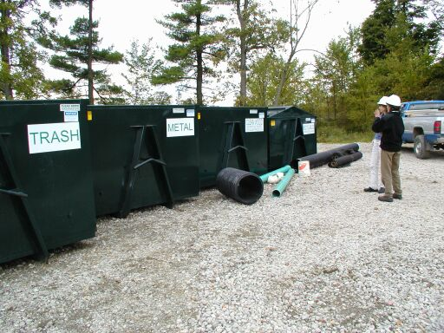
How can industrial materials recycling help your agency comply with E.O. 13423?
C&D waste diversion and recycling
EPA’s IMR program can:
  Help you identify local C&D recyclers
  Provide you with case studies and model contract language
  Assist in waste reduction opportunities

Slide 18
So, is anybody else doing it?
(Yes!)

Slide 19
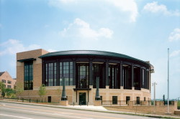
Case Study 1
Jones Federal Building and Courthouse
70%+ construction materials recycled
Soil, concrete reused for site grading
60% of materials used (by cost) were sourced or manufactured locally
Youngstown, OH. Photo credit: Peter Aaron/ESTO

Slide 20
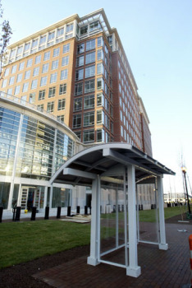
Case Study 2
EPA Potomac Yards Building
LEED Gold certified
70%+ construction waste recycled
27% of the materials contained recycled content
63% of the materials were manufactured regionally
Arlington, VA
Source: USGBC case study

Slide 21

Case Study 3
Ronald Reagan Building & International Trade Center
Largest building in Washington, DC
Concrete contains 25% coal fly ash
Recycled content: steel, aluminum, gypsum wallboard

Slide 22
Summary Points
Industrial materials can help your agency comply with EO 13423
  Recycled-content construction products
  C&D waste diversion and recycling
Earns LEED credits (materials & resources)
EPA’s IMR Program staff can offer agencies technical assistance & connect you with experts in the field
  Industrial Resources Council (Coal ash, slag, foundry sand, scrap tire, C&D recycling industries)

Slide 23
For More Information:
Using coal ash in building construction: www.epa.gov/epaoswer/osw/conserve/c2p2/use/buil d.htm
CPGs: Cement and Concrete www.epa.gov/cpg/products/cement.htm
Federal Green Construction Guide for Specifiers: www.wbdg.org/design/greenspec.php
Recycling C&D materials: www.epa.gov/epaoswer/non-hw/debris- new/index.htm

Slide 24

Questions?
Thank you!
Nicole Villamizar
Villamizar.Nicole@epa.gov
Tel: (703) 347-8952

