Slide 1


Green Procurement Overview and Green Contracts Exercise
Beth Martin
US Army Center for Health Promotion
and Preventive Medicine
Aberdeen Proving Ground, Maryland
Beth.a.martin@us.army.mil
410-436-5202
USACHPPM - Readiness thru Health
USACHPPM - Readiness thru Health

Slide 2
What do we mean by
“Green Procurement”?
Showing preference for purchasing products that are:
  Made with Recycled Content
  Biobased
  Environmentally Preferable
  Energy Efficient or Water Efficient
  Renewable Energy Sources
  Alternative Fuels or Vehicles
  Lacking in Ozone-Depleting Substances (ODS)
  Lacking in Priority Chemicals
  EPEAT-Registered Electronics

Slide 3
DOD Green Procurement
Policy and Strategy
August 27, 2004
Formally Establishes DOD Green Procurement Program (GPP)
Requires that green products and services be considered as first choice for all procurements
Assigns responsibility to virtually every DOD employee; notes need for GPP awareness training
Requires implementation at organizational level where initial purchasing requirements are defined
Requires documentation of objectives, targets, and actions in an installation-level plan
Uses the EMS framework for implementation

Slide 4

Product Designations
EPA’s “Buy Recycled” Program
  Products designated since 1995
  Currently 61 designated products
USDA’s “BioPreferred” Program
  Six items designated March 06
  20 more proposed August 06

Slide 5
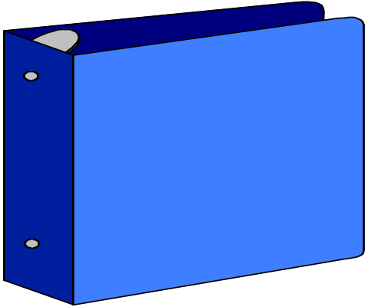
The Comprehensive Procurement Guidelines (CPGs) and Recovered Materials Advisory Notices (RMANs)
CPGs list the products that must contain recovered material
RMANs provide minimum recovered material standards in the form of recycled-content ranges
CPG:
What
Products
To Buy
RMAN:
Recycled
Content
Levels

Slide 6

EPA-Designated Products Under the Buy Recycled Program
Product Categories:
Construction
Landscaping
Non-paper Office Products
Paper and Paper Products
Parks and Recreation
Transportation
Vehicular
Miscellaneous
Notes:
These are the 8 categories of designated products under the Buy Recycled Program. You can see there is a wide range of products designated – this means there are many purchasers and contract specialists on an installation who must implement these requirements.

Slide 7



CONSTRUCTION PRODUCTS
DESIGNATED ITEMS:
Building insulation
Carpet
Cement and concrete
Consolidated and reprocessed latex paint
Floor tiles
Laminated paperboard
Patio blocks
Shower and restroom dividers
Structural fiberboard
Carpet cushion
Flowable fill
Railroad grade crossings/surfaces
Modular Threshold Ramps
Nonpressure Pipe
Roofing Materials
Notes:
Under the construction products category, these are the designated products. When renovating or constructing anything on post, these products should be purchased with recycled material. This applies to both in-house and contracted construction projects.

Slide 8

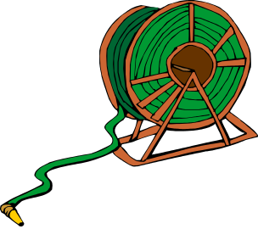

LANDSCAPING PRODUCTS
DESIGNATED ITEMS:
Garden and soaker hoses
Hydraulic mulch
Lawn and garden edging
Yard trimmings compost
Food waste compost
Landscaping timbers and posts (plastic lumber)
Notes:
These are the landscaping CPGs – of particular importance to DPW Roads and Grounds and golf course maintenance personnel.

Slide 9

NON-PAPER OFFICE PRODUCTS
DESIGNATED ITEMS:
Binders (paper, plastic covered)
Office recycling containers
Office waste receptacles
Plastic desktop accessories
Plastic envelopes
Plastic trash bags
Printer ribbons
Toner cartridges
Office furniture
Solid plastic binders
Plastic clipboards
Plastic clip portfolios
Plastic file folders
Plastic presentation folders
Notes:
Many of our office products are purchased with credit cards. When purchasing these designated items, you should make sure they all contain recovered materials.

Slide 10

PAPER AND PAPER PRODUCTS
DESIGNATED ITEMS:
Commercial/industrial sanitary tissue products
Miscellaneous papers
Newsprint
Paperboard and packaging products
Printing and writing papers
Notes:
Under the paper category, these are the EPA-designated items. Note that the category includes the papers typically used in janitorial contracts – restroom tissue and paper towels.

Slide 11


PARK AND RECREATION PRODUCTS
DESIGNATED ITEMS:
Plastic fencing
Playground surfaces
Running tracks
Park and recreational furniture
Playground equipment
Notes:
Many of these recreational products can be made with recycled material. For example, the rubber from used tires is often used to make running track or playground surfaces.

Slide 12


TRANSPORTATION PRODUCTS
DESIGNATED ITEMS:
Channelizers
Delineators
Flexible delineators
Parking stops
Traffic barricades
Traffic cones
Notes:
You may not know what channelizers are, but if you use these transportation products, they should be purchased with recycled material content.
(Channelizers are used to direct traffic around obstacles or work areas. They are usually orange and white and look like large plastic drums on the highway).

Slide 13
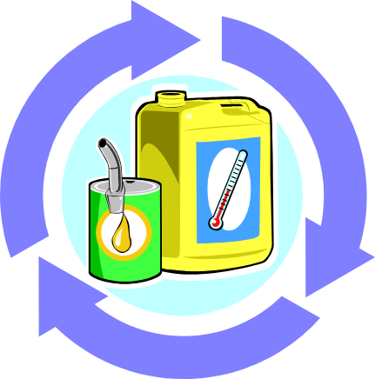
VEHICULAR PRODUCTS
DESIGNATED ITEMS:
Engine coolants
Re-refined lubricating oils
Retread tires
Rebuilt vehicle parts
Notes:
The vehicular products are commonly used in our motor pools and other maintenance areas. They are important because these items are at the top of the EPA inspector’s checklist. The EPA has identified motor pools as the first target in their multimedia inspections.

Slide 14



MISCELLANEOUS PRODUCTS
DESIGNATED ITEMS:
Pallets
Sorbents
Awards and plaques
Industrial drums
Mats
Signage, including supports
Strapping and stretch wrap
Bike racks
Blasting grit
Notes:
Under the miscellaneous category, these items have been designated.

Slide 15


Designated Biobased Items
16 March 06, 7 CFR Part 2902, Designation of Biobased Items for Federal Procurement, Final Rule
The six designated items are:
  mobile equipment hydraulic fluids
  urethane roof coatings
  water tank coatings
  diesel fuel additives
  penetrating lubricants
  bedding, linens, and towels
Notes:
In March 2006, the USDA designated the first six biobased items for federal agency affirmative procurement programs. The six items are listed here. Two items, water tank coatings and bedding/linens/towels, have the effective date for implementation deferred. That’s because those items are currently only available from a single source, and USDA is waiting for more manufacturers to make these biobased products before making their purchase mandatory.

Slide 16
Exercise
You’ve been assigned to review or assist in developing a contract. Your job is to incorporate products or design features that will “green” the contract.
List products or services in the first column. Check other columns or explain briefly what attributes you will specify for that product or service.

Slide 17


Example:
Construct Running Trail
Product/ Service | Recycled Content | Environmentally Preferable | Other

Slide 18
Example:
Construct Running Trail
Product/ Service | Recycled Content | Environmentally Preferable | Other
Running Surface

Slide 19
Example:
Construct Running Trail
Product/ Service | Recycled Content | Environmentally Preferable | Other
Running Surface | Recycled Rubber | Natural soil or wood chips | Avoid disturbance of wetlands and habitat

Slide 20


USACHPPM GPP Services
Training – EQCC Briefings, full and half day seminars, tailored classes for various audiences
Developing GPP Plans
GPP Audits
Green Procurement Training
GP Plan

