Slide 1
Argonne National Laboratory
Sustainable Design
Lessons Learned
Building 46
Central Supply Facility
Presentation to the Office of Science
October 24, 2002

Slide 2
Argonne National Laboratory
Sustainable Design Regulatory Drivers
DOE 413.3 Program and Project Management for the Acquisition of Capital Assets
  “Sustainable Design Principles must be applied to the siting, design, and construction of new facilities”

Slide 3
Argonne National Laboratory
Sustainable Design Regulatory Drivers
Executive Order 13101: Greening the Government Through Waste Prevention, Recycling, and Federal Acquisition
  Promotes environmentally preferable purchasing and requires recycled content construction products.

Slide 4
Argonne National Laboratory
Sustainable Design Policies and Procedures
PFS/Facilities Engineering and Construction Sustainable Design Policy Statement
  “FEC will demonstrate a commitment to sustainable design on all projects by striving to upgrade existing facilities and design new facilities to be as resource efficient and pollution free as possible.”

Slide 5
Argonne National Laboratory
Sustainable Design Incentives
Reduce operating costs
Conserve resources
Reduce environmental impact
Community Outreach
Environmental stewardship

Slide 6
Argonne National Laboratory
LEEDs Projects
Central Supply Facility – Received LEED 2.0 Silver rating
Rare Isotope Accelerator (RIA) Illinois Science Center (ISC)
Center for Nanoscale Materials (CNM)

Slide 7
Argonne National Laboratory
Central Supply Facility Case History
1993 – First submission of CDR for 35000sf facility
1998 - Reduced necessary square footage to 25000 through just in time delivery and other operational improvements
1999 – Received approval and Congressional funding to proceed – revised design from stand alone facility to building addition. Reduced footprint to 19000sf by utilizing existing support facilities.

Slide 8
Argonne National Laboratory
Central Supply Facility Case History
2001 –Recognized with the White House Closing the Circle Award for Environmental Preferability
2002 – Received LEED 2.0 Silver rating

Slide 9
Argonne National Laboratory
Central Supply Facility Case History
Project Performance
  20% reduction in electric energy use
  30% reduction in natural gas
  55 tons per year avoided ghg emissions

Slide 10
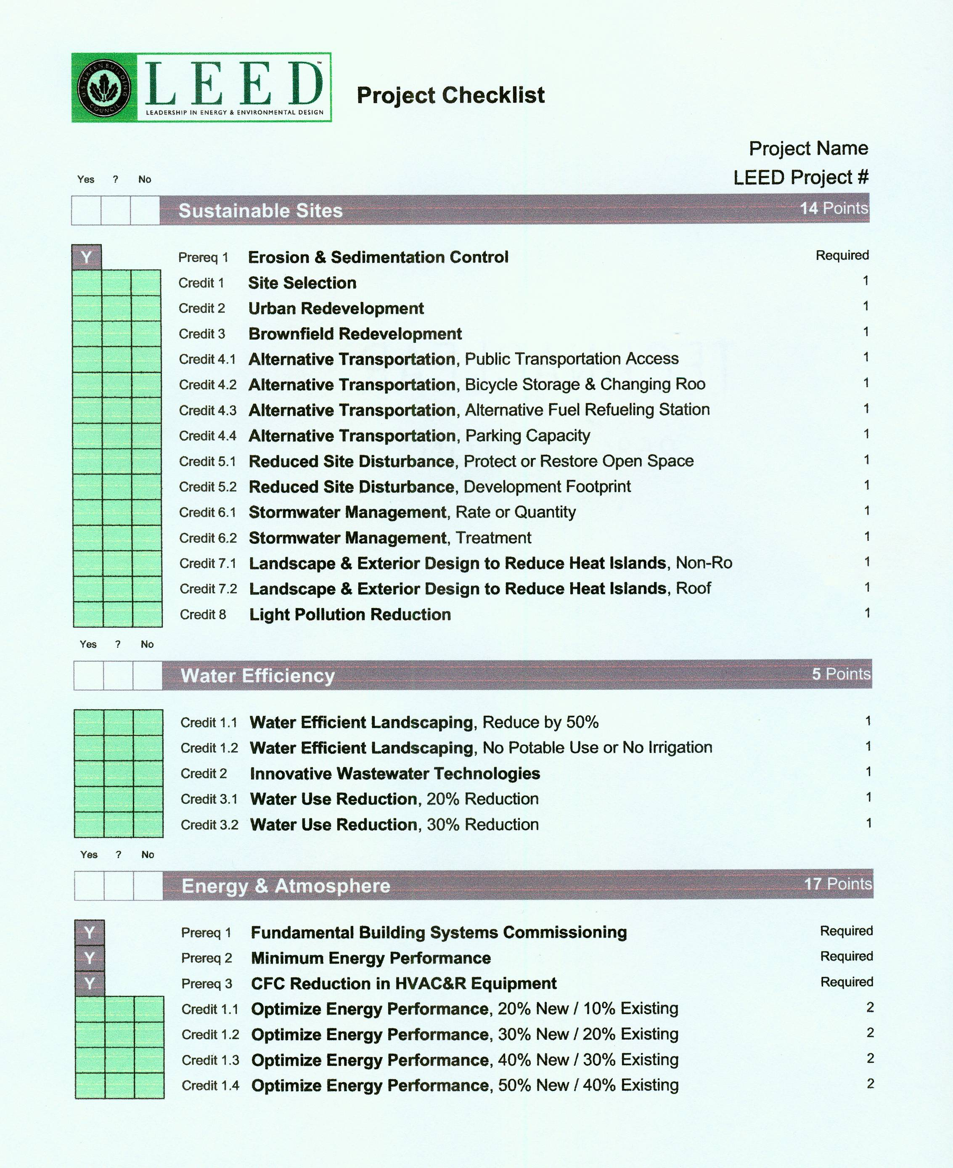
Argonne National Laboratory
LEED Checklist
The LEED Checklist
  Sustainable Sites
  Water Efficiency
  Energy & Atmosphere
  Materials & Resources
  Indoor Environmental Quality
  Innovation & Design Process

Slide 11
Argonne National Laboratory
Central Supply Facility Sustainable Features
Fly ash aggregate in concrete
Recycled concrete block
Pulverized and reused existing gravel asphalt and sub-base
Reuse of excavated soil
Recycled concrete curbs
Native trees
Native grass seed
Roof drainage into existing wetland
Recycled structural steel
Recycled sustainable lumber
Natural Linoleum floor
Recycled carpet

Slide 12
Argonne National Laboratory
Central Supply Facility Sustainable Features
White roof
Low VOC and Lead free paint
Recycled content ceiling tiles
Recycled Plastic toilet partitions
Recycled content gypsum board
High performance optimum location windows
Clerestory glazing
Energy efficient mechanical and electrical systems
Construction site recycling
Building commissioning

Slide 13
Argonne National Laboratory
Central Supply Facility LEED Associated costs
Consultants and commissioning $75,000
A/E effort additional options $10,000
Construction $45,000
LEED application effort $38,000
Total $168,000
        2.85% of TEC

Slide 14
Argonne National Laboratory
Sustainable Design Lessons Learned
FEC Professional Facilities Staff must be active participants (not recipients)
Expand current Design Review activities (technical) over a larger population for optimum benefit
Initiate Process EARLY

Slide 15
Argonne National Laboratory
Sustainable Design Lessons Learned
Educate building occupants
Document, Document, Document
Develop on staff trained professionals for LEED process.
Implementation plan to dovetail experience form one project to the next

Slide 16
Argonne National Laboratory
Sustainable Design Information
http://p2.pfs.anl.gov/sustainable_design.htm
Contacts:
  Karen Hellman, Manager Facilities Engineering and Construction Department (630)252-7808, khellman@anl.gov
  Keith Trychta, Pollution Prevention Coordinator,(630)252-1476, ktrychta@anl.gov

