Slide 1

Notice: The views expressed here are those of the individual authors and may not necessarily reflect the views and policies of the United States Environmental Protection Agency (EPA). Scientists in EPA have prepared the EPA sections, and those sections have been reviewed in accordance with EPA’s peer and administrative review policies and approved for presentation and publication. The EPA contributed funding to the construction of this website but is not responsible for it's contents. Mention of trade names or commercial products does not constitute endorsement or recommendation for use.

Slide 2

Vulnerability of Mid-Atlantic Forested Watersheds to Timber Harvest Disturbance
Rex H. Schaberg
Nicholas School of the Environment and Earth Sciences, Duke University
Robert C. Abt
Department of Forestry, North Carolina State University

Slide 3
Objectives
Describe a simulation using the Subregional Timber Supply (SRTS) model
    Prior: developed SE; extended NE
    Current: recalibrated to MA watersheds
  Explore relative likelihood of harvests among HUC 6 watersheds
  Relate to potentially sensitive ecological areas (e.g., aquatic biodiversity “hotspots”)
Consider related land-use impacts
  planted pine plantations
  urbanization
Focus on results, rather than models and methods

Slide 4
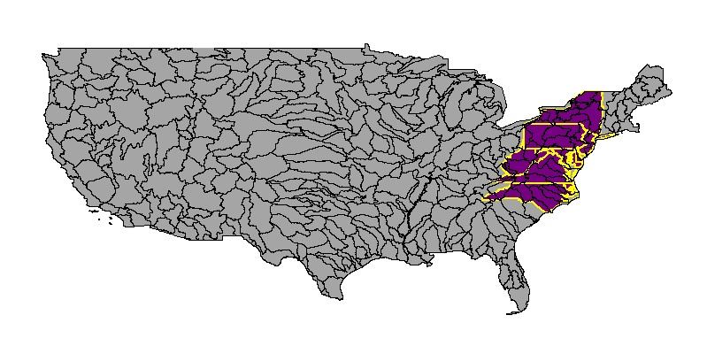
Watershed Based Analysis
USGS Hydrological classification
We consider 41 HUC6 watersheds
Within 8 Mid-Atlantic States
Over a 28 year period 1998 - 2025

Slide 5
Role of Economic Resource Models in Ecological Assessment
Provide a relatively robust vector to drive implicit future trade-offs among ecological benefits
Forest cover in watersheds is highly correlated with many important ecological functions
  Commodity production may compete
    Economic models can help locate and quantify potential conflicts
    SCALE of analysis is necessarily COURSE
Triage: In conjunction with GIS snapshots: (econ.) can suggest and (GIS) verify existence of likely stressors
  Target monitoring and intervention to areas identified as critical by policymakers

Slide 6
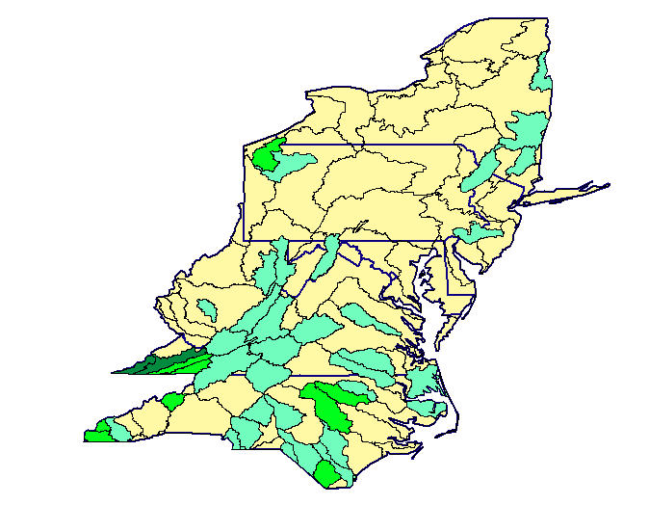

Mid-Atlantic Aquatic Diversity “Hotspots”
15% of USGS Huc8 watersheds (327) identified as aquatic “hotspots” for biodiversity preservation
47 (14%) are within the Mid-Atlantic 8 state region
Species of Conservation Concern
NatureServe; Masters et al. 1998

Slide 7
Land-Use Legacy and Forest Extent
Forests converted to agriculture, harvested (catastrophic fire, erosion)
  Percent ecosystem converted or degraded (~ 200 yrs.)
    Appalachian/Blue Ridge 83%
    Appalachian Mixed Mesophytic: 95%
    Southeastern Mixed: 99%
MA forests in recovery throughout last century
Private Forest 77.8 MM acres in 8 MA states (1982)
Fed. land, 7.2 MM acres: much in forest
Forests (esp. hardwood) now at economic maturity
  Harvest levels increasing (demand; supply decline PNW)
  New market applications: chip mills, oriented strand board
  Private forests were 55% of the MA land area in 1982

Slide 8
Timber Availability, Data, Models
Demand for developed land
  Decision variable: Most lucrative land use
    Timber as byproduct of land conversion
  Byproduct => not subregional timber economics
    Not modeled in SRTS
    USDA Natural Resource Inventory (NRI) data
Market demand for wood products
  Furniture, lumber, pallets, pulp mills, OSB, chip mills
  USDA Forest Service: forest inventory and analysis (FIA) data
    Harvests, growth, inventory
  SubRegional Timber Supply (SRTS) Model

Slide 9
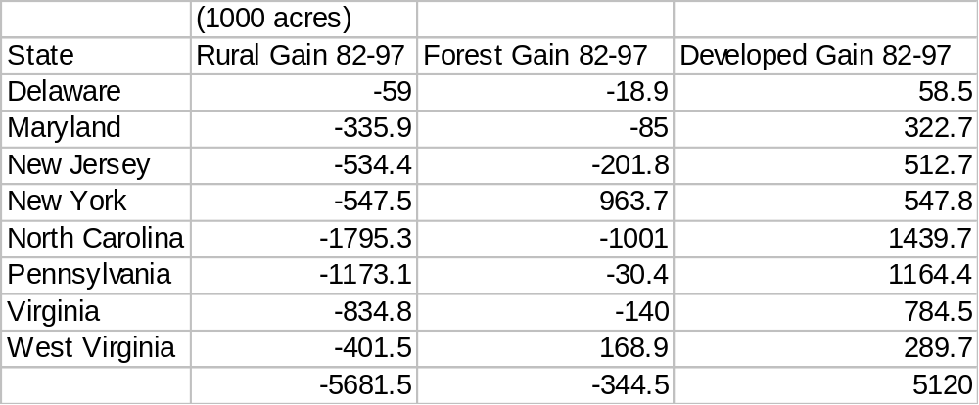
Mid-Atlantic Land Use Trends
NRI 1997
All Mid-Atlantic states becoming less rural
All MA rural areas becoming proportionally more forested
Trends in forest extent are highly variable (e.g., NC,NY)

Slide 10
SubRegional Timber Supply (SRTS) Model
Present Analysis (1998–2025) initial assumptions:
  Timber demand assumed constant
  Timber land acres held constant
  Pine plantation acres constant, productivity increased
    Industry > 50% by 2025 Private > 30% by 2025
  FIA data converted to HUC 6 watersheds
Objective: characterize relative economic vulnerability
  Possible to fine tune with sensitivity analysis

Slide 11
Mid-Atlantic Harvest Summary
Hardwoods predominate, except in NC, VA Coastal Plain region
Total 28 yr. harvest of 30.7 MM acres
  Equivalent of 44% of 70.2 MM timberland acres
    Will include some multiple harvests on some acres
Annual harvest of 1.56% of timberland/year
Regional forest timber rotation: 64 yrs.

Slide 12
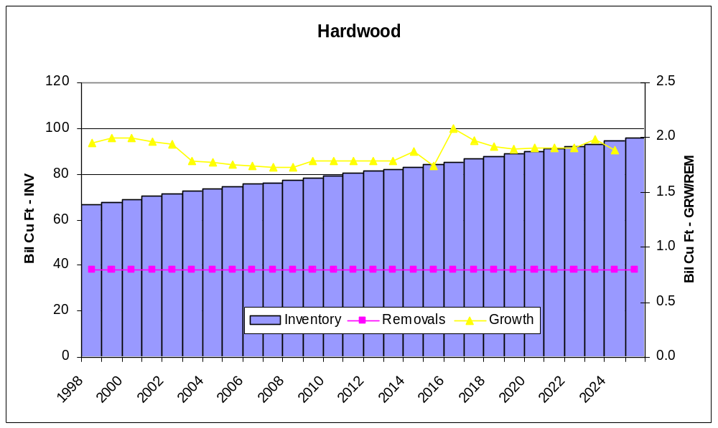
Mid-Atlantic Hardwood Timber: Inventory, Growth, and Removals

Slide 13
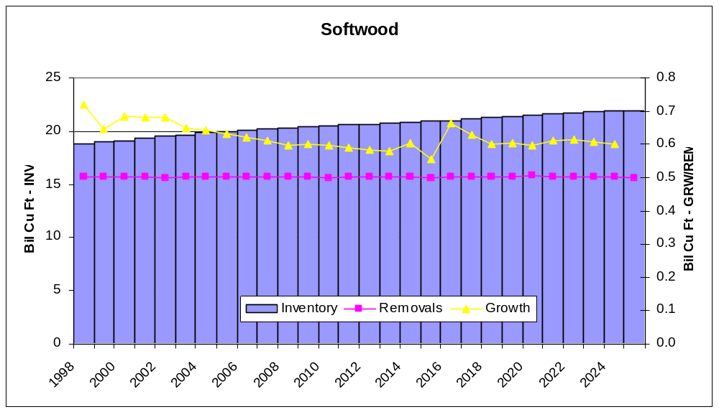
Mid-Atlantic Softwood Timber: Inventory, Growth, and Removals

Slide 14
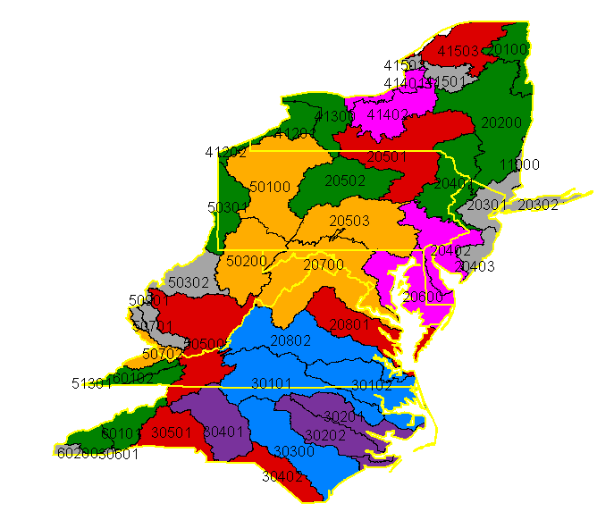

Mid-Atlantic Harvest Extent
Harvest Acres
1998 - 2025

Slide 15
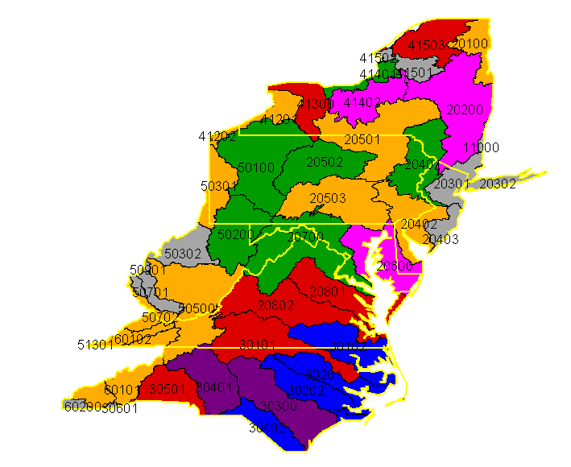

Mid-Atlantic Harvest Intensity
Cumulative Harvest as a Percent of Forest
1998 - 2025

Slide 16
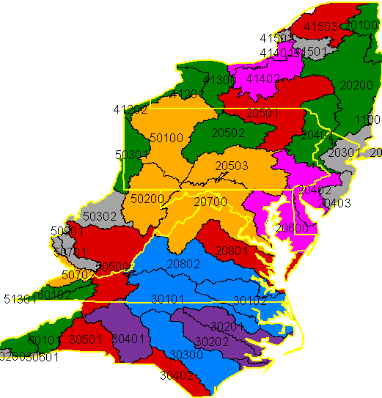
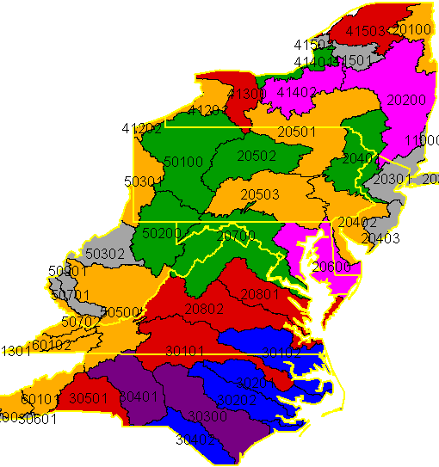
Mid-Atlantic Harvest:
Comparative Patterns of Extent and Intensity
Extent
Percent

Slide 17
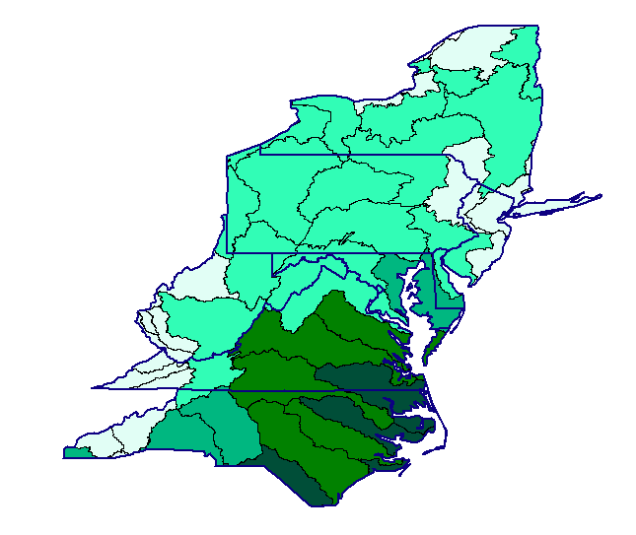

Pine Plantation Extent
Percent of watershed forest currently in plantation pine
Regional extent of pine plantations:
  6.53% of forest
Intensive management
High disturbance
    Relative frequency
    Intensity
High productivity
Reduce pressure elsewhere

Slide 18
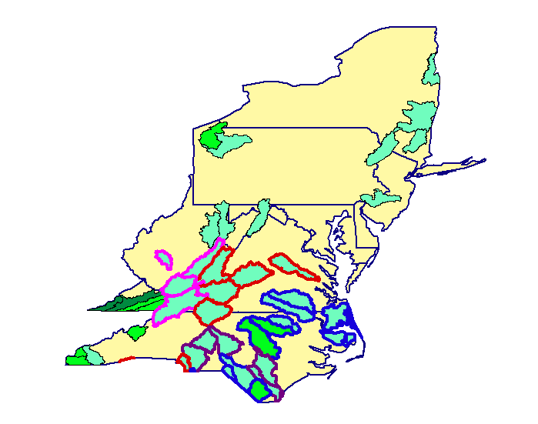

Linking Aquatic Biological “Hotspots” With Harvest Trends
USGS HUC 8 of
conservation concern
Percent of watershed acres
affected by harvest
Harvest
(1998 – 2025)
greater than 1MM ac.
OR Forest area % impact
  Greater than 50%
Displayed by harvest intensity
Species of Conservation Concern

Slide 19
Summary and Conclusions
SRTS doesn’t predict harvest, does predict where given harvests are likely to occur
Southern MA (e.g., NC, VA) qualitatively different than rest of the region
  More harvest, more pine, more intensive disturbance
Identify areas that are relatively more vulnerable
  Opportunities for improved BMPs
  Conservation easements or set asides for critical habitat
In conjunction with other data, may help prioritize monitoring and allocation of management resources

Slide 20
Vulnerability of Mid-Atlantic Forested Watersheds to Timber Harvest Disturbance
Rex H. Schaberg
Nicholas School of the Environment and Earth Sciences, Duke University
Robert C. Abt
Department of Forestry, North Carolina State University

