Slide 1
U.S. LCI Database Project
Michael Deru, Ph.D.
Center for Buildings and Thermal Systems
March 24, 2005
www.nrel.gov/lci

Slide 2
Project Objective
Develop a publicly available life cycle inventory (LCI) database for commonly used materials, products, and processes

Slide 3
Motivation
Growing demand for more scientific assessment of environmental impact
Life-cycle analysis (LCA) is the best tool for environmental impact assessment
LCA quality depends on the quality of LCI data
Currently, there is no publicly available source of LCI data in the U.S.

Slide 4
What is LCI and LCA?
LCI is an accounting of the material and energy flows into and out of the environment
LCA is a tool for the systematic evaluation of the environmental aspects of a product or service system – “cradle-to-cradle”

Slide 5
Generic LCA Model
Goal & Scope Definition
Inventory Analysis
Impact Indicators
LCI Data
Interpretation
Impact Assessment (LCIA)
Notes:
Make clear that improvement assessment is not formally part of LCA and there are no international standards for that activity. But it is a way that LCA results can be used and also a way that LCA can be used to assess improvements.

Slide 6
Project Organization
NREL
Project Manager &
Database Owner
Steven Janzou
Database Programming
Advisory Board
Athena Institute
Prime Subcontractor
Other LCI and LCA experts

Slide 7
Three-Phase Project
I - Initiation Phase (2001-2002) (Completed)
  Develop research guidelines and parameters
  Prepare Phase II work program
II – Inventory (2002-2004) (Completed)
  Collect, analyze, and review LCI data
III – Long-term support
  Continued expansion of the database
  Disseminate data
  Maintain database

Slide 8
Funding and Support
Government for Phase I
  DOE & GSA
Government and private sector for Phases II & III
  DOE, GSA, EPA, Navy, & USDA
  NIST — agricultural products
  Vehicle Recycling Partnership — transformations
  Consortium for Research on Renewable Industrial Materials (CORRIM) — wood products
  American Plastics Council — resins
FY04 private support exceeded public support

Slide 9
Expected Users and Uses
Developers of LCA tools
  For LCA practitioners (SimaPro, TEAM, …)
  For non-practitioners (Athena EIE, BEES)
Product assessment and labeling
Manufacturers & researchers for specific product or process LCAs

Slide 10
Key Database Criteria
Consistent protocol following ISO standards
  transparent
  representative
  peer reviewed
Uniform treatment of all materials
Regional data development as necessary
Fully accessible in format(s) to maximize use

Slide 11
Data Format
EcoSpold built on ISO 14048, SPOLD, SPINE
EcoSpold import being implemented by major LCA tool developers
  SimaPro, GaBi, Umberto
International data exchange (e.g., with Swiss EcoInvent data)
Export formats
  EcoSpold XML
  EcoSpold Spreadsheet
  Streamlined Spreadsheet
  Detailed Spreadsheet

Slide 12
Cradle-to-Gate Focus
Resource extraction
Recycled materials
Material Acquisition
Primary Manufacturing
Life Cycle Stages
Secondary Manufacturing
Use/reuse/Maintenance
Recycling/Waste Management

Slide 13
Working With Data Modules
Trucking
Steel
Production
Quarrying
Electricity
generation
Roof
Trusses
Scrap steel
processing
Dimension
Lumber
Energy
Pre-combustion
Basic
LCI Data
Material
LCI Data
Product
LCI Data

Slide 14
Using the Results
LCI of roof trusses
LCA
tools
Impact Potentials
Global warming
Ozone depletion
Etc.
specialized
tools
ATHENA™
BEES

Slide 15
Use by Manufacturers
Database modules
floor covering LCA
In-plant processes
Use phase
Brand X
floor covering LCA
In-plant processes
Use phase
fair comparison
reduced assessment costs
Brand Y

Slide 16
Long-Term
Benchmarking & Validation
Database modules
floor covering LCA
Generic or average
benchmarking
floor covering LCAs
validation
Brands X and Y

Slide 17
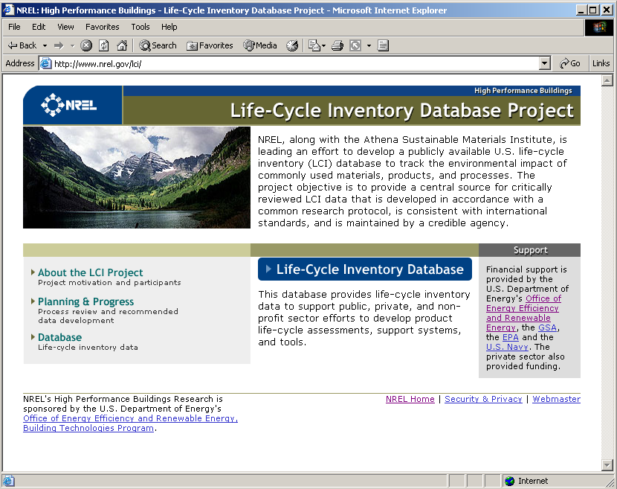
Website – www.nrel.gov/lci

Slide 18
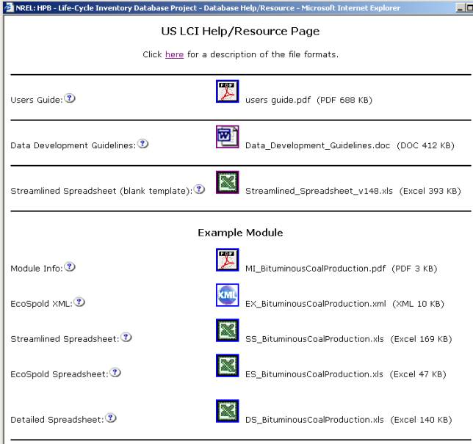
Resource Page
User’s Guide
“How to” guide for data users and suppliers
Data Development Guidelines
Guide for data suppliers
Streamlined Spreadsheet Template
Blank spreadsheet for data suppliers

Slide 19
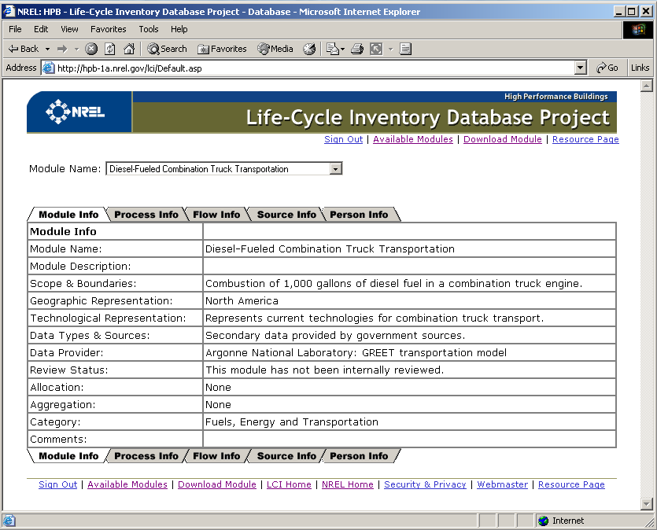
View Module – Module Info Page

Slide 20
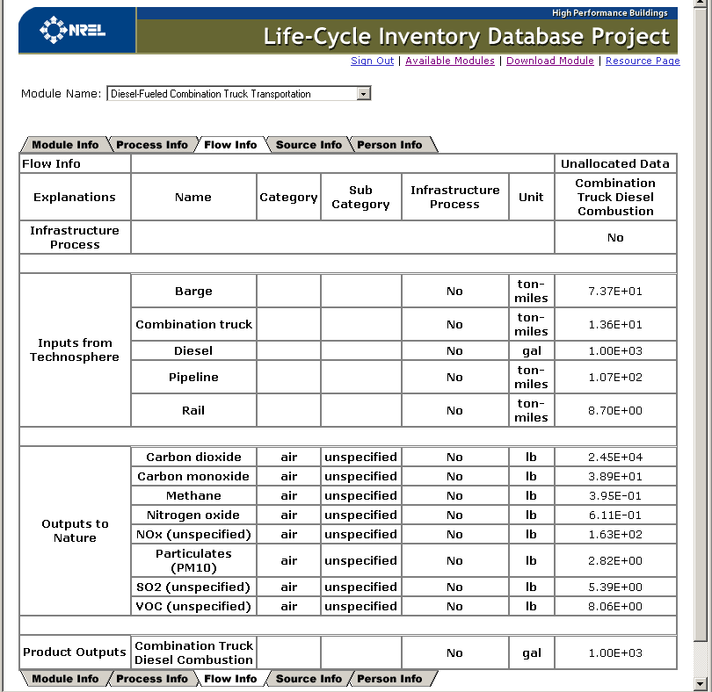
View Module – Flow Info Page

Slide 21
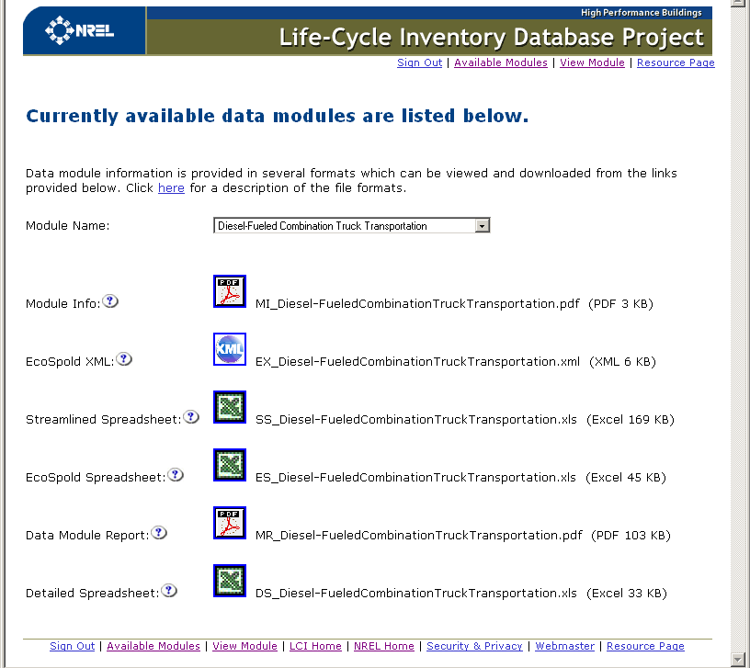
Download Module Page

Slide 22
Available Data Modules (57)
Primary Fuel Production (7) | Transportation (10)
Primary Fuel Combustion (18) | Transformation Processes (4)
Alternative Fuel Combustion (1) | Materials Used in Durables Manufacturing (6)
Fuels/Energy Pre-combustion (1) | Building and Construction Products (5)
Electricity Generation (1) | Non Metallic Minerals (4)

Slide 23
Modules Under Development
Plastic resins and polyurethane precursors
Materials for durables production
  Steel from integrated mills
Building and construction products
  Additional wood products and adhesives
Transformations
  Plastic fabrication
  Steel stamping
Bio-based products

Slide 24
Related Efforts
“LCA in LEED”
  US Green Building Council using LCA to improve rating system
  U.S. LCI Database is preferred source of data
Athena Environmental Impact Estimator will be compatible with the U.S. LCI Database
BEES is switching to U.S. LCI Database data
NIST is developing agricultural LCI data that will be added to the database when appropriate

Slide 25
Support of EERE Programs
FEMP
Sustainability
Distributed Energy
Energy & Emissions benefits
Geothermal
Emissions benefits
Buildings
Energy &
Materials Analysis
Hydrogen
Analysis of Production & Use
Biomass
Analysis of Production & Use
LCI Database
Industrial Technologies
Improved Manufacturing
Solar Energy
Improve Production & Calculate Benefits
Wind & Hydropower
Emissions benefits
Vehicles
Fuels and Materials Analysis
Weatherization & Intergovernmental Programs
Sustainability

Slide 26
Short-Term Priorities
Develop business plan
Form advisory board
Build broad support
Implement critical review process
Revise database interface
Expand database

Slide 27
Longer-Term Priorities
Add data following Phase II work plan priorities
Maintenance
  Continual up-dates - how often?
Coordinate with related efforts

Slide 28
Questions
www.nrel.gov/lci

