Slide 1
Short and Mid-Term US Energy Outlook
Presentation to the
National Governor’s Association
2004 Winter Meeting
Energy Information Administration
February 23, 2004

Slide 2
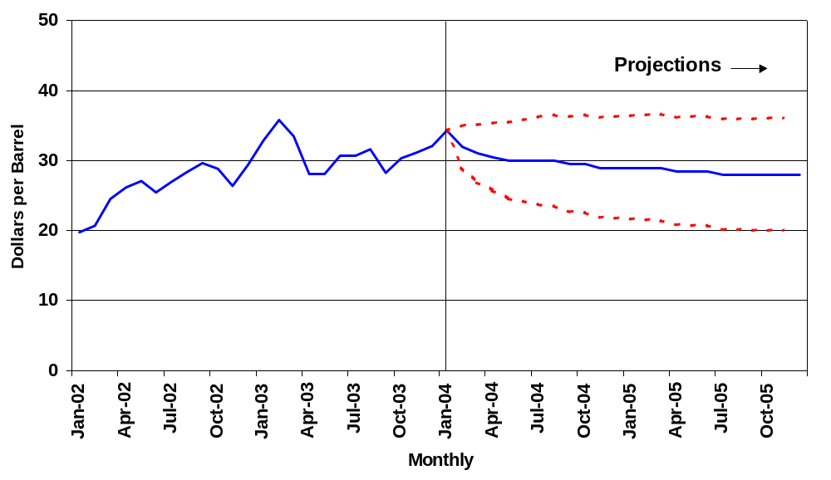
WTI Crude Oil Price
(Base Case and 95% Confidence Interval*)
*The confidence intervals show +/- 2 standard errors based on the properties of the model. The ranges do not include the effects of major supply disruptions.
Short-Term Energy Outlook, February 2004
Notes:
Looking first at the near-term trends.
Average crude oil prices rose from the end of last summer through January. The West Texas Intermediate (WTI) spot average for January 2004 was $34.31 per barrel compared to $28.31 in September 2003. Prices averaged $31.12 for all of 2003 and are expected to average just above $30 for 2004.
EIA’s Outlook is for prices to remain relatively high (in the $28 to $30 per-barrel range through 2005. Oil inventories remain low in the aggregate, in the United States and in other industrialized countries.
The recent (Feb 10) OPEC announcement, indicating a cut in official quotas from 24.5 mmbd to 23.5 mmbd and an intention to reduce production above quota levels, would signal somewhat higher prices than indicated here “IF” the actual cuts in the OPEC production level between January and April 2004 exceeds 1.5 million barrels per day (the amount of OPEC reductions already assumed in the current Outlook). This is certainly possible but it is not seen as particularly likely.

Slide 3
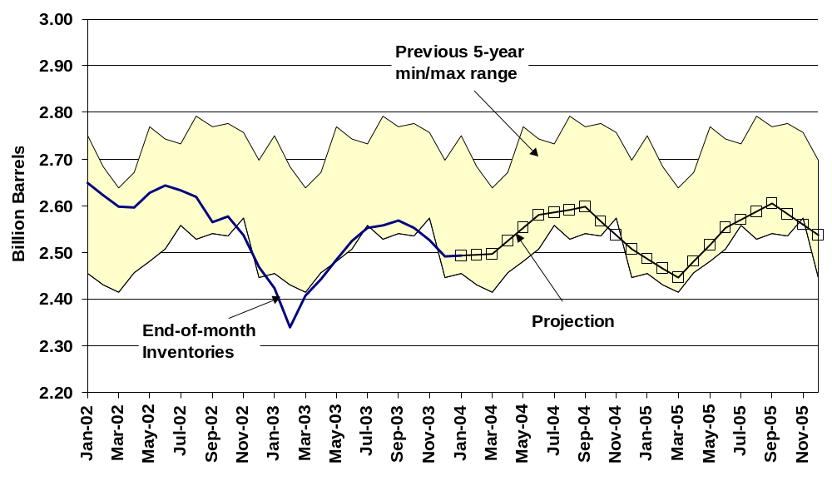
OECD Commercial Oil Stocks
Short-Term Energy Outlook, February 2004

Slide 4
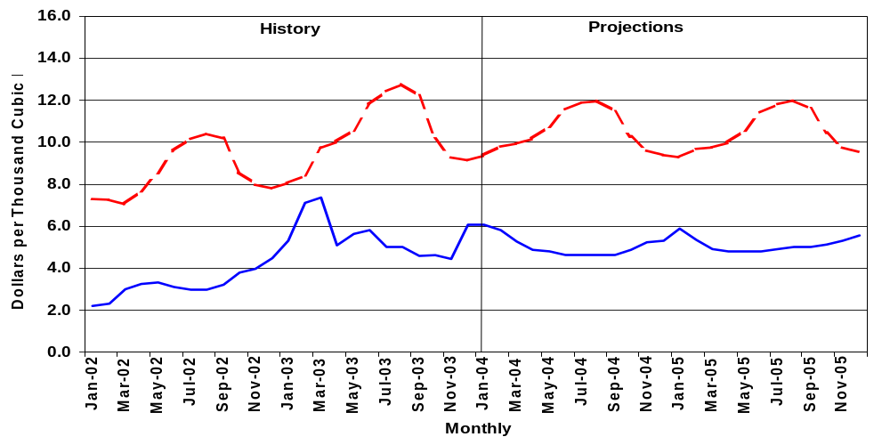
Natural Gas Prices, 2002-2005
Residential
Spot
Price Summary ($/mcf)
2002
2003
2004
2005
Spot Wellhead
3.22
5.51
5.07
5.12
Residential
7.86
9.41
9.95
9.91
Short-Term Energy Outlook, February 2004

Slide 5
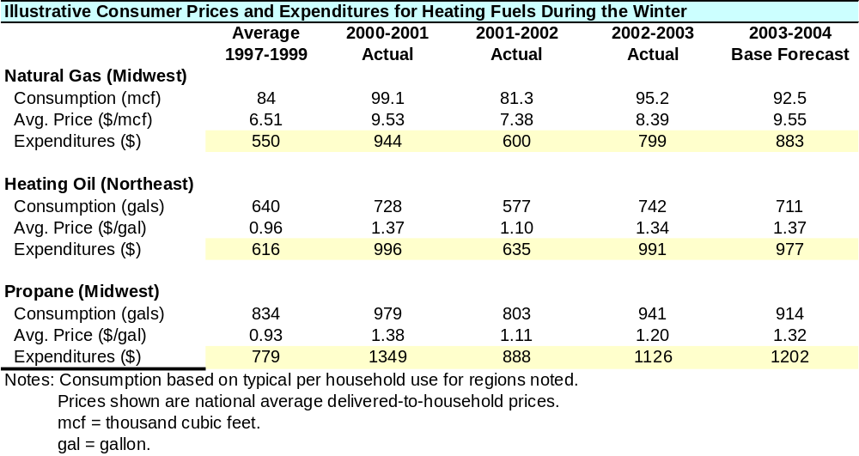
Household Heating Cost Trends
Short-Term Energy Outlook, February 2004

Slide 6
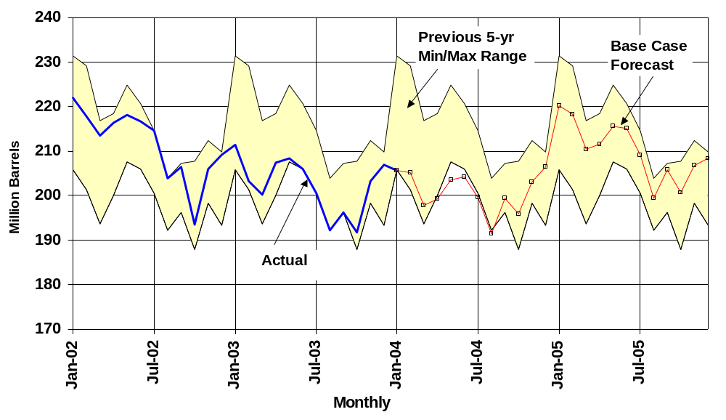
U.S. Gasoline Inventories
Short-Term Energy Outlook, February 2004

Slide 7
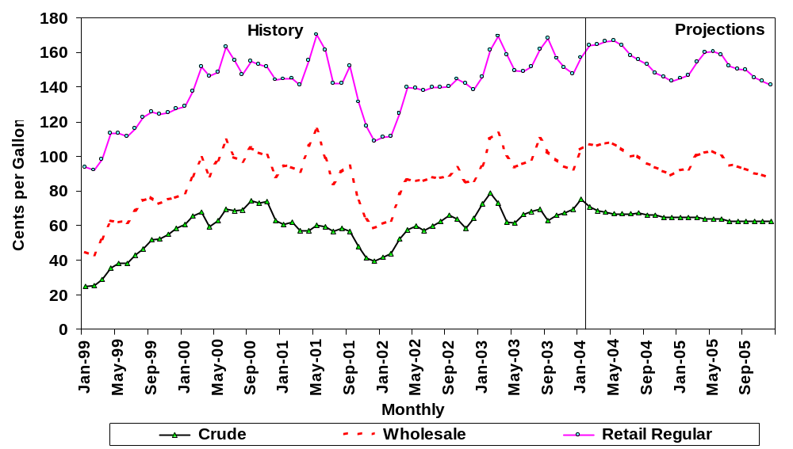
Gasoline Prices and Crude Oil Costs
Short-Term Energy Outlook, February 2004

Slide 8
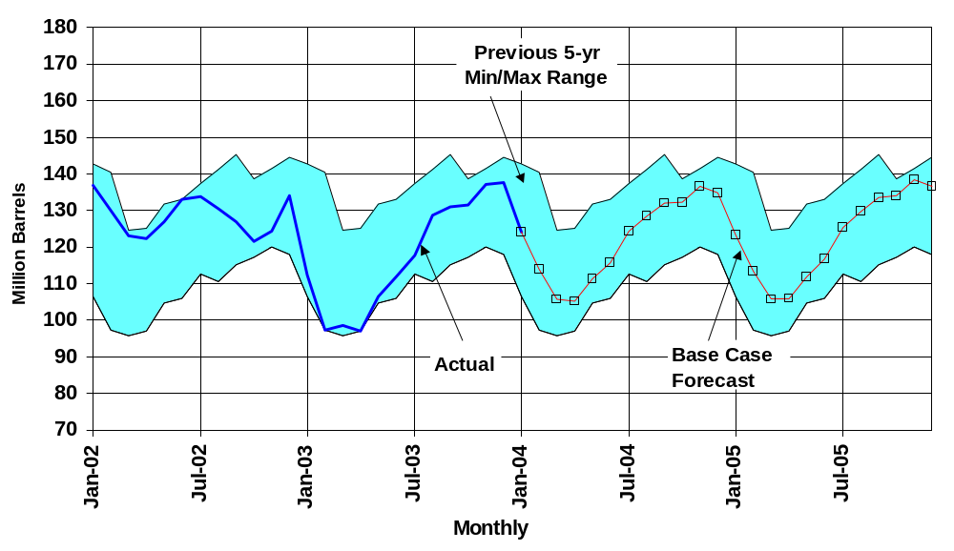
Distillate Fuel Inventories
Short-Term Energy Outlook, February 2004

Slide 9
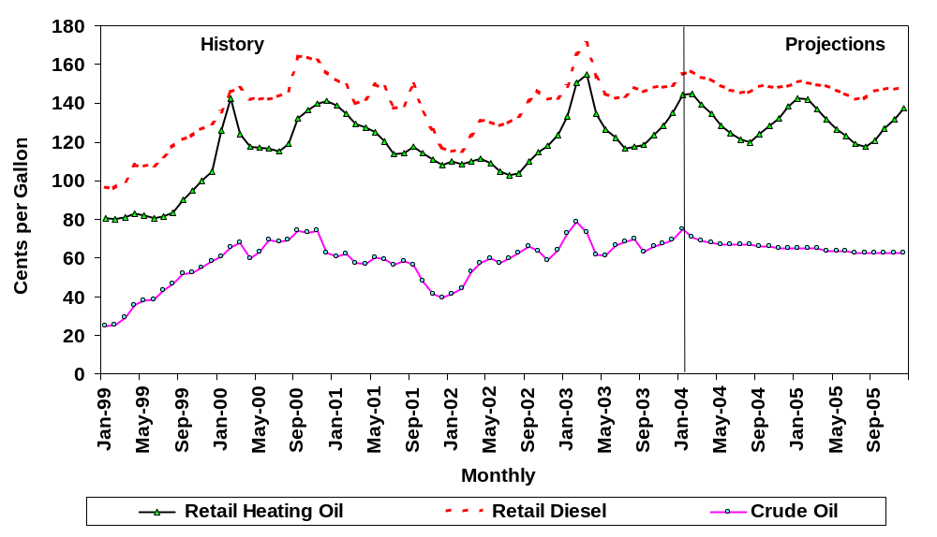

U.S. Distillate Fuel Prices
Short-Term Energy Outlook, February 2004

Slide 10
Primary Energy Consumption, 1960-2025
(quadrillion Btu)
140
120
100
80
60
40
20
History
Projections
0
1960
1970
1980
1990
2000
2010
2025

Slide 11
Primary Energy Consumption, 2002 and 2025
(quadrillion Btu)
45
40
2002
35
2025
30
25
20
15
10
5
0
Residential
Commercial
Industrial
Transportation

Slide 12
Light-duty Vehicle Efficiency, 2002 and 2025
(miles per gallon)
32
30.8
2002
28.2
2025
28
26.9
24.7
24
23.8
20.5
20
16
12
8
4
0
New Car
New Light-duty
New Light-duty
Truck
Vehicle Average

Slide 13
Projected Sectoral Composition of Output Growth,
2002 – 2025 (percent per year)
Gross domestic product
Retail trade
Other services
Transportation, communication & utilities
Wholesale trade
Manufacturing
Finance, insurance and real estate
Construction
Government enterprises
Agriculture
Mining
0.0
1.0
2.0
3.0
4.0
5.0
6.0

Slide 14
Projected Sectoral Composition of Manufacturing Growth,
2002 – 2025 (percent per year)
Manufacturing
Electronic equipment
Industrial machinery
Miscellaneous manufacturing
Instruments
Transportation equipment
Rubber and plastics
Chemicals
Fabricated metals
Stone, clay and glass
Furniture
Printing and publishing
Beverages and tobacco
Paper
Food
Petroleum refining
Primary metals
Textiles
Apparel
Lumber
Leather
-3.0
-2.0
-1.0
0.0
1.0
2.0
3.0
4.0
5.0
6.0

Slide 15
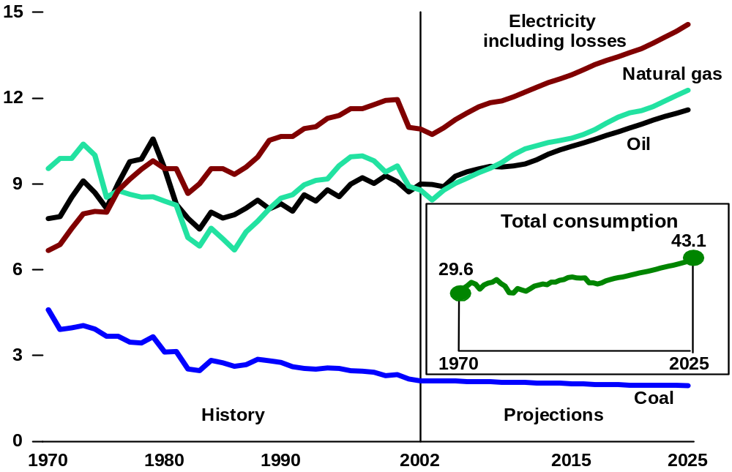
Industrial Primary Energy Consumption by Fuel, 1970 - 2025
(quadrillion Btu)

Slide 16
Industrial Primary Energy Consumption by Industry Category,
1998 – 2025 (quadrillion Btu)
30
History
Projections
Manufacturing
heat and power
20
Nonmanufacturing
heat and power
Nonfuel use
10
0
1998
2002
2010
2015
2025

Slide 17
Energy Use per Capita and per Dollar of Gross Domestic
Product, 1970-2025 (index, 1970 = 1)
1.2
1.0
Energy use per
capita
0.8
0.6
0.4
Energy use per
dollar of GDP
0.2
History
Projections
0.0
1970
1980
1990
2000
2010
2025

Slide 18
U.S. Energy Production and Consumption, 1960-2025
(quadrillion Btu)
140
Consumption
120
36%
100
Net imports
26%
80
Production
60
40
20
History
Projections
0
1960
1970
1980
1990
2000
2010
2025

Slide 19
World Oil Price, 1970-2025
(2002 dollars per barrel)
70
$51.74

60
$17.14
50

Reference case
(nominal dollars)
40
1995
2025
30
20
10
History
Projections
0
1970
1980
1990
2000
2010
2025

Slide 20
Petroleum Supply, Consumption, and Imports, 1970-2025
(million barrels per day)
30
History
Projections
25
20
Consumption
Net imports
70%
15
54%
10
Domestic supply
5
0
1970
1980
1990
2000
2010
2025

Slide 21
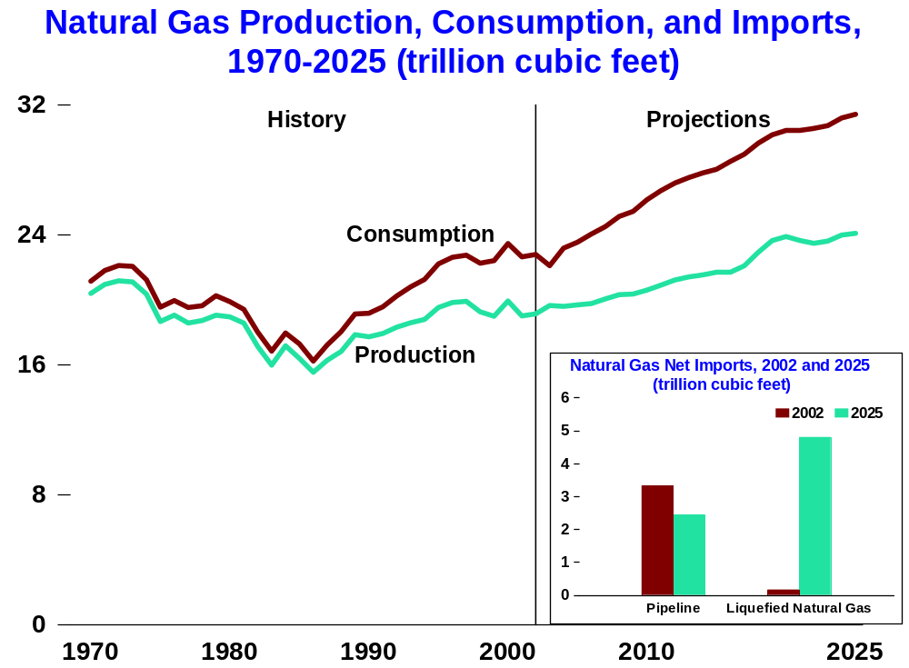
23%
Net imports
15%

Slide 22
Major Sources of Incremental Natural Gas Supply,
2002-2025 (trillion cubic feet)
32
Growth in Alaskan Production
28
Growth in LNG Imports
24
Growth in Non-associated
Unconventional
20
*
All Other Production
16
2002
2010
2020
2025
*Includes total associated-dissolved, non-associated conventional, lower-48 offshore,
supplemental natural gas production, Canadian, and Mexican imports.

Slide 23
Natural Gas Wellhead Price, 1970-2025
(2002 dollars per thousand cubic feet)
5
History
Projections
4
3
2
$8.44

1
$1.55

Reference case
(nominal dollars)
1995
2025
0
1970
1980
1990
2000
2010
2025

Slide 24
Coal Minemouth Price, 1970-2025
(2002 dollars per ton)
54
$31.76

48
$18.83
42

36
Average price
30
(nominal dollars)
1995
2025
24
18
12
6
History
Projections
0
1970
1980
1990
2000
2010
2025

Slide 25
Coal Production by Region, 1970-2025
(million short tons)
1,600
Total
1,200
West of the Mississippi
800
400
East of the Mississippi
History
Projections
0
1970
1980
1990
2000
2010
2025

Slide 26
Electricity Price, 1970-2025
(2002 cents per kilowatthour)
10
8
6
13.2

4
1.7
Average price
2

(nominal cents)
1970
2025
History
Projections
0
1970
1980
1990
2000
2010
2025

Slide 27
Projected Electricity Generation by Fuel,
2002 and 2025 (billion kilowatthours)
3,500
52
- percent of total
3,000
2,500
2002
2,000
50
1,500
2025
23
1,000
20
14
18
9
500
9
2
2
0
Coal
Nuclear
Natural gas
Renewables
Oil

Slide 28
Electricity Capacity, 2002-2025
(gigawatts)
1,200
Natural Gas
Coal
Needed
1,000
Renewable
Capacity
800
600
400
Existing Capacity,
with Future Retirements
200
0
2002
2010
2020
2025

Slide 29
Total Carbon Dioxide Emissions, 1960-2025
(million metric tons)
8,000
8142 in 2025
6,000
6559 in 2010
4,000
Carbon Dioxide Emission Intensity,
1.0
1990-2025 (index, 1990 = 1.0)
0.8
0.5
Carbon dioxide emissions
2,000
per dollar of gross domestic product
0.3
0.0
History
Projections
1990
2000
2010
2025
History
Projections
0
1960
1970
1980
1990
2000
2010
2025

Slide 30
Forecast Uncertainties
Regulatory Change
Technological Breakthroughs
Demographic Shifts
Domestic and International Political Instability
Energy Price Uncertainty

