Slide 1
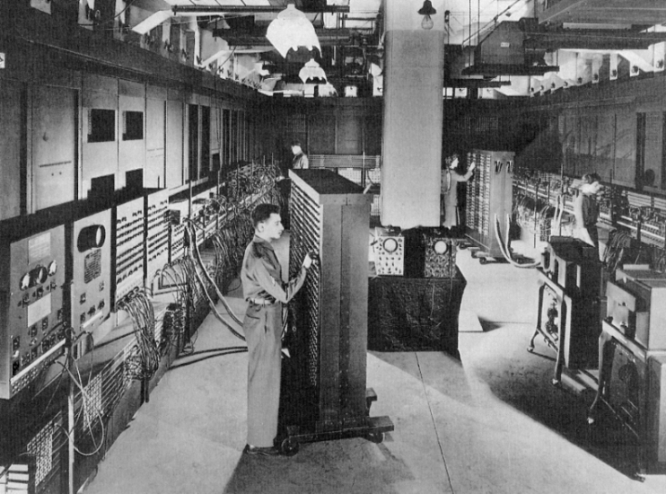
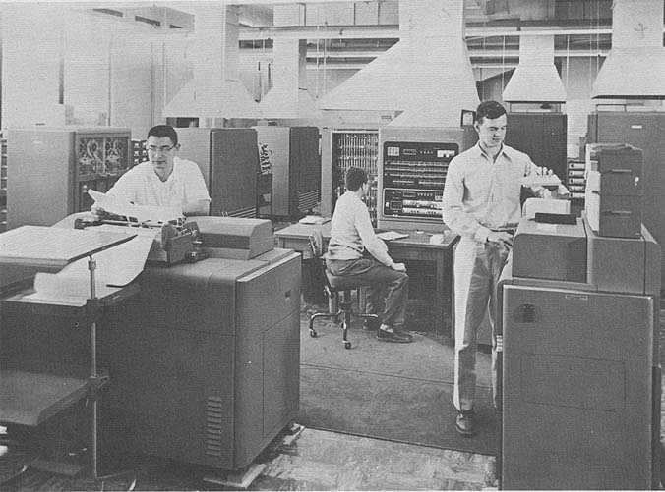
Bridging the Gap:
The U.S. Move
from Research…
…to Operational
NWP
Kristine C. Harper

Slide 2
April 1945

Slide 3
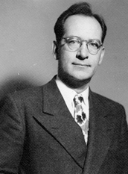
John Mauchly
Moore School
University of Pennsylvania
Notes:
John Mauchly – developer of ENIAC

Slide 4
November 1945

Slide 5
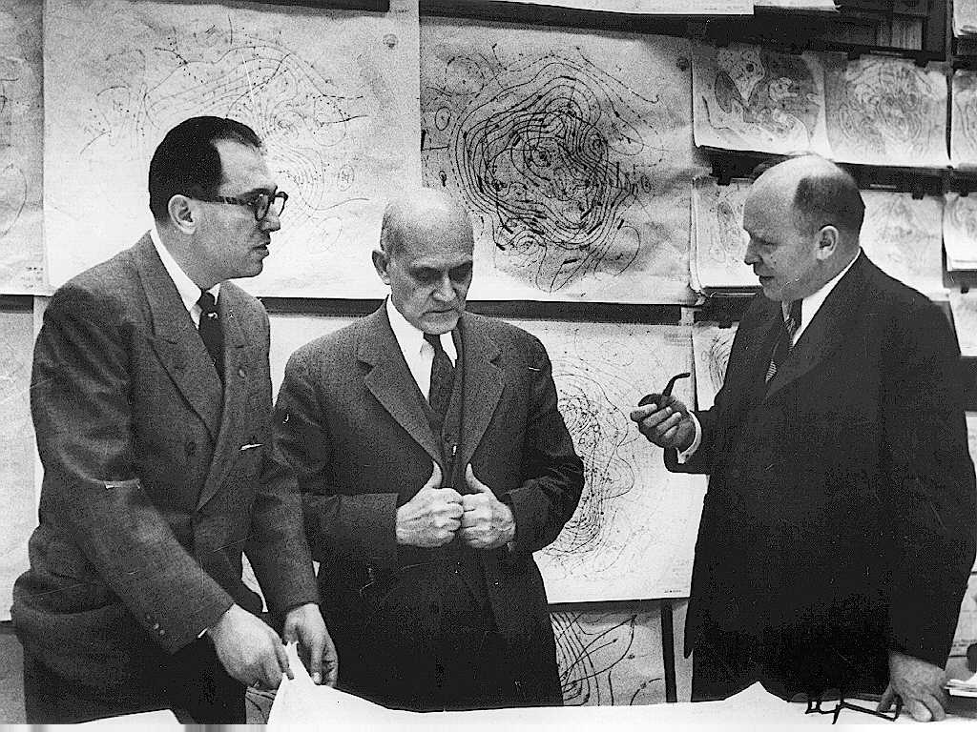
Weather Bureau Chief
Francis W. Reichelderfer

Slide 6
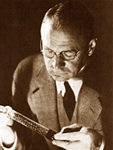
Vladimir K. Zworykin
RCA Laboratory,
Princeton, New Jersey

Slide 7
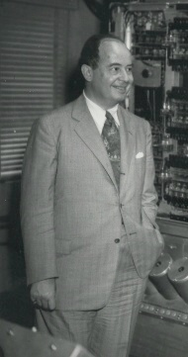
John von Neumann
Institute for Advanced Study
Princeton, New Jersey

Slide 8
“Weather Forecasting by Calculator Run by Electronics is Predicted”
New York Times, 11 January 1946, p. 12.

Slide 9
April 1946

Slide 10
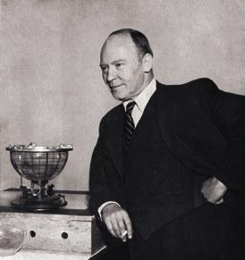
Carl-Gustaf Rossby
Meteorology Department
University of Chicago

Slide 11
1 August 1946:
The Meteorology
Project

Slide 12
1947 Phil Thompson works alone
Jule Charney visits in March
Charney and Arnt Eliassen arrive
John Freeman relieves Thompson
1949 Ragnar Fjørtoft relieves Eliassen

Slide 13
1950 1st ENIAC Expedition
(Charney, Fjørtoft, Freeman,
Joseph Smagorinsky, George
Platzman)
Freeman departs
In and out are: Bert Bolin, Thomas V. Davies,
and Margaret Smagorinsky
Joseph Smagorinsky and Norman Phillips
on board
May/June: 2nd ENIAC Expedition

Slide 14
1952 Late March – von Neumann’s computer ready
April – Air Force’s Atmospheric Analysis Lab
announces the production of upper-level
wind forecasts in real time by numerical
methods
May – Rossby’s Stockholm group holds a
meeting on NWP
5 August – Charney, von Neumann, and
Reichelderfer call a meeting to discuss
the future of operational NWP

Slide 15
Science Service article proclaims:
Electronic “Brain” to Forecast the Weather

Slide 16
June 1953:
Ad Hoc Committee on
Joint Numerical Weather
Prediction

Slide 17
1 July 1954:
Joint Numerical Weather Prediction Unit

Slide 18
YIKES!

Slide 19
Four goals to be met:
* Model development
* Computer acquisition
* Personnel training
* A suitable location

Slide 20
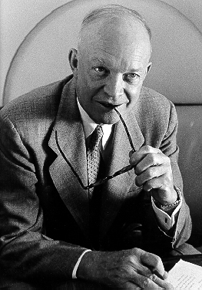
President
Dwight D. Eisenhower

Slide 21
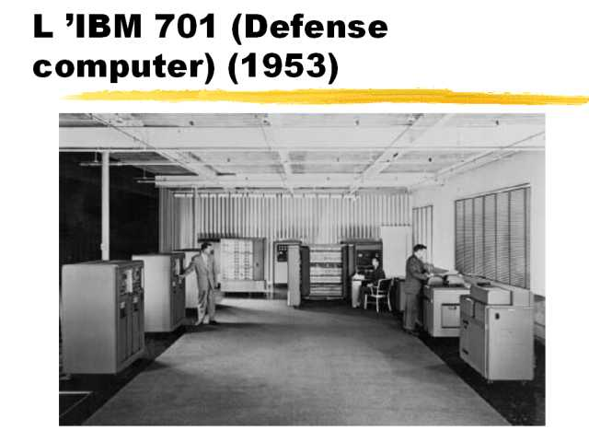
IBM 701
“Defense Calculator”

Slide 22
The End

