Slide 1
Network Research Infrastructure:
Back to the Future
Bob Aiken
Director, Engineering
Academic Research and Technology Initiatives (ARTI)
Cisco
August, 2003

Slide 2
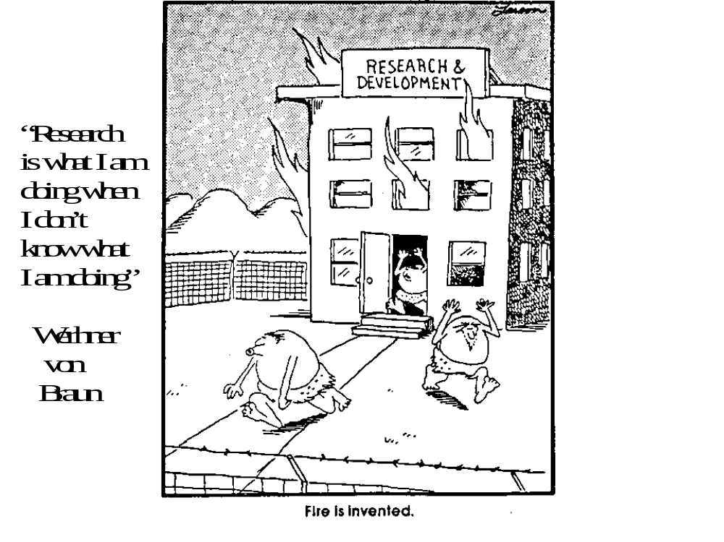

Slide 3
Evolution of Networks
1st the Earth cooled
then we had Dinosaurs
then we had oil
then we had Mercedes Benz
then we had ENIAC
then we had ARPAnet
then we had research networks (NSFNET, SURFnet, ESnet,…)
then we had NGI
then we had “THE Internet”, BMWs, and IPOs
then we had the technology market bubble burst
then the earth cooled – again - or did it?

Slide 4
Evolution of Networks – really
ARPAnet
NSFNET/JANET/SURFNET/SINET/ESnet/etc.
NSFNET II - NAPs, vBNS, ... (circa 1992) - peering & network mgmt R&D
  Commercialized Internet
Gigabit testbeds (circa 1992-95) - optics R&D and ATM
WEB takes off (circa 1994)
I-WAY (circa 1995) – 1st temporary “GRID”
Internet2/NGI – Deja vu all over again ala NSFNET (circa 1996)
Middleware / Globus / GRIDs (circa late 1990s)
E-Presence / Ubiquitous computing / Nano technologies / PDAs / wireless - all Chaos agents changing way we work and live
Concurrent network research & production networks (e.g. NLR, CENIC) & GRIDs – idea from 1997 MORPHNET

Slide 5
Network Research Trends
Intelligent Networks (not just Speed & Feeds)
Dark Fiber & Waves
VPNS & Tunneling
Security, High availability, resiliency
End to End Capabilities (core is least of our worries)
  Host, Campus, PAN, LAN, MAN, WAN
Next Generation TCP & Congestion control
  E.g. FAST, XCP, HS-TCP, RDMA , etc.
Convergence of Application, middleware and networks
Network Research Infrastructures (e.g. NLR)

Slide 6
Intelligent Networks
Network management
Dynamic provisioning
VPNS & Tunnels
Signaling and control
QoS
Policy
Content and Path optimization
Security
Adaptive and agile networks

Slide 7
GGF Network R&D WG
Congestion Control & scaling of IP & TCP
Routing : packet size vs TCP scaling
Multicast
OSes (end system, kernels, memory copies)
Light vs heavy weight protocols (eg.PDA)
Macroscopic traffic and System considerations

Slide 8
Industry and Researcher Collaboration Opportunities
All of the prior mentioned network trends provide ample opportunities for REAL Industry and R&E&D collaboration ;
BUT

Slide 9
We Need a New Model for
Industry-R&E Collaboration
Ask not what your industry partner can do for you , rather ask what you can do for your Industry Partner
It’s the relationship developed not the cheap or free HW & SW which is a value in the future

Slide 10
Cisco Research & Development
Research
Technology
R&D
Product
Concept
Cisco Product
Development
Customer Solution
URP
CARD
ARTI
Network Research Infrastructure
Research Networks
CA/CIAG
TG/BU
BU R&D
Tech Center

Slide 11
Technology Transfer & Industry
Collaboration MYTH
The Vast majority of research is never transferred to Industry or commercialized
Industry collaborators should be more than names proposals
“Submarine Truths”
  R&D will develop niche markets which Industry won’t pursue due to lack of markets
  so Government and R&D community needs to belly up to the bar and pay for it – don’t pass off as TECH XFER

Slide 12
Need New Model of Industry-R&E
Relationship
Quit looking to Industry as cash cows to just fund lunches, conferences, etc.
Quit asking for free HW and SW
Look for real partnerships
  Put real $ on table – pay for somethings – Industry will meet you halfway
  No AUP – get real industry involved at all layers
  Adopt real joint research and production infrastructure
    No Pain No Gain – ie. cannot claim its cutting research when its based on 99. 999% up time!
    Real joint R&D will benefit both Industry and R&D

Slide 13
CalREN-2 : Design Methodology
Tier 3 – Experimental/Developmental
Bleeding edge services
Dedicated Waves
Dynamic Provisioning
10G, 40G, OC-768
Break and Break
XD
Network Playground
Unknown Services
λ
HPR
Tier 2 – High Performance Research
Research Apps, low latency, GRID
Advanced Services IPv6, QoS, IPMc
10GE, Shared Waves
Break and Fix
Fix
DCP
Tier 1 – Commodity Internet
High Availability
Aggregated Connectivity
NxGE, OC-12, OC-48
CalREN

Slide 14
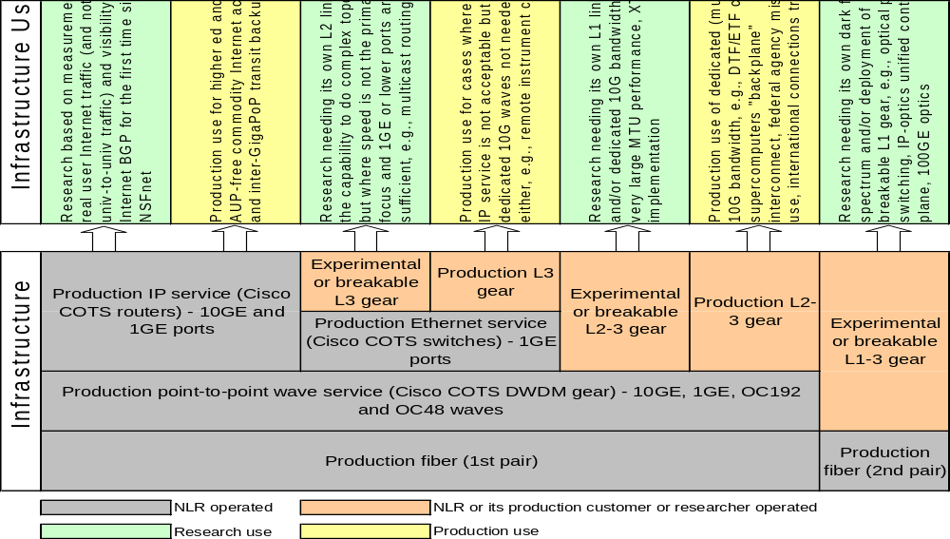
NLR networking research use vs. production (aka MORPHNET) – NO AUP!

Slide 15
Experimental network facilities: NLR
SEA
POR
SAC
NYC
BOS
OGD
CHI
SVL
DEN
CLE
PIT
FRE
WDC
KAN
NAS
RAL
LAX
STR
PHO
WAL
ATL
SDG
OLG
DAL
JAX
15808 Terminal
15808 OADM
Fiber route

Slide 16
Summary
Application and Network research were coupled on the ARPANET and NSFNET
WEB grew as result of Application requirements and the existence of a transparently connected network research infrastructure
Need to go back to the Future and do this again
  This will only occur when we see a real partnership between Industry and R&D community that goes beyond just getting free HW/SW
  Programs need to budget accordingly for Networks and other infrastructure and people

Slide 17
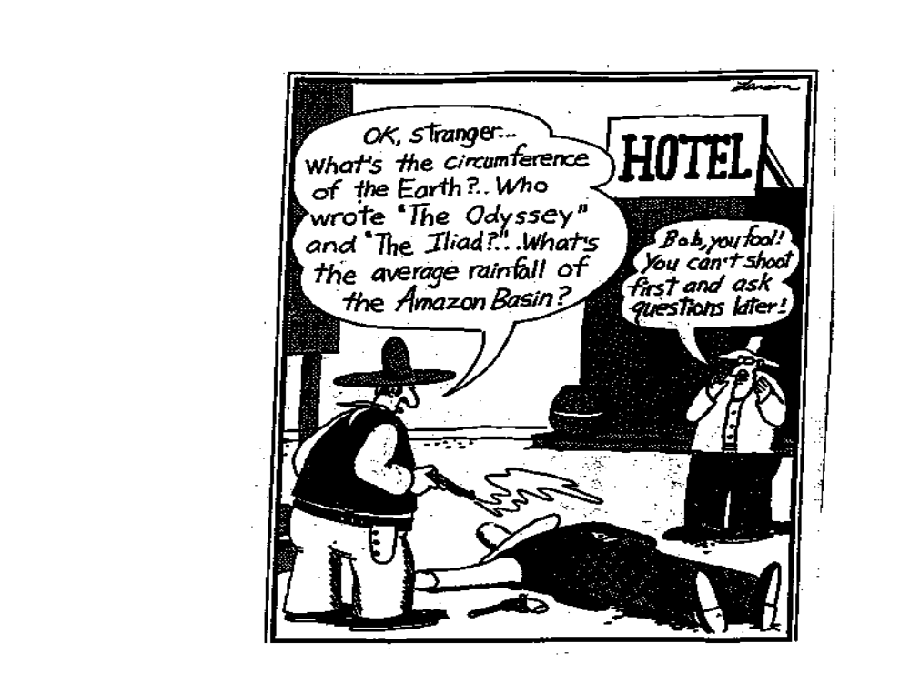

Slide 18
