Slide 1
Pink
A 1024 Node Science Appliance
Sung-Eun Choi, Erik Hendriks,
Ron Minnich, Matt Sottile,
Greg Watson
LA-UR-02-7246

Slide 2
Cluster state-of-the-art: ca.1990
Scripts for install, maintenance, scheduling, etc.
1 FTE required (at least) per 128 nodes*
NFS for file systems, which works poorly in clusters
Console is either glass tube or serial port
  Impractical on large scale
Have to “rsh” to node to do things
Proprietary Unix makes changing things hard
*informal survey of research and industry systems

Slide 3
Cluster state-of-the-art: 2003
Scripts for install, maintenance, scheduling, etc.
1 FTE required (at least) per 128 nodes*
NFS for file systems, which works poorly in clusters
Console is either glass tube or serial port
  Impractical on large scale
Have to “rsh” to node to do things
*informal survey of DOE labs

Slide 4
General Goals
To provide users with a single logon cluster:
  That provides SSI capabilities
  That scales to 1024 or more nodes
  That is compatible with existing practice
  With O(1) software failure points instead of O(n)
  With software that anticipates or tolerates failure
  As a consequence: single point for management, console, and use

Slide 5
But … we also want:
.01 FTE per 128 nodes (current is 1)
5 seconds to install all software on all nodes
5 seconds to upgrade
5 seconds to boot
Eliminate Ethernet and serial port networks
Reduce all the significant measures by at least O(100)

Slide 6
Science Appliance
Culmination of a research program started in 2000
Our goal was to address a simple problem:
  clusters are too hard to build, install, manage, and use
Hardware problems are easy to solve
  if you buy unreliable hardware, it will be unreliable
  so don’t buy unreliable hardware
The issue is software architecture
  software requiring disks on each node requires unreliable hardware

Slide 7
Science Appliance Architecture
Fast, reliable, maintainable firmware
Single process space
Private name spaces
Parallel file system
Scalable monitoring
In short, very little in common with older Linux cluster techniques
Few moving parts

Slide 8

Science Appliance Software
Available as “Clustermatic”
LinuxBIOS (firmware)
BProc (single process space)
V9fs (private name spaces)
Panasas or Lustre (parallel file system)
Supermon (scalable monitoring)

Slide 9
LinuxBIOS
Replaces existing BIOS
Boots to Linux in a few seconds
Eliminates BIOS setup screens and stupid failure modes
  “No keyboard hit F1 to continue”
Configures hardware correctly
Allows maintenance to be done from Linux

Slide 10
Beoboot
Loads Linux kernel from network
Then boots Linux from Linux
Eliminates need for PXE, Etherboot, etc.
Puts the full capabilities of Linux in use for booting
  Can boot over Myrinet, QSW, etc.
  Can use IPV4, IPV6, NFS[2,3,4], etc.

Slide 11
Global PID space
Global process state maintained from one node only (BProc master)
Applications that use standard process system calls work no matter what node they are on
Problem of PID management reduced from O(N²) to O(N) (N is # nodes)

Slide 12
BProc
Single system image for process space
  i.e. ALL process system calls work transparently across the cluster
Allows a cluster to have single login, single IP address, single point of control
  rsh is dead
Tested to 15,000 procs
  Started up in 3 seconds over TCP/IP
Uses asymmetric single system image as opposed to symmetric single system image

Slide 13
Symmetric single system image
System-centric
The entire system shares all resources transparently
Which means all nodes have resources from all nodes
If anything fails, you fail. If you fail, everyone fails.
Actually, worse than that …
Add in all file servers, etc.

Slide 14
Asymmetric single system image
Application-centric
Application sees unified
  PID space
  File system space
  Message-passing space
Global process space is visible from front-end node only
File system provided by private name spaces
Message-passing space is TCP/IP or other network – solved problem

Slide 15
Asymmetric SSI Advantages
Scaling
  conventional SSI scaling is measured in 10s
  our system scaling is measured in 1000s
Much less complex
  no distributed lock manager, consensus protocols, message journals, etc.
  in this case, simpler means faster and more reliable

Slide 16
Private name spaces
Application-centric, not node-centric
With global file systems, node reliability is determined by reliability of all servers
With private name spaces, application reliability is determined by reliability of servers used by that application
Greatly reduces the reliability requirements

Slide 17
V9fs private name spaces
Process-group-private mounts a la Plan 9
Eliminates global NFS mounts and attendant performance and reliability problems
Performs as well as NFS in tests
Processes carry mounts as they migrate

Slide 18
BJS: BProc Job Scheduler
Exploits BProc capabilities for performance
Single scheduling process for entire cluster
Framework for scheduling policy is a pluggable module
Being integrated to LSF/Maui

Slide 19
Supermon
Monitors OS, application, and hardware info
  many systems can’t do hardware monitoring from Linux!
  example: Compaq DS-10 cluster requires serial ports for hardware monitoring
Scalable job monitoring with support for hierarchy
Data stream based on symbolic expressions (LISP)
Allows stream composition and filtering based on symbolic rules
Real-time visualization

Slide 20
Other work
ZPL
  automatic check pointing
Debuggers
  parallel
  relative debugging (Guard)
Latency tolerant applications

Slide 21
Previous LANL Science Appliance systems
13-node cluster at SC 2000
128-node Alpha cluster assembled June 2001
128-node dual P4 cluster

Slide 22
Systems outside LANL
Full “Science Appliance” installations
  SNL/CA
Partial installations
  Academic (eg. ENIAC cluster at U. Penn, Clemson U.)
  Industry (eg. Cluster at Pharmaceutical company that processes 25 jobs/second)

Slide 23
Pink: Newest LANL Science Appliance
1024 nodes
  Dual P4, 2.4 Ghz, SMT (Hyper Threading)
Myrinet interconnect
Panasas file systems
Science Appliance software

Slide 24
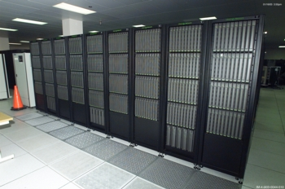
Pink Vital Stats
1024 nodes
2048 P4 CPUs
1024 Myrinet cards
2048 fiber (8.8 miles)
3072 switch ports
4096 RAM sticks (~2TB)
7000+ fans
1 disk
1 CDROM

Slide 25
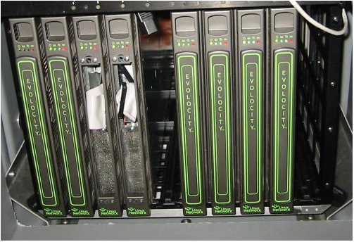
The nodes
2- 2.4 Ghz CPUs
1 GByte per CPU
Mounted in a .8U rack mount

Slide 26
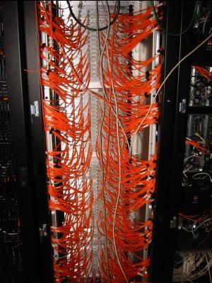
The interconnect
Myrinet “C” cards
  200 Mhz CPU
  64/66 PCI
Fiber
Clos network with full bisection bandwidth
Only network for all nodes
  This is somewhat novel
  Every other cluster needs Ethernet for maintenance and/or booting

Slide 27
Parallel file systems
Panasas
Lustre
NFS V4 (via Panasas or Lustre)
  Not strictly a parallel file system

Slide 28
What’s missing?
Parallel debugger
  i.e. TotalView for the small scale (128 nodes)
  something else for the large scale (256 and up)
New programming paradigm (e.g. ZPL)
  SPMD does not hack it at this scale
Failure anticipation
  although failure rates on Pink are so far very low

Slide 29
Short-term tasks (Linux)
Fix NFS
Processor affinity
Improve VM system for large contiguous areas
Let apps know the state of their pages
  Dirty, in-memory, etc.
  Previously done on FreeBSD
  Runtime systems could use this

Slide 30
Short-term tasks (Net)
Improve map times for source-route net
  Myrinet work will apply to Infiniband
“Network serial port”
  Minimal Myrinet Control Program that gives us poll-based NIC interface
Fix route computation
  Way too ad-hoc, way too slow, way too fragile
Fix route loading
  Done!

Slide 31
Future Opportunities
Faster boot
Application-specific configuration of node
  e.g. hyper threading on/off per application
Failure anticipation

Slide 32
Conclusion
Science Appliance is a dramatically new cluster software architecture
Eliminate as much software as possible
  especially any and all Perl and other such guck
The software architecture impacts the hardware architecture:
  eliminate as much hardware as possible
  especially if it has motors
Provide users with a single system image environment

Slide 34
Protein folding application
Performance relative to PIII 800Mhz

Slide 35
Panasas
128 Panasas Object-Based Disks
  2 disks in a cabinet with a power cord and gigE
64 I/O nodes in Pink connect to gigE switch
Bandwidth is pretty good
Still in a rough state but very promising

Slide 36
Panasas structure
Node
Node
Metadata servers map pathnames to objects
Node
Once a node maps an object all node I/O goes to the object. Objects span OBDs.
Metadata
server
gigE switch
OBD
OBD
OBD
OBD
OBD
OBD

Slide 37
Lustre
Lustre Cluster File System
DOE Tri-Lab funded, GPL, developed by Braam et. al.
Similar scale to Panasas
Architecture is pretty much the same as Panasas
  With one advantage; server is Linux-based, GPL

Slide 38
File systems general comments
An early, and failed, goal was to put the file system into the disk
There is enough CPU in there to do it
Now the systems all look like Linux-based motherboards running a server
So why is it called OBD?
  Marketing …

Slide 39
Compiler technology
Compiler support for check pointing
Job reallocation in the event of failure
Early results show:
  Up to 75% reduction in checkpoint size
  Can take a job running on n processors and restart on m processors

Slide 40
So just fix the BIOS!
Not fixable
Misconfigures memory
Misconfigures PCI
Full of bugs (busted tables, etc.)
  This recently broke Linux 2.4.19 …
“no keyboard hit <F1> to continue”
Windows-based configuration
No configuration from Linux

