Slide 1
Department of Energy
Secretary
Spencer Abraham
$23.4B FY 2004
Departmental Staff and Support Offices
Federal Energy
Regulatory
Commission
Counterintelligence
Intelligence
Office of Security and
Emergency Operations/ Chief Information Officer
Office of Independent Oversight
and Performance Assurance
Office of Public Affairs
Office of Policy
Office of Management
and Administration
Office of Worker and
Community Transition
Office of Hearings and Appeals
Contract Reform and
Privatization Project Office
Secretary of Energy
Advisory Board
Defense Nuclear Facilities
Safety Board Liaison
Inspector General
Office of Economic Impact and Diversity
Under Secretary for Nuclear Security/ Administrator for Nuclear Security
$8.8B
Under Secretary for Energy, Science and Environment
General Counsel
Chief Financial Officer
Assistant Secretary for Environment, Safety and Health
Assistant Secretary for Fossil Energy $519M
Assistant Secretary for Congressional & Intergovnm'tal Affairs
Assistant Secretary for Energy Efficiency and Renewable Energy
$1.3B
Assistant Secretary for International Affairs
Deputy Administrator for Defense Programs
Deputy Administrator for Defense Nuclear Nonproliferation
Assistant Secretary for Environmental Management
$7.2B
Deputy Administrator for Naval Reactors
Nuclear En, Science & Tech $391M
Director,
Office of Science
$3.3B
Energy Information Administration
Power Marketing Administration
Office of Civilian Radioactive
Waste Management $591M

Slide 2
DOE Office of Science
Office of Basic
Energy Sciences
Associate Director
Patricia Dehmer
$1009 M
Office of
High Energy and
Nuclear Physics
Associate Director
S. Peter Rosen
$1127 M
HEP $738M
NP $389M
Director
Raymond Orbach
Principal Deputy Director
James F. Decker
Deputy Director for Operations
Milt Johnson
$3.31 B – FY 2004
Office of
Biological and
Environmental Res.
Associate Director
Aristides Patrinos
$500 M
Office of Advanced
Scientific
Computing Res.
Associate Director
Ed Oliver
$173 M
Office of Fusion
Energy Sciences
Associate Director
N. Anne Davies
$257 M
Office of Resource
Management
Associate Director
John Rodney Clark
Office of Planning
and Analysis
Director
William Valdez
Office of
Laboratory Policy
Director
Antoinette Joseph
Office of Lab.
Operations and
ES&H
Associate Director
James A. Turi
Chicago
Operations Office
Manager
Marvin E. Gunn Jr.
Oakland
Operations Office
Manager
James M. Turner
Oak Ridge
Operations Office
Manager
Gerald Boyd

Slide 3
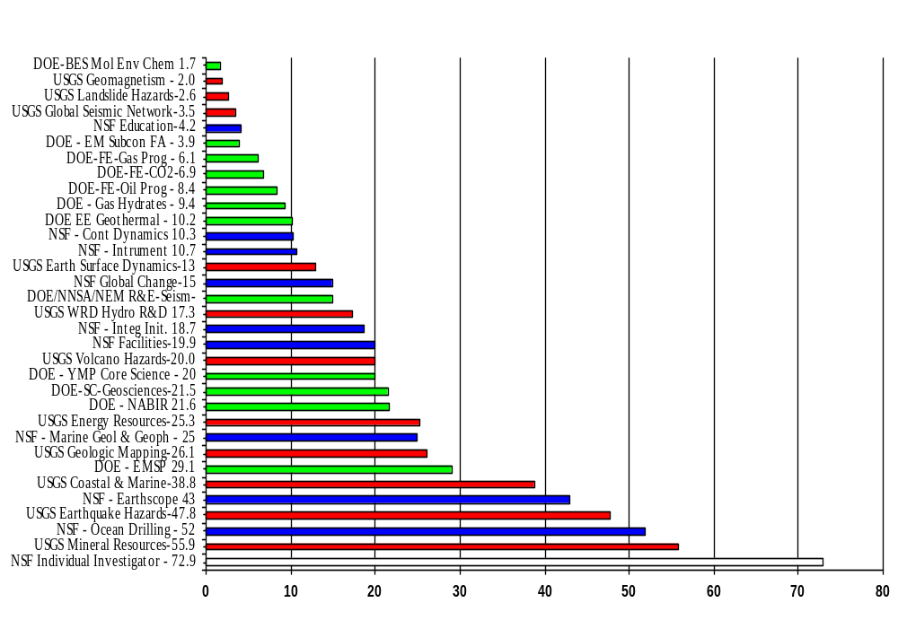
FY 2004 National Research Programs in Geosciences
Directed Research $ 593.3 M
Investigator/Team Basic Research $ 94.4 M (NSF , DOE)
USGS – National assessments
BES - Atomic-to-continuum-scale studies of earth processes and properties important to DOE missions ($21.5 M)
NSF - Geology and Paleontology, Geophysics, Hydrologic Sciences, Petrology and Geochemistry, and Tectonics ($72.9 M)
USGS 11 programs $ 252.3 M
NSF 10 programs $ 271.7 M
DOE 12 programs $ 153.7M
FY04 Total $ 687.7 M

Slide 4
DOE Office of Science
Energy Efficiency and Renewable Energy $1.3B (2004)
Office of Basic
Energy Sciences
Associate Director
Patricia Dehmer
$1019M
Office of
High Energy and
Nuclear Physics
Associate Director
S. Peter Rosen
$1127M
HEP $738M
NP $389M
BES $1.009B
Director
Raymond Orbach
Principal Deputy Director
James F. Decker
Deputy Director for Operations
Milt Johnson
$3.31B
Fossil Energy R&D
$591M
(2004)
Office of
Biological and
Environmental Res.
Associate Director
Aristides Patrinos
$500M
Office of Advanced
Scientific
Computing Res.
Associate Director
Ed Oliver
$173M
Office of Fusion
Energy Sciences
Associate Director
N. Anne Davies
$257M
Office of Resource
Management
Associate Director
John Rodney Clark
Office of Planning
and Analysis
Director
William Valdez
Office of
Laboratory Policy
Director
Antoinette Joseph
Office of Lab.
Operations and
ES&H
Associate Director
James A. Turi
Chicago
Operations Office
Manager
Marvin E. Gunn Jr.
Oakland
Operations Office
Manager
James M. Turner
Oak Ridge
Operations Office
Manager
Gerald Boyd
FY 03 Budget requests

