Slide 1

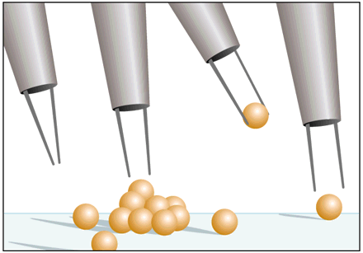
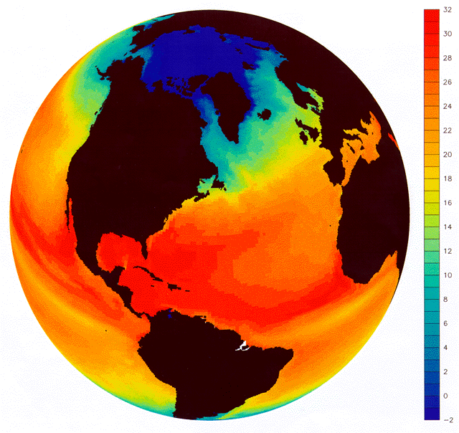

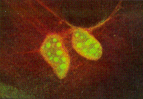
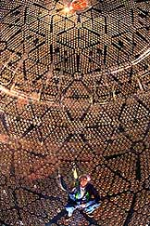
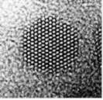
Strength Through Science
University Research Association Policy Forum
Leadership and Cooperation in the Physical Sciences
Dr. Mildred S. Dresselhaus
Former Director, Office of Science
U.S. Department of Energy
January 31, 2001

Slide 2
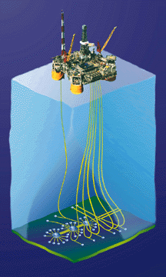
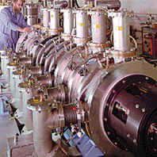

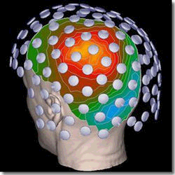
DOE Mission Areas
Energy Resources - To Foster a Secure and Reliable National Energy Supply
National Security - To Maintain the Safety and Reliability of the Nuclear Stockpile
Science...
Environmental Quality
- To Repair the Environmental Consequences of the Cold War

Slide 3
Office of Science Organization
Director
vacant
Principal Deputy Director
James F. Decker
Deputy Director for Operations
Milton Johnson
BESAC
BERAC
HEPAP
NSAC
FESAC
ASCAC
Office of Basic
Energy Sciences
Associate Director
Patricia Dehmer
Office of
Biological and
Environmental Res.
Associate Director
Aristides Patrinos
Office of
High Energy and
Nuclear Physics
Associate Director
S. Peter Rosen
Office of Fusion
Energy Sciences
Associate Director
N. Anne Davies
Office of Advanced
Scientific
Computing Res.
Associate Director
C. Edward Oliver
Office of Resource
Management
Associate Director
John Rodney Clark
Office of Planning
and Analysis
Director
William J. Valdez
Office of
Laboratory Policy
Director
Antoinette Joseph
Office of Lab.
Operations and
ES&H
Associate Director
James Turi
Chicago
Operations Office
Manager
Marvin Gunn
Oak Ridge
Operations Office
Manager
Leah Dever
Berkeley
Site Office
Manager
Richard Nolan
Stanford
Site Office
Manager
John Muhlestein

Slide 4
The Department of Energy is a Science Agency
Top Five Government Research Organizations for*:
Physical Earth and Mathematics Engineering Life R&D
Sciences Environmental & Computing Sciences Facilities
Sciences
1. Energy (2,012)
2. NASA (1, 019)
3. NSF (515)
4. DOD (412)
5. HHS (205)
1. NASA (1,051)
2. NSF (481)
3. DOD (383)
4. INTERIOR (364)
5. Energy (335)
1. DOD (657)
2. Energy (623)
3. NSF (399)
4. HHS (127)
5. COMMERCE (89)
1. NASA (1,948)
2. DOD (1,837)
3. Energy (851)
4. NSF (484)
5. TRANS (323)
1. HHS (11,838)
2. USDA (1,215)
3. DOD (519)
4. NSF (403)
5. Energy (288)
1. Energy (939)
2. NASA (403)
3. DOD (386)
4. NSF (271)
5. HHS (227)
* Numbers are FY 1999 Dollars in Millions - Source: NSF -- Preliminary Federal obligations for research, by agency and field of science and engineering: fiscal year 1999
** Numbers are FY 1999 Dollars in Millions - Source: OMB

Slide 5
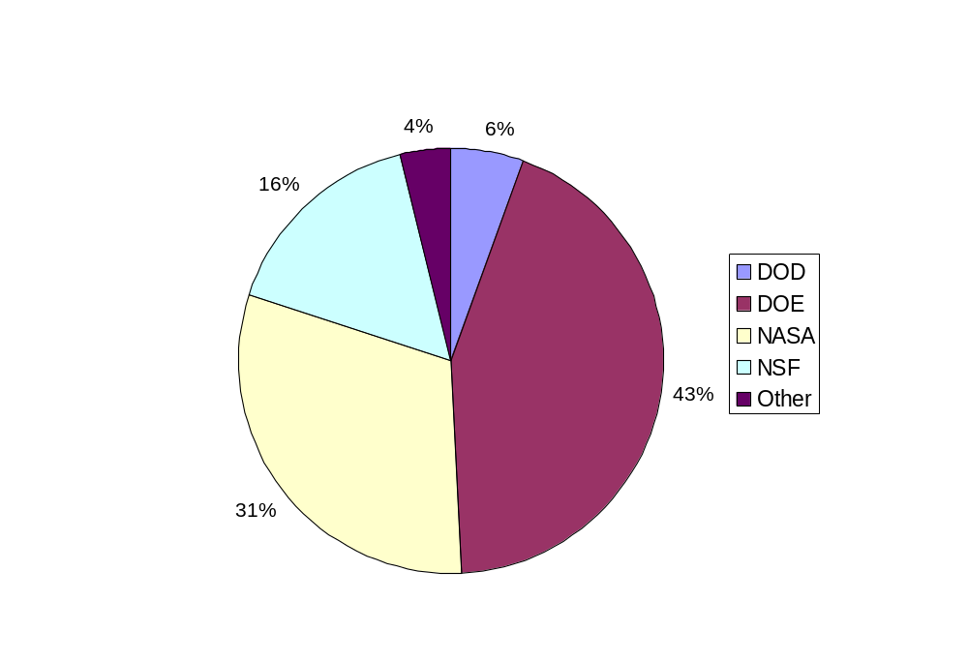
DOE is the Physical Sciences Agency
Federal Support for the Physical Sciences
Source: NSF - Division of Statistical Research Services

Slide 6
Percent of Federal Funding of Research by Field
Federal Obligations for Basic Research
50%
40%
Life Sciences
30%
Share of Federal Funds
Physical Sciences
20%
*
Environmental Sciences
10%
Engineering
0%
Math & Computer Science
1970
1975
1980
1985
1990
1995
Source: OMB Analysis of data from the NSF publication “Federal Funds for Research and Development, Federal Obligations for Research by Agency and Detailed Field of Science and Engineering, Fiscal Years 1970-2000 (NSF 01-306)”
* Includes - Atmospheric & Geological sciences, Oceanography & Environmental sciences, n.e.c.

Slide 7
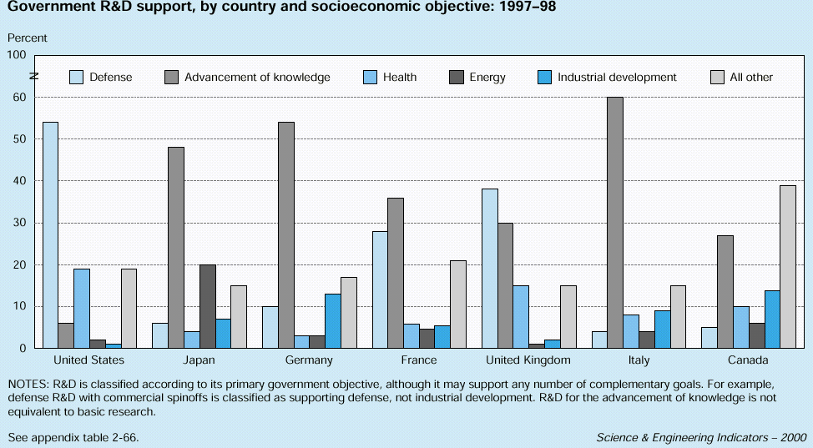
Emphasis on Health Research Much More Pronounced in U.S.
This emphasis is especially notable in support of life sciences in academic institutions.
In 1996, the U.S. Government devoted 18% of its R&D investment to health R&D
Health R&D support approaches 10% of total spending in the governmental R&D budgets of the United Kingdom, Italy, and Canada.

Slide 8
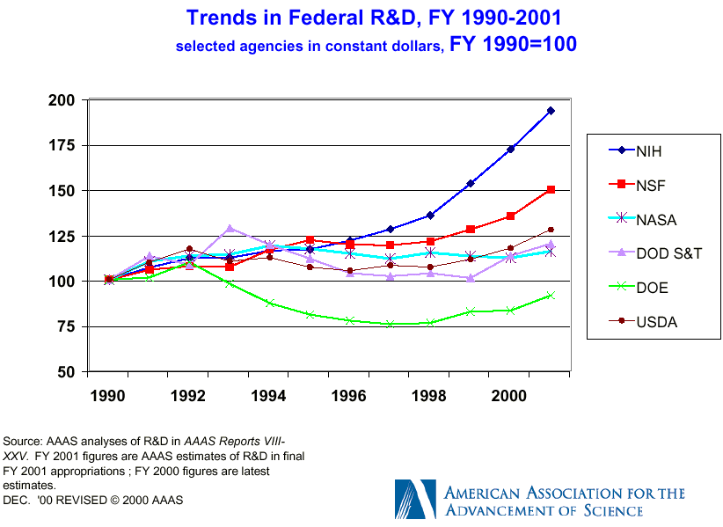
$7.99 Billion (up 12.3% from FY2000)

Slide 9
A Balanced Portfolio - Essential to Progress
Harold Varmus
Squeeze
On Science
In recent weeks both presidential campaigns have voiced their support of efforts to double the budget of the National Institutes of Health. This is an encouraging sign that the current bipartisan enthusiasm for medical re- search will continue in the next administration. But it also offers an opportunity to make an important point about the kinds of science required to achieve breakthroughs against disease.
The NIH does a magnificent job, but it does not hold all the keys to success. The work of several science agencies is required for advances in medical sciences, and the health of some of those agencies is suffering.
For the coming fiscal year, Congress has again--magnanimously and appropriately--slated the NIH for a major increase, its third consecutive 15 percent increase.
“Congress is not addressing with sufficient vigor the compelling needs of the other science agencies, especially the National Science Foundation and the Office of Science at the Department of Energy. This disparity in treatment undermines the balance of the sciences that is essential to progress in all spheres, including medicine.”
“Medical advances may seem like wizardry. But pull back the curtain, and sitting at the lever is a high-energy physicist, a combinational chemist or an engineer.”
“Sens. Bond and Mikulski have proposed to double the budget of the NSF over five years. This admirable effort should be vigorously supported and extended to include the DOE's Office of Science, which funds half of all research in the physical sciences and maintains the national laboratories that are central to biomedicine.”
Wednesday, October 4, 2000; Page A33

Slide 10
National Science Goals
The National Academy of Science Committee on Science, Engineering and Public Policy (COSEPUP) 1993 report entitled “Science, Technology, and the Federal Government: National Goals for a New Era” made two recommendations:
  “ The United States should be among the World leaders in all major areas of science.”
    Supports World Class Research Toward National Goals
    Enables Rapid Response to Breakthroughs in other Nations
    Supports Excellence in University Science Education
    Attract Bright Young Students to Science
  “ The United States should maintain clear leadership in some major areas of science.”
    IF Required by National Objectives
    IF a Field is of a Broad Interest to Society
    IF a Field Significantly Affects Other Areas of Science

Slide 11
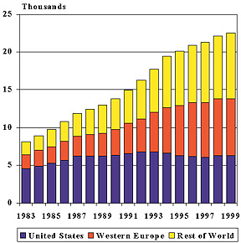
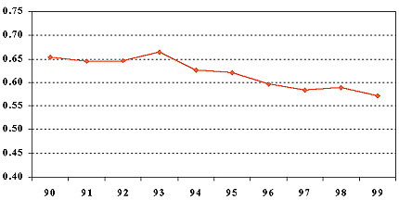
Physical Review & Physical Review Letters
Percent of Submissions Published
Total Submissions
Source: American Physical Society - APS News August/September 2000 - Letter to the Editor - Editor-in-Chief Martin Blume Replies

Slide 12
Declines in DOE Research are Impacting Materials
A COSEPUP panel of expert researchers in, and users of, materials science concluded that
  "the United States is among the world leaders in all subfields of materials science and engineering research and is the leader in some subfields, although not in the field as a whole."
  "a general area of US weakness for most subfields is in materials synthesis and processing. Increasingly, US researchers must rely on specialty materials suppliers in Europe and Japan for bulk crystals and other specialty materials."
The panel warned that the US position is at risk because of insufficient funding to modernize existing facilities and build new ones.

Slide 13
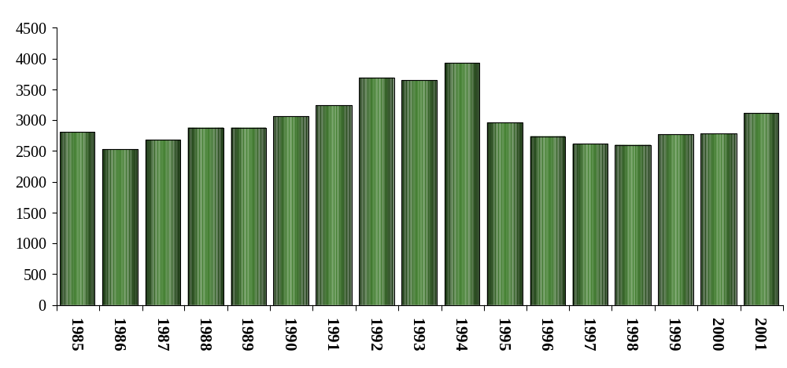
Office of Science Budget History*
{
SSC
$3.122 Billion Constant FY00
$2.788 Billion
Constant 2000 Dollars - in Millions*
$3.186
Billion as Appropriated
*Total Science Budget (in Millions of Constant FY 2000 Dollars) - Does NOT Include Rescission

Slide 14
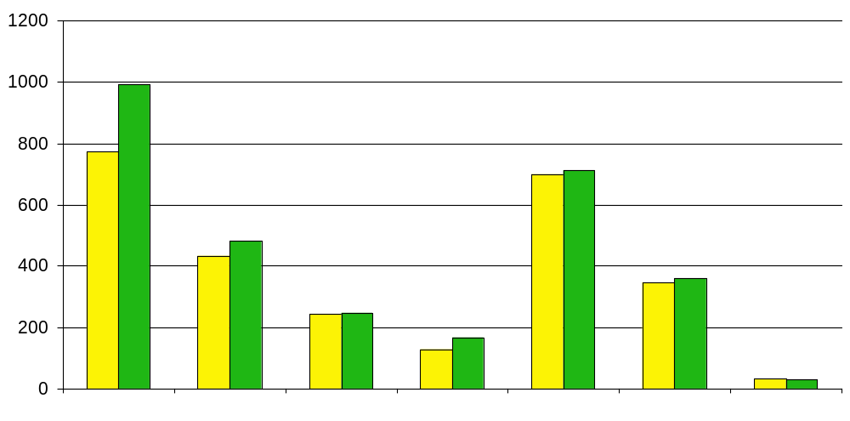
DOE Office of Science Budget
Spallation Neutron Source
$992
$772
($ in Millions)
$698
$712
Congressional Mandates
$483
$433
$348
$361
$245
$248
$128
$166
$33
$30
Basic
Energy
Sciences
Biological &
Environmental
Research
Fusion
Energy
Science
Advanced
Scientific
Computing
Research
High
Energy
Physics
Nuclear
Physics
Multiprogram
Energy Labs-
Facilities
Support
FY 2000
FY 2001 Appropriation with General Reduction allocated; includes $24 Million for Waste Management activities

Slide 15


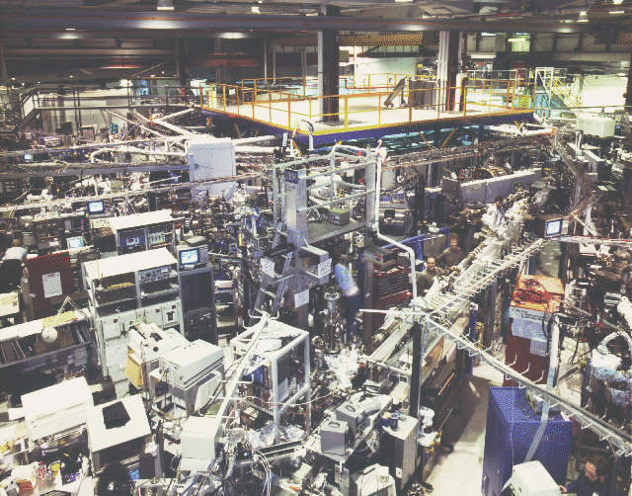
DOE Office of Science FY2001 Budget Highlights
(FY2001 Appropriation, change from FY2000)
Spallation Neutron Source ($278M, +160M)
High-Performance Computing for Science in the 21st Century -- Enhanced Capabilities ($176M, +53M)
Scientific User Facilities Upgrades & Increased Utilization ($1,174M, +14M)
Nanoscale Science, Engineering, & Technology ($83M, +36M)
Life Sciences -- Understanding the Microbial Cell & Microbial Genomes and Biomedical Engineering ($40M, +25M)

Slide 16
Office of Science Major Research Areas
Materials Sciences
Catalysis
Ceramics
Condensed Matter Physics
Corrosion
Electronic Properties of Materials
Experimental Techniques & Instrument Devel.
Intermetallic Alloys
Magnetism and Magnetic Materials
Materials Physics and Chemistry
Mechanical and Physical Behavior
Metallic Glasses
Metallurgy, Metal Forming, Welding & Joining
Neutron and Photon Scattering
Nondestructive Evaluation
Photovoltaics
Polymer Science
Radiation Effects
Solid Dynamics
Structural Characterization
Superconductivity
Surface Science
Synthesis and Processing Science
Theory, Modeling, & Computer Simulation
Geosciences
Geochemistry of Mineral-fluid Interactions
Geophysical Interrogation of Earth’s Crust
Rock-fluid Dynamics
Biogeochemistry
Engineering Sciences
Materials Engineering
Nanotechnology and Microsystems Engineering
Multi-component Fluid Dynamics and Heat Flow
Nonlinear Dynamic Systems
Chemical Sciences
Analytical Chemistry
Atomic, Molecular & Optical Physics
Advanced Batteries & Fuel Cells
Chemical Kinetics
Chemical Physics
Catalysis - Homogeneous and Heterogeneous Phase
Combustion Dynamics
Electrochemistry
Heavy Element Chemistry
Interfacial Chemistry
Organometallic Chemistry
Photochemistry
Photosynthetic Mechanisms
Radiation Effects
Separations Science
Solar Energy Conversion
Theory, Modeling, & Computer Simulation
Thermophysical Properties
Biosciences
Biochemistry, Biocatalysis, Bioenergetics, Biomaterials, and Biophysics
Extremophilic Organisms
Fermentation Microbiology
Photosynthetic Mechanisms
Plant and Microbial Sciences
Plant Genomics
Physics
High Energy and Particle Physics
Heavy Ion & Medium Energy Nuclear Physics
Accelerator and Detector R&D
Particle Astrophysics
Physics Theory
Fusion Sciences
Experimental Plasma Physics
Theory, modeling, and simulation
Accelerator Physics
Plasma Diagnostics R&D
Specialized Materials Science
Tritium Science
Microwave Systems R&D
Integrated Fusion Systems
Life Sciences
Human Genome
Structural Biology
Microbial Genome
Low Dose Radiation Research
Functional Genomics
Human Subjects in Research
Structural Biology Facilities
Genome Instrumentation
Computational & Structural Biology
Medical Sciences
Molecular Radiopharmaceutical Development
Boron Neutron Capture Therapy
Molecular Nuclear Medical Imaging
Imaging Gene Expression
Biomedical Engineering
Environmental Sciences
Decade to Century Climate Modeling
Atmospheric Radiation Measurement (ARM)
Atmospheric Science & Chemistry
Carbon Cycle Research
Ocean Sciences
Ecosystem Function and Response
Information & Integration
Integrated Assessment of Climate Change
Bioremediation of Metals & Radionuclides
Environmental Molecular Sciences Lab
Mathematics and Advanced Computing
Linear Algebra Libraries
Scientific Computing & Network Testbeds
Advanced Computer Science
Applied Mathematics
Advanced Computing Facilities
Advanced Computing Software and
Collaboratory Tools
  BES - Basic Energy Sciences
  HENP - High Energy and Nuclear Physics
  FES - Fusion Energy Sciences
  BER - Biological & Environmental Research
  ASCR - Advanced Scientific Computing Res

Slide 17
Office of Science Scientific User Facilities and the Universities That Utilize Them
Electron Microscopy
Center for
Materials Research
Fermilab
National Synchrotron
Light Source
Environmental Molecular
Sciences Lab
Intense Pulsed
Neutron Source
Advanced Photon
Source
Stanford Linear Accelerator Center
Center for
Microanalysis
of Materials
MIT-Bates Accelerator
Center
Advanced Light
Source
Relative Heavy
Ion Collider
Princeton Plasma Physics Lab
National Center for
Electron Microscopy
Continuous Electron
Beam Accelerator Facility
Stanford Synchrotron
Radiation Laboratory
Surface Modification &
Characterization Center
Combustion
Research Facility
Shared Research
Equipment Program
General
Atomics
88” Cyclotron
Los Alamos Neutron
Science Center
Spallation
Neutron Source
(under construction)
Holyfield Radioactive Ion
Beam Facility
National Energy Research Scientific Computing Facility
Pulse Radiolysis
Facility
High-Flux
Isotope Reactor
James R. MacDonald
Laboratory
SC User Facilities
Universities that Use SC Facilities
DOE EPSCOR States
50% of Facility Users are University Researchers

Slide 18
BES Synchrotron Light Sources
Fiscal Year

Slide 19
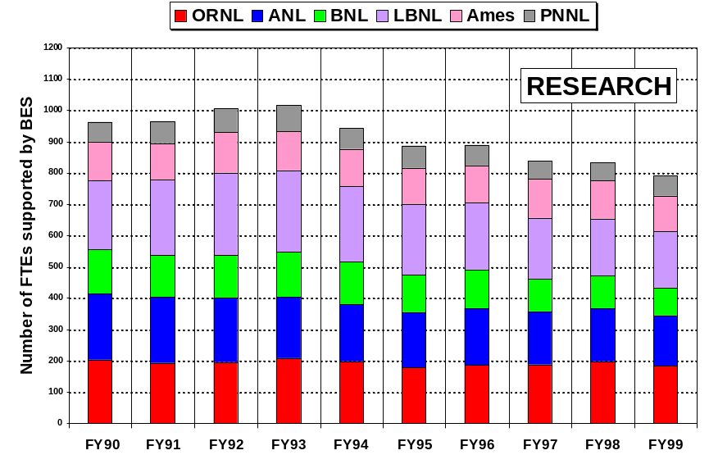
BES Staffing Trends - Research

Slide 20
Staffing Trends at Major Fusion Contractors
2000
450
Staffing
1800
L
L
N
L
400
Funding
G
A
1600
O
R
N
L
6
350
M
I
T
1400
P
P
P
L
300
1200
FTE’s
250
1000
200
$ in Millions (As Spent)
800
150
600
400
100
200
50
0
0
1
9
9
0
1
9
9
1
1
9
9
2
1
9
9
3
1
9
9
4
1
9
9
5
1
9
9
6
1
9
9
7
1
9
9
8
1
9
9
9
2
0
0
0
Fiscal Year

Slide 21
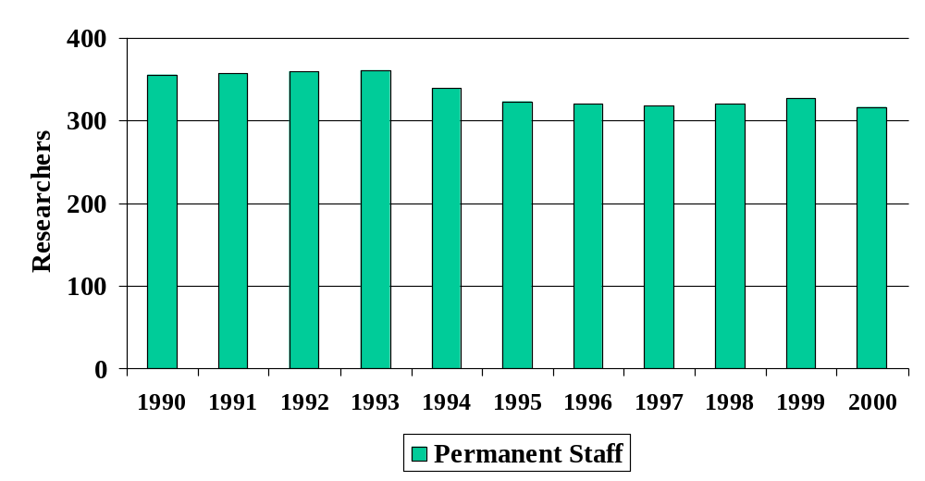
FY2000 Nuclear Physics Manpower Survey
DOE Support Manpower
National Laboratories

Slide 22
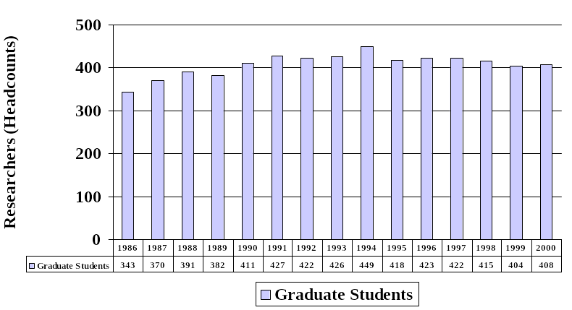
FY2000 Nuclear Physics Manpower Survey
DOE Supported Manpower
Laboratories and Universities

Slide 23
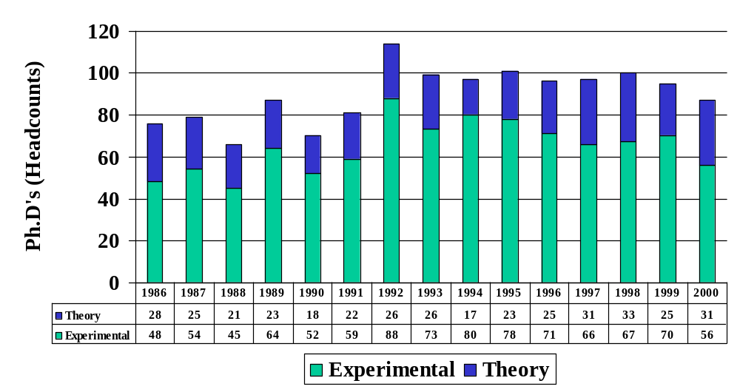
FY2000 Nuclear Physics Manpower Survey
Ph.D.s Awarded

Slide 24
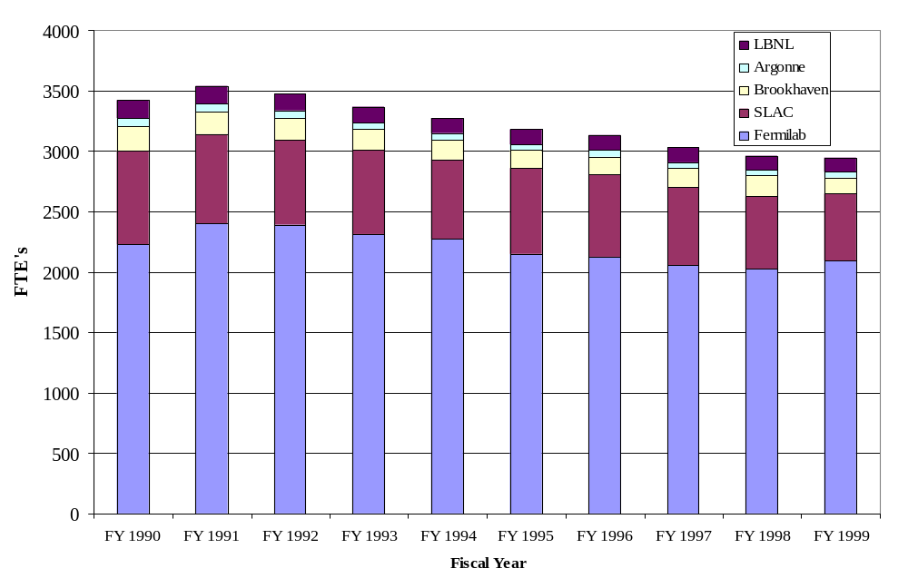
High Energy Physics Staffing Trends

Slide 25
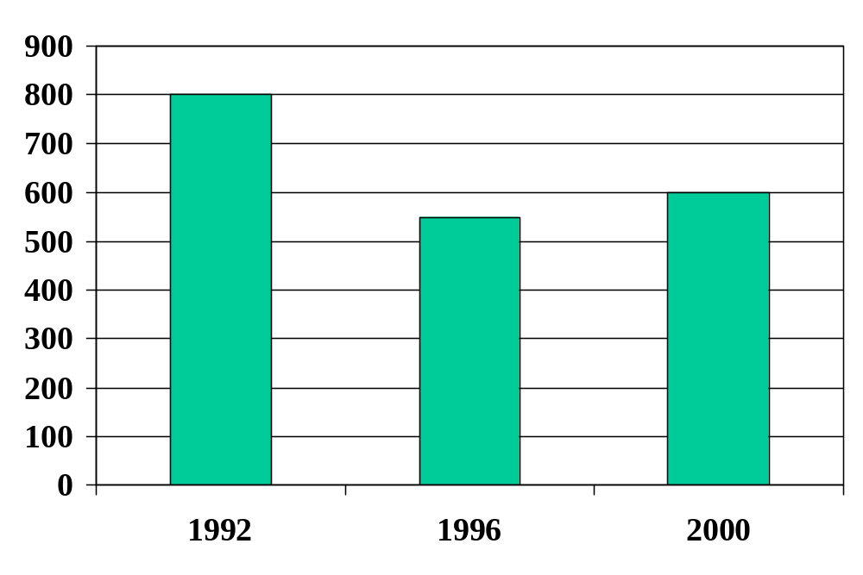
High Energy Physics Graduate Student Trends*
SC Supported University Based Graduate Students
* Data from records of the HEP University Program

Slide 26
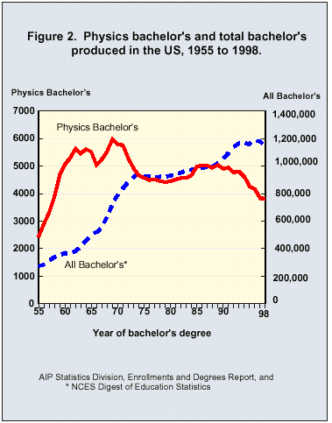
Where are the Students?
In 1997, 24% of U.S.
High School seniors
took Physics
but only 0.3% of U.S. Bachelors Degrees were awarded in Physics

Slide 27
Attrition Starts Early
In 1997-1998, 24% of U.S. High School seniors took Physics
Undergrad. B.S. Physics 1st year Grad M.S. Physics PhD Physics
Physics Majors Awarded Physics Awarded Awarded
7116 5033 3132 1781 1112
5857 3821^ 2423 1365* 1323
1988-1989
1997-1998
* Includes both Terminal / Professional Master’s and Master’s Enroute.
^ 0.3% of U.S. Bachelors Degrees (both B.A. and B.S.) earned.
Source: AIP Statistics Division, Enrollment and Degree Report

