Slide 1

U.S. Department of Energy’s Office of Science
Overview of the Office of Science
for the BESAC Workshop on
Basic Research Needs
to Assure a Secure Energy Future
Dr. James F. Decker, Deputy Director
October 21, 2002

Slide 2
DOE’s Office of Science (SC)
Supports basic research that underpins DOE missions.
  Provides over 40% of federal support to the physical sciences (including more than 90% of high energy and nuclear physics)
  Provides sole support to select sub-fields (e.g. nuclear medicine, heavy element chemistry, magnetic fusion, etc.)
  Supports the research of 15,000 PhDs and graduate students
Constructs and operates large scientific facilities for the U.S. scientific community.
  Accelerators, synchrotron light sources, neutron sources, etc.
  Used by about 18,000 researchers every year
Provides infrastructure support for the ten SC laboratories.

Slide 3
The Department of Energy is a Science Agency
Top Five Government Research Organizations for*:
Physical
Sciences
Mathematics
& Computing
Life
Sciences
Environmental
Sciences
1. Energy (1,938)
2. NASA (1,152)
3. HHS (794)
4. NSF (593)
5. DOD (364)
1. Energy (862)
2. DOD (861)
3. NSF (515)
4. HHS (181)
5. Commerce (78)
1. HHS (18,216)
2. USDA (1,342)
3. DOD (616)
4. NSF (500)
5. Energy (267)
1. NASA (1,113)
2. NSF (515)
3. Interior (353)
4. DOD (301)
5. Energy (298)
* Numbers are FY 2002 dollars in millions - Source: NSF -- Preliminary Federal obligations for research, by agency and field of science and engineering: fiscal year 2002

Slide 4
DOE Provides 43% of Federal Support to the Physical Sciences
Other 4%
DOD 6%
NSF 16%
DOE 43%
NASA 31%
Source: NSF - Division of Statistical Research Services

Slide 5
Office of Science Organization
Director
Raymond L. Orbach
Principal Deputy Director
James F. Decker
Deputy Director for Operations
Milton Johnson
BESAC
BERAC
HEPAP
NSAC
FESAC
ASCAC
Office of Basic
Energy Sciences
Associate Director
Patricia Dehmer
Office of
Biological and
Environmental Res.
Associate Director
Aristides Patrinos
Office of
High Energy and
Nuclear Physics
Associate Director
S. Peter Rosen
Office of Fusion
Energy Sciences
Associate Director
N. Anne Davies
Office of Advanced
Scientific
Computing Res.
Associate Director
C. Edward Oliver
Office of Resource
Management
Associate Director
John Rodney Clark
Office of Planning
and Analysis
Director
William J. Valdez
Office of
Laboratory Policy
Director
Antoinette Joseph
Office of Lab.
Operations and
ES&H
Associate Director
James Turi
Chicago
Operations Office
Manager
Marvin Gunn
Oak Ridge
Operations Office
Manager
Leah Dever
Berkeley
Site Office
Manager
Richard Nolan
Stanford
Site Office
Manager
John Muhlestein

Slide 6
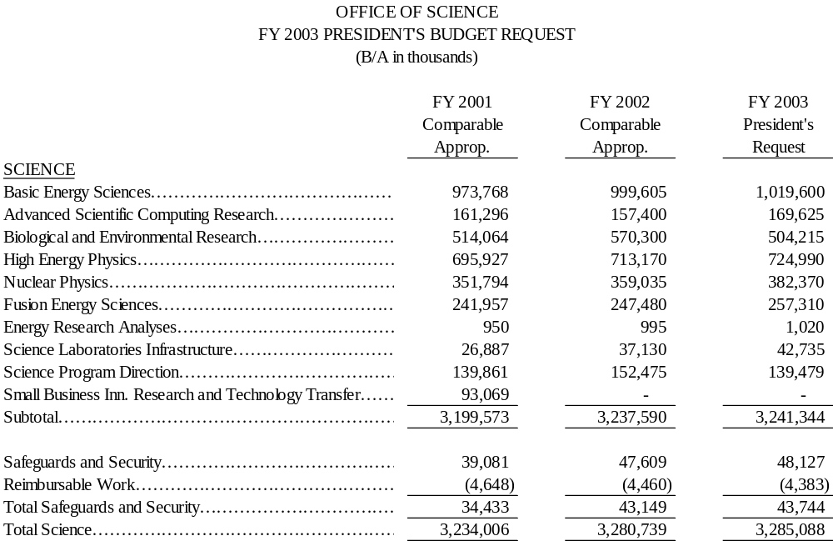
FY2003 Budget Request

Slide 7
SC Laboratories, User Facilities, and the Institutions that Use Them
Fermi
National
Accelerator
Laboratory
National Energy Technology Laboratory
Pacific Northwest
National Laboratory
Idaho National Environmental & Engineering Laboratory
Ames Laboratory
Argonne National
Laboratory
Lawrence
Berkeley National
Laboratory
Brookhaven
National
Laboratory
Princeton
Plasma
Physics
Laboratory
Stanford
Linear
Accelerator
Center
Thomas Jefferson National Accelerator Facility
Lawrence Livermore
National Laboratory
General Atomics
Oak Ridge
National Laboratory
Los Alamos
National Laboratory
National
Renewable Energy Laboratory
Sandia
National Laboratories
SC Supported Research Institution (Universities, Colleges, Medical Centers)
User Facilities
SC Multiprogram Laboratory
SC Program Dedicated Laboratory
Other DOE Laboratory

Slide 8
Basic Energy Sciences
Research
Science at the nanoscale: increased research in condensed matter physics and materials synthesis and processing.
  X-ray and neutron scattering: research and new instrumentation at the major user facilities.
  Other core research programs: heavy-element chemistry, separations and analysis, materials chemistry, photochemistry, combustion, and catalysis.
Facilities
  New and upgraded instrumentation.
  Continued high level of service at major user facilities.
Construction, Engineering & Design
  Construction of the Spallation Neutron Source is fully funded.
  Nanoscale Science Research Centers (NSRC): continue engineering & design at ORNL, LBNL, SNL/LANL.
  Begin construction of the NSRC at ORNL.
  The Linac Coherent Light Source at SLAC begins project engineering and design.

Slide 9
Biological and Environmental Research
Genomes to Life will enable revolutionary advances in energy supply, greenhouse gas mitigation, and environmental cleanup.
    Bioterrorism detection/defeat.
The Human Genome Program will provide high quality complete sequence of Chromosomes 5, 16, and 19.
Climate Change Research underpins the President’s initiative. Research and observations will improve climate models and understanding of the global carbon cycle.
Climate Change Research Initiative.
The Environmental Management Science Program is transferred from the Office of Environmental Management.
Boron Neutron Capture Therapy.

Slide 10
Genomes to Life
Genomes to Life builds on advances in sequencing, molecular science and computing to understand and eventually harness microbes and microbial communities to address DOE’s energy, environmental and national security missions. In FY 2003 we will:
Continue joint research that combines capabilities of DOE’s advanced biological and computational sciences programs.
Support DNA sequencing of microbes closely related to potential bio-threat agents.
Determine the composite DNA sequence and functional capability of microbes in a complex microbial community to address DOE energy, environmental, and national security needs.
Begin the complex task of characterizing all of the multi-protein molecular machines and their associated regulatory networks in microbes of importance to DOE's energy, environmental, and national security missions.
$15M increase enables full funding for up to 4 multidisciplinary, multi institutional research teams at universities and national labs needed to address the 4 goals of Genomes to Life.

Slide 11
Fusion Energy Sciences
Science and Enabling R&D
  Innovation in fusion energy, plasma science and related technologies are part of the Administration’s National Energy Policy.
  Explore innovative approaches to confining, heating, and fueling plasmas.
Facilities
  Significantly increase operating time on three national fusion facilities to resolve issues in energy transport and plasma stability, using a variety of heating techniques.
Fabrication, Engineering & Design
  Expand concept innovation with fabrication of a new stellarator, the National Compact Stellarator Experiment (NCSX), at the Princeton Plasma Physics Laboratory

Slide 12
High Energy & Nuclear Physics
Nuclear Physics
High Energy Physics
Increased facility operating time to:
Exploit the opportunity to answer two key questions about matter and energy:
Create and study a quark-gluon plasma at the Relativistic Heavy Ion Collider
Explore how quarks bind together to form protons and neutrons at the Continuous Electron Beam Accelerator Facility
Explore the origin of mass in the search for the Higgs boson at the Tevatron
Understand the absence of antimatter in the Universe by studying Charge-Parity Violation at the B-Factory

Slide 13
Advanced Scientific Computing Research
Mathematical, Information, & Computational Sciences
  Supports operation of supercomputer and network facilities available to researchers 24-7-365:
    National Energy Research Scientific Computing Center (NERSC),
    Advanced Computing Research Testbeds, and
    Energy Sciences Network (ESNet).
  Scientific Computing Research Investments:
    Applied Mathematics,
    Computer Science, and
    Advanced Computing Software Tools.
  High Performance Networking, Middleware and Collaboratory Research Investments:
    Networking,
    Collaboratory Tools, and
    National Collaboratory Pilot Projects.
Laboratory Technology Research

Slide 14
Scientific Discovery through Advanced Computation
SciDAC brings the power of tera-scale computing and information technologies to several scientific areas -- breakthroughs through simulation.
SciDAC is building community simulation models through collaborations among application scientists, mathematicians and computer scientists -- research tools for plasma physics, climate prediction, combustion, etc.
State-of-the-art electronic collaboration tools will facilitate the access of these tools to the broader scientific community to bring simulation to a level of parity with theory & observation in the scientific enterprise.
Topical Computing (TC)
  FY03 increases will reconfigure some resources at existing
  facilities around TC concept.
  These facilities will support applications communities to
  develop the operational model.
  Full-scale TC facilities will be proposed in FY-04.

Slide 15
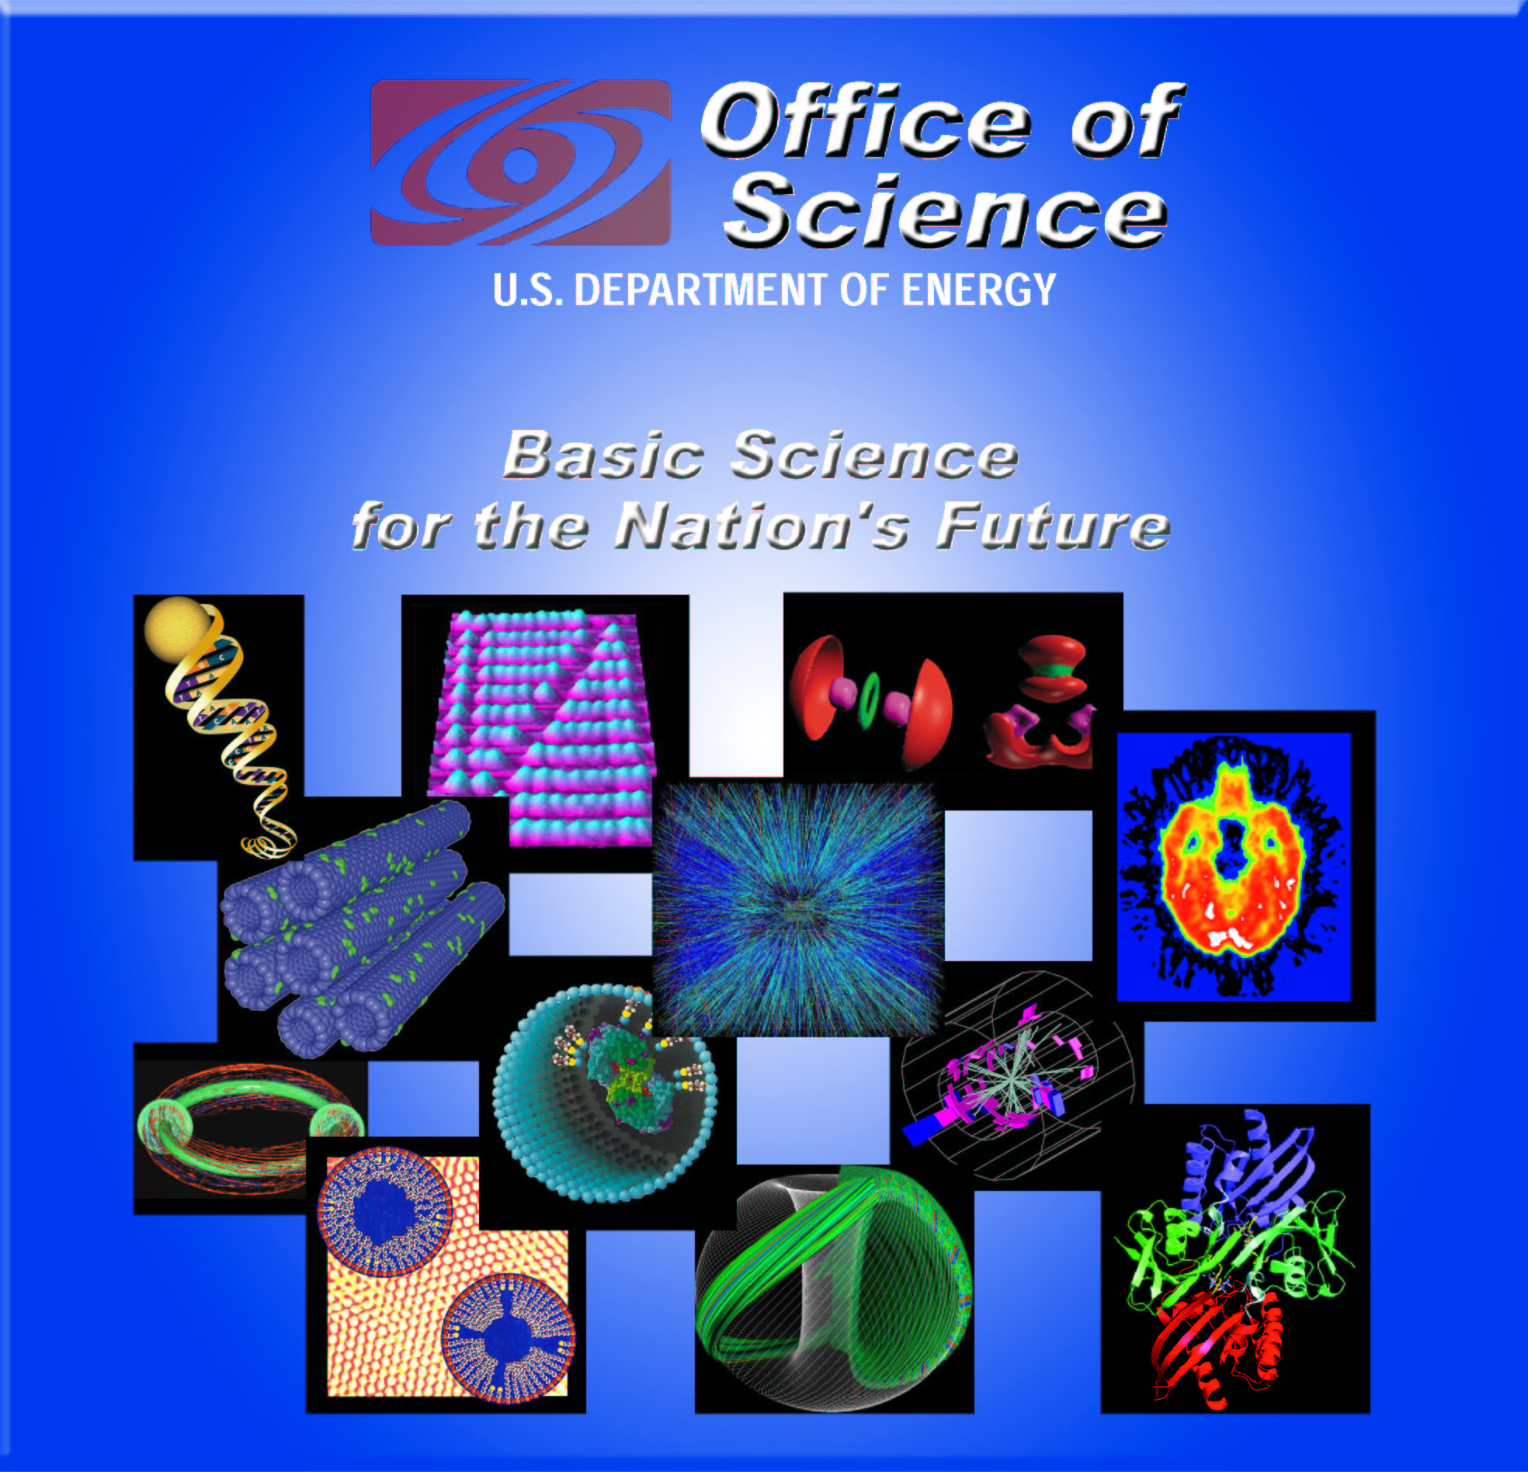
The Future
Reasserting U.S. Leadership in Scientific Computation
The Beauty of Nanoscale Science
Building a 21st Century Workforce
Dark Energy—the Mystery that Dominates the Universe
Fusion: Bringing a Star to Earth
Scientific Foundations for Countering Terrorism
Using Nature’s Own Tool Kit to Clean Up the Environment
Biotechnology for Energy Security
Occasional Papers
Spring 2002

