Slide 1

U.S. Department of Energy’s
Office of Science
Advanced Scientific Computing Research
Introduction to Strategic Plan
Dan Hitchcock
7/22/03

Slide 2
What is Purpose of Meeting?
Participate in development of Strategic Plan for ASCR

Slide 3
Purpose of a Strategic Plan
Create a shared vision for a technology area based on the capability needs of users, now and in the future.
Develop a common understanding of what technology/capabilities will be needed by when—and what will be available, by when.
Communicate technological needs and expectations among users and those developing new capabilities.
Tell a cogent story about what is important to do in a research area and why.
Notes:
Tailor to meet your needs!

Slide 4
The Big Idea
“we’d like to have…”
Strategic Mission Needs
Science,
Technology,
Products & Services
“we can supply…”

Slide 5
The Hard Parts
Getting stakeholders to participate.
Getting participants to be a precise as possible.
Staying on track—and focused on the outcome.
Putting it all together.

Slide 6
What You Get from a Strategic Plan
A common understanding of what is most important to do.
Increased “buy-in” from user community.
Increased cross-pollination in research community.
A clearer, more focused story about what you are doing and why.

Slide 7
Context: Previous Workshops and Reports
Blueprint for Future Science Middleware and Grid Research and Infrastructure, August 2002
  http://www.nsf-middleware.org/MAGIC/default.htm
DOE Science Network Meeting, June 2003
  http://gate.hep.anl.gov/may/ScienceNetworkingWorkshop/
DOE Science Computing Conference, June 2003
  http://www.doe-sci-comp.info
Science Case for Large Scale Simulation, June 2003
  www.pnl.gov/scales/
Workshop on the Road Map for the Revitalization of High End Computing
  http://www.cra.org/Activities/workshops/nitrd/
Cyberinfrastructure Report
  http://www.cise.nsf.gov/evnt/reports/toc.htm

Slide 8
Structure of this Workshop
5 Discussions by Program Area
  Applied Mathematics
  Computer Science
  Network Environment Research
  Partnerships and Pilots
  Facilities
Discussion of interagency collaborations and program integration
Opportunity for breakouts to supplement plenary discussions

Slide 9
Template for Program Area Discussions
Contribution of Program Element to Overall ASCR Strategic Goal:
Planning horizon for Program Element:
Areas of research Program Element currently invests in:
How does Program Element transfer knowledge or provide services to application scientists?
Program Element Strengths:
Program Area Weaknesses:
Program Element Opportunities:
Program Element Threats:
Program Element Gap Analysis:

Slide 10
Advanced Scientific Computing Research (ASCR)
Mission:
Deliver forefront computational and networking capabilities to scientists nationwide that enable them to extend the frontiers of science, answering critical questions that range from the function of living cells to the power of fusion energy.

Slide 11
ASCR in Relationship to Office of Science
Office of Science
NOTE: Director of Science equivalent to
Assistant Secretary position and filled by
Presidential Appointment (Senate confirmed);
Principal Deputy Director equivalent to Principal
Deputy Assistant Secretary; Associate Directors
equivalent to Deputy Assistant Secretaries.
Director
Raymond L. Orbach
Principal Deputy Director
James F. Decker
Deputy Director for Operations
Milton D. Johnson
Chief of Staff
Jeffrey T. Salmon
Office of Basic
Energy Sciences
Associate Director
Patricia M. Dehmer
Office of
Biological and
Environmental
Research
Associate Director
Aristides Patrinos
Office of
High Energy and
Nuclear Physics
Associate Director
S. Peter Rosen
Office of Fusion
Energy Sciences
Associate Director
N. Anne Davies
Office of Advanced
Scientific
Computing Research
Associate Director
C. Edward Oliver
Office of Resource
Management
Associate Director
John Rodney Clark
Office of Planning
and Analysis
Director
William J. Valdez
Office of Information
Technology
Management
Senior Information
Management
Executive
C. Edward Oliver
(Acting)
Office of
Laboratory Policy
Director
Antionette Joseph
Office of Laboratory
Operations and
ES&H
Associate Director
G. Leah Dever
Chicago
Operations Office
Manager
Marvin E. Gunn, Jr.
Oak Ridge
Operations Office
Manager
Gerald G. Boyd
Berkeley
Site Office
Director
Richard H. Nolan
Stanford
Site Office
Director
John S. Muhlestein
www.science.doe.gov

Slide 12
ASCR in Relationship to Federal IT Research
White House
U.S. Congress
President’s Information Technology Advisory Committee
(PITAC)
OSTP/OMB
National Science & Technology Council
(NSTC)
Senior Principal’s Group for IT
National Coordination Office for Computing, Information and Communications
NCO/CIC
Interagency Working Group on IT R&D
IWG/ITR&D
Participating Agencies
AHRQ, DARPA, DOE, EPA, NASA, NIST, NOAA, NSA, NSF, OSD/URI
HECC
High End Computing and Communication
Coordinating Group
LSN
Large Scale Networking
Coordinating Group
HCI&IM
Human Computer Interface & Information Management
Coordinating Group
HCSS
High Confidence Systems & Software
Coordinating Group
SDP
Software Design & Productivity
Coordinating Group
SEW
Social, Economic & Workforce Implications of IT and IT Workforce Development
Coordinating Group
Joint Engineering Team (JET)
Network Research Team (NRT)
== DOE Direct Involvement
Middleware and Grid Infrastructure Coordination (MaGIC)

Slide 13

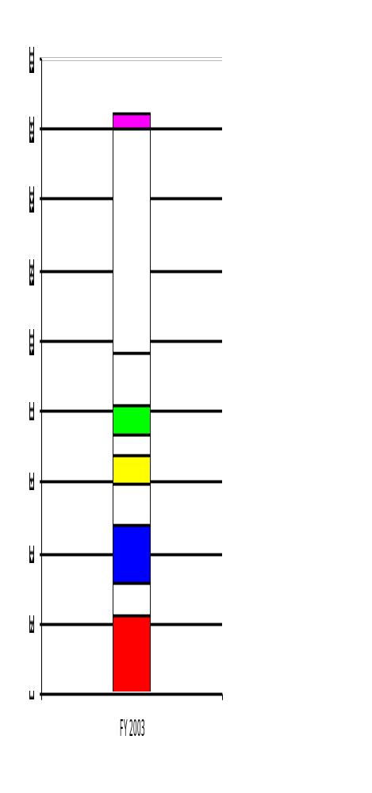
ASCR Supports end-to-end Process of Scientific Discovery
FY 2003 Budget
Research
Idea
Applied
Math
Computer
Science
$160M
$140M
ESnet
Analyze/Integrate &
Visualize
Data
Develop Mathematical Model
$120M
Collaborate,
Deliver Data,
Remote Access
Data from Experiments
$100M
Partnerships
$ 80M
Store/Organize
Data
Develop/Modify
Scientific
Application
$ 60M
Collaboratories
Network
Research
$ 40M
Run/Optimize
Scientific
Application
$ 20M
NERSC
ACRTs
SciDAC

Slide 14
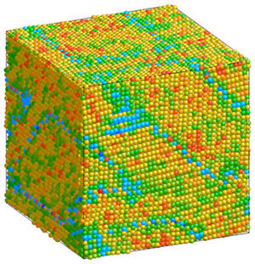

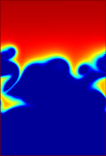

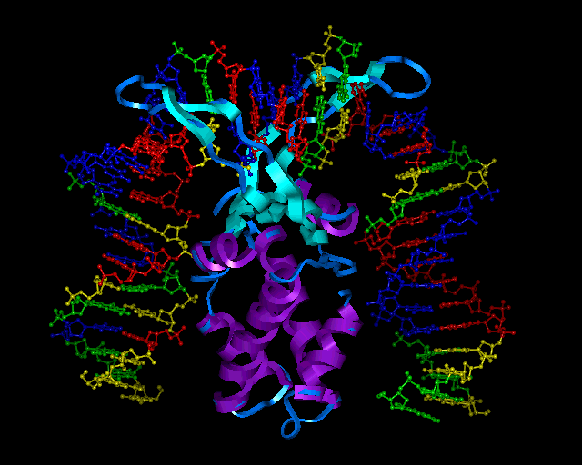
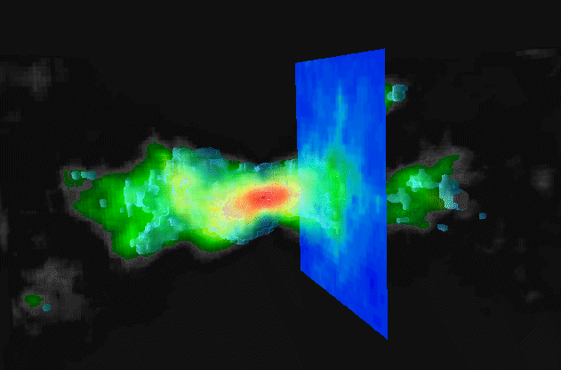

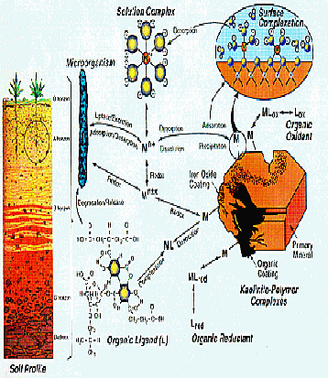
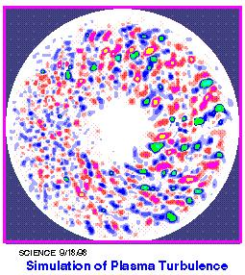
Scientific Discovery Through Advanced Computation (SciDAC)
Brings the power of terascale computing to science
Hardware
Infrastructure
Software Infrastructure
A
R
C
H
I
T
E
C
T
U
R
E
COMPUTING SYSTEMS
SOFTWARE
M
A
T
H
E
M
A
T
I
C
S
S
C
I
E
N
T
I
F
I
C
S
I
M
U
L
A
T
I
O
N
O
P
E
R
A
T
I
N
G
R
E
S
E
A
R
C
H
S
Y
S
T
E
M
Data Analysis &
Visualization
C
O
D
E
S
Programming
Environments
Scientific Data
Management
Problem-solving
Environments
ASCR
BES, BER
FES, HENP
State-of-the-art electronic collaboration tools will facilitate access to these tools to bring simulation to a level of parity with theory and experiment in the scientific enterprise.

