Slide 1
A National Surveillance System for West Nile Virus in Zoological Institutions
Dominic Travis, Lincoln Park Zoo
Tracey McNamara, Wildlife Conservation Society
Amy Glaser, Animal Health Diagnostic Lab, Cornell University
Roy Campbell, DVBID, CDC
Duane Gubler, DVBID, CDC

Slide 2
Background
June 2001 meeting
  The National West Nile virus Zoological Surveillance system working group
Guidelines: Surveillance for West Nile Virus in Zoological Institutions
One-year pilot study for national zoological surveillance (Aug ’01 – Aug ’02)
Objectives
  Affordable/reliable testing for zoos
  Novel data source for national surveillance
  Increase relationships btw PH and Zoos/Vet Med

Slide 3
Sampling Scheme
Phase I:
Begun August 2001 – current
Solicited tissue/blood samples from ill/dead at-risk animals found on zoo grounds (captive/local wildlife)
At-risk animals = any animal (any taxa) housed outdoors and at risk of mosquito exposure

Slide 4
Sampling Scheme (cont.)
Phase II:
Serosurvey of at-risk animals
  Entire country w/emphasis on emerging region
Archived serum/plasma 6 months prior to first known positive in each state
Opportunistically collected blood samples from healthy animals
  Seropositive follow-up to evaluate long term sequelae of WNV exposure
  Data on varying susceptibilities and rates of WNV seroconversion in zoo species and indigenous wildlife.

Slide 5
Diagnostics
Animal Health Diagnostic Laboratory at Cornell University, College of Veterinary Medicine performs all tests required for the project.
Tissues are tested by RT-PCR and virus isolation
Serum and plasma tested for virus and/or antibody, depending on history

Slide 6
Looking for Virus
RT-PCR for WNV
  Positives confirmed with virus isolation or second independent RT-PCR
All tissues processed for virus isolation
  Identification of all viruses observed
    Avian reovirus

Slide 7
Looking for Antibody
Screen serum or plasma at 1:40 by PRNT
Positives are titrated to a dilution of 1:640 against WNV and SLE

Slide 8
Results Aug 1, 2001 – Feb 28, 2002
Over 1,450 animals tested
  967 birds (195 species)
  40 equids (8 species)
  436 other mammals (110 species)
  20 reptiles (6 species)
64 participating institutions ( 20 more will submit in spring ’02)
30 states including the District of Colombia

Slide 9
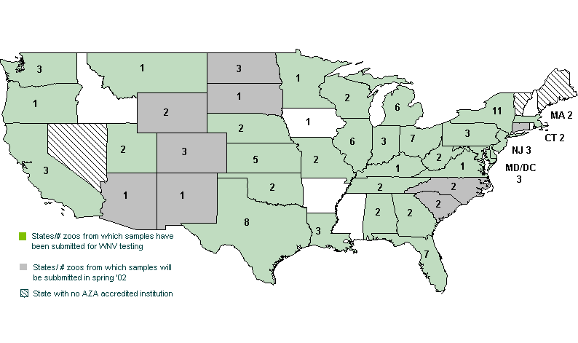
Sample Distribution

Slide 10
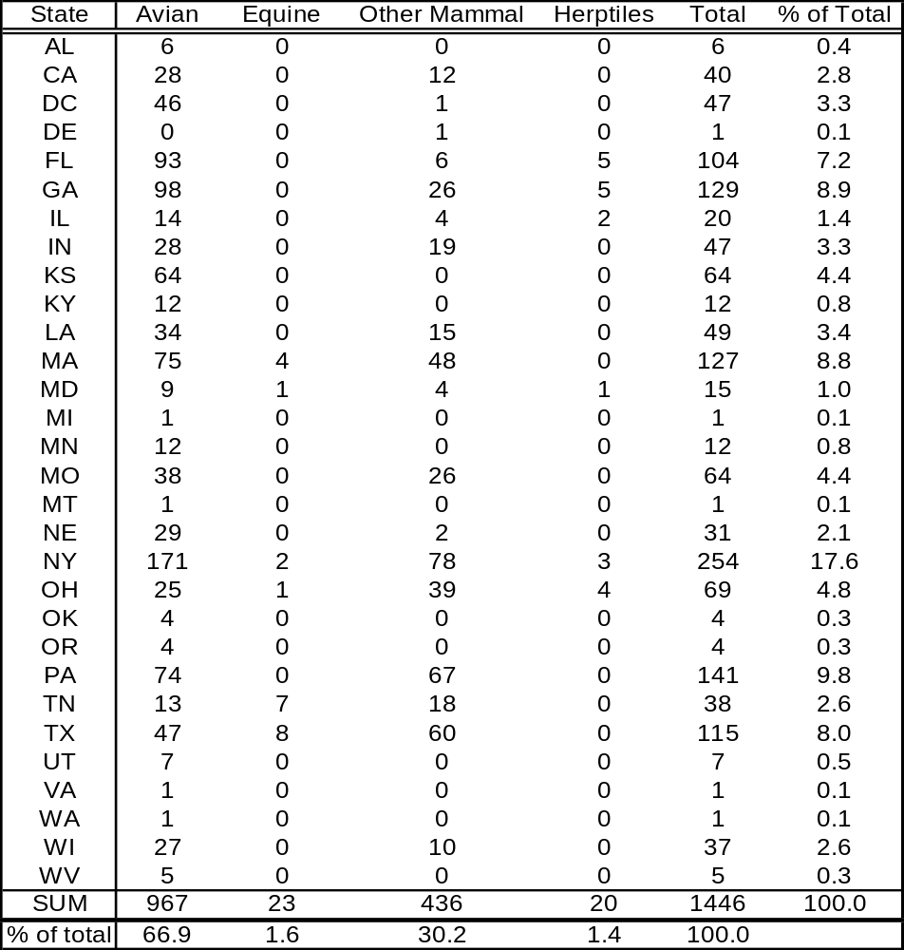

Slide 11
Confirmed Results
30 WNV antibody-positive birds (1 wild, 29 captive)
29 WNV virus-positive birds (16 wild, 13 captive)
1 WNV antibody-positive reptile (captive crocodile monitor)
1 captive bird was antibody-positive for St. Louis encephalitis virus (SLE) in GA
13 animals (10 avian, 2 mammal, 1 reptile) screened antibody-positive and are currently undergoing confirmatory testing.

Slide 12
Distribution of WNV Positives
Antibody positive animals - zoos from 9 states
  FL, GA, LA, MA, MD/DC, NY, PA, TN, WI
Virus-positive animals - zoos from 4 states
  MD/DC, GA, NY, PA
All (antibody and virus) were from known WNV-endemic areas in the United States
No positive zoo sample has predated the first positive predated the first event in any area

Slide 13
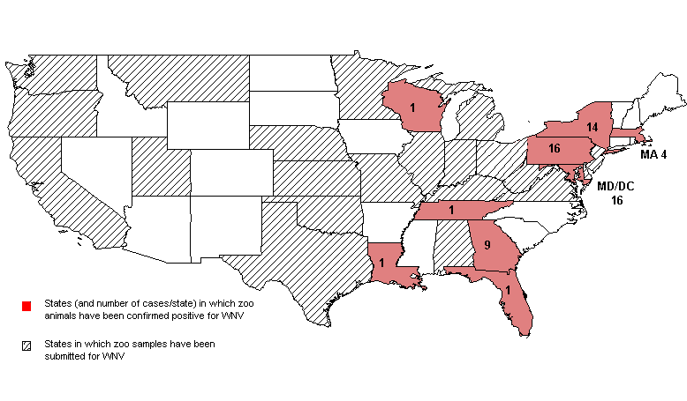
Confirmed Positive Distribution

Slide 14
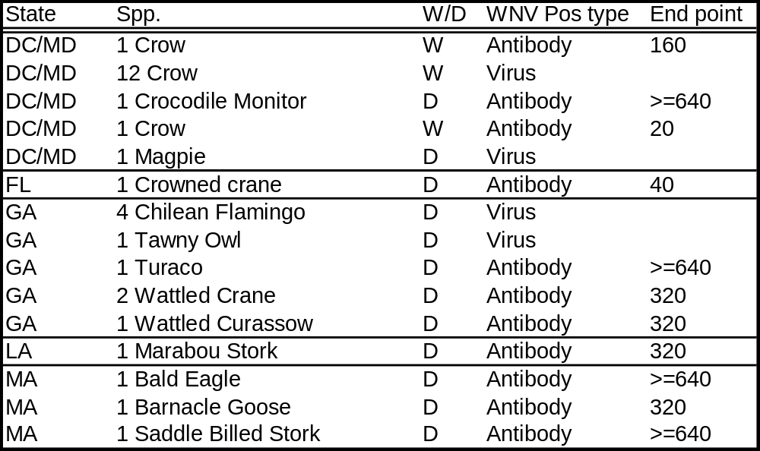

Slide 15
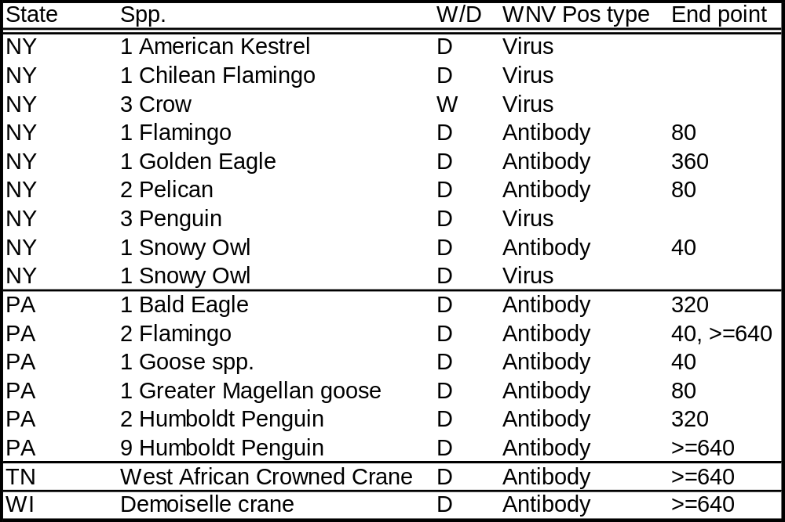

Slide 16
Clinical Illness
6 (21%) WNV virus-positive captive animals exhibited clinical signs of illness
  23 (79%) were found dead in exhibits or on zoo grounds.
6 (20%) WNV antibody-positive animals presented with neurologic clinical signs (including one wild crow and the crocodile monitor)
  24 (80%) were found through serosurvey.

Slide 17
Inconclusive Results
7 captive animals (6 birds, 1 African wild dog) were WNV antibody-positive upon screening but could not be conclusively classified as WNV or SLE upon end-point titration
4 captive birds WNV virus-positive by PCR were not confirmed by virus isolation
1 captive bird that was WNV antibody-negative but WNV virus-positive

Slide 18
Other Interesting Findings
6 wild crows found culture-positive for an unidentified virus of the family Reoviridae
6 birds were shipped to one institution from Africa with weakly positive antibody titers to WNV found in serum samples archived during quarantine.

Slide 19
Reporting Structure
Results reported to submitting institution and central zoo database
Submitting institutions required to report to local PH
  Local PH code and incorporate data into national system
Validation survey in progress
  30 institutions validated

Slide 20
Conclusions
Phase I and II have:
  Created/strengthened relationships between zoos and local/state health officials for the detection/reporting of a zoonotic disease threat.
  Provided data to the public health system
  Given zoos an avenue for testing endangered species
Future Directions:
  This project created a framework that may be applied to other biologic threats of concern.
  Regional diagnostic centers
  Vaccination

Slide 21
Working Group Members
Bruce Akey, VA Dept. Agriculture
Wilbur Amand, American Association of Zoo Veterinarians
Robyn Barbiers, Lincoln Park Zoo
Bobby Brown, CDC
Grant Campbell, CDC, DVBID
Pamela Diaz, Chicago Department of Public Health
Cindy Driscoll, MD Dept. Nat. Res.
Ed DuBovi, Cornell College of Veterinary Medicine
Millicent Eidson, NY State Dept. of Health
Amy Glaser, Cornell College of Veterinary Medicine
Thomas Gomez, USDA, APHIS, VS
Duane Gubler, CDC, DVBID
Nicholas Komar, CDC, DVBID
Laura Kramer, NY State Dept. of Health
Bob McLean, USGS, National Wildlife Health Center
Rita McManamon, Zoo Atlanta
Tracey McNamara, Wildlife Conservation Society
Hayley Murphy, Zoo New England
Eileen Ostlund, USDA, NVSL
Mary Grace Stobierski, MI Dept. of Community Health
Scott Terrell, Disney's Animal Kingdom
Kristin Vehrs, American Zoo and Aquarium Association

