Slide 1
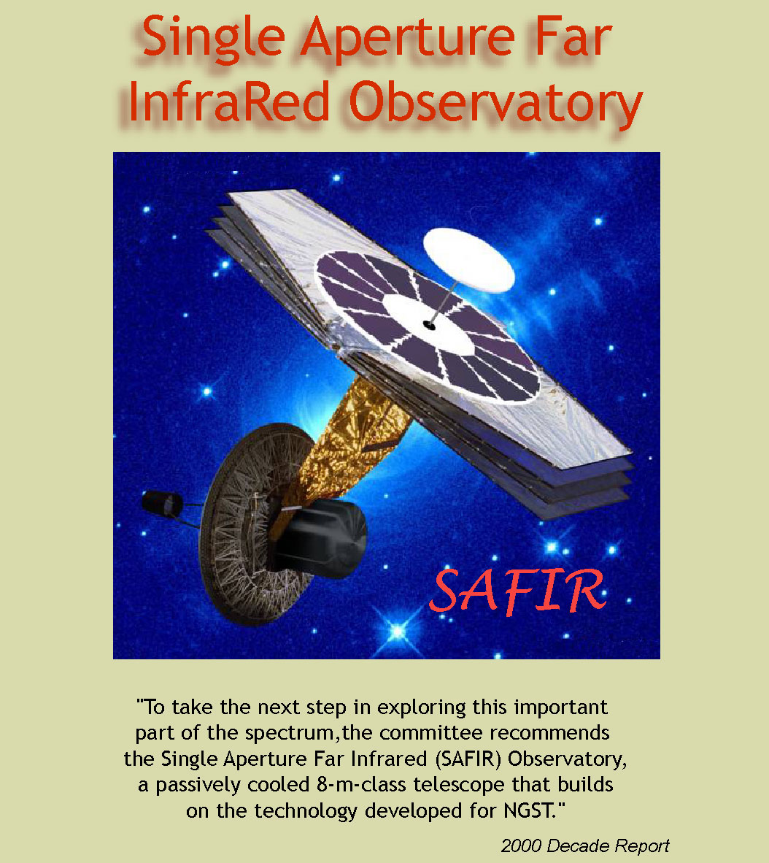
Paul M. Harveyª
George H. Rieke^{b}
Daniel F. Lesterª
Dominic J. Benford^{c}
ªUniversity of Texas
^{b}University of Arizona
^{c}Goddard Space Flight Center

Slide 2
SAFIR
Single Aperture Far-Infrared Observatory
Basic observatory parameters
  10-m Class
  Operating temperature ~ 4K
  Wavelength range 20 – 500+ μm
  Lifetime > 5 years
SAFIR concept embraces FAIR and DART mission goals as well
Decadal Survey Recommendation

Slide 3
Context of the SAFIR Mission
A Far-IR mission with sensitivity and resolution to complement and enhance the investments in neighbouring spectral regions
2000-2010 Decade
  SIRTF launch and mission completion
  SOFIA operating
  Herschel Space Observatory launched
  NGST near completion
  ALMA begins operations
Rapid progress possible due to slow start for Far-IR

Slide 4
SAFIR Science Drivers
The Ubiquity of Far-IR/Submm Radiation
Dust is an extremely efficient reprocessor of short wavelength radiation into IR/Submm
The young distant universe is redshifted from the visible/NIR to Far-IR/Submm
Young objects are cool −> both line and continuum emission occur at long λ

Slide 5
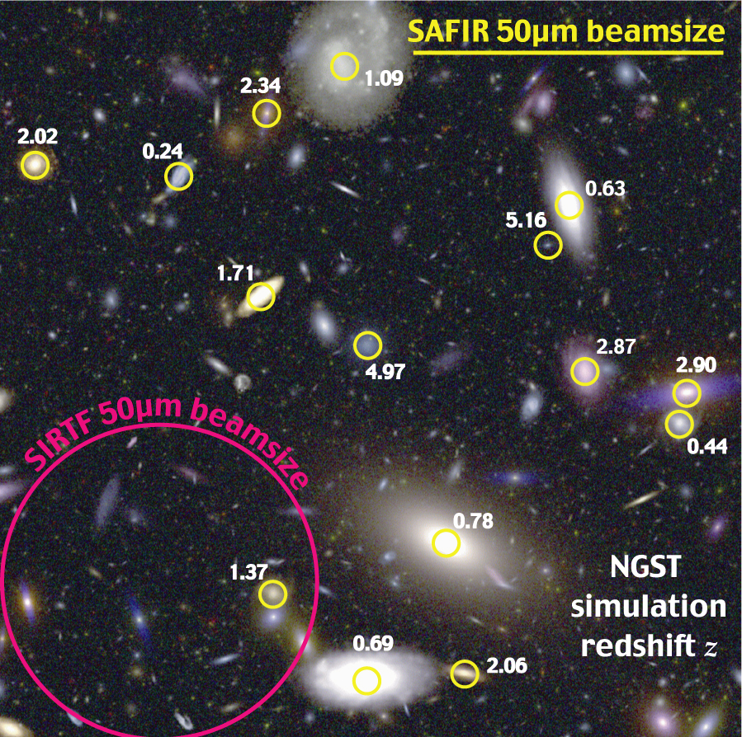
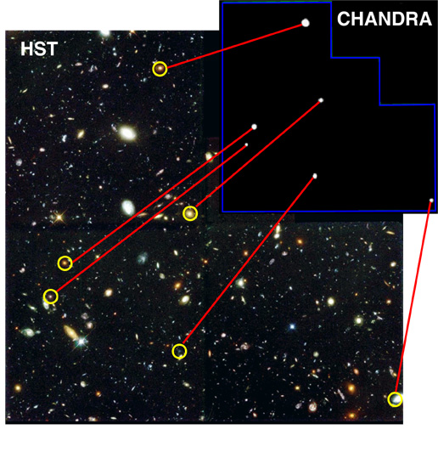
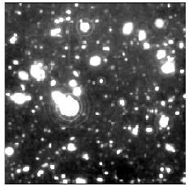
Early Galaxies and the Birth of AGN
When and How Do Black Holes Form
X-Ray background indicates most AGN’s at high redshift are heavily absorbed
  AGN/Starburst separation can be done with IR fine structure lines, e.g. Ne
Far-IR/Submm background and low-res imaging shows many high luminosity, dust enshrouded galaxies

Slide 6
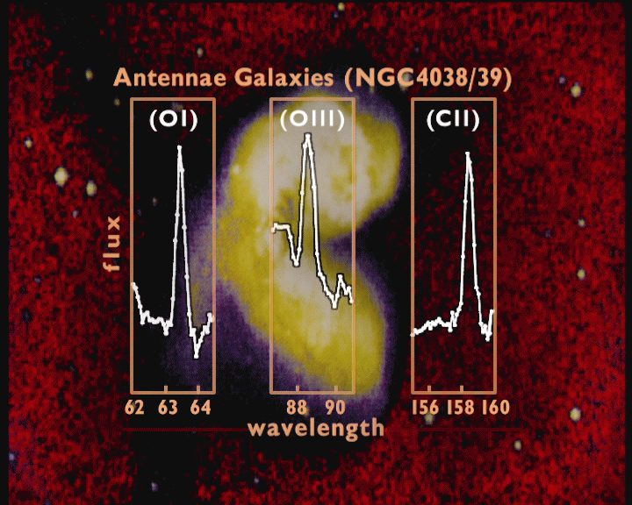
The Youngest Gas Clouds
The Birth of Stars and Galaxies
H₂ lines at 17, 28μm (redshifted) will be emitted by very young, metal-poor gas clouds
As soon as metal production starts:
  C⁺ line at 158μm, N⁺ lines at 122 and 205μm
  Will be redshifted into 200 - 700μm where observations from the ground are very difficult

Slide 7
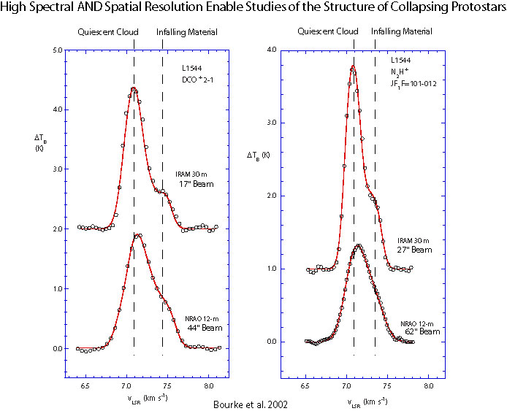
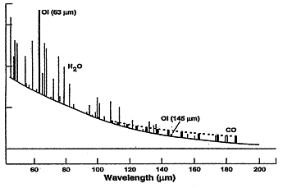
Star and Planetary System Birth
Physical Structure of Circumstellar Disks
OI (63μm)
H₂O
Imaging and spectroscopy with < 100 AU spatial resolution for nearby protostars
  CO, H₂O, [O I] lines probe different physical and spatial regimes.
  The combination of spatial and spectral resolution means that the collapse process can be dissected and compared among stars of different masses and environments.
OI (145μm)
CO
60 80 100 120 140 160 180 200
Wavelength (μm)

Slide 8
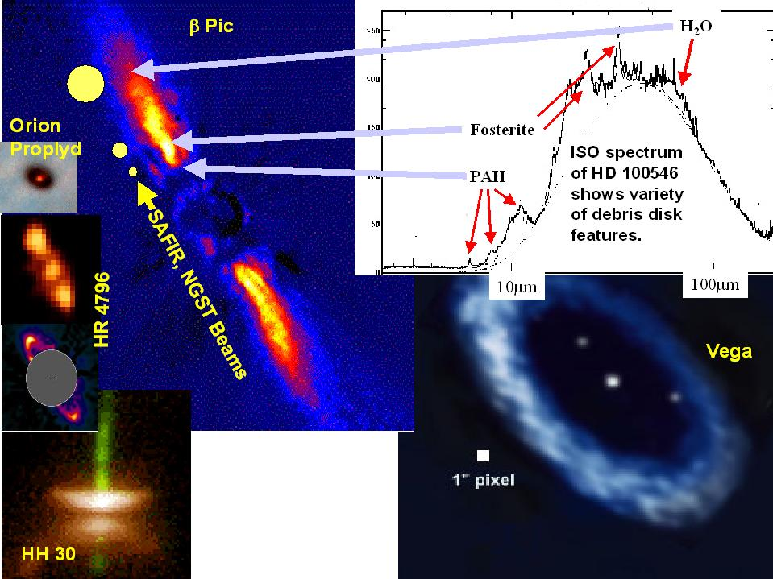
Planetary System Evolution
Debris Disks and Their Interaction With Planets
KBO’s in our Solar System enable primitive Solar Nebula conditions to be studied.
Debris disks around other stars provide a similar laboratory, and many will be found by SIRTF in the next few years.
Spatial resolution and spectroscopic capability can help us understand how planetary systems form and evolve.

Slide 9
Telescope Requirements
Parameter | Requirement | Driving Science
Aperture | > 8m | High z Galaxies; Debris Disks
Temperature | ~ 4K | Spectroscopy; L* Galaxy@ z ~ 5
Wavelength Range | 20-800μm | NGST Overlap; Gas Cooling Lines
Diffraction Limit | 40μm | Debris Disks; Distant Galaxies
Pointing Accuracy | 0.5 – 1” | Driven by 40μm diffraction limit
Pointing Stability | ~ 0.1” | Driven by 40μm diffraction limit
Lifetime | > 5 years | Productivity

Slide 10
Strawman Instrumentation
Instrument | λ range | Spectral Resolution | FOV | Driving Science
Camera | 20 - 600μm | ~ 5 | 1-4’ | High z reddening KBO’s
Spectrometer | 20 - 100μm | ~ 100 | ~10” Img Slicer | Debris Disks; YSO’s
Spectrometer | 20 - 800μm | ~ 2000 | ~ 1’ | C⁺; N⁺; Chemical Evolution
Spectrometer | 25 - 520μm | ~10⁵ | > 1 beam | Dynamics; Gas Cooling

Slide 11
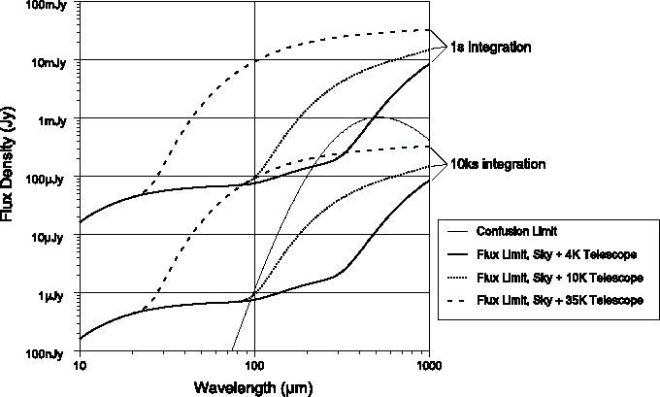
Sensitivity Drivers
The Natural Sky Confusion Limit
Fig 3 from paper

Slide 12
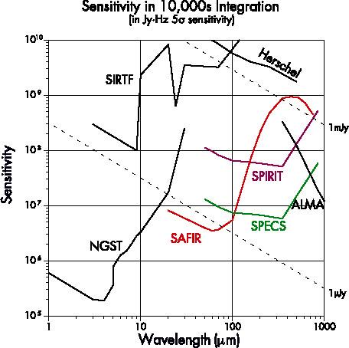
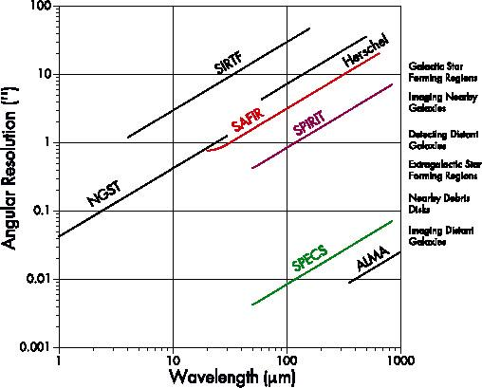
Comparison With Other Facilities
Fig 4 from paper

Slide 13
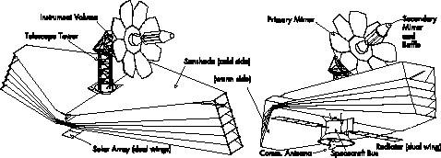
Observatory Concepts – NGST-like
Smaller Aperture – Relaxed Surface Tolerance

Slide 14
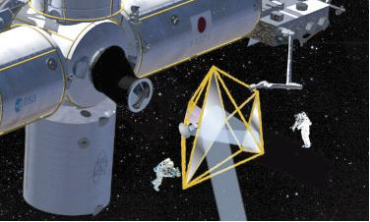
Observatory Concepts – New Tech
Membrane Mirror

Slide 15
Near-Term Goals
Technology Studies/Development
Detector technology advancing rapidly but needs continued support
  Bolometers
  Photoconductors
  Heterodyne detectors and local oscillators
Telescope technology tradeoffs
  NGST-like with less stringent performance
  New, e.g. membrane telescope technology
NASA has just begun an initial technology study
Most significant issue likely to be telescope cooling

Slide 16
Summary
“The combination of its size, low temperature, and detector capability makes its astronomical capability about 100,000 times that of other missions and gives it tremendous potential to uncover new phenomena in the universe. SAFIR will complement ALMA, NGST, and TPF by providing sensitive coverage of the wavelengths that lie between the capabilities of these missions.”

