Slide 1


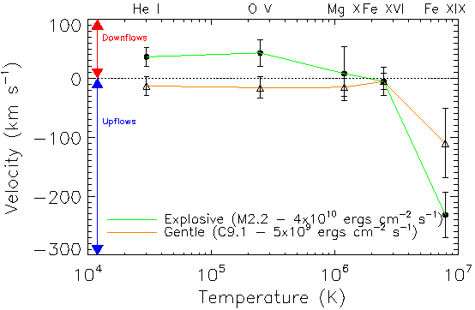
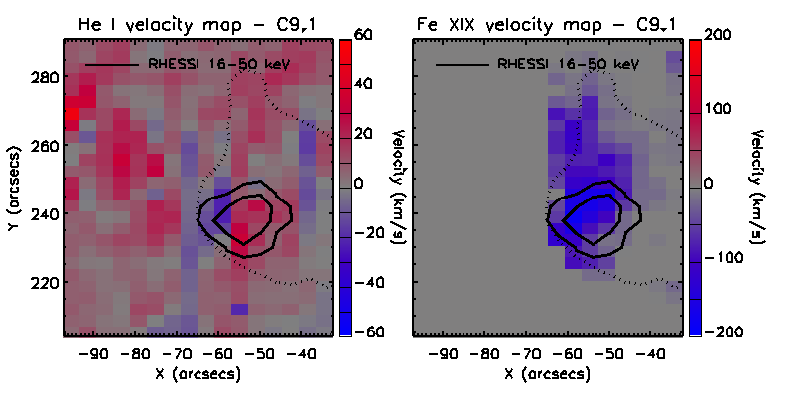
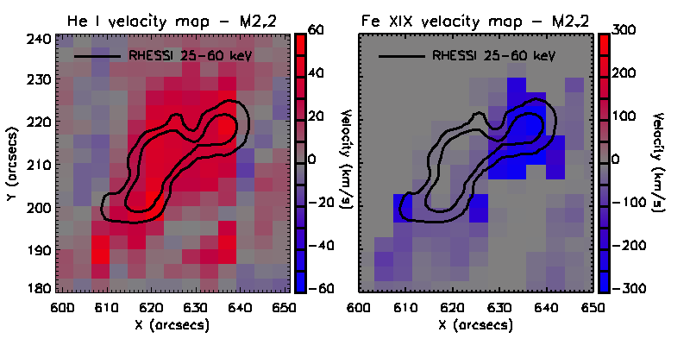
Observational Evidence of Chromospheric Evaporation
Ryan O. Milligan^{1,3}, Peter T. Gallagher^{2,3,4}, Mihalis Mathioudakis¹, Francis P. Keenan¹
¹Dept. of Physics and Astronomy, Queen’s University Belfast, Belfast, BT7 1NN, Northern Ireland
²School of Physics, Trinity College Dublin, Dublin 2, Ireland
³Laboratory for Astronomy and Solar Physics, NASA Goddard Space Flight Center, Greenbelt, MD 20771, U.S.A.
⁴L-3 Communications GSI
r.milligan@qub.ac.uk
ABSTRACT
Observational evidence for chromospheric evaporation during the impulsive phase of two solar flares is presented using data from the Reuven Ramaty High-Energy Solar Spectroscopic Imager (RHESSI) and the Coronal Diagnostic Spectrometer (CDS) on board SOHO. For the first time, co-spatial imaging and spectroscopy have been used to observe both gentle and explosive evaporation processes within HXR emitting regions. For a GOES C9.1 flare, a low flux of non-thermal electrons was found to produce low-velocity upflows in the cool He I and O V emission lines and moderate upflows in the 8 MK Fe XIX line indicative of gentle evaporation. An M2.2 flare, on the other hand, showed low-velocity downflows in the He I and O V lines and high-velocity upflows in the Fe XIX line, for an electron flux value which was an order of magnitude higher, indicative of an explosive process. These findings confirm that the dynamic response of the solar atmosphere is sensitively dependent on the flux of incident electrons as predicted by current hydrodynamical simulations.
EVIDENCE OF GENTLE EVAPORATION
( Milligan et al. ApJL, 2006b)
Flux of non-thermal electrons >5×10⁹ ergs cm⁻² s⁻¹.
Velocity observed in He I ~ 13±16 km s⁻¹ upflows
Velocity observed in O V ~ 16±18 km s⁻¹ upflows
Velocity observed in Fe XIX ~ 110±58 km s⁻¹ upflows
BACKGROUND
During the impulsive phase of a solar flare, accelerated electrons propagate along closed magnetic field lines to the dense underlying chromosphere, where they lose their energy via Coulomb collisions and heat the local plasma. The resulting expansion of this plasma is known as “chromospheric evaporation”. Current solar flare models (e.g. Fisher et al. 1985a,b,c) predict two types of evaporation processes:
The flux of non-thermal electrons responsible for driving the evaporation can be determined using the imaging and spectroscopic capabilities of RHESSI. The resulting atmospheric response can be determined by measuring Doppler shifts in emission lines observed by CDS over a wide range of temperatures.
Figure 3: Plasma velocity as a function of temperature for the five emission lines observed by CDS for the two flares. Positive velocities indicate upflows, while negative velocities indicate downflows.
Figure 1: The spatial distribution of velocities for the He I and Fe XIX lines for the C9.1 flare.
CONCLUSIONS
The dynamic response of the solar atmosphere during the impulsive phase of solar flares is critically dependent upon the flux of incident electrons (as shown in Figure 3).
A non-thermal electron flux threshold exists beyond which the chromosphere is unable to radiate efficiently. (Fisher et al. proposed that this value was ~3×10¹⁰ ergs cm⁻² s⁻¹.)
It is only above this threshold that the pressure in the evaporated material is great enough to drive chromospheric condensation.
The properties of the accelerated electron spectrum and corresponding evaporation velocities are consistent with the predictions of theory.
 | Gentle Evaporation | Explosive Evaporation
Nonthermal electron flux (ergs cm⁻² s⁻¹) | <10¹⁰ | >3×10¹⁰
Upflow Velocities (km s⁻¹) | <100 | >200
Downflow Velocities (km s⁻¹) | None | <100
EVIDENCE OF EXPLOSIVE EVAPORATION
(Milligan et al. ApJL, 2006a)
Flux of non-thermal electrons >4×10¹⁰ ergs cm⁻² s⁻¹.
Velocity observed in He I ~ 36±16 km s⁻¹ downflows
Velocity observed in O V ~ 43±22 km s⁻¹ downflows
Velocity observed in Fe XIX ~230±38 km s⁻¹ upflows
OBSERVATIONS AND DATA ANALYSIS
The limited field of view, cadence and operating schedule of CDS, coupled with RHESSI nighttime and South Atlantic Anomaly passes, make simultaneous observations by the two instruments quite rare. Here we focus on the impulsive phase of two flares, GOES class C9.1 and M2.2.
The RHESSI spectra were fitted assuming an isothermal distribution at low energies and thick-target emission at higher energies.
The spectrum from each CDS pixel was fitted with a broadened Gaussian profile for each of the emission lines. Velocity maps were created by measuring Doppler shifts relative to quiet-Sun spectra.
SELECTED REFERENCES
Fisher, G. H., Canfield, R. C., & McClymont, A. N. 1985a, ApJ, 289, 414
Fisher, G. H., Canfield, R. C., & McClymont, A. N. 1985b, ApJ, 289, 425
Fisher, G. H., Canfield, R. C., & McClymont, A. N. 1985c, ApJ, 289, 434
Milligan, R. O., Gallagher, P. T., Mathioudakis, M., Bloomfield, D. S., Keenan, F. P.,
& Schwartz, R. A. 2006a, ApJL, 638, 117
Milligan, R. O., Gallagher, P. T., Mathioudakis, M., & Keenan, F. P. 2006b, ApJL, 642, 169
Acknowledgements: SOHO is a project of international collaboration between NASA and ESA. This work has been supported by a Cooperative Award in Science and Technology (CAST) studentship from Queen's University Belfast and the NASA GSFC SOHO project.
We would like to thank Brian Dennis and the RHESSI team, Joe Gurman, and Dominic Zarro for their continued support
Figure 2: The spatial distribution of velocities for the He I and Fe XIX lines for the M2.2 flare.

