Slide 1
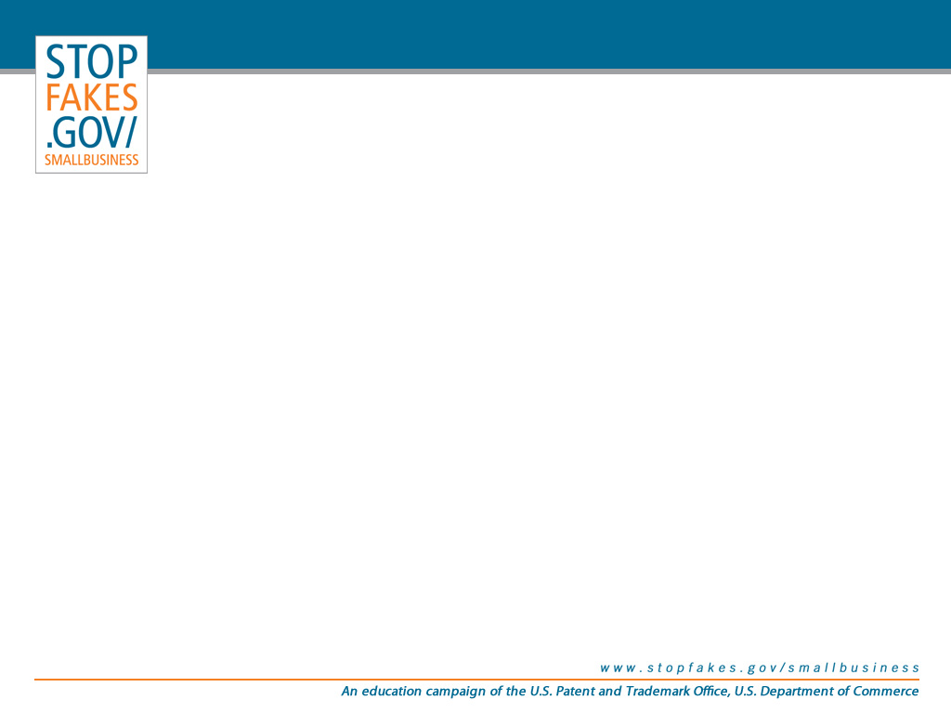
Patents and Trademarks and Copyrights -- Oh My!
An Intellectual Property Overview
Conference on Intellectual Property in the Global Marketplace
Susan Anthony
Attorney-Advisor
Office of International Relations
U.S. Patent and Trademark Office

Slide 2
Overlapping IP Protection
Patents, Trademarks & Copyrights
  These IP rights are often confused. There are some similarities, but these IP rights are different and serve different purposes.
  But they need not be mutually exclusive. For any one work, more than one form of IP protection may apply, as long as it meets the requirements of the laws that govern that form of protection.

Slide 3
Forms of Intellectual Protection
Patents
  Patent protection is afforded to inventions and industrial designs (and even plants).
  A patent gives the inventor the exclusive right to exclude others from making, using, offering for sale or selling the invention.
  Different types of patents have different terms:
    Utility patents have a 20-year term.
    Design patents have a 14-year term.

Slide 4
Forms of Intellectual Protection
Trademarks
  Trademark protection is afforded to words or designs that are used to distinguish the source of the goods or services from the goods or services of others.
  A trademark gives the owner the right to prevent others from using a confusing, similar mark.
  Trademark rights may continue indefinitely.

Slide 5
Forms of Intellectual Protection
Copyright
  Copyright protection is afforded to authors of “original works of authorship,” including literary, dramatic, musical, artistic and certain other intellectual works.
  A copyright gives the owner the exclusive right to do certain things, e.g., copy the work, adapt the work and distribute copies of the work.
  Copyright terms (for works created on or after January 1, 1978).
    Individual: life + 70 years
    Work made for hire: 95 years from publication or 120 years from creation

Slide 6
Overlapping IP Protection
An ornamental design may be protected by copyright as a work of art and also may be the subject of a design patent.
Where a copyrighted artistic representation identifies a product or service, it also may be the subject of a trademark.
In some instances, an industrial design can span patent, trademark and copyright protection.

Slide 7
Overlapping IP Protection
Depending on the features of the “intellectual property” in question, it may be covered by:
  Patent protection
    Design 14 years, or
    Utility 20 years.
  Copyright protection:
    Life + 70, or
    Works made for hire, 95 or 120.
  Trademark protection
    Indefinite

Slide 8
Overlapping IP Protection
Patents, trademarks, copyright – OH MY!
  Different types of protection
  Different terms of protection
Therefore, the “exclusive” use of the creation/invention may be extended if:
  It spans; or
  Is made to span more than one type of IP.

Slide 9
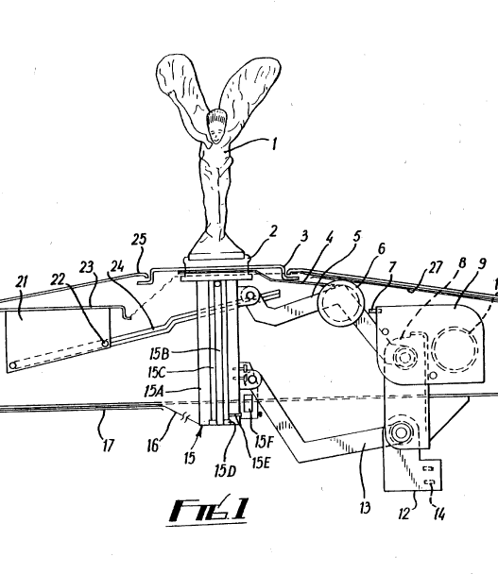
Rolls-Royce “Spirit of Ecstasy”
“The Spirit of Ecstasy” mascot could be protected by various types of intellectual property.
  Patent
  Trademark
  Copyright
(WO 9400316 A1)

Slide 10
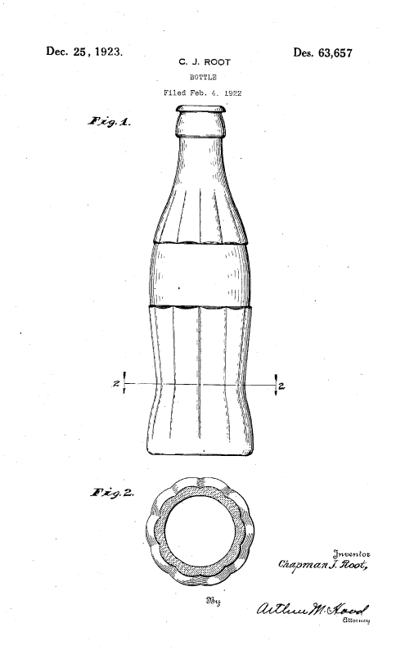
Overlapping IP Protection: The Coca-Cola Contour Bottle
In 1915, Alexander Samuelson and Earl R. Dean designed the original "hobble skirt" contour bottle.
The first design patent on the bottle, D63,657, was granted on December 26, 1923, to the bottle manufacturer.

Slide 11
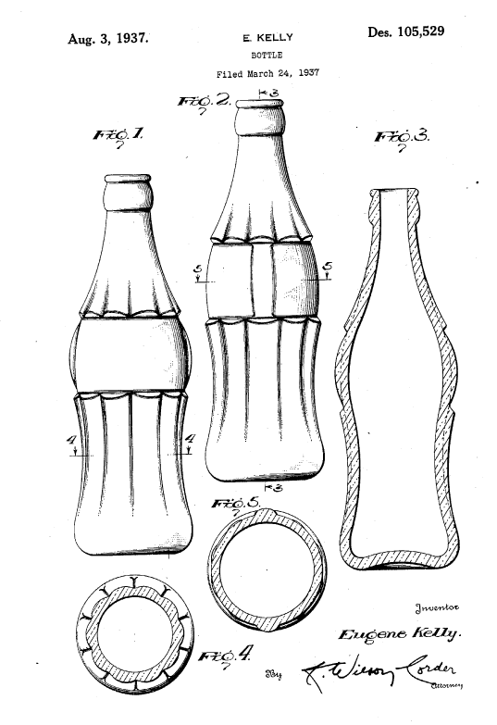
Overlapping IP Protection: The Coca-Cola Contour Bottle
The Coca-Cola Company received a second design patent for the contour bottle on March 24, 1937, preventing imitation of the bottle for another 14 years.

Slide 12
Overlapping IP Protection: The Coca-Cola Contour Bottle
The bottle became so well known that it became synonymous with the Coca-Cola product.
The Coca-Cola Company sought and obtained a federal trademark registration for its contour bottle on April 12, 1960, enabling the company to safeguard the bottle design indefinitely.

Slide 13
Other IP Rights in Play:
The Coca-Cola Product
Trademark: Bottle, COCA-COLA, COKE
Copyright: Bottle, keychain, advertising
Trade secret: The formula
(SHHH! It’s a secret!)
Right of publicity: Use of sports figures

Slide 14

Hypothetical Scenario:
“IP Cosmetics, Inc.”
Our hypothetical company, IP Cosmetics, Inc., a cosmetics manufacturer and marketer, is headquartered in Alexandria, Virginia.
Notes:
NOTE to 6K: Insert picture of USPTO headquarters from USPTO.gov website.

Slide 15
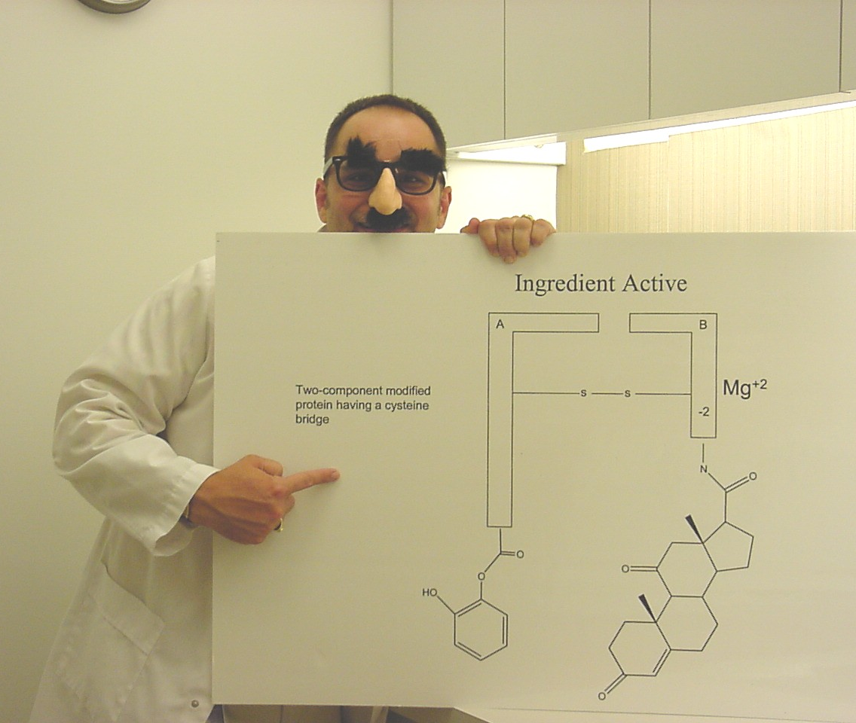
Hypothetical Scenario:
“IP Cosmetics, Inc.”
IP Cosmetics, Inc.’s ace inventor, Ivan Vent, has just made a discovery that promises to put the company on the map and turn the cosmetics industry on its head.
Just in time for the aging “baby boomer” generation, chemist Vent invents an anti-aging cream.
Notes:
NOTE TO 6K: We are going to insert photograph of “inventor”. Will provide.
Also, could you give me a SOUND CLIP of mice or rats running around on the floor that I can access by clicking the space bar after I show this slide and before I show the next? (It is to accompany me in saying, “This produces a lot of scurrying around at the company as they try to figure out what they need to do to protect their IP in this new, revolutionary, product!”

Slide 16
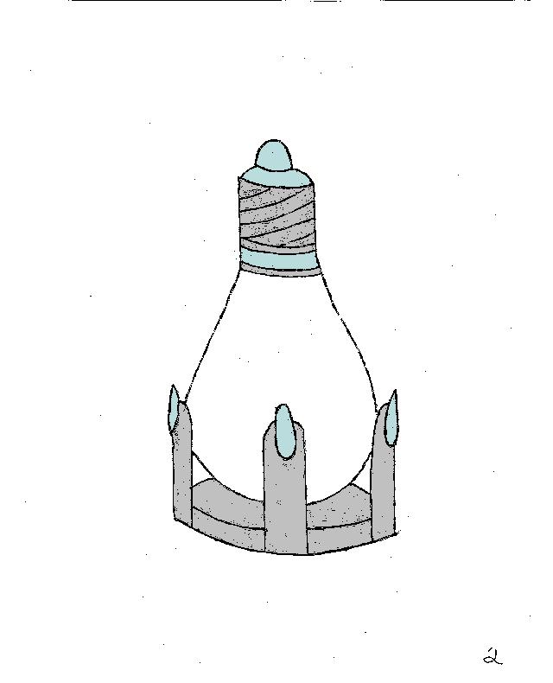
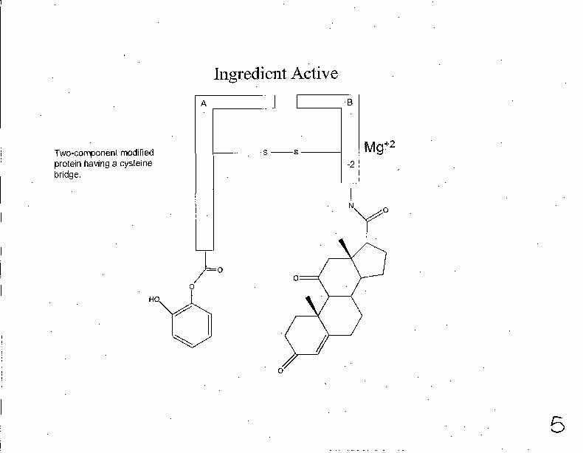
Hypothetical Scenario:
“IP Cosmetics, Inc.”
Design patent protection
  Bottle?
Utility patent/Trade secret
  Formula/Active ingredient?
Notes:
NOTE to 6K: Insert pictures of bottle (Figure2) / active ingredient (Figure5).

Slide 17
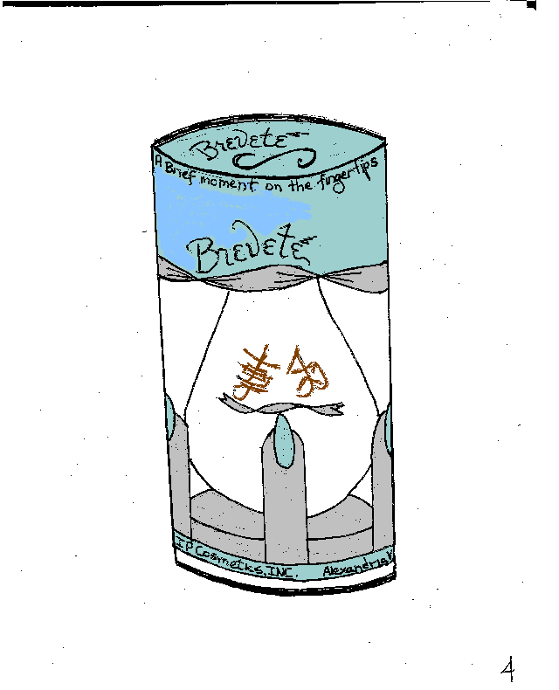
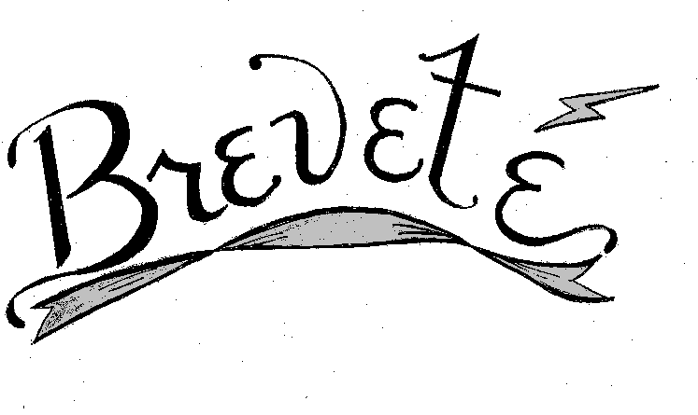
Hypothetical Scenario:
“IP Cosmetics, Inc.”
Trademark protection
  Company name? – IP Cosmetics, Inc.
  Product name? – Breveté
  Domain name? – www.brevete.com
  Slogan? – “Beauty is brief…Breveté is forever.”
  Logo?
  Bottle?
Notes:
NOTE to 6K: Insert Pictures of
Company Name: IP Cosmetics, Inc.
Brevete logo (figure1),
Slogan: A Brief moment on the fingertips erases years from the complexion.
Bottle: Figure2
Domain Name: Brevete.com
ipcosmetics.com
brevete.com
“Beauty is brief…Brevete is forever.”
Brevete Logo
Bottle design alone
Bottle with everything on it

Slide 18
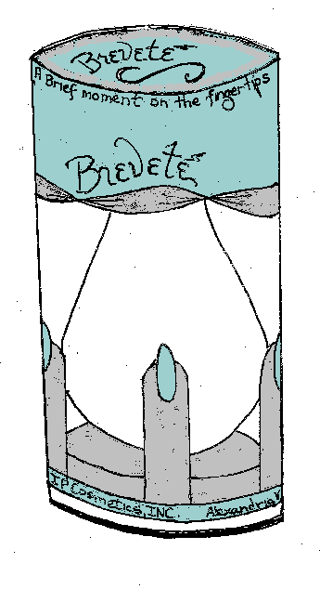
Hypothetical Scenario:
“IP Cosmetics, Inc.”
Copyright protection
  Bottle?
  Packaging for bottle?
  Advertising?
  Catalog?
  Demo video?
  Web site?
Notes:
NOTE to 6K: Insert pictures of bottle (figure 2) / package (figure 3)

Slide 19
Hypothetical Scenario:
“IP Cosmetics, Inc.”
Enforcement of rights, U.S. and abroad.
Intellectual property theft and counterfeiting.
Notes:
Note to 6K: Insert pictures of counterfeited bottle. (figure 4)

Slide 20
Hypothetical Scenario:
“IP Cosmetics, Inc.”
The problems faced by IP Cosmetics, Inc., are typical of the kinds of problems facing all businesses today, regardless of size.
Together, the team at IP Cosmetics, Inc. – and you – will attempt to identify and address these myriad issues and explore various strategies.
Notes:
NOTE TO 6K: I hope to be able to provide a photograph of the “team” that will be involved in Phoenix (SHHH! Larry et al. – it’s a secret & a surprise!) – the way this should go is slide will be shown and then with a click of the spacebar, the phrase “Your team at IP Cosmetics, Inc. --” should come up along with the photograph of the team.]

Slide 21
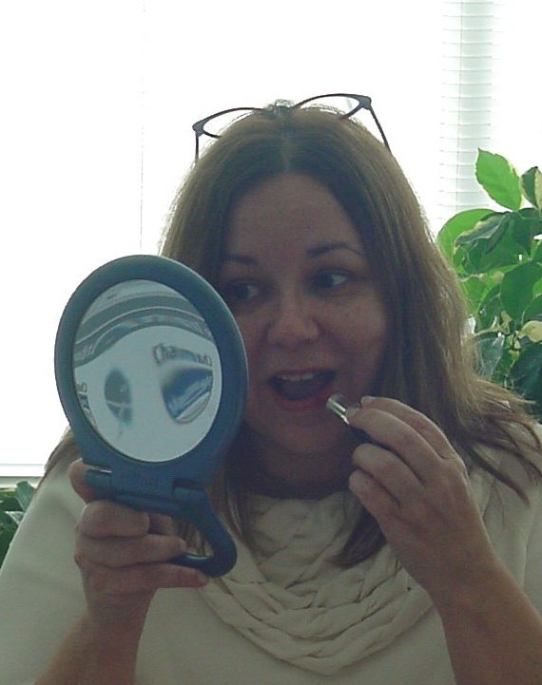

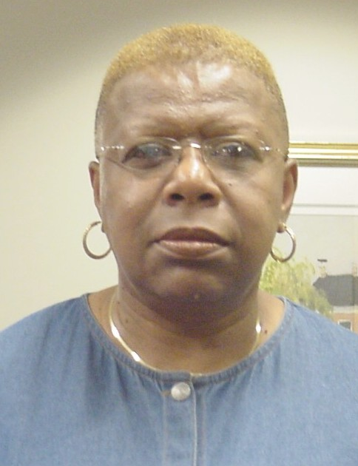

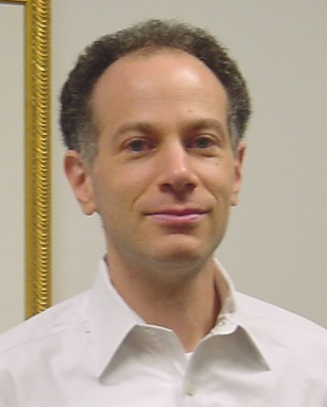




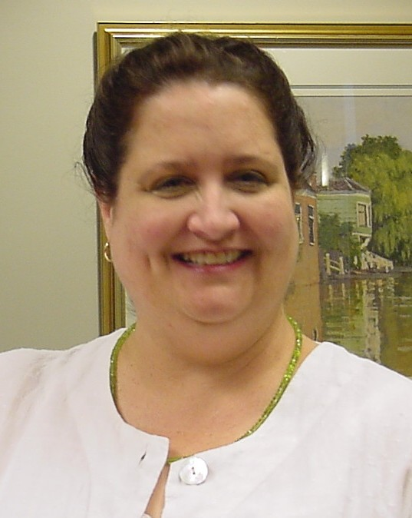

IP Cosmetics, Inc. Team
Susan Anthony
Jean Marc Brun
Corine Gore
Dominic Keating
Ari Leifman
Jackie Morales
Michael Ness
John Rodriguez
Steve Schiffman
Elizabeth Shaw
Larry Tarazano

Slide 22
Patents and Trademarks and Copyright, Oh My!
An Intellectual Property Overview
Conference on Intellectual Property in the Global Marketplace
Susan.Anthony@uspto.gov
THANK YOU

