Slide 1
Introduction to the Water Quality Analysis Modeling System
WASP
Version 7.0
April, 2005

Slide 2
US EPA Disclaimer
Although this work was reviewed by EPA and approved for presentation, it may not necessarily reflect official Agency policy.
Mention of trade names or commercial products does not constitute endorsement or recommendation for use.

Slide 3
Course Objectives
Modeling Principles
Modeling Theory
  Processes in WASP
  Limitations of process descriptions
Modeling Practice
  Using the WASP Interface
  Using WASP for real-world problems
    Case Study Applications of WASP
    Discussion of Data Needs

Slide 4
Basic Principle of Mechanistic Models
Laws of Conservation
  Conservative properties are those that are not gained or lost through ordinary reactions. Therefore we can account for any change by simply keeping track of all those processes that can cause change
Examples of conservative properties
  Mass (water mass, constituent mass)
  Momentum
  Heat

Slide 5
Three Dimensional Transport Equation
Control Volume
z
y
x

Slide 6
Box Model Approach
Numerical solution allows greater flexibility as to processes considered (i.e. eutrophication, toxics, etc.)
Allows greater flexibility as to segmentation
Flows and mixing coefficients are obtained from
  Field data
  Hydrodynamic models (which produce output that can be read by WASP)

Slide 7
Box Modeling Approach
Boxes
  The boxes have no defined shape, so can be fit to any morphometry
  The boxes can be “stacked” so the approach can be applied to 0 dimensions (1 box) or 1, 2 or three dimensional systems

Slide 8
WASP Modeling Framework
Binary Wasp Input File (wif)
Model Preprocessor/Data Server
WASP
CSV, ASCII Output
Input
Messages
Hydrodynamic
Interface
Models
Binary Model Output
Stored
Data
Eutrophication
BMD
Hydro
Conservative
Toxicant
Exported Model Results
Organic
Toxicants
MOVEM
Mercury
Graphical Post Processor
Heat

Slide 9
WASP7 Water Quality Modules
Eutrophication (eutro.dll)
  DO, BOD, nutrients, phytoplankton, periphyton
Simple Toxicant (toxi.dll)
  Partitioning and first order decay
  Simple metal or organic chemical, solids
Non-Ionic Organic Toxicants (toxi.dll)
  Detailed fate processes, reaction products, solids
Organic Toxicants (toxi.dll)
  Detailed fate processes, ionization, reaction products, solids
Mercury (mercury.dll), slightly altered from toxi.dll
  Hg0, HgII, MeHg, solids
HEAT (heat.dll)
  full/equilibrium heat balance + pathogens

Slide 10
WASP Structure
WASP
Transport
Bookkeeping
Organic Chemical Model
Eutrophication Model
Mercury Model
Kinetics

Slide 11
WASP Terminology
Segments
1
2
3
4
5
6
NH3
NO3
DO
BOD
Chla
OPO4
Systems (i.e., State Variables)
Calculated Variables
BOD Decay Rate
Growth Rate, etc.

Slide 12
WASP Systems:
Conventional Water Quality Modules
EUTRO
  Dissolved oxygen
  CBOD (three forms)
  Phytoplankton
  Periphyton
  Detritus (C, N, P)
  Dissolved organic nitrogen
  Ammonia/ammonium
  Nitrate
  Dissolved organic phosphorus
  Orthophosphate
  Salinity
  Solids
  Sediment Diagenesis
HEAT
  Temperature
  Salinity
  Coliform
  Conservative 1 and 2

Slide 13
WASP Systems: Toxicant Modules
Simple Toxicant
  Chemical
  Silts/Fines
  Sands
  Biotic solids
Organic Toxicants (both non-ionizing and ionizing)
  Chemical 1
  Chemical 2
  Chemical 3
  Silts/Fines
  Sands
  Biotic solids
Mercury
  Elemental, Hg0
  Divalent, HgII
  Methyl, MeHg
  Silts/Fines
  Sands
  Biotic solids

Slide 14
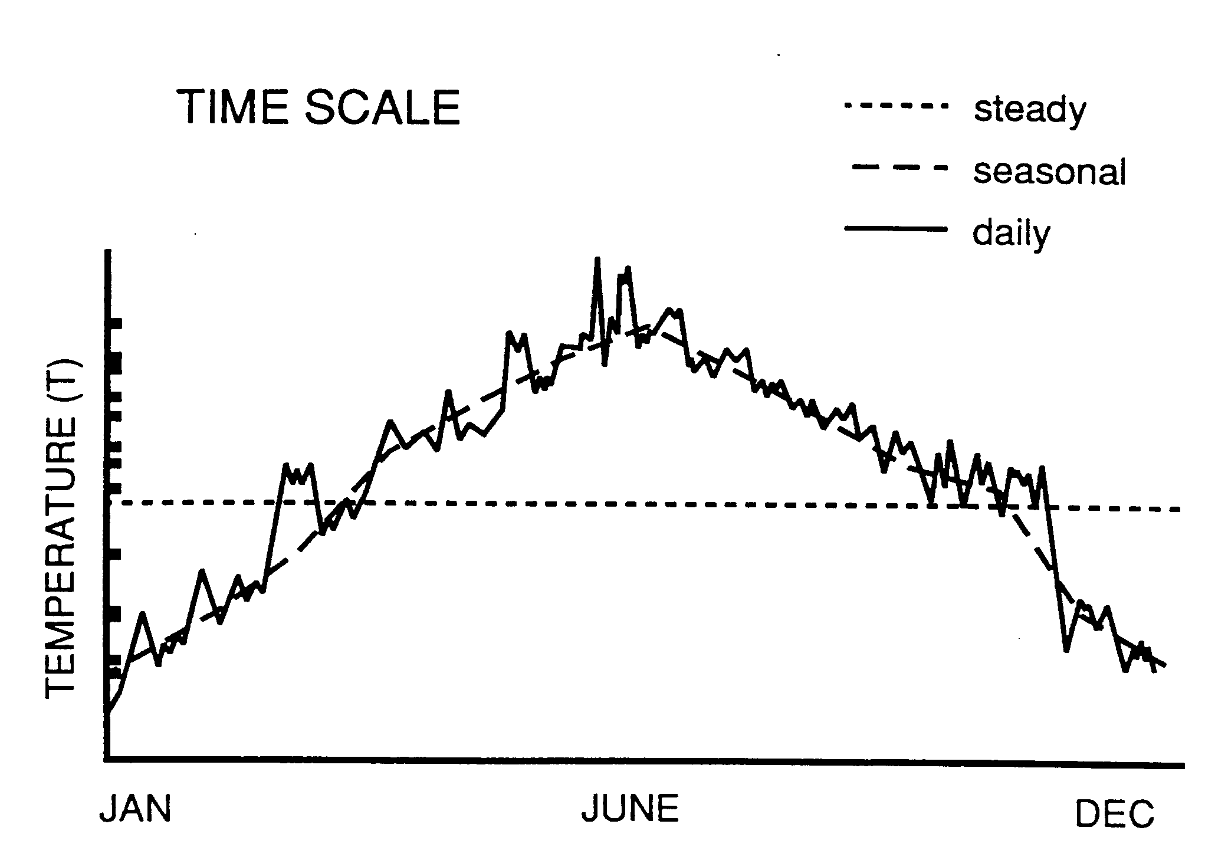
Potential WASP Time Scales
Steady
Seasonal
Monthly
Daily/Hourly

Slide 15
WASP Advantages and Features
Network Flexibility
  Applicable to most water body types at some level of complexity
Most Water Quality Problems
  Conventional Water Quality: DO, eutrophication, heat
  Toxicant Fate: organics, simple metals, mercury
Separation of Processes
  Transport
  Kinetics
External Links to Models and Spreadsheets
Two Solution Techniques
  Simple/Quick – Euler
  Complex/Flux Limiting -- COSMIC

Slide 16
WASP External Linkages
Loading Models
SWMM
HSPF
LSPC
NPSM
PRZM
GBMM
Bioaccumulation
BASS
FCM-2
WASP
Hydrodynamic
Models
EFDC
DYNHYD
EPD-RIV1
SWMM
External
Spreadsheets
ASCII Files
Windows
Clipboard

Slide 17
WASP Limitations
Does not handle some variables and processes:
  Mixing zone processes
  Non aqueous phase liquids (e.g., oil spills)
  Segment drying (mudflats, flood plains)
  Metals speciation reactions (special module, META4, not part of general WASP release)
Potentially large external hydrodynamic files
Separate eutrophication and toxicant fate modules
Cannot readily be run in batch mode
  Automatic calibration programs
  Monte Carlo programs

Slide 18
WASP is a Variable Complexity Modeling System
When building a water body model, adjust complexity to match the problem.
  More Complex Aquatic Systems
  More Complex Chemical Behavior
  More Complex Management Questions

Slide 19



Development of Complexity in
Water Quality Modeling
Applications
A model is more like a
than a
Dominic Di Toro

Slide 20
Iterative Model Development Process
General
Conceptual Model
Available Data
Site-Specific
Conceptual Model
(Preliminary Data Collection)
Initial Screening
Mathematical Model
(usually simple)
Project Data Collection
Evolving Operational Mathematical Model
(usually more complex)
Model evaluation,
Post-audit data

Slide 21
How Complex Should Final Computational Model Be?
Proper model complexity is driven by:
  The complexity of the environmental system.
  The complexity of the pollutants of concern.
  The management questions and related need for accuracy.
Consequences for overly simple model:
  Miss key processes and extrapolate inaccurately.
  May not address relevant management questions.
  May not be defensible to adversarial review.
  Insufficiently adaptable to changing management requirements.
Consequences for overly complex model:
  Adds unnecessary data collection and computational burdens.
  Adds to uncertainty.
  Shifts focus away from problem solutions to endless analysis.

Slide 22
Management-Related Questions Requiring More Complex Models
What are the spatial and temporal distributions of target pollutants (particularly in mixed-media environments) under various management scenarios?
What are the relative contributions of various sources of pollutants over time?
What are the likely pollutant attenuation trajectories and times to recovery under various management scenarios?
What are the relative effects of transient or extreme events, such as spills or storms?
What are the possible effects of poorly understood environmental events?

Slide 23
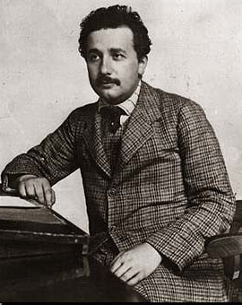
Goal of Model Complexity
“Make things as simple as possible,
but not any simpler.”
Albert Einstein

