Slide 1


Measurement of the W-Boson Helicity Fractions in Top-Quark Decays at CDF
Thorsten Chwalek, Dominic Hirschbühl, Thomas Müller, Jeannine Wagner-Kuhr, Wolfgang Wagner
Karlsruhe Institute of Technology

Slide 2
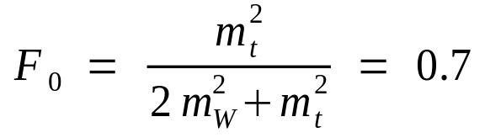
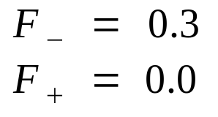
W-Boson Helicity in Top-Quark Decays
Top-quark lifetime is shorter than hadronization time
Decay products preserve the helicity content of the underlying weak interaction
Chance to probe the V-A structure of the weak interaction in the top-quark decay
Helicity fractions that differ from the SM predictions indicate new physics
For example: V+A component in weak interaction, anomalous couplings in top-decay.
t
SM prediction for m_{t}=175 GeV/c², m_{b}=0
b
W⁺
S_{b}=1/2 S_{t}=1/2 S_{W}=1
longitudinal
left-handed
right-handed

Slide 3
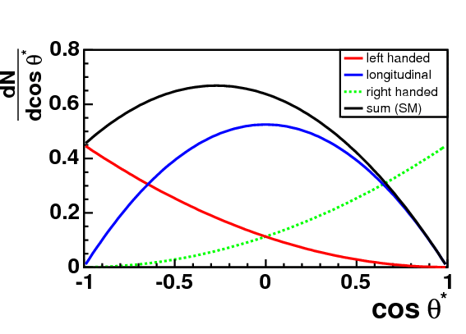
Sensitive Observable: cos*
ℓ
Angle between the direction of the charged lepton in the W-boson rest frame and the direction of the W-boson in the top-quark rest frame
Characteristic angular distribution depending on the polarization of the W-boson
To calculate * we have to reconstruct the four-vectors of top-quark, W-boson, and charged lepton
*
b
W⁺
_{ℓ}

Slide 4
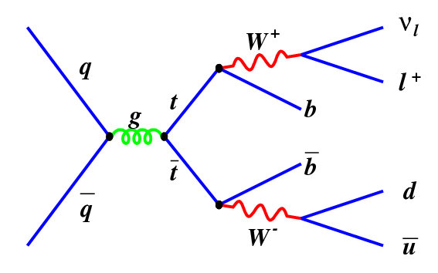
Full Reconstruction
Lepton+Jets:
one charged lepton, missing trans-verse energy, four or more jets (one with a secondary vertex tag)
Neutrino four-vector is obtained from MET and W-boson mass-constraint
All possibilities to assign the jets to the 2 b-quarks and 2 light quarks are considered
 Leads to a multiplicity of possibilities to reconstruct the event
The challenge is to find the right hypothesis for each event using constraints on:
  mass of reconstructed W-boson
  mass difference of the two top-quarks
  transverse energy of the two top-quarks
  b-likeness of the jets assigned to the b-quarks (NN b-tagger)
Number of possibilities to reconstruct one event:

Slide 5


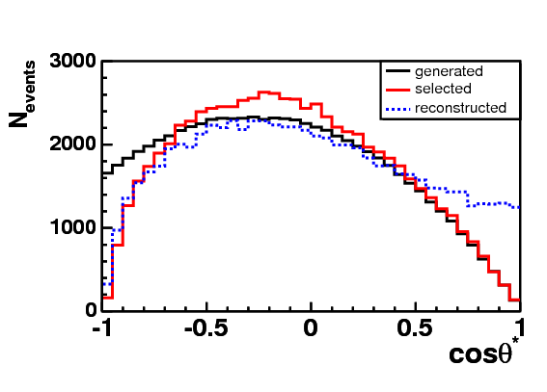
Measurement
Calculate expected number of events in each bin of the cos* distribution
Consider effects due to event-selection and event-reconstruction
  by applying efficiency and migration matrix
Two separate measurements:
  measure F₀, fix F₊ = 0.0 (SM)
  measure F₊, fix F₀ = 0.7 (SM)
   One free parameter
Combined measurement:
  F₀ and F₊ are both free parameters
Perform binned likelihood fit

Slide 6
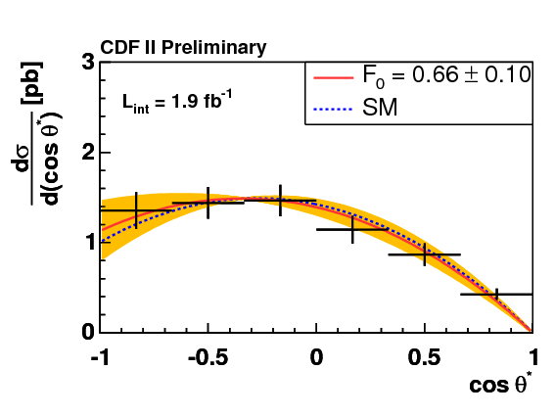
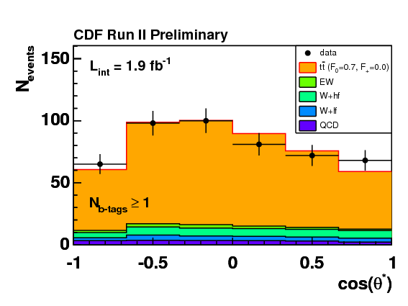
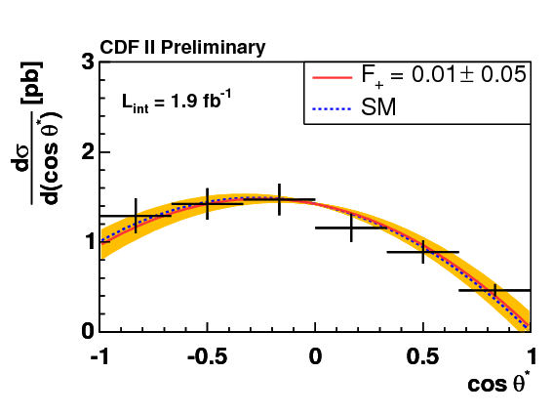
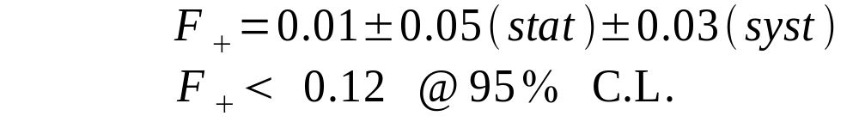
Results (1 parameter fit)
484 candidates in L_{int}=1.9fb⁻¹
Measurement of F₀ (F₊=0):
Correct distribution for event-selection and reconstruction effects
Measurement of F₊(F₀=0.7):

Slide 7
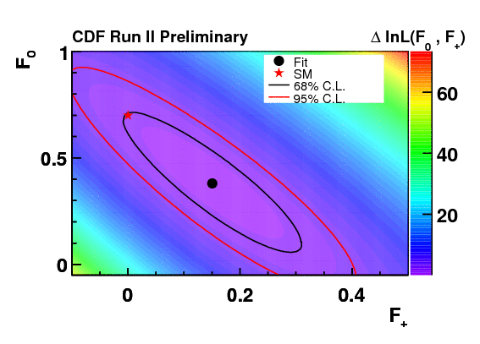
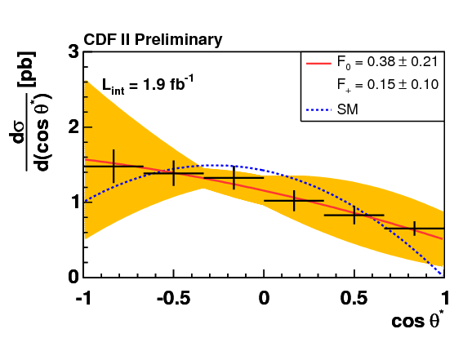
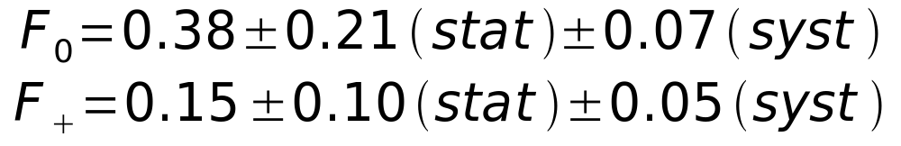
Results (2 parameter fit)
484 candidates in L_{int}=1.9fb⁻¹

Slide 8
Conclusion
Results are within the uncertainties in agreement with the standard model prediction.
Analysis is still statistically limited.

