Slide 1

GSA Missing
Children Alert
U.S. General Services Administration
Concerned about America’s Children
Notes:
1
1
1
1
1
1
1
1
1
1
1
1
1

Slide 2
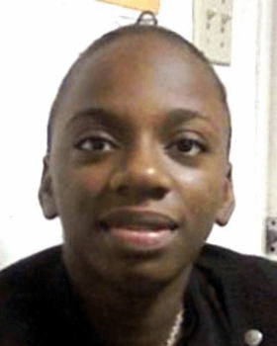
Brittany A Ceasar
ANYONE HAVING INFORMATION SHOULD CONTACT:
The National Center For Missing and Exploited Children
1-800-The-Lost
Last Seen: Oakland Park, FL 11/08/2008
Age: 14 years
Notes:
7
7
7
7
7
7
6
6
6
5
5
5
5

Slide 3
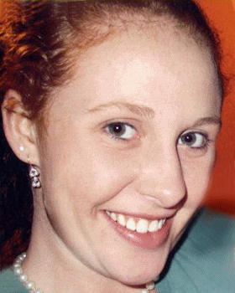
Whitney Denise Coffey
ANYONE HAVING INFORMATION SHOULD CONTACT:
The National Center For Missing and Exploited Children
1-800-The-Lost
Last Seen: Sevierville, TN 11/07/2008
Age: 17 Years
Notes:
7
7
7
7
7
7
6
6
6
5
5
5
5

Slide 4

Yessenia Diaz
ANYONE HAVING INFORMATION SHOULD CONTACT:
The National Center For Missing and Exploited Children
1-800-The-Lost
Last Seen: San Jose, CA 10/10/2008
Age: 14 Years
Notes:
7
7
7
7
7
7
6
6
6
5
5
5
5

Slide 5
GSA Missing
Children Alert
U.S. General Services Administration
Concerned about America’s Children
Notes:
1
1
1
1
1
1
1
1
1
1
1
1
1

Slide 6
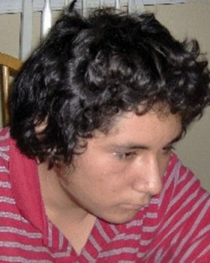
Shane L Dunson
ANYONE HAVING INFORMATION SHOULD CONTACT:
The National Center For Missing and Exploited Children
1-800-The-Lost
Last Seen: Ocala, FL 10/31/2008
Age: 14 Years
Notes:
7
7
7
7
7
7
6
6
6
5
5
5
5

Slide 7
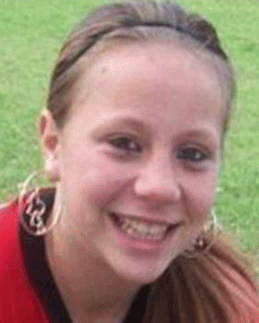
Ashley Tayler Harker
ANYONE HAVING INFORMATION SHOULD CONTACT:
The National Center For Missing and Exploited Children
1-800-The-Lost
Last Seen: Tampa, FL 09/25/2008
Age: 13 years
Notes:
7
7
7
7
7
7
6
6
6
5
5
5
5

Slide 8
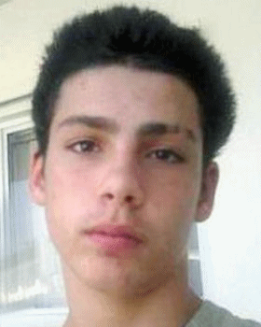
Angelo Dominic Lombardo
ANYONE HAVING INFORMATION SHOULD CONTACT:
The National Center For Missing and Exploited Children
1-800-The-Lost
Last Seen: Plantation, FL 10/31/2008
Age: 13 Years
Notes:
7
7
7
7
7
7
6
6
6
5
5
5
5

Slide 9
GSA Missing
Children Alert
U.S. General Services Administration
Concerned about America’s Children
Notes:
1
1
1
1
1
1
1
1
1
1
1
1
1

Slide 10
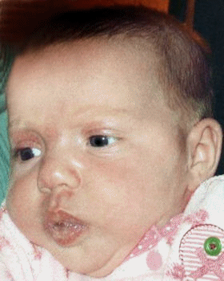
Abagael McGowan
ANYONE HAVING INFORMATION SHOULD CONTACT:
The National Center For Missing and Exploited Children
1-800-The-Lost
Last Seen: Sevierville, TN 11/07/2008
Age: 3 months
Notes:
7
7
7
7
7
7
6
6
6
5
5
5
5

Slide 11
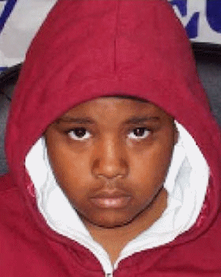
Goi Anne Smith
ANYONE HAVING INFORMATION SHOULD CONTACT:
The National Center For Missing and Exploited Children
1-800-The-Lost
Last Seen: Baltimore, MD 10/20/2008
Age: 13 Years
Notes:
7
7
7
7
7
7
6
6
6
5
5
5
5

Slide 12
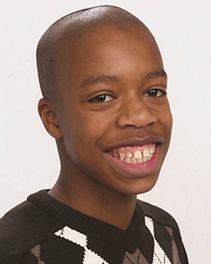
Tarik Toyshawn Smith-Whitmore
ANYONE HAVING INFORMATION SHOULD CONTACT:
The National Center For Missing and Exploited Children
1-800-The-Lost
Last Seen: Coon Rapids, MN 11/14/2008
Age: 14 Years
Notes:
7
7
7
7
7
7
6
6
6
5
5
5
5

