Slide 1
SWIM Implementation Team Status

Slide 2
Agenda
Service Container
  Contract Information
  Products
  Licenses
  Training
  Application of Products
Resource Kit
WJHTC SWIM Labs
ITWS SWIM Prototype

Slide 3
Service Container Contract
Contract award to Iona Technologies on August 18, 2008
Indefinite Delivery Indefinite Quantity
Base year + 12 option years
Contract options:
  Software
  Documentation
  Support Licenses
  Training
  Consulting Services

Slide 4
Iona Acquisition
Iona was purchased by Progress Software on September 12, 2008
  Fuse will remain and continue to evolve
  ARTIX will be combined with Progress SOA portfolio
  ARTIX already interoperates with the Progress Sonic ESB
  Product integration between Artix and Actional for run-time visibility and governance is already underway as part of an existing partnership between IONA and Progress

Slide 5
Available Products on Contract
Products Available:
  FUSE Suite
    FUSE ESB
    FUSE Services Framework
    FUSE HQ
    FUSE Mediation Router
    FUSE Message Broker
  Artix Data Services
  Artix Registry/Repository
  Artix ESB C++
  Artix Connect for WCF
  Artix Security
  Artix Enterprise Management Service Plug-in
Artix Orchestration (meets desirable requirement for BPEL) available at extra cost
Fuse is not currently supported on AIX but the CO is in Negotiations with Iona
Software is downloadable from us
  KSN today
  COTS Repository coming soon
Keys are not required for the Fuse Products

Slide 6
Licenses
Licenses are purchasable in two forms
  Development Licenses
    Per named user
    Support available 8 hours, 5 days a week
  Production Licenses
    Per machine based on Single CPU, Dual Core, Quad Core, Production, Backup or Test
    Two named users and alternate
    Support available 24 hours, 7 days a week
Licenses are renewable annually
Named users are changeable
Implementation Team will be single point for acquiring licenses, renewing licenses and changing named users

Slide 7
Available Training
FUSE Product Line training 5 day class
FUSE Message Broker 2 day class
FUSE ESB 2 day class
FUSE Mediation Router 2 day class
FUSE Services Framework 2 day class
Fuse HQ (manage/monitor FUSE infrastructure) 2 day workshop
Fuse for Architects 3 day class***
Artix for Developers (C++, Std) 2 day class
Artix for Developers (Advanced) 4 day class
Artix for Architects 3 day class
Artix RegRep Workshop 2 day class
Artix Data Services Workshop 2 day class
Web Services Foundation Course 1 day class
Web Services and SOA Boot Camp 4 day class
*** In Negotiations with Iona

Slide 8
Training Classes
Classes will be held at
  CSC, Rockville, MD
  Volpe, Cambridge, MA
  FAATC, Atlantic City, NJ
Classes are bundled in 1 week increments
Hardware for classes will be supplied by Iona
Internet connection for each student is required
Class size is 12 students
Implementation Team will be single point for scheduling classes and students

Slide 9
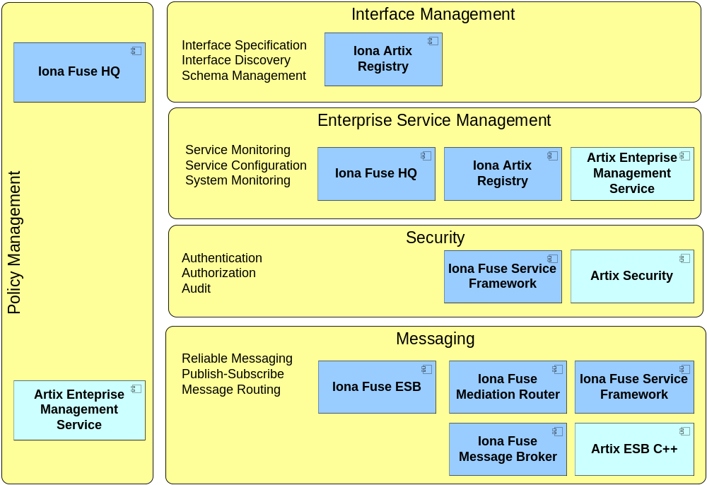
Application of Iona Software for Service Container and Core Services

Slide 10
What is the purpose of SWIM Resource Kit?
To assist the SIP developers in learning and utilizing the SWIM Core Services
To assist the SIP developers in debugging COTS and related third party products
To assist the SIP developers in obtaining and managing the resources required for development.
To assist the SIP developers in identifying the SWIM Service Container components required to implement their Service.
To assist the SIP developers in sharing knowledge.
To provide tools to assist the SIP developers with testing.

Slide 11
What is the Resource Kit?
Guidance Documentation
  Maven Guidance
  Developers Guide for Fuse ESB
    Procedures for installing Eclipse, Fuse tools for Eclipse and Maven plug-in
    Build procedures
    Debugging procedures
    Examples
COTS Repository
  Fuse ESB, Fuse Mediation Router, Fuse Message Broker, Fuse HQ, Fuse Service Framework
  Spring
  Eclipse
  Maven
  Ant

Slide 12
What is the Resource Kit? (Cont.)
SWIM Reference Model
  Description of Service Container components and interfaces
  Maps Service Container components to Core Services
  Decision Tree for identifying which Service Container components and architecture are required to achieve particular operational needs
      i..e, guaranteed messaging
Governance and Policy Guidance
Standards
  Core Service Standards
  Industry Standards

Slide 13
What is the Resource Kit? (Cont.)
Tools
  WS-I Testing Tools
  iTKO LISA – SOA Test Tool and Virtual Service Emulation (VSE)
Qualified Vendor List
  XML Gateway
Potential Acquisition
  Policy Server
SWIM Wiki
  https://ksn.faa.gov/km/atow/com/sysegr/SWIM/SIPs/SWIM%20Segment%201/swimwikirequest_pub_0001.pdf
Third Party References and Training Information

Slide 14
What is the Resource Kit? (Cont.)
Available on the SWIM Wiki as Resource Kit items are completed (NLT 1/1/09)
Resource Kit is dynamic
  New items will be added as required

Slide 15
WJHTC SWIM Labs - Status
Following the Service Container evaluation SWIM labs are being configured in 1st Quarter FY09 to develop and sustain:
  A SWIM Product Repository for commercial and open-source software
  A SWIM Registry for design-time SWIM Implementers and consumers
  A SWIM Wiki for SWIM community information exchange
SWIM labs are also being used for:
  XML Gateway qualified vendor laboratory evaluation
Information is being sought on how and when SWIM lab facilities can provide additional support to SIPs such as providing an environment and resources to facilitate SIP development and evaluation of services.
  Lab request form is available on KSN at: https://ksn.faa.gov/km/atow/com/sysegr/SWIM/SE/DocWork_1/SE_Prototyping/Lab%20Infrastructure/swim_RFR2%20_pub_0001.pdf

Slide 16
WJHTC SWIM Labs – Service Container Products Availability Today
IONA FUSE products now available via KSN at: https://ksn.faa.gov/km/atow/com/sysegr/SWIM/SIPs/COTSProducts/default.aspx
This site contains FUSE installers for download and installation on Windows & Unix platforms for familiarization purposes only
No support for these products at this time and this is not the SWIM COTS Product Repository
All those with access to KSN SIP page have access to the COTS Products page.

Slide 17
WJHTC SWIM Labs – Service Container Products Availability in the Future
SWIM Implementation Team is standing-up a repository of IONA products for SIP use via the internet. The goal is to provide a managed stable version of the SC products that all SIPs will use in developing their SWIM services. SWIM management involves building FUSE products from source and running unit tests to validate the repository is complete.
Initial repository will contain IONA FUSE product line:
  FUSE ESB
  FUSE Services Framework
  FUSE Message Broker
  FUSE Mediation Router
ARTIX Products and FUSE HQ will be added in future
Repository will maintain versions of:
  Product installers for FUSE Products
  Product artifacts for all dependencies
Artifactory open-source software will be used to provide repository management

Slide 18
SWIM Lab Administrative Information
How can SIPs schedule the Lab?
  Laboratory Plan, schedule for lab activities, resource allocation and latest system configurations are being posted in SWIM’s KSN website under Prototyping Workspace/Lab Infrastructure https://ksn.faa.gov/km/atow/com/sysegr/SWIM/SE/DocWork_1/SE_Prototyping/Lab%20Infrastructure
  Scheduling of lab resources will be done by submitting a Request For Resources (RFR) form to the lab manager, also to be found on lab infrastructure KSN page
  Calendar of lab activities will be derived from the schedule and information provided by the technical leads
Dominic (Bud) Timoteo is POC for the SWIM Lab
  Voice: 609-485-4055
  dominic.timoteo@faa.gov

Slide 19
Prototype: Goals
The ITWS-SWIM Prototype was developed as a proof of concept
  Evaluate a service container product provided by IONA FUSE
  Deploy the prototype service to interested non-FAA consumers to evaluate web services and XML formats, and overall products’ usability
    Publishing 4 ITWS weather products
      Micro bursts; Gust fronts; Configured Alerts; Terminal Text
ITWS-SWIM Prototype scheduled to be operational by Sept 30, 2008 and run until ITWS-SWIM Segment One is deployed in December 2010

Slide 20
Prototype: FY08 Accomplishments
Initial design and coding completed in August 2008
Initial end-to-end testing and stress testing successful, August 2008
Conducted successful tests with the FTI National Test Bed (FNTB) and the ED-8 Gateway
Three airlines selected to participate
  JetBlue, UPS, NWA
SCAP update effort successful to date – with late September Certification and Authorization target
FTI backbone between Volpe and the WJHTC in place
  Backbone will support ITWS SWIM Prototype subscriber traffic
  UPS connectivity scheduled for week of September 23
Successfully explored “don’t code, configure” principles. Results to date with Iona Fuse have been very promising.
  Produced a proof-of-concept configuration enabling WS-Security functions in SWIM ITWS Prototype System through configuration only (no coding required)
End-to-end proof of concept testing between Volpe and the ED-8 gateway at the WJHTC is scheduled for September 18

Slide 21
Prototype: FY09 Plans
Agreement reached and documented in the PLA to maintain the Prototype through FY’10
  No enhancements after initial deployment are currently funded or planned
Volpe will provide client software and a user guide to service consumers
More service consumers may be added until the current allocated bandwidth limit for the prototype is reached

