Slide 1

Ruth Ellen Luehr
Health Services –
Student Support Specialist
Pandemic Influenza Planning for Schools
A State Perspective

Slide 2
EDUCATORS’ QUESTIONS:
WHO has the authority to close schools?
WHEN schools close, is there continued funding?
How will children with special needs be cared for?
Do you REALLY think a pandemic will happen?
Will we be the first to know of a threat & school closings?
This too shall pass.

Slide 3
State Education Role in
MINNESOTA PANDEMIC INFLUENZA PLANNING
FOR SCHOOLS Components
COORDINATE – COMMUNICATE – COLLABORATE
DISEASE PREVENTION, CONTROL, SURVEILLANCE
CSERVICE CONTINUATION PLAN
with STATE PARTNERS
with SCHOOL PARTNERS

Slide 4
COORDINATE – COMMUNICATE – COLLABORATE
Minnesota works with STATE PARTNERS
Investigated state emergency management / public health plans; find resources.
Reviewed complexity of education system:
types of schools, local control, school culture.
Established state agency communication plan; school plan: public, non-public & charter schools.
Adding education assumptions to emergency management and public health assumptions.

Slide 5
COORDINATE – COMMUNICATE – COLLABORATE
Minnesota works with SCHOOL PARTNERS
Communicated the communication plan:
- State Education sending regular notices to schools
throughout four phases of All Hazards planning.
Encouraging local partners to link with each other:
- Fall 06 regional meetings of Emergency Managers
- Notices to Superintendents and School Nurses
- Plan to establish web links.

Slide 6
DISEASE PREVENTION, CONTROL, SURVEILLANCE
Minnesota works with STATE PARTNERS
Confirmed trigger points for social distancing including student dismissal.
Examining public health’s recommendation for N95 respirators in all settings. Plan for schools?
Encouraging emergency management / public health to use schools as a conduit to reach families with prevention messages.
Encourage schools to use public health materials.

Slide 7
DISEASE PREVENTION, CONTROL, SURVEILLANCE
Minnesota works with SCHOOL PARTNERS
Verifying the threat of pandemic influenza. People continue to ask if the threat is real and imminent.
Explaining the rationale for student dismissal as a major strategy to control pandemic influenza;
translating prevention and protection priorities.
Reviewing use of disinfectants, effective personal hygiene measures, safety for personnel/staff before and during an epidemic.

Slide 8
continued - SCHOOL PARTNERS
Using formal and informal health education opportunities; ex. teachers are role models!
Stepping up surveillance by school nurses;
protocols for case identification; on-line reporting.

Slide 9
Example:
DISEASE PREVENTION & CONTROLTHROUGH SOCIAL DISTANCING
“A community mitigation framework:
early, targeted, layered mitigation strategy
involving the directed application of multiple
partially effective non-pharmaceutical measures
initiated early and maintained consistently.”
IOM report: http://www.nap.edu/catalog/11800.html Report 12/06.
My Space
Your Space
Notes:
A community mitigation framework:
early, targeted, layered mitigation strategy
involving the directed application of multiple
partially effective non-pharmaceutical measures
initiated early and maintained consistently during an epidemic wave.

Slide 10
SERVICE CONTINUATION PLAN
Minnesota works with STATE PARTNERS
Clarified authority to dismiss students:
- in emergencies, the Governor & Commissioner of
Education have authority to close schools.
- Education’s role: State Emergency Operations Center.
Clarified funds are available to schools during school closure; criteria to be developed.
Clarifying roles of schools in pandemic planning:
- expectations of state and local partners
- limitations: food services, direct care, transportation
- opportunities: communication, care coordination.

Slide 11
continued - STATE PARTNERS
Continuing to clarify that the children belong to the community; all sectors need to be involved in providing basic & emergency services, not only schools.
Table tops show complexity of school issues:
Governor’s Table Top – September 2006 Homeland Security
Four diverse communities – January 2007 State Health Agency
Multi-state Leaders Table Top – March 2007
National Governors Association

Slide 12
SERVICE CONTINUATION PLAN
Minnesota works with SCHOOL PARTNERS
Lay foundation using All Hazards plan:
provides framework, clarifies authority;
relate to existing school crisis planning.
Simplify / consolidate planning.
Begin by addressing mental health / social
emotional learning.

Slide 13
continued - SCHOOL PARTNERS
Hosting forums for Stakeholders regarding continued instruction during pandemic influenza:
- listen to policy / legal concerns:
testing, special needs students, care for children
- explore decision dilemmas.
Hosting regional table top exercises for schools and partners – fall 2007:
- review resources for planning!
- confirm partnerships!
- examine needs that are revealed through the exercises.

Slide 14
Example:
CLARIFY SCHOOL RESPONSIBILITIES IN Minnesota
Type of directive Source for directive
Presidential Directive
Crisis/Safety Policy
School Health Plan
Employee Health/Wellness
State authority in Emergencies
Governor’s Executive Order
Codes of Standards/Ethics
Partner expectations
Community expectations
- Homeland Security Presidential Directive (HSPD)-5 established DHS & NIMS
- Minnesota Statute 121A.035 Crisis Policy - SDFSC Title IV Sec 4114 (d)(7)(D)
- Minnesota Statute 121A.21 Health Services - Health and Safety Plan (levy)
- OSHA directives and guidelines
- Minnesota Statute chapter 12 Gov. and Commissioner ->close schools
- Directive to state agencies – All Hazards Planning GEO 4-04, rev 5-07
- Fellow education & health professionals
- Emergency Management & Public Health
- Parents and families

Slide 15
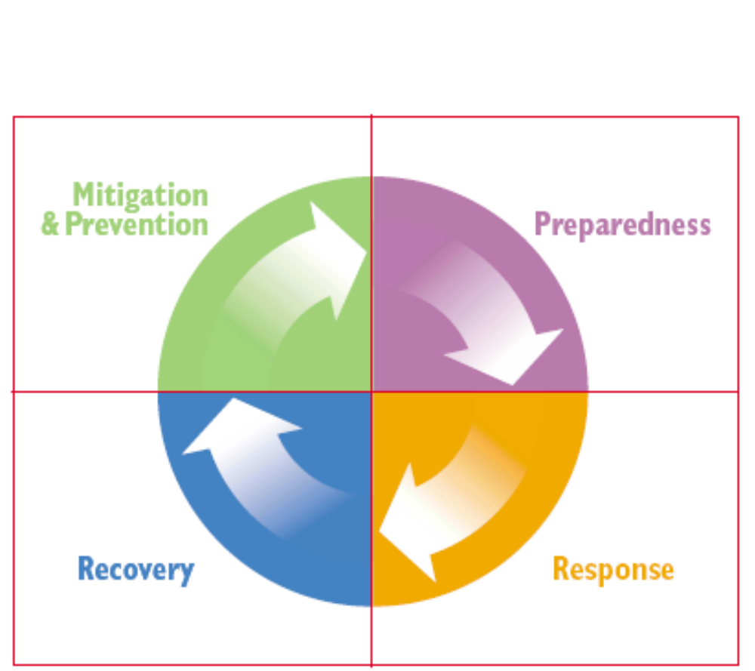
Example:
BASIS FOR PANDEMIC PLANNING IS ALL HAZARDS PLANNING
US Dept of Education
www.ed.gov/
emergencyplan
FEMA
www.training.
fema.gov
New course for educators - June 07

Slide 16

Minnesota’s All Hazards ->
PANDEMIC INFLUENZA PLAN for Schools
COMPONENTS
COORDINATE – COMMUNICATE – COLLABORATE
DISEASE PREVENTION, CONTROL, SURVEILLANCE
CONTINUATION OF OPERATIONS PLAN (COOP)
C SERVICE CONTINUATION PLAN
Hazard-specific Supplements

Slide 17
A COORDINATE – COMMUNICATE – COLLABORATE
B DISEASE PREVENTION, CONTROL, SURVEILLANCE
C SERVICE CONTINUATION PLAN: 1 KEEP STAFF EMPLOYED; SUSTAIN EDUCATION INFRASTRUCTURE. 2 CONTINUE TEACHING & LEARNING.
POLICY & ADMINISTRATION
CURRICULUM/ INSTRUCTION
STUDENT SUPPORT
FAMILY / PARENT INVOLVEMENT

Slide 18
MN CAPSULE: PANDEMIC INFLUENZA PLAN for SCHOOLS
C SERVICE CONTINUATION PLAN 2CONTINUE TEACHING AND LEARNIING.
 | PHASES of All Hazards EMERGENCY MANAGEMENT
School Program COMPONENTS | PREVENTION/ MITIGATION | PREPAREDNESS | RESPONSE | RECOVERY
POLICY AND ADMINISTRATION
CURRICULUM AND INSTRUCTION
STUDENT SUPPORT
FAMILY AND PARENT INVOLVEMENT
C SERVICE CONTINUATION PLAN 2 CONTINUE TEACHING AND LEARNIING.
 | PHASES of All Hazards EMERGENCY MANAGEMENT
School Program COMPONENTS | PREVENTION/ MITIGATION | PREPAREDNESS | RESPONSE | RECOVERY
POLICY AND ADMINISTRATION
CURRICULUM AND INSTRUCTION
STUDENT SUPPORT
FAMILY AND PARENT INVOLVEMENT

Slide 19
Addressing social – emotional needs:
Commissioner: Recognize the stress of planning.
PREPAREDNESS:
Training: Psychological First Aid, Personal Preparedness
Planning: Build in support systems
RESPONSE:
Solidify personal / family plans
Teachers: check status of student / family -> refer
Teachers: use Facing Fear – American Red Cross
Student Support Services: partner with community agencies
& prioritize resources, assess student/family; link
RECOVERY
Learning problems may occur related to stress

Slide 20
Challenge
What is necessary
to make social measures work?
Social cohesion, local leadership & trust in government.
IOM report: http://www.nap.edu/catalog/11800.html Report 12/06.
Understand health behavior and behavior change.
Appreciate innovation.

Slide 21
References
Theory at a Glance: A Guide for Health Promotion Practice (2nd ed).
The monograph describes influential theories of health-related behaviors, processes of shaping behavior, and the effects of community and environmental factors on behavior. www.nci.nih.gov/theory/pdf
New and Improved, Creating Growth Through Innovation
http://www.newandimproved.com/ and
http://www.creativity-portal.com/articles/bob-eckert/fear-innovation-killer.html

Slide 22
US Department of Education
Safe and Drug Free Schools and Communities
August 4, 2007
****************************************
Ruth Ellen Luehr, MS, RN, FNASN
Pandemic Influenza Planning for Schools
Health Services/Student Support Specialist
NCLB and Related Federal Programs, Safe and Healthy Learners Team
Minnesota Department of Education
1500 West Hwy 36
Roseville, MN 55113
voice 651-582-8403 fax 651-582-8499
email ruthellen.luehr@state.mn.us

