Slide 1


Are Children Too Heavy for Age-appropriate Child Passenger Safety Seats?
William Basco, Paul Hletko*, Lynn West, and Paul Darden
AHRQ National PBRN Research Conference
May 16-18, 2007

Slide 2
SCPPRN
South Carolina Pediatric
Practice Research Network
www.musckids.com/scpprn

Slide 3
Funding
Supported in part by:
  HRSA – Grant # D54HP05448
  Agency for Healthcare Research and Quality – Grant # 1KO8 HS015679-01A1

Slide 4
SCPPRN Members
Charleston Pediatrics
Seacoast Pediatrics
MUSC Children’s Care, N. Charleston
MUSC Pediatric Primary Care
MUSC Children’s Care, Moncks Corner
Barnwell Pediatrics
Georgetown Pediatrics
Beaufort Pediatrics

Slide 5
Background:
Motor vehicle related injury (MVA) is the number one cause of unintentional injury death in children under 19 years old in South Carolina and the US.
Improper use of child automobile restraints is an important contributor to risk of death if involved in a MVA

Slide 6
Background, MVA Injury:
Arbogast (2004): review of 1998-2002 US crash data
  proper use of child restraints for children 12-47 months old reduced the risk of serious injury by 78% (OR 0.22, 95% CI 0.11-0.45) compared to seat belts
Durbin (2005): 1998-2002 US crash data
  Children not properly restrained had an increased risk of injury (OR 1.8, 95% CI 1.4-2.3) compared to properly restrained children.
  Unrestrained children had an OR for severe injury of 3.2 (95% CI 2.5-4.1).
Elliott (2006): Proper use of child passenger restraints reduces the risk of DEATH in motor vehicle crashes by 28%.

Slide 7
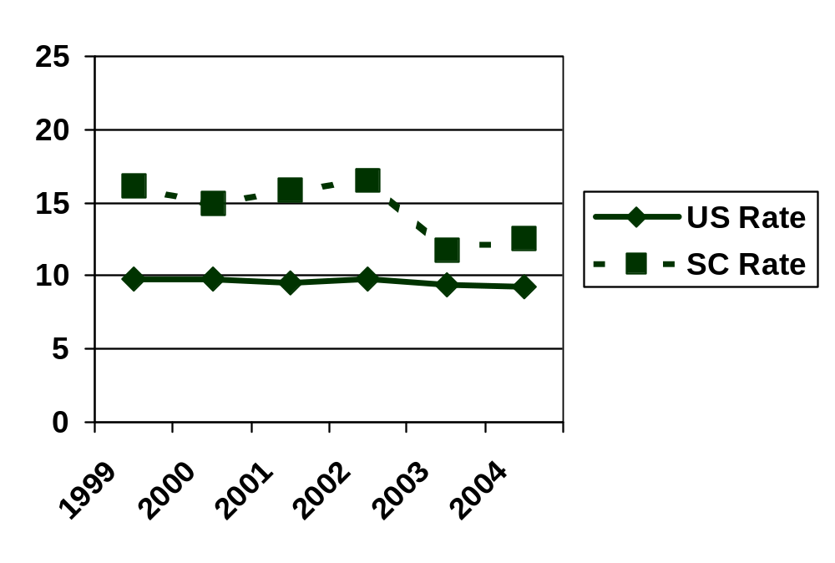
1999 - 2004, US and South Carolina
Unintentional, Overall Motor Vehicle Deaths and Rates per 100,000
All Races, Both Sexes, Ages 0 to 19
Source: WISQARSTM (Web-based Injury Statistics Query and Reporting System),
Centers for Disease Control and Prevention

Slide 8
There ought to be a (SC) law!
Children from birth to 1 year old, or who weigh less than 20 pounds, must be secured in a rear-facing child safety seat.
Children 1 through 5 years old weighing 20 to 40 pounds must be restrained in a forward-facing child seat.
Children 1 through 5 years old weighing 40 to 80 pounds must be secured in a belt-positioning booster seat.
Children under the age of 6 are not required to be in booster seats if they weigh more than 80 pounds or if they can sit with their backs against the car's seat and bend their legs over the seat edge without slouching.
Children under 6 may not sit in the front passenger seat. However, this restriction does not apply if the vehicle has no rear passenger seats or if all other rear passenger seats are occupied by children less than 6 years old.

Slide 9
Usual Restraint cutoffs:
Infant carrier: at least 20 lb AND 12 months
Toddler seat: at least 40 lb AND 5 years
Booster seat: at least 80 lb
Front seat (air bag): > 12 years (SC law > 6 years)
http://www.aap.org/family/carseatguide.htm

Slide 10
Background, Obesity:
Ogden (2003), Hedley (2004), and Freedman (2006): rates of obesity have been increasing in US children, especially among low-income children.
Trifiletti (2006): 1999-2000 data from the National Health and Nutrition Examination Survey (NHANES)
  modeled the potential impact of weight changes on proper restraint selection.
  Generous in their selection of an upper bound for infants (35 lbs – the typical infant carrier is rated to only 20-22 lbs).
  Ages 2-3 years old appeared to be the most problematic strata with significant numbers of children in those strata too heavy for age-appropriate restraints.

Slide 11
Objective:
To determine what percentages of children in critical age strata are too heavy for their age-appropriate child passenger restraint.

Slide 12
Hypotheses:
Hypothesis #1: Significant numbers of children in this sample will be too heavy for age-appropriate car restraints.
Hypothesis #2: Minority children will be too heavy for age-appropriate car restraints at higher rates than the comparison, non-minority children.
Hypothesis #3: There will be significant variation in the percentages of children too heavy for age-appropriate car restraints among practices.
Hypothesis #4: Is location (urban vs rural).

Slide 13
Anthropometrics:
Method
6 practices collected data on consecutively-seen patients.
Each practice collected data on 20 patients per age stratum, in the units they typically used (lbs or kg, etc.)
Data converted to kg and cm by research staff

Slide 14
Anthropometrics:
Age Strata
Age categories (12)
  0-6 months, recorded in months
  7-12 months, recorded in months
  13-24 months, recorded in months
  25-35 months, recorded in months,
  Two-year groupings: 3-4 year olds, 5-6 year olds, 7 and 8 year olds, 9 and 10 year olds, 11 and 12 year olds, 13 and 14 year olds, 15 and 16 year olds, and 17 and 18 year olds.

Slide 15
Analyses:
1. Descriptive analysis of the SC cohort as well as by practice.
a. Mean Weight and mean Height by age stratum
b. Mean Weight and mean Height by Gender
c. Mean Weight and mean Height by Ethnicity/Race
d. Mean Weight and mean Height by Practice Site
2. Compare mean weight and mean heights among practices to determine if any adjustment should be made for clustering of observations within a practice.

Slide 16
Analyses, 2:
Percentage of children be misclassified by seat type based on weight vs age.
  For example, children less than 12 months old should be in an infant carrier, but weight cutoff should be ~ 22lbs.
Percentage of children 13 months to < 6 years who are too heavy for a forward facing toddler seat (> 40 pounds).
Percentage of children age 13 months to < 6 years who are too heavy for a belt-positioning booster seat (> 80 pounds).
Compare rates determined in #3 by ethnicity/race breakdown of the children, comparing percentages overweight for age restraint in African-American and Hispanic children to White children.
Adjust all comparisons by site if children are found to vary a significant amount by site.

Slide 17
Results:
6 practices provided data on 1,390 subjects
717 subjects < 6 years old
  Male = 56%
  N per age stratum:
    < 12 months, 267 subjects
    12 months to < 6 years, 450 subjects
  Race/ethnicity
    White, 42%
    Black, 42%
    Hispanic, 15%
    Other, 1%

Slide 18
Results: < 12 months and above 20-lb cutoff
24% - 63 of 267 subjects

Slide 19
Results: < 12 months and above 20-lb cutoff – race/ethnicity
24% - 63 of 267 subjects
 | < 20 lbs (%) | > 20 lbs (%)
white | 77 | 23
black | 77 | 23
Hispanic | 75 | 25

Slide 20
Results: < 12 months and above 20-lb cutoff - practice
24% - 63 of 267 subjects
Range by practice 16-41%
Practice | < 20 lbs (%) | > 20 lbs (%)
1 | 82 | 18
2 | 82 | 18
3 | 78 | 22
4 | 84 | 16
5 | 78 | 22
6 | 59 | 41
P=.04

Slide 21
Results: < 6 years and above 40-lb cutoff
21% - 96 of 450 subjects

Slide 22
Results: < 6 years and above 40-lb cutoff – race/ethnicity
21% - 96 of 450 subjects
 | < 20 lbs (%) | > 20 lbs (%)
white | 79 | 21
black | 80 | 20
Hispanic | 77 | 23

Slide 23
Results: < 6 years and above 40-lb cutoff - practice
21% - 96 of 450 subjects
Range by practice 13-26%
Practice | < 20 lbs (%) | > 20 lbs (%)
1 | 79 | 21
2 | 76 | 24
3 | 86 | 13
4 | 76 | 24
5 | 80 | 20
6 | 74 | 26
P>.05

Slide 24
Results: < 6 years and above 80-lb cutoff
0.22% - 1 of 450 subjects

Slide 25
Conclusions:
Substantial percentages of children in this SC cohort were too heavy for their age-appropriate child automobile restraint.
Substantial variation in % overweight by practice site greater variation at younger ages.
Less variation than expected by race/ethnicity.

Slide 26
Implications:
Changing weights of US children will have an adverse effect on proper automobile restraint selection.
This will place increased numbers of children at risk for injury if involved in an MVA.
Providers should stress both age AND weight when advising parents about selection of proper child automobile restraint.

