Slide 1
GSI Analysis System
David Parrish
NOAA/NWS/NCEP/EMC

Slide 2
general comments
GSI analysis code is an evolving system.
  Scientific advances – e.g.,
    situation dependent background errors
    new satellite data
    new analysis variables
  Improved coding – e.g.,
    Bug fixes
    Removal of unnecessary computations, arrays, etc.
    More efficient algorithms
    Generalizations of code to allow use on different compute platforms
    Improved documentation

Slide 3
general comments
New versions released approximately every 3 months
  Old versions are not supported
Developers are expected to keep up with current version
Code is intended to become Operational
(already operational in NAM—June, 2006)
  must satisfy NCEP coding requirements
  must fit into NCEP infrastructure
EMC does not have resources to provide high level of support.

Slide 4
general comments
A LOT of details skipped over in this presentation
More detailed information can be found on the GSI web site
http://www.emc.ncep.noaa.gov/gmb/treadon/gsi/
Location for outside users to obtain latest code and script updates
Use at own risk—high level support not provided

Slide 5
History
The GSI (Gridpoint Statistical Interpolation) system was initially developed as the next generation global analysis system
  Wan-Shu Wu, R. James Purser, David Parrish
    Three-Dimensional Variational Analysis with spatially Inhomogeneous Covariances. Mon. Wea. Rev., 130, 2905-2916.
  Based on SSI (Spectral Statistical Interpolation) analysis system
  Replace spectral definition for background errors with grid point version based on recursive filters

Slide 6
History
After development of initial GSI analysis system, desire for single global/regional analysis system expressed by EMC management
  realization that GSI fairly straightforward to modify for both applications
GMAO collaboration
Modification to fit into WRF and NCEP infrastructure
Evolution to ESMF

Slide 7
History
Implemented with WRF-NMM into the NAM system in June, 2006
Preimplementation testing for replacement of SSI in GFS system in March, 2007

Slide 8
Basic analysis problem
J = J_{b} + J_{o} + J_{c}
J = (x-x_{b})^{T}B⁻¹(x-x_{b}) + (H(x)-y₀)^{T}(E+F)⁻¹(H(x)-y₀) + J_{C}
J = Fit to background + Fit to observations + constraints
x = Analysis
x_{b} = Background
B = Background error covariance
H = Forward model
y₀ = Observations
E+F = R = Instrument error + Representativeness error
J_{C} = Constraint term

Slide 9
GSI Code - General Flow
Read in &
distribute
observations
User input &
initializations
Additional
initializations
Outer loop (2 or 3 iterations)
(Read/distribute) guess & derived fields
(Read/distribute) background error
Set up right hand side of analysis equation
Call inner loop (50 to 150 iterations)
  Compute gradient information (J_{x} – path towards minimum)
  Apply background error (Bv where v = J_{x})
  Compute search direction (better path to minimum)
  Compute step size (how far to move to get max decrease of J)
  Update analysis increment
Write analysis & related output

Slide 10
Expected Scientific advancements
Inclusion of new types of data
  COSMIC GPS – radio-occultation
  Radiance data
    SSM/I and SSM/IS radiances
    NASA instruments from AQUA, TERRA, CHEM
    NPOESS and METOP
    Next Generation Geostationary satellite
  Doppler radial velocities and reflectivities
  Precipitation observations
  Cloud observations
  Ozone observations

Slide 11
Expected Scientific advancements
Improved specification of observational errors
  Situation dependent representativeness errors
  Increased granularity in specification of obs errors.
Advanced DA techniques
  Situation dependent background errors
  4-D var.
  Improved balance constraints

Slide 12
Expected Scientific advancements
New analysis variables
  SST
  Clouds
  Aerosols
  Precipitation
  Constituents
Others

Slide 13
Background error
J_{b} = (x-x_{b})^{T}B⁻¹(x-x_{b})
B background error covariance matrix
x vector of gridpoint values of
u, v, T, q, c_{w} , oz, p_{s}, T_{skin}
Length of x currently 10⁸ for NAM, so
B is 10⁸ x 10⁸ = 10¹⁶ !
Much too big to define directly
Recursive filter used to define B as sequence of
inexpensive subroutines. Routines contain small number of parameters.

Slide 14
Background error
State variable x :
  ψ stream function contribution to wind
  χ_{bal} balanced potential function contribution to wind
  T_{bal} balanced temperature
  p_{bal} balanced temperature
  χ_{unbal} unbalanced potential function contribution to wind
  T_{unbal} unbalanced temperature
  p_{unbal} unbalanced temperature
  q moisture
  c_{w} cloudwater
  oz ozone (GFS only WRF-NAM does not currently
  carry prognostic ozone variable)
  Each component of x has its own partition of the background error matrix B

Slide 15
Multivariate relations in B
Balanced part of the temperature is defined by
T_{bal} = G ψ
where G is an empirical matrix that projects increments of stream function at one level to a vertical profile of balanced part of temperature increments. G is latitude dependent.
Balanced part of the velocity potential is defined as
χ_{bal} = c ψ
where coefficient c is function of latitude and height.
Balanced part of the surface pressure increment is defined as
P_{bal} = W ψ
where matrix W integrates the appropriate contribution of the stream function from each level.

Slide 16
Background error parameters
Error variance (diagonal of B)
Correlation lengths (diagonal dominance of B)
Multivariate coupling (dynamic balance between stream function and divergent wind, temperature, and pressure)

Slide 17
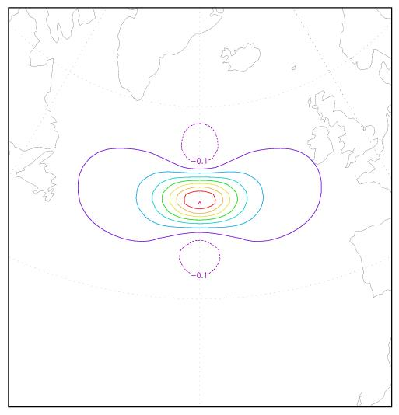
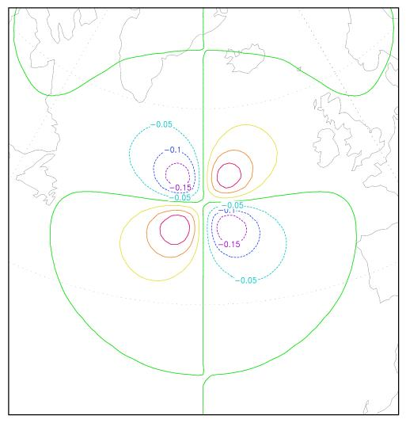
B visualized with single observation analysis
(background error example for GFS from 2 years ago)
J = (x_{a} -x_{b})^{T}B⁻¹(x_{a} -x_{b}) + (Hx_{a} -y₀)^{T}(E+F)⁻¹(Hx_{a} -y₀)
u (left) and v (right) increments (x_{a} – x_{b}) at sigma level 0.267, of a 1 m/s westerly wind observational residual (y_{o} - Hx_{b}) at 50N and 330 E at 250 mb.

Slide 18
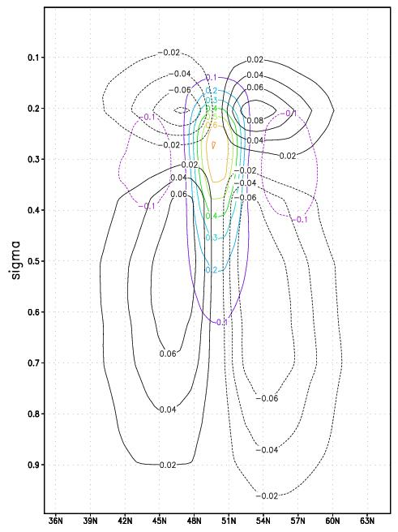
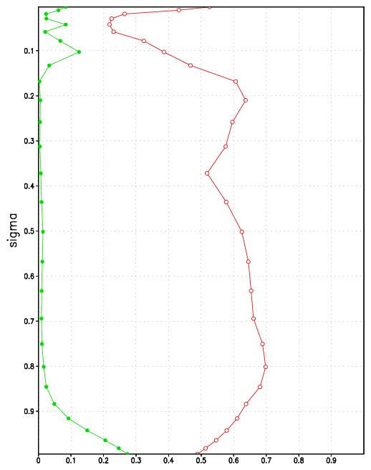
B visualized with single observation analysis
T_{bal} = G ψ
χ_{bal} = c ψ
Only use surface coupling
to get surface friction effect
(convergence in lows,
divergence in highs)
vertical cross section of u and T coupling of stream function to temperature and velocity potential

Slide 19
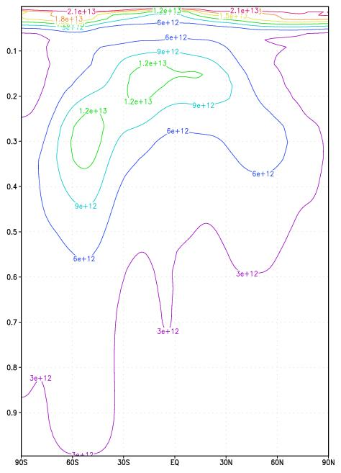
Error variance (diagonal of B)
Error statistics are estimated in grid space with the ‘NMC’ method. Stats of ψ are shown.
Stats are function of latitude and sigma level.
The error variance (m⁴ s⁻²) is larger in mid-latitudes than in the tropics and larger in the southern hemisphere than in the northern.

Slide 20
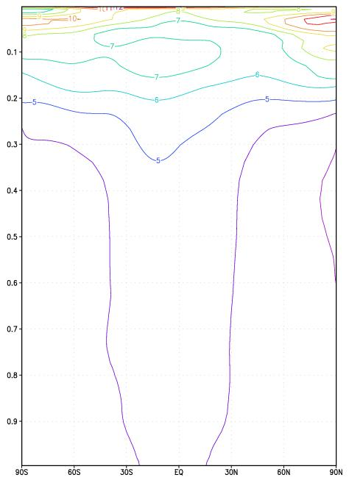
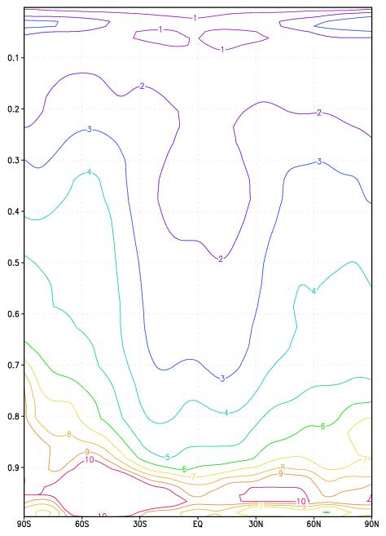
Horizontal/vertical scale lengths
(spread of B away from diagonal)
horizontal scales in units of 100km vertical scale in units of vertical grid
The horizontal scales are larger in the tropics, and increase with height.
The vertical scales are larger in the mid-latitude, and decrease with height.

Slide 21
Forward Model H
Transforms state variable x into simulated observation y = H(x)
Can be linear or nonlinear
As simple as interpolation from grid to observation location (conventional point observations)
As complex as radiative transfer model (CRTM) for satellite radiance observations.
CRTM development crucial for successful assimilation of aerosols and chemical constituents

Slide 22
Satellite Radiance treatment
John C. Derber
NOAA/NWS/NCEP/EMC

Slide 23
Overview
Goals
  Extract as much information as possible from data
  Prepare for the new data sources
  Improve NWP guidance
Dogma
  Use data with minimal processing
    Simplify error structure
    Simplify quality control
    Use only information in observations

Slide 24
Overview
Difficulties
  Instrument and Radiative transfer issues
    Surface emissivity
    Instrument characterization
    Scattering from clouds, precipitation and aerosols
    Impact of variations in atmospheric constituents
  Quality control issues
  Large volume of data (very redundant)
  Computational cost
  Nonlinearity
  Model biases

Slide 25
Radiative transfer
Radiative transfer being developed and maintained by JCSDA
  http://cimss.ssec.wisc.edu/~paulv/Fortran90/CRTM/Prototype/
  Library called from GSI
Improvements under development
  Enhance modular RT system through JCSDA (VanDelst, Yang)
  Inclusion of cloud water and precipitation effects in microwave and IR (Bennartz, Weng, Gasiewski, Liou)
  Improved microwave (Okamoto,Yan and Weng) and IR (VanDelst) oceanic surface emissivity
  Inclusion of aerosol effects (Lu)

Slide 26
Assimilation of Aerosols
CRTM is being expanded to include effects of aerosols
But to get estimates of aerosols or other new atmospheric constituents, they must be predicted quantities in the forecast model
Example: ozone is not a predictive quantity in the WRF-NAM. So satellite channels with strong sensitivity to ozone are not currently used.

Slide 27
Assimilation of Aerosols
When a new constituent variable has been added to the forecast model, then it is possible to augment the background error B and run retrospective tests to get biases for satellite channels which are sensitive to the new variable.

Slide 28
Obstacles for regional hi res applications involving aerosols
Very difficult to put together all pieces using WRF framework.
Too expensive to do testing over full 12km NAM domain

Slide 29
Progress
Matt Pyle has developed a 15km, half domain assimilation system with all required pieces, including extended forecasts and verification. More practical for the testing required to include new obs types/model variables.
Ozone, aerosol, chemical constituents in WRF NAM???

Slide 30
Current GSI work
J_{c} term – needed to control gravity wave noise, a serious problem in WRF-NDAS.
Approximate 4dvar – include time dimension when doing analysis.

Slide 31
J_{c} term (for dynamic balance)
“generic” adiabatic model contained in GSI
  Compute analysis increment tendencies of state variables due to passive advection of constituents and adiabatic dynamics for u, v, T, p.
  Use tangent linear model linearized about analysis estimate from previous outer loop.
Normal mode initialization ideas being adapted to construct constraints which minimize gravity wave noise added by analysis increment while preserving meteorological signal.

Slide 32
Control of noise needed for:
More frequent assimilation (6hrs to 1hr in GFS, 3hrs to 1hr in WRF NDAS)
Improvement in fit of background to observations
Use of approximate 4dvar

Slide 33
Approximate 4dvar
Forward model H is augmented to include linear time extrapolation over time of analysis window (currently +/- 3 hrs for GFS, +/- 1.5 hrs for WRF NDAS)
Use analysis increment tendency to do the extrapolation
Forward model H now includes tangent linear model used to get analysis increment tendencies
For passive advected aerosols, the wind field is now coupled, being the principle contribution to tendency of aerosol
Thus winds indirectly observed from aerosols

Slide 34
Approximate 4dvar
Doesn’t work unless gravity wave noise minimized with good J_{c} term
With good J_{c} term approximate 4dvar should be even better over shorter assimilation interval, because linear extrapolation has smaller error

Slide 35
Approximate 4dvar
Very intensive effort underway to get effective J_{c} term and 4dvar.
Substantial progress has been made with both for use with the GFS.
Some difficulties still with application to WRF-NDAS, not for 4dvar, but the J_{c} term
Expect to have everything working long before we will be able to do aerosol/ other constituent assimilation experiments (waiting on model).

