Slide 1
Radiance Assimilation Activities at SPoRT
Will McCarty
SPoRT SAC
Wednesday June 13, 2007

Slide 2
Motivation for Radiance Assimilation
SPoRT emphasis on short-term regional weather forecast improvements
Value of AIRS radiances
  supplement raobs in data sparse regions (over oceans and between raobs)
  Aqua platform provides asynoptic observations over CONUS
  Regional assimilation allows to the use of more satellite measurements (every cloud-free footprint) spatially and spectrally
    Smaller-scale features in the data are retained
Challenges in identifying the proper utilization of the measurements, relative to global methodologies

Slide 3
Radiance Assimilation
Advantages of Radiance Assimilation
  By theory, radiances will have a larger impact in a variational system than profiles
    Direct measurement is being used, not a retrieved product
    No additional error from retrieval process impacting data
Disadvantages of Radiance Assimilation
  Computationally expensive
  Less intuitive
Many issues (sfc ε_{ν}, cloud contamination) inherent to both

Slide 4
Radiance Assimilation @ SPoRT
SPoRT and JCSDA
  Emphasize transition of NASA technologies to operations
    SPoRT focus – short-range (0-48 hr), mesoscale
    JCSDA focus – Medium-range (48+ hr), global
  Assimilation of NASA measurements to improve initial conditions
    Improved initial condition lead towards improved forecasts
  Collaboration on AIRS assimilation in within North American Model (NAM) Data Assimilation System (NDAS)

Slide 5
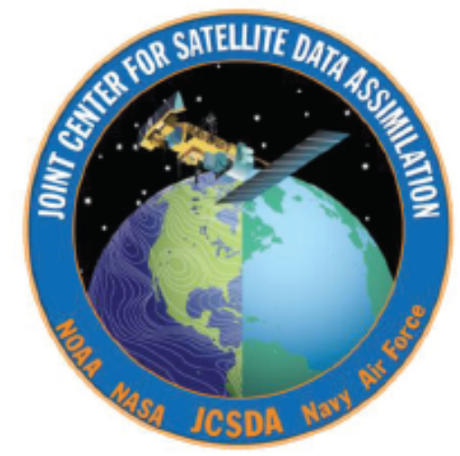
Collaboration with JCSDA
McCarty at JCSDA summer of 2006
  Spent working onsite at the JCSDA, under the direction of then-director John Le Marshall
  Developed a working knowledge of the Gridpoint Statistical Interpolation (GSI) 3D-VAR system
    Multi-agency development
    At NCEP, currently the Regional and Global Data Assimilation System
Data Assimilation workshop - July 2007
Computational resources
  Resources from JCSDA and NCEP/EMC (S. Lord) have been made available to allow SPoRT focus with national-scale office resources

Slide 6
Expected SPoRT Contributions to JCSDA
Assess system configuration
  Assess differences in bias adjustments between the NAM system and the GFS system
  Evaluate thinning methodologies between regional and global model assimilation applications
    spatial
    spectral
Evaluate impact of AIRS data at regional scale
  Data density and coverage
  Cloud-free radiance detection

Slide 7
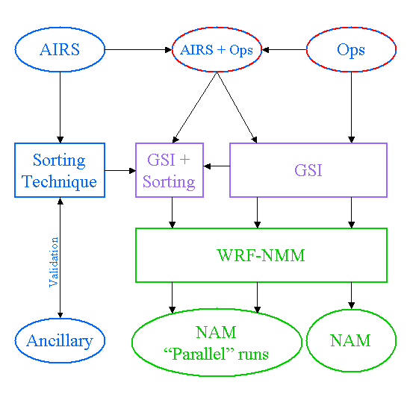
Flow Chart of Radiance Assimilation Research
Focus on specific problems
  Assess the use of AIRS in the NDAS (GSI and WRF-NMM)
  Consider spatial (horizontal) and spectral (vertical) characteristics for optimal impact on regional model
  Consider the sorting technique, an aggressive approach to assessing cloud contamination
    Develop algorithm
    Implement algorithm in DA system
Basic outline of Ph. D. research, anticipated to be finished in Spring of 2008

Slide 8
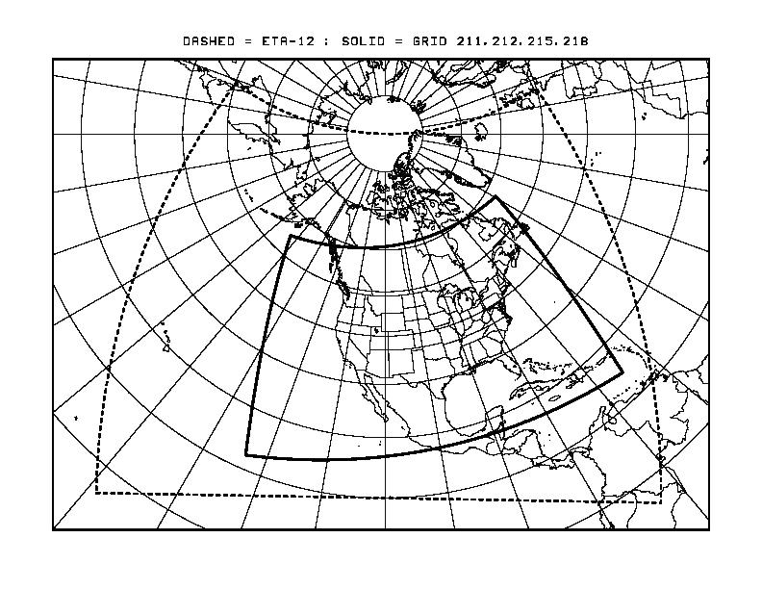
Spatial Concerns
Spatial Thinning
  Global system – 180 km thinning, based on warmest from 3x3 IFOV
  Regional system can utilize larger number of radiances spatially, due
to finer grid-spacing and smaller domain
SPoRT configuration considers every (15km) IFOV to maximize impact

Slide 9
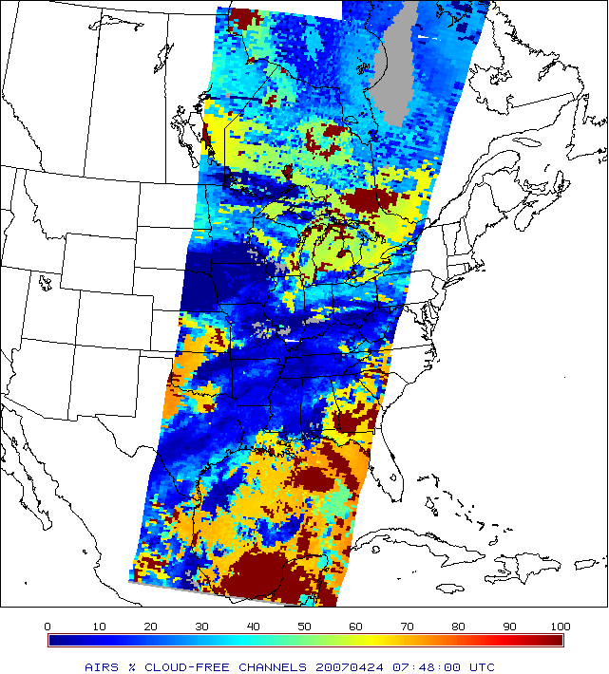
Spectral Concerns
Cloud Contamination
  CO₂ sorting technique developed to identify cloud-free radiances
    run locally in NRT
    implemented within the GSI system
  Developed to maximize the amount of information content in cloudy portions of the atmosphere
    More aggressive than approach inherent in GSI
    Utilizes the high spectral (thus vertical) resolution of AIRS
      Current technique is applicable to all thermal infrared sounders

Slide 10
Spectral Concerns
Spectral Thinning
  Currently, AIRS 281 channel subset is considered
    However, sorting method, situational background errors (EnKF), could be considered for proper definition of subset on a per-IFOV basis, to optimally select AIRS channels used for assimilation
    Many channels in operational subset (281 of 2378 channels) chosen for global applications
      Upper atmosphere channels
        NAM TOA (2 hPa) > GFS TOA (~0.25 hPa)
      Ozone channels
        No Ozone in the NAM
      These channels are not applicable as they revert to climatology

Slide 11
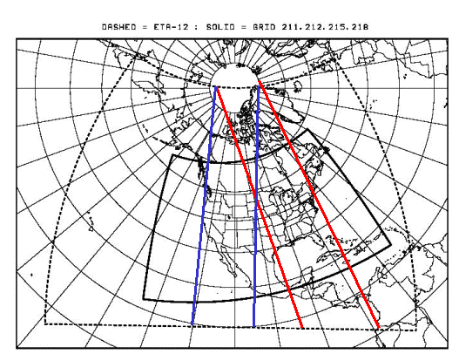
Domain and Analysis
NAM-12 Grid
  Denoted by dashed line
  Allows for use of operational NAM as control
  12 km gridspacing
  Fits action of transition of research to operations
Analysis System
  GSI 3D-VAR system
    Operational NAM Data Assimilation System (NDAS)
    Universal DA system used by NOAA and NASA for numerous models, including GFS, WRF-NMM (NAM), WRF-ARW (WRFRUC), and GEOS-5

Slide 12
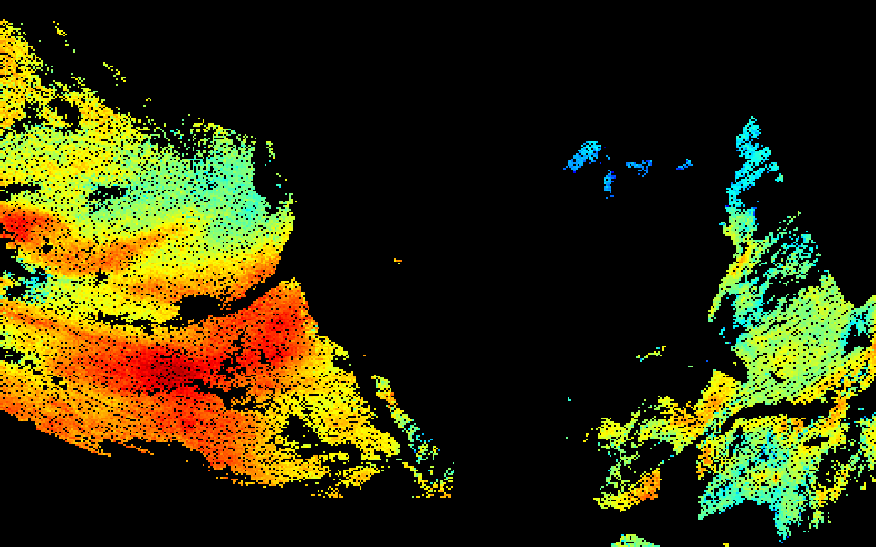
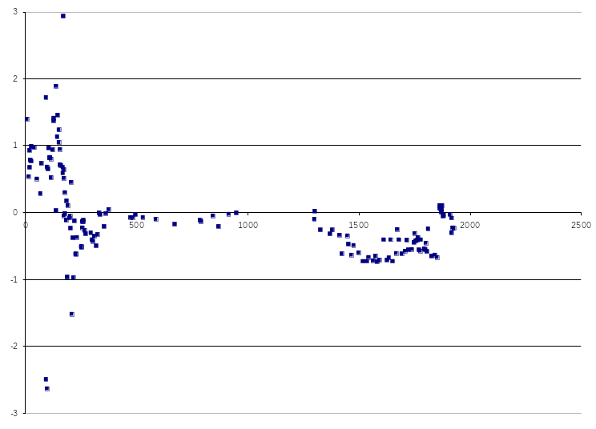
Current Status
Ongoing Validation
  Initial validation is being performed
  Problem with validating an analysis is the use of an independent dataset
    Currently using GOES sounder measurements
  Initial results demonstrate that more work is needed to address aforementioned concerns

Slide 13
Future Work
Continue to investigate appropriate use of AIRS radiances at regional scales in an experimental NDAS system
  Include more cloud-free channels (tune CO₂ sorting approach)
  Maximize / optimize the amount of data available for assimilation
  Forecast validation based on improved analyses
Demonstrate impact of regional scale methodologies on forecast

