Slide 1
Skill Standards, Certification and Assessment for Technicians in the Information & Communications Technology (ICT) Industries

Slide 2

Topics
Current State
Certification Overview
ICT Skill Standards
Phases of research
Status of research

Slide 3
Current State In IT Workforce Marketplace
CompTIA et al.
Industry Certifications
IT Employers
Demand
Schools
IT Equipment Suppliers
Academic Delivery and Credentialing
Worker Specifications
IT Products/Brands
Supply
IT Workers
Worker specifications are central to the market system and typically include: 1) Experience in an occupational skill set 2) Educational credentials 3) Product specific training, knowledge, experience, certifications 4) Industry certifications

Slide 4
Current State In IT Workforce Marketplace
CompTIA et al.
Lack of clarity in what they are getting
Industry Certifications
IT Employers
Demand
Schools
IT Equipment Suppliers
Academic Delivery and Credentialing
Worker Specifications
IT Products/Brands
Lack of clarity in what to deliver
Supply
Lack of clarity in where they are going
IT Workers

Slide 5
Worker Competency Leveling
CompTIA and Other Industry Certifications
Job Experience
Specialization Level 3-Mastery
Specialization Level 2-Full Working
Specialization Level 1-Foundational
Core Competency Personal And Technical Skills For Entry Into Specialization Areas
Basic Personal And Technical Skills For Entry Level Employment In IT
ECDL
CertiPort
MOUS

Slide 6
Audiences
Industry Employers
Support
Organizations
Job
Placement
Services
Small
Businesses
Fortune 1000;
Government
Counselors;
Parents
Certifying
Bodies
ICT Vendors;
OEM
ICT
Unemployed;
Career Changers
ICT Training
Providers
ICT Professionals
K-12 Schools
Learning
Institutions
New Entrants
Colleges;
Universities
ICT Workers

Slide 7
Stakeholder Goals
IT Employers
Shorter time to competency for workforce and assurance of high quality work.
Better payback for training dollar
More consistency in worker performance through certification
Pay for demonstrated performance
IT Workers
IT Educational Community
Greater clarity in career paths
Better training with OJT component
Diplomas and Certifications
Produce industry ready workers
Closer linkages with employers
New product opportunity

Slide 8
The Current Process Of Schooling Entry Level IT Workers (New Entrants)
Begin to learn a job
Worker readiness for employment

Job Placement

Graduation

Possible Participation In An Internship

Classroom Instruction and Labs

Choice of an IT Related Major

Entry into College, Technical School Or University

Possibly Some IT Training In High School

Scope

Slide 9
Certification Mission
Set industry-wide, globally accepted standards for IT core skills and foundation competencies
Maximize efficiency in recruiting, hiring, training and promoting employees
Create and promote a reliable predictor of employee success
Meet the needs of today's IT workforce by certifying individuals with transferable skills
Provide job seekers identifiable career paths and credentials that are industry recognized
Create the standards necessary for educators and trainers to better prepare individuals to meet today's IT related job requirements

Slide 10
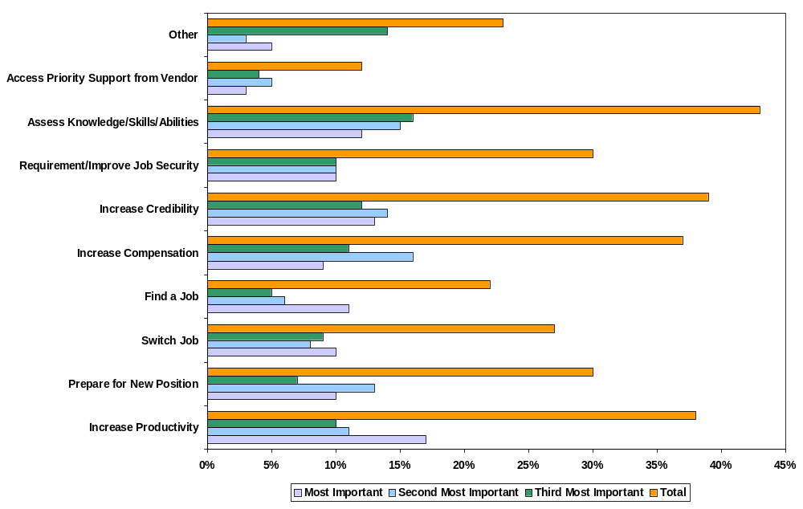
3 Most Important Reasons for Certification
Notes:
C Question
Assessing knowledge, skills and abilities was mentioned most often among the top three most important reasons for certification

Slide 11
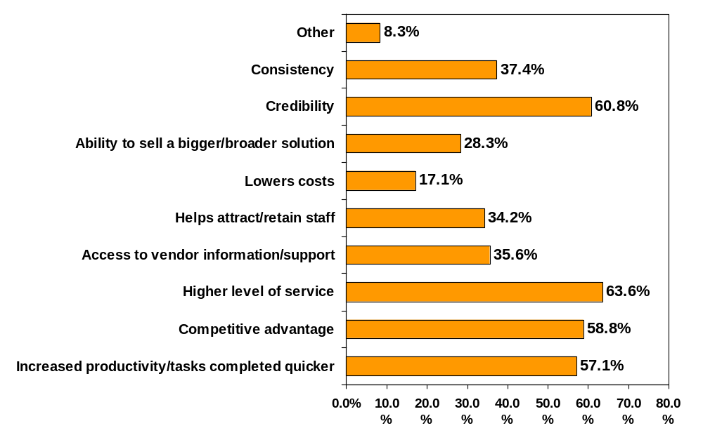
Benefits of Certified Staff
Notes:
ITM Question: Benefits of Certified Staff
NOTES
Benefits with the most mentions varies by region
Americas: Credibility
EMEA: Higher Level of Service
Asia/Pacific: Competitive Advantage
However Higher Level of Service received highest number of mentions overall

Slide 12
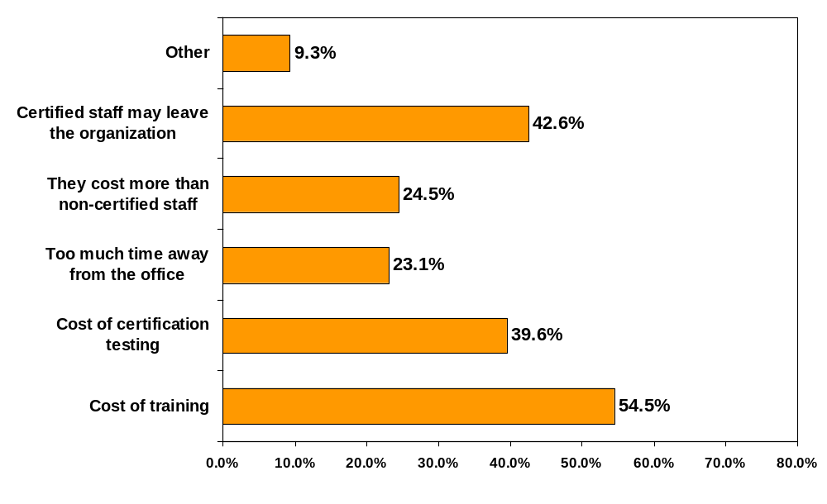
Drawbacks of Certified Staff
Notes:
ITM Question: Drawbacks of Certified Staff
NOTES:
Need to provide cost justification to managers - cost/benefit analysis.

Slide 13
Has employer rewarded you for gaining your certification?
1999
Yes
24%
32%
Something Else
19%
Other Benefit
8%
12%
N=2652
No
Promotion
17%
76%
26%
2001
New Responsibilities
35%
Yes
48%
34%
Increased Salary
43%
66%
No
0%
10%
20%
30%
40%
50%
60%
70%
80%
66%
1999
2001
Notes:
AC Question 12a: Did your employer reward you for gaining your certification?
AC Question 12v: If Q12A equals 1 (yes): How has your employer rewarded you for gaining certification? Please check all that apply.
NOTE:
Yes increased from 24% last year
Only 21% of Government respondents were rewarded
44% of Hardware reseller/consultant respondents were rewarded
66% of those who changed employers had not been rewarded for becoming certified, but this was the same percentage for those who did not change employers.
Salary: Increased by 23% since last year
70% of Corporate respondents who were rewarded indicated a salary increase.
This is the most common reward method across all employer types
New Responsibilities: Increased by 13% since last year
Promotion: Increased by 9% since last year
Other Benefits: Increased by 4% since last year
Something Else: Decreased by 13% since last year

Slide 14
Certification Program Elements
➢ Business / education goals
➢ Funding model
➢ Definition of certification
➢ Defined audience
➢ Linkage to partner or accreditation programs
➢ Defined benefits for certification
➢ Criteria for product / subject inclusion
➢ Testing and scoring goals
➢ Legal policies
➢ Development plan
➢ Implementation plan
➢ Marketing / communications plan
➢ Compliance plan
➢ Recertification / maintenance plan
  Evaluation / reporting plan

Slide 15
Certification
Product Life Cycle
Market Needs
Job Task Analysis
Cert. Blueprint
Research
Membership Driven
Skills (Gap) Definition
Stakeholder Consensus
Surveys
Focus Groups
Industry Data
Content Mapping
Test Forms
Psychometrics
Beta Testing
Cornerstone Approval
Legal Defensibility

Slide 16
Certification
Product Life Cycle (cont.)
Exam Launch
Maintenance
Revision
Global Delivery
Localization
Proven Delivery Channels
Training Support
Quality Control
Security
Performance Reviews
Item Maintenance
Advisory Committee Driven
Market Performance
Psychometrics
JTA Update

Slide 17





Industry Needs
Microsoft
Novell
Cisco
Other
Certifications
Computer Concepts
Desktop Applications
Fundamental Skills
Schooling

Slide 18
National ICT Skill Standards Project

Slide 19
Governance
Lead by Voluntary Partnerships
  Business leaders
  Educators
  Labor leaders
  State officials
  Interest groups
Research by VP and technical team

Slide 20
CompTIA is VP lead, other VP Members include:
ITAA
GWEC
NWCET
IBM
CWA
Lucent
Microsoft
HP
Cisco
Novell
North Carolina
Courseware Pubs.

Slide 21

Scope
Skill Standards
Certification Tests
Key Jobs

Slide 22
Specialty
Concentration
Core
Specialty
Certificates
Core+1 Certificate
Specialty
Certificates
Notes:
Where is all this going?
The end result is not skill standards! The end result is a system of certifications which will serve workers and employers. Workers will be able to prove what they know and are able to do, and employers will be able to find the workers they need with the appropriate skills. Training groups will be able to provide the training for workers to pass there certifications.
The current idea is that the voluntary partnerships will develop core+ certifications and industry will continue to develop what are called specialty certifications. For example we will have core IT/Telecommunications certifications, but vendor-specific certifications such as CISCO and MSCE will be specialty.
The NSSB does not want to compete in any way with industry certifications.

Slide 23
About Skill Standards

Slide 24

About Skill Standards
A skill standard is a description of the work activities
to be performed, how well the work must be
performed and the level of knowledge and skill
required to perform that work.

Slide 25
About Skill Standards
Work
  Describes the Work
    Critical Work Functions
    Key Activities
    Performance Indicators
Worker
  Describes Worker Knowledge & Skills
    Academic & Employability Skills
    Occupational & Technical Knowledge & Skills

Slide 26
Phases of Research

Slide 27

Three Phases of Research
1a. Define the Industry
    Telephony
    Internet Service Providers
    System Integrators
    Cable
    Wireless
    Satellite
    Software
    Broadcast, Radio and TV

Slide 28

Three Phases of Research
1b. Develop Concentrations
  Network Operations
  Database
  Programming
  Field Operations
  Technical Support
  Web Development
  Digital Media
  Technical Writer

Slide 29

Three Phases of Research
2. Develop the Work & Worker Components
  Thought leaders
  Senior expert focus groups
  Worker focus groups

Slide 30

Three Phases of Research
National Survey
  Gather ratings to validate focus group findings
  Three surveys
    CWF-KA
    OTKS
    High Performance Work Group
  Target sample size = 1,500 per concentration

Slide 31

Reviews and Approvals
ERP review and approval
Voluntary Partnership review and approval
NSSB review and approval
30 days of public comment

Slide 32
Status of Research

Slide 33
Status of Research
Completed:
  Phase 1a - Industry definition
  Phase 1b - Concentration definition
  Phase 2 – Develop work & worker components

Slide 34
Status of Research: Concentrations
Network Operations
Database
Programming
Technical Writer
Technical Support
Web Development
Digital Media

Slide 35

Status of Research: Future Work
Phase 2b – We have issues
Phase 3 – National validation survey
Phase 3 - A&E validation

Slide 36
Status of Research: Current Issues
Phase 2b
  Technical Support & Field Operations
  Web Development & Network Operations
  Digital Media & Technical Writer
  More telecommunications
  More refined OTKS
  Align other skill standards

Slide 37
Status of Research: National Validation Survey
Phase 3
  Gather ratings to validate focus group findings
  Three surveys
    CWF-KA
    OTKS
    High Performance Work Group
  Target sample size = 1,500 per concentration

Slide 38
We are already developing tools…
  for the Industry to manage workforce performance and training
  for the Individual to enable management of careers
  for the Trainers and Certifying Bodies to plan curricula to meet industry requirements

Slide 39

TCC.COMPTIA.ORG
Jobs & Skills:
Jobs & Alternate Names
Essential Work Functions
Skills & Knowledge & Tasks
Training & Vendor Links
Certifications & Vendor Links
Certifications & Vendor Links
A&E Skills
Education & Experience
Career Guidance Tools:
Career Paths
Higher Level Careers
IT Career Fit Assessment
Workplace Readiness Assessment
IT Job Match Assessment
Skill Gap Analysis
Job Bank Links
Links to Approved Trainer by Area
Success Sharing:
Photographs
Videos
Cybercasts
Interviews
Testimonials
HR Tools:
Performance Reviews
360 Degree Feedback Tool
Individual Development Plans
General Information:
ICT Industry Overview
Marketing Materials
Value of Certification
Vendor Neutrality
Salary Statistics
A Day in the Life…
Articles & News
Research
Press Releases
Legislation
Pending Regulations
ICT Jargon Defined
Skill Standards Defined
Training Sponsored:
K-16 Programs
College Level Programs
Models & Programs
Website Support:
Comments Capture
Question Capture
Database Maintenance
Search
CompTIA Home Page Links
Printable Versions
FAQs
Industry Sponsored:
Resume Matching
Apprenticeships
Internships
Tutoring
Online Mentors
Expert Chats

Slide 40
Project Mission
Our mission is to: explore ICT certification and assessment system built on job roles as an approach for:
  increasing the supply of competent IT workers in US and Denmark
  facilitating the cost-effective attainment of IT worker competency leading to new entrants becoming “industry ready” in a shorter period of time,
  3) providing a “best practices” methodology for adding new skill sets to IT existing workers and/or migrating existing workers to new specializations within IT,
  4) ensuring the competency and quality of IT workers through industry certification, and
  5) clarifying the career paths, skill sets and professional standards of IT workers.
While the terms “explore and assess” imply a research orientation, we will add product development and marketing dimensions.

Slide 41
Benefits
More competent technicians
Greater competitiveness
Up-to-date curricula
Source of skilled technicians
Compare “high performance” level to others

Slide 42
Questions?
www.comptia.org
John Engman
630-678-8352
Jengman@comptia.org

