Slide 1
Lessons Learned from Encoding the DON NDR
March 15, 2006
US/DoC/NIST/MEL/MSID

Slide 2
Outline of the Talk
Who we are
What we are doing: NDR encoding project
What we’ve learned
Recommendations
Demonstrations:
  Quality of Design Tool
  Validation Page
Where we are going
Discussion
Notes:
The purpose of this slide is to tell the audience what we want to tell them and to hint that the proposed MDLC, the IDEF model is not an absolute model. However, it serves our purpose to motivate our research work around MDLC to help the industry achieve interoperability.

Slide 3
Who We Are
US/DoC/NIST/MEL/MSID
United States Government
Department of Commerce
National Institute of Standards and Technology
Manufacturing Engineering Laboratory
Manufacturing Systems Integration Division
= A government resource that provides technical solutions to advance system integration capabilities.

Slide 4
NIST Interoperability Testbed
Legacy Migration
Through
Semantic
Mapping
Automotive
Inventory
Visibility
CAD/CAM
Integration
Simulation
System
Integration
Manufacturing
Metrology
Interoperability
(Inspection)
Process
Plant
Construction
Information
Integration
Manufacturing
B2B
Integration
Integrated
Circuit
Manufacturing
Government
Systems
Integration
“Generic” Testing Infrastructure and Tool Development
(e.g., XML, ebXML, schema quality, test case generation)
Semantic Web R&D

Slide 5
Background
NIST B2B Interoperability Testbed
  XML-based interoperability project with the automotive and aerospace industries
NIST AEX Testbed
  XML-based interoperability project with the building construction industry
Product Data Exchange and Validation Testing activities
  Data exchange-based integration project, not XML-based (ISO10303: STEP)
Common characteristics
  Specifications are segmented
  Data exchange specifications evolve as integration projects proceed
Notes:
hide

Slide 6
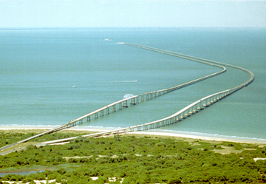
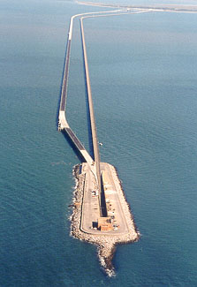
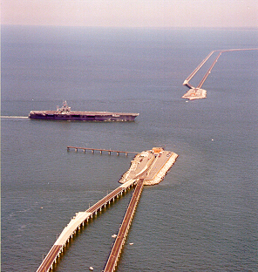

Content Standards are Bridges

Slide 7

Bridge Building Process
Design the bridge
Test the design
Build a frame
Pour the concrete
Paint the roads
Stress test
Maintenance

Slide 8
NDRs are a Basis for Building Interoperability Bridges

Slide 9
Rationale for Rules
Clarity: make the semantics of a construct clear to the user
Structural clarity: contribute to a schema’s readability, which can facilitate consistent interpretation of a standard
Extensibility: promote reuse through extension
Common symbolic syntax: foster the use of common naming conventions. enable better automation and improve readability and clarity
Maintainability: reduce the maintenance burden especially when changes occur
Performance: reduce computational overhead associated with the XML instance parsing, validation, and other XML processing
Interoperability: promote interoperability among partners sharing the same schema
Model validity: ensure a schema’s semantic validity (e.g., no duplicate content)

Slide 10
Benefits of NDR Encoding
NDR can be enforced!*
Encoding of rules results in better rules
  The process of encoding tests the rules
Executing the rules results in better XML Schemas
  The benefits of the NDR are achieved
Cycle time from requirements for a schema to production XML is reduced
* computationally enforced

Slide 11
Experience From Korea
Our partner, the Korean Institute of Electronic Commerce (KIEC), has used our tool (QOD) to implement “Guideline for XML Document in Korea”
Oct. 2005: tested 30 documents used in customs
Feb. 2006: tested 29 documents used in electric power industry
Feb. 2006: used in the development of documents for port services area

Slide 12
Lessons from Korean Experience
Typically it takes 4 hours to examine a single electronic document manually
Total validation time reduced from two weeks to 3 days (in power industry)
Used as a supplementary tool during training on electronic document standardization
  Increased understanding of NDR
  Reduced errors in designing electronic documents

Slide 13
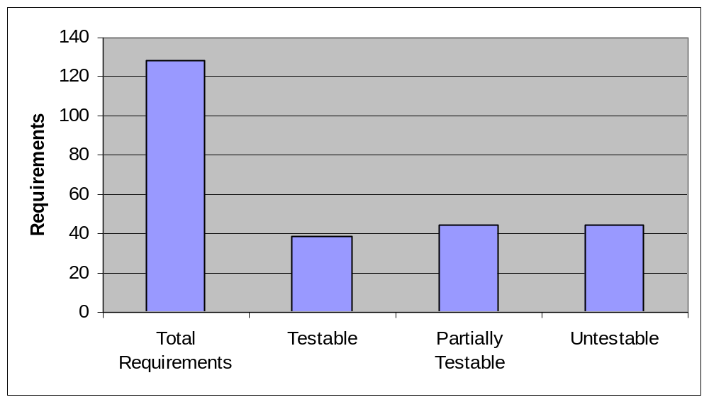
Encoding DON NDR
We encoded as many DON NDR rules as possible in Schematron
NDR has 128 rules

Slide 14
Problems In Encoding Rules
Clarity of the rule (text is not clear or text and examples conflict)
External interfaces required
Applies to something other than the schema
Guidance rather than rule
Mismatch with needs of technical publications

Slide 15
Clarity
MDC 3: If a DON ccts:DataType is extended or restricted, it MUST retain the original business context.
DateTypes in the ccts should be independent of business context
NMS 2: URNs MUST be in lowercase, except multiple words, which MUST use lower camel case and the root element, which will use upper camel case.
NMS 11: All DON namespace declarations MUST be qualified.
The definition of qualified is left to user interpretation

Slide 16
Requires External Interfaces
GNR1: DON XML element, attribute, and type names MUST be in the English language, using the Oxford English Dictionary for Writers and Editors (Latest Ed.). Where both American and English spellings of the same word are provided, the American spelling MUST be used
What is classified as the “Latest Ed.”
No automated way to distinguish American from English spelling
The Oxford English Dictionary does not offer an automated lookup service (last I checked.)

Slide 17
Requires External Interfaces
CDL 1: All codes used in DON MUST be part of a DON-maintained or externally maintained Code List Schema module.
This rule would be testable if
  the lists exist and
  the interface for accessing the lists were known
  Full testing of this rule needs both these aspects.

Slide 18
Not a Schema Design Rule
ATD 4: The objectIDRef xsd:attribute value MUST be equal to the value of an ID ccts:BBIE element.
Applies to instance data rather than schema
GRN 4: Abbreviations and acronyms MUST be submitted to an FNC for approval.
Applies to business process rather than schema design

Slide 19
Guidance -- flaggable
ELD 5: For CCTS:BBIEs that are based on ID, code, and measure, a local element MAY be declared in the xsd:complexType of the parent ABIE.
GSX 8: The xsd:choice element MAY be used.
Use of the word MAY
  Pass/fail testing not possible
  Flagging may be possible
  Is the implication that use should be flagged or not?

Slide 20
Guidance – not flaggable
CDL 2: The DON library MAY design and use an internal code list if an existing external code list needs to be extended or if no suitable external code list exists.
GNR 6: DON XML element, attribute, and type names MUST be in singular form unless the concept itself is plural (example: goods).
Semantic understanding of words necessary
CDL 2 could be flagged but the word suitable is subjective
GNR 6 is not flaggable

Slide 21
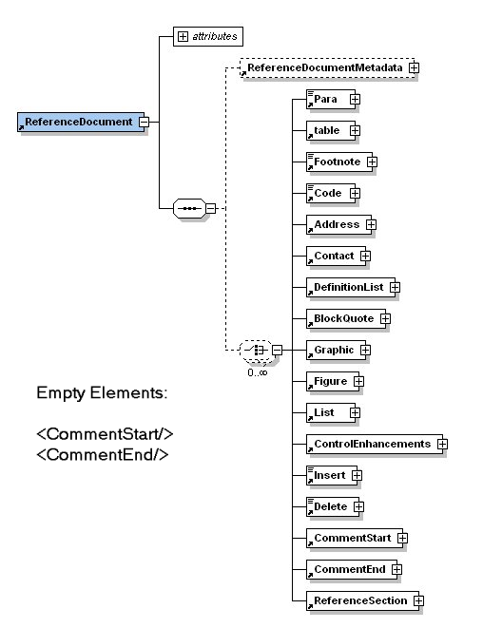
Mismatch with Needs of Technical Publications
ELD6: Empty elements SHALL NOT be declared except for reference elements and Xlink elements, which MUST be approved by the cognizant FNC and BSC
Rule is too restrictive
EMPTY elements are traditionally used for graphics, multimedia, etc.
People will circumvent this rule by creating a 'string' type and not plan on entering the data which will cause confusion on the user of the schema.

Slide 22
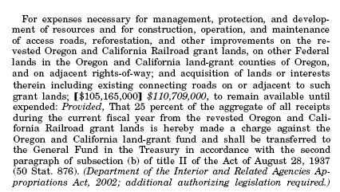
Technical Publication Requirements
MDC4: Mixed content MAY only be used when an XML schema component is defined by a namespace from a BSC-approved business standard (e.g. XHTML).
Mixed content is required for document-centric XML data.
Identifying keywords and components in paragraph text is essential:
  Cross-references
  Superscript/subscripts
  In-line Graphics
  etx.c

Slide 23
Lesson Learned in coding NDRs
NDR documents need to be regarded as rigorous technical documentation
Rules that can not be implemented are non-enforceable
Definition of NDR’s is non-trivial
  Many rules can not be tested
  Many rules are more difficult to implement than thought
  Difficult to reuse rules due to namespace definitions
  Often rules are ambiguous or unclear
Implementation of rules is non-trivial
  Testing of rules is complex
  All boundary conditions need to be thought of and covered
Legacy data and 3rd party schemas need to be addressed in NDRs

Slide 24
Recommendations for NDRG
Define rules rigorously and include examples
Identify actual external interfaces
Limit scope of NDRG to XML Schema specification (define Dictionary requirements and process elsewhere)
Distinguish rules from guidance for testability purposes
Review requirements for technical publication and impact on data specification
Partition NDR for data versus documents
Recommend using QOD for developing NDR

Slide 25
Schema Quality of Design Testing Tool (QOD)
Contains rules based on naming and design guidelines (NDRs) from a number of sources
Stores executable test cases written in Schematron and Java Expert System Shell (JESS)
Executes tests against user-provided schemas and reports results
Used to organize tests into profiles
Notes:
Surveyed naming and design rules documents
Coded some of the rules
Developed a harness for executing rules
Available as a web-based service

Slide 26
Why QOD?
Addresses proliferation of NDRs
  Overlapping NDR standards
  Supports reusability of rules
Highlights ambiguous rules
Provides an explicit structure for rules in NDRs
Automates rule enforcement
Enables versioning and traceability of rules

Slide 27
Demo
Quality of Design tool (QOD)
Naming Report: http://syseng.nist.gov/b2bTestbed/projects/xmlvalidation/NamingReport.html
Validation Page

Slide 28
What’s Next for our Project
Provide feedback to DON NDR authors
Provide input into Federal NDRG effort
Continue to expand our NDR rule-base
Identify collaborators
Develop NDR authoring environment
Produce a Toolkit for XML Schema developers

Slide 29
Collaboration Opportunities
QoD tool and executable rules: http://qod.sourceforge.net/
Software enhancement based on user requirements: Send us mail!
  xmlTestbed@cme.nist.gov
  Tell us what you like
  Tell us what would make our tools more useful for your project
  Tell us if you want to help

Slide 30
Future work: NDR Authoring Environment
Specify an XML Schema for NDRs
Integrates schema for rule capture (QoD Schema) with documentation solutions
  Extend QoD Schema for rule capture to include documentation components of NDR
  Base on existing vocabulary such as DocBook or XHTML
Use to connect rules to executable formats

Slide 31
Benefits of NDR Authoring Environment
Makes an NDR real
  Executable rules are integral to NDR
  Schemas can be tested for consistency with NDR
  Problems in written rules are flushed out as they are developed
Reduce time spent on formatting
  Multiple outputs from same source (HTML, PDF, …)
Promote reuse
  Make it easier to extract rules from document
  Make it easier to tailor an existing NDR to meet new requirements
  Improve traceability

Slide 32
Summary
A process for XML schema development is necessary for promoting interoperability and reuse
Tools can automate the schema development process thereby reducing labor and deployment time
Definition and implementation of NDR’s is non-trivial but necessary to support reuse of schemas
Use of NDRs will ultimately make XML schemas more acceptable to a wide audience
Common format for NDR development, encoding of rules, and validation tools will increase the effectiveness of NDRs

Slide 33
Contacts
KC Morris – kcm@nist.gov
Simon Frechette – simon.frechette@nist.gov
Serm Kulvatunyou – serm@nist.gov
Josh Lubell – lubell@nist.gov
Puja Goyal – pgoyal@cme.nist.gov
Betty Harvey, ECC, Inc. -- harvey@eccnet.com
Websites
Tools available from MSID: http://www.mel.nist.gov/msid/xml_related.htm
Developer’s site for QoD tool and executable rules: http://qod.sourceforge.net/

